Slide 1
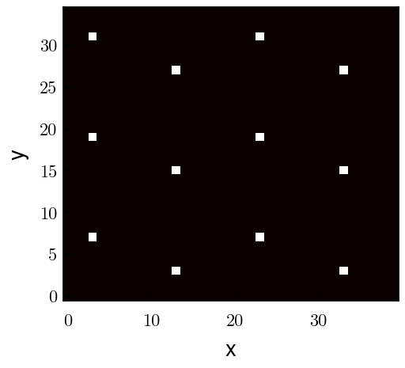
Padded PBC (Full FFT)

Slide 2
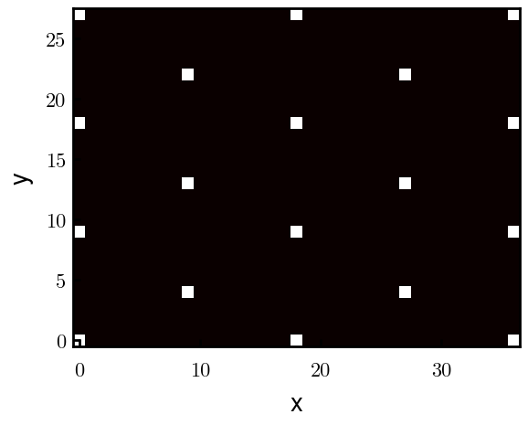
Unpadded PBC (Full FFT)

Slide 3
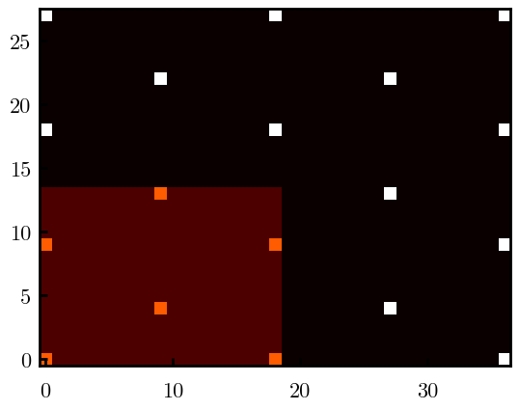
Unpadded PBC (Full FFT)

Slide 4
