Slide 1
SYSG

Slide 2
Schematic, similar to NFH but simpler like Chao, not multiblock protein

Slide 3
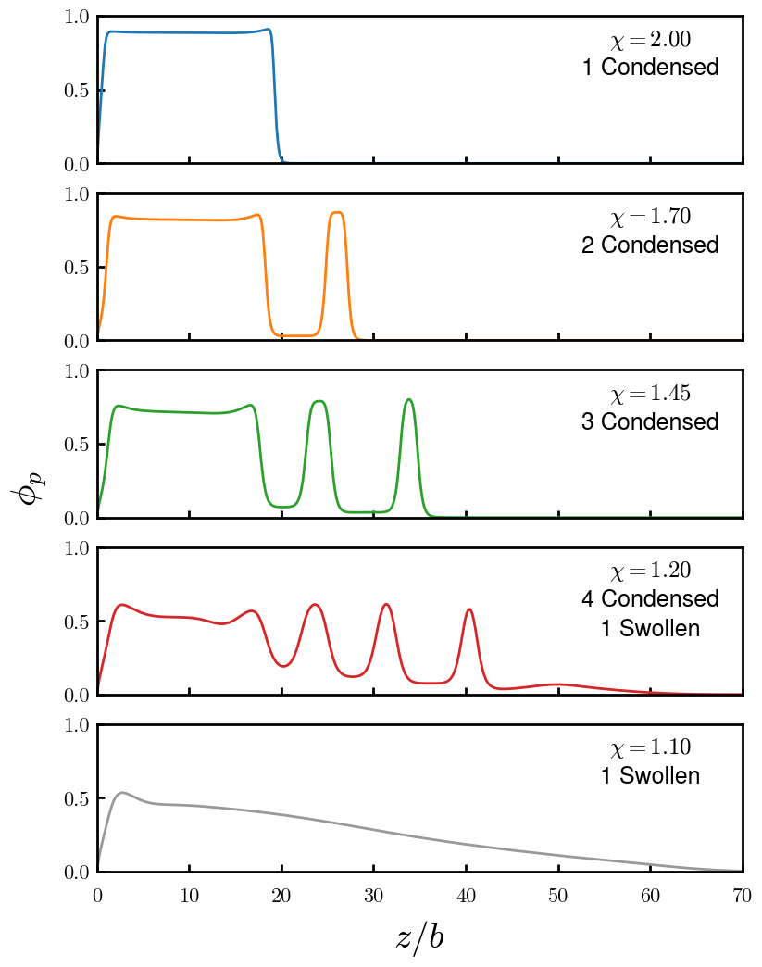
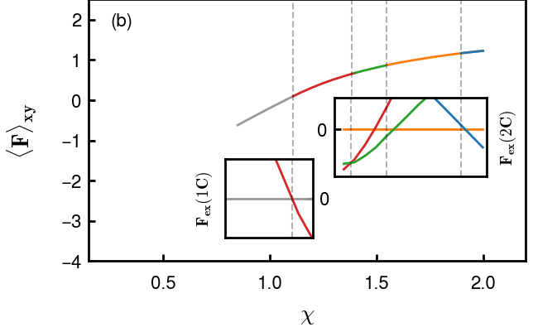
Possible brush morphologies (including +d)
Find cleaner way to portray F change and transition points

Slide 4
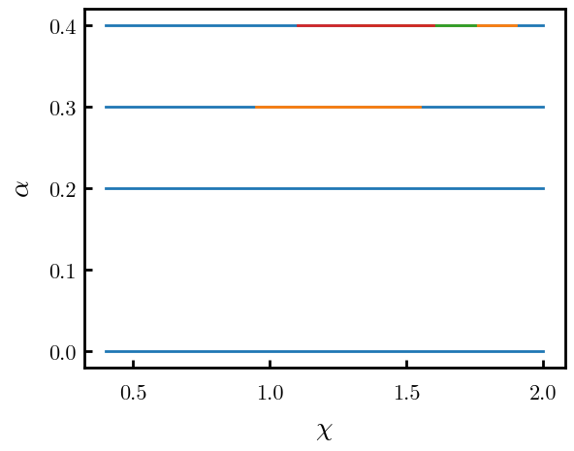
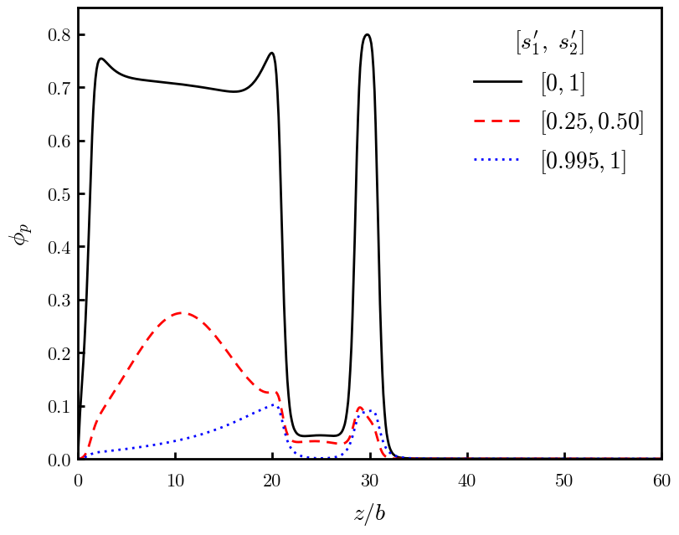
Phase diagram to highlight stability region of layers and +d regions
Explain locked-in-layer model using end-point distributions
Colored schematic, like NFH paper

Slide 5
Population of chains diagram (vertical, 1C includes, 2C includes, etc. d at the top)

Slide 6
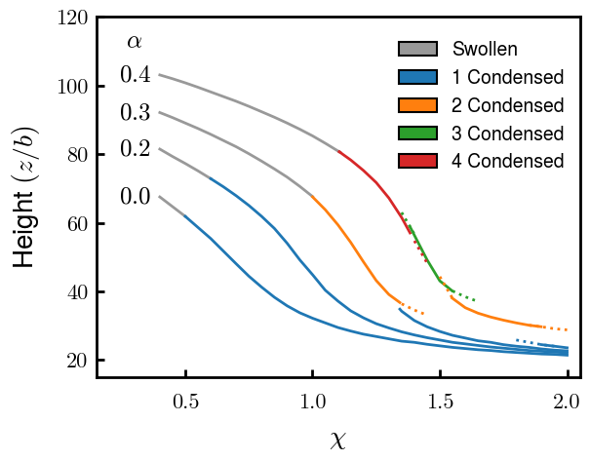
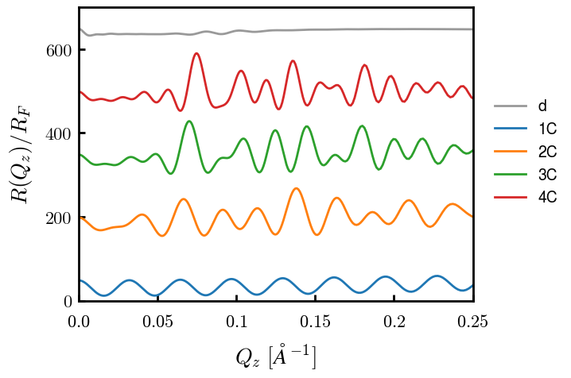
Detecting xC through experiments: Height (via threshold)
Scaling chi available?
Reflectivity: Signatures of each C
# of peaks at low Qz (high frequency)
Find more rigorous way to mark peaks

Slide 7
Force for alpha = 0.4
Could be interesting for detecting xC+d? Have not done enough calculations to know yet

Slide 8
Interacting

Slide 9
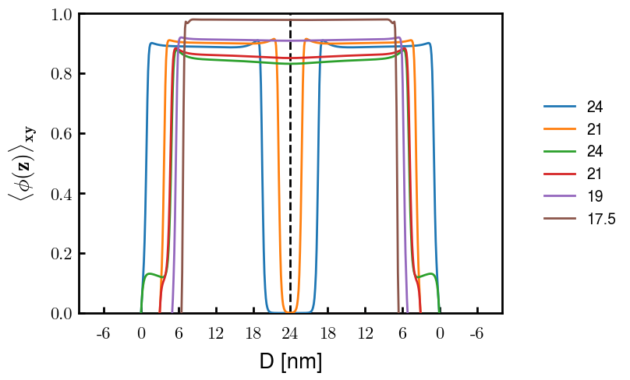
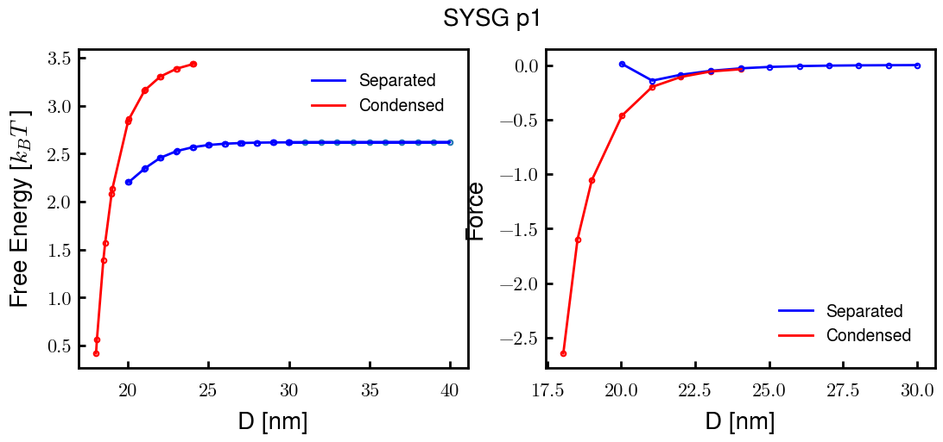
p1a4 c2.00

Slide 10
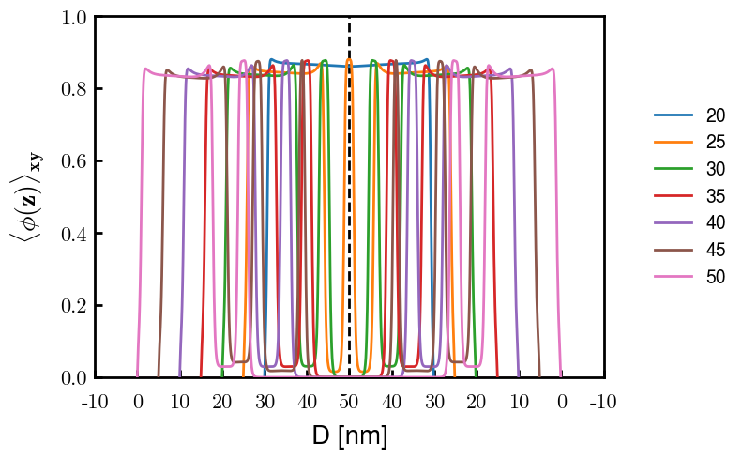
p2a4 c1.75

