Slide 1
Interacting brushes

Slide 2
Preliminary MFT
Homopolymer charge alpha
Alpha = 0.5, Chi = 0.4, Nm = 200,
sigma = 0.05, b = 1.0, v = 4/3pi

Slide 3
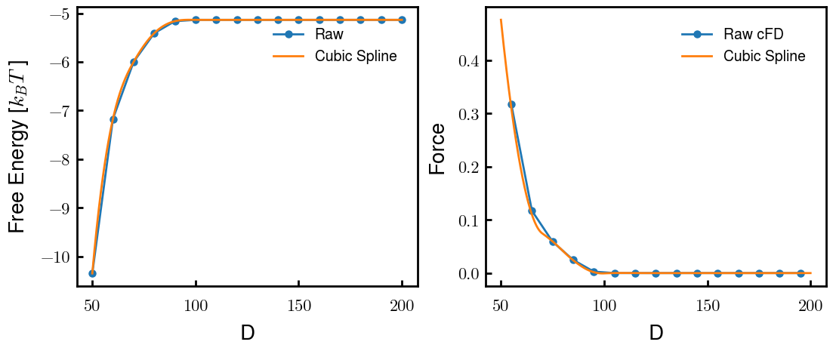
c100

