Slide 1
SYSG

Slide 2
Interacting

Slide 3
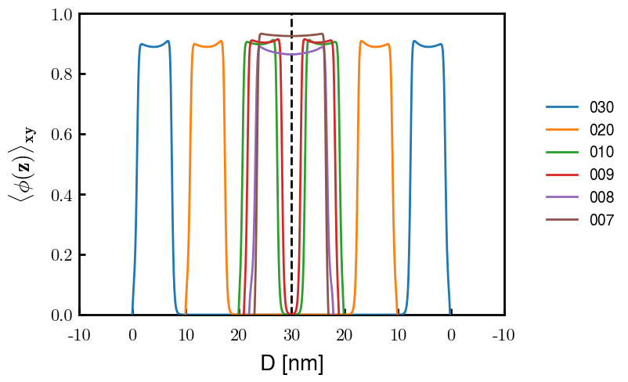
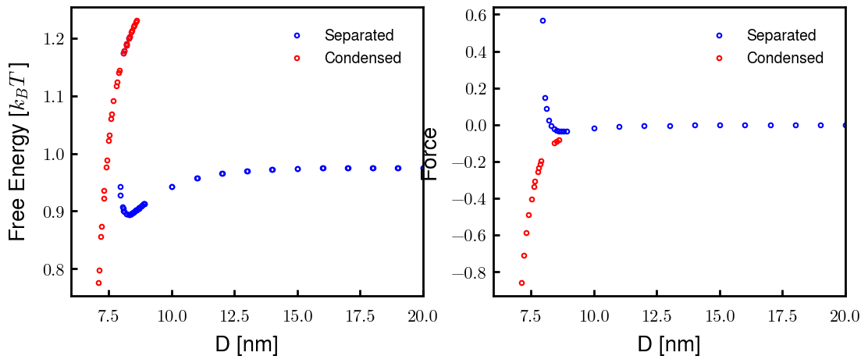
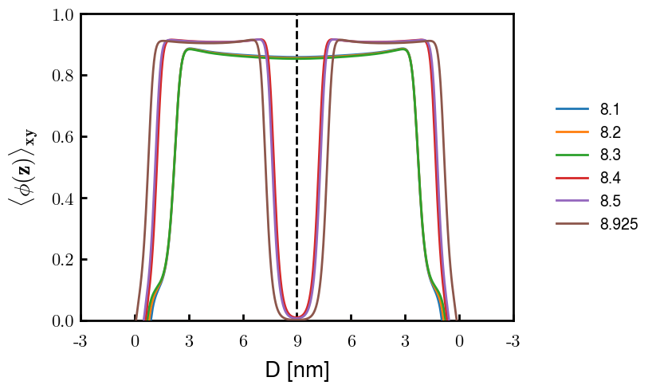
p1a4 c2.00
Old Nm

Slide 4
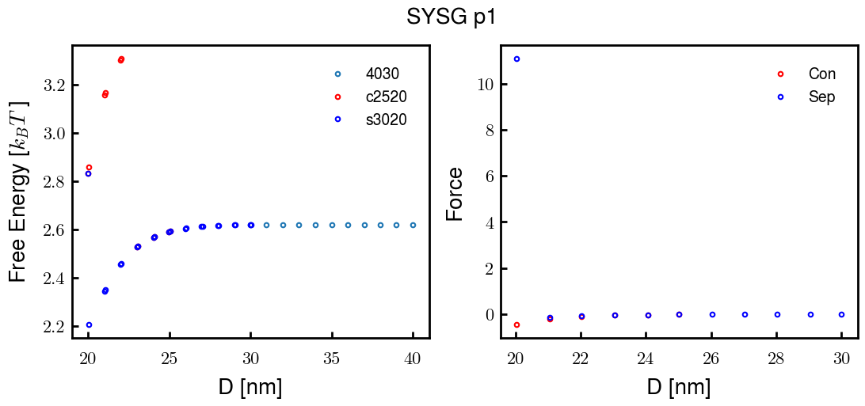
p1a4 c2.00

Slide 5
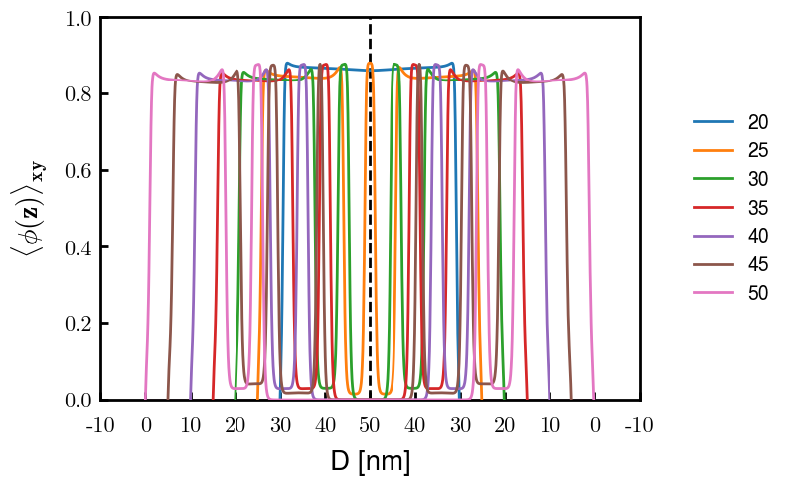
p2a4 c1.75

