Slide 1
Nafion

Slide 2
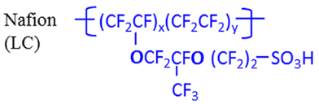
System
+
+
−
+++++++++++
+
Simple picture:
Polymer brush immersed in solution
Solution in contact with positively charged electrode
In real fuel cell:
Proton source from splitting of hydrogen (cathode)
Proton sink from reaction with oxygen at Pt, forming water (anode)
In CV experiments:
Solution of 0.100 M HClO4
+
+
−
+
+
+
−
+
+
+
+
−
+
+
+
−
+
+
+
−
+
+

Slide 3
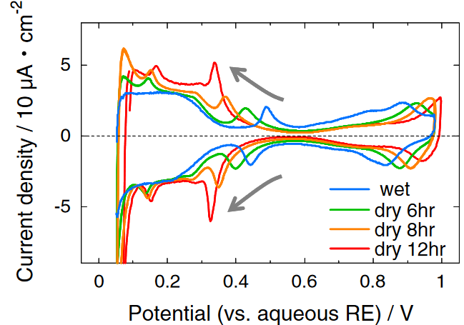
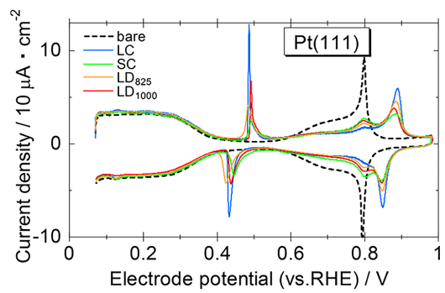
Motivation
Pt poisoned by adsorbed SO3 from ionomer
Pt loading/efficiency is limiting factor for fuel cells
Scientific community has limited understanding of polymer physics
Adsorption measured by cyclic voltammetry (CV) – 0.100 M HClO4
Apply potential at some scanning rate, measured current corresponds to interaction at electrode (e.g., reaction, adsorption)
(top) As humidity decreases, more current at lower voltage
As ionomer-Pt distance decreases, more adsorption
(bottom) Long sidechains (LC) more current than short sidechain (SC)
Discussion on long distance between ether/SO3H (LD) becomes muddled
Kodama et al. (2013) Electrochem. Commun. Kodama et al. (2018) ACS Catal.

Slide 4
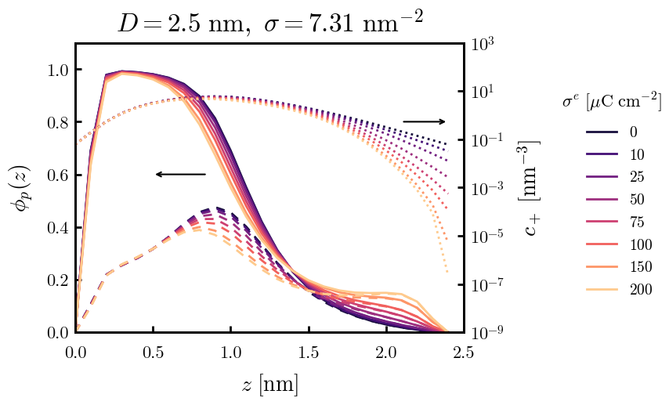
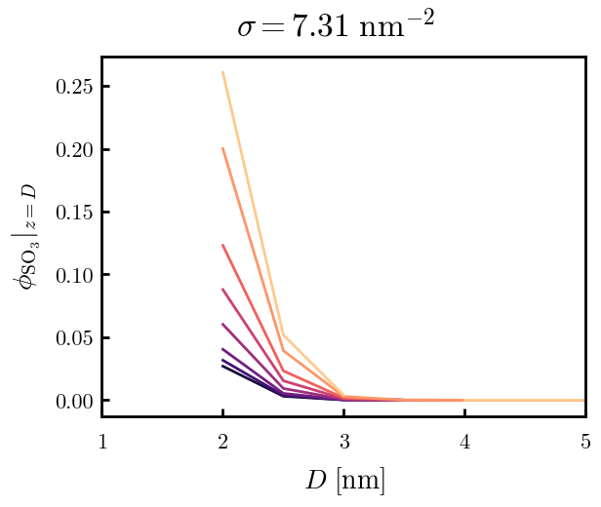

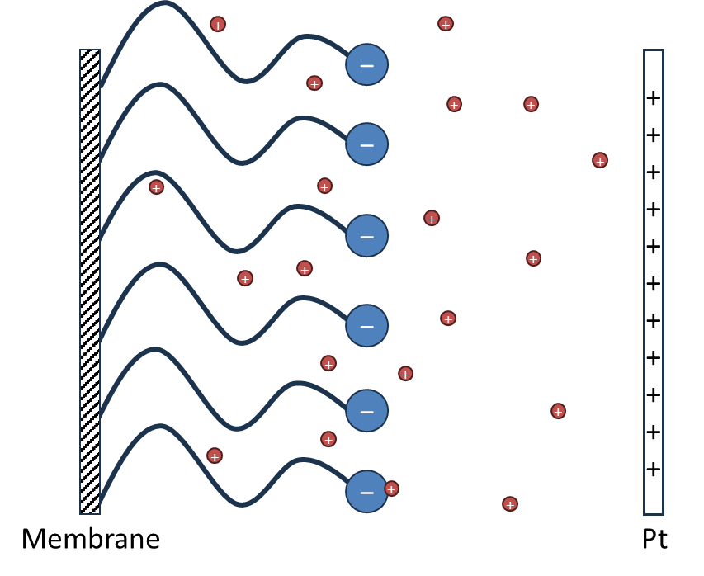
Sidechain only (Continuous Gaussian Chain)
Ionic strength 0.100 M
Model: “grafting surface” is bulk membrane/thin film; only considering elasticity of sidechains
True grafting density unknown, 7.31 c/nm² is approximately the density of sidechains based on the random walk of its backbone
Left: Density of polymer on Pt surface as a function of membrane–Pt separation distance. Colors indicate Pt surface charge density
Right: Polymer density distributions (solid) and proton distributions (dotted) for D = 2.5 nm and grafting density 7.31 c/nm². Density distribution of sulfonate block is dashed.

Slide 5
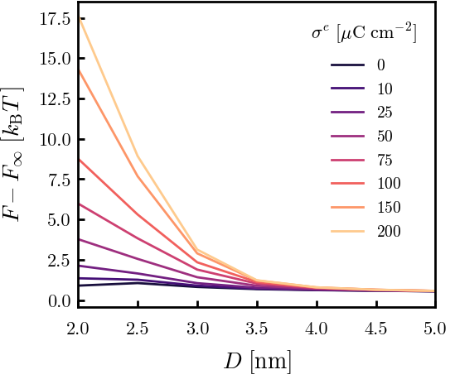
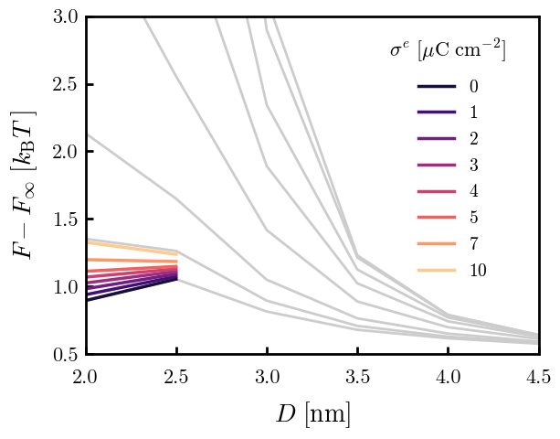
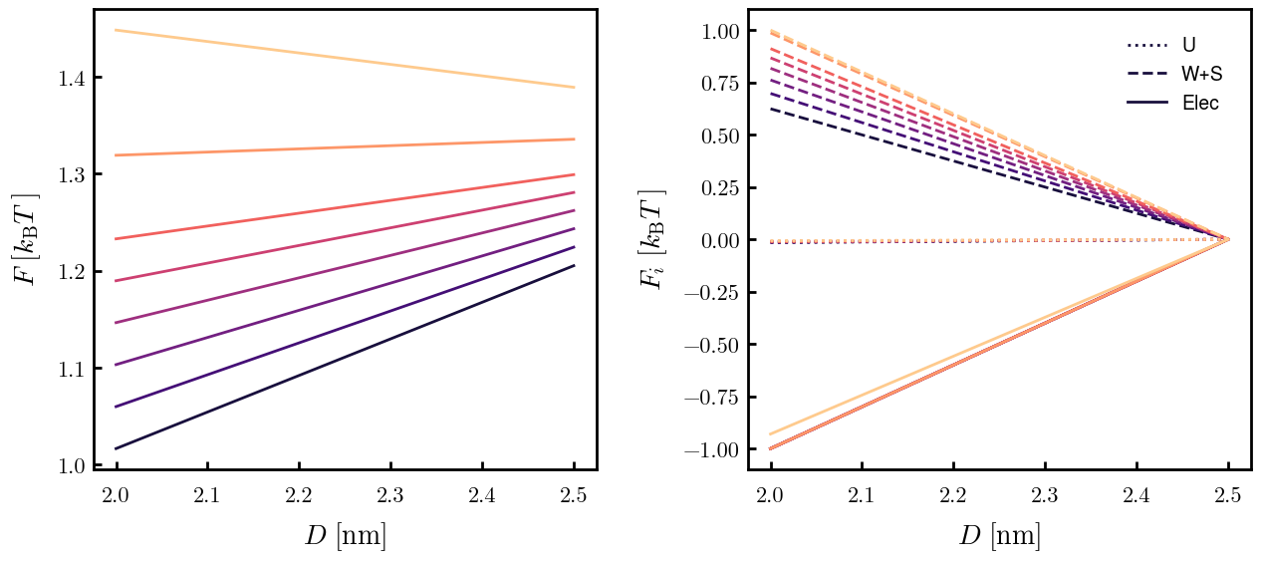
Sidechain only (Continuous Gaussian Chain)
0.100 M
Discussion
In CV data, reaction goes to completion by 0.5 V (vs. RHE)
Surface charge ~10 uC/cm2 according to Saha & Zenyuk. JPCC. 2021.
(Top) SCFT free energies as a function of D.
(Top right) Free energies for 1—10 uC/cm2 colored. Small D is favorable at low charges, becomes unfavorable as surface charge reaches ~7 uC/cm2
(Bottom right) Normalized contributions of free energy for 1—10 uC/cm2. As surface charge increases, electrostatic interactions outweigh elastic penalties. At 10 uC/cm2, elastic penalties become dominant.

Slide 6
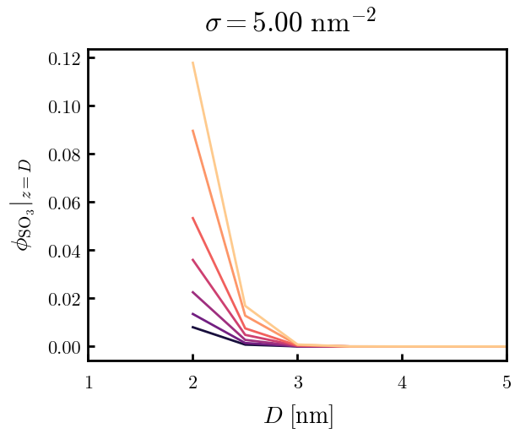
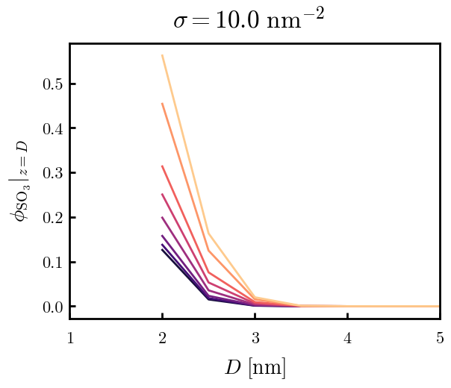
Notes
\
SWITCH TO DGC SOON – thread dne bead-spring at N = 2

Slide 7
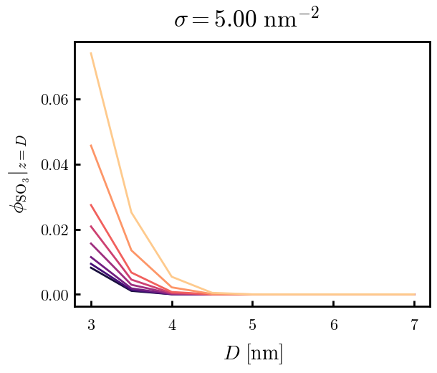
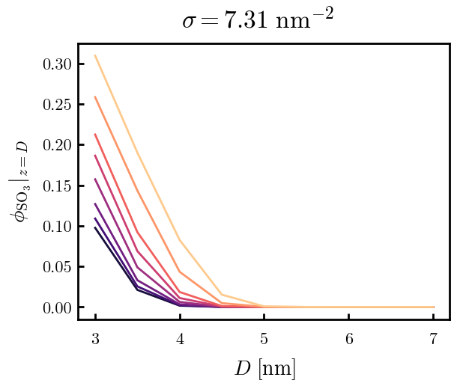
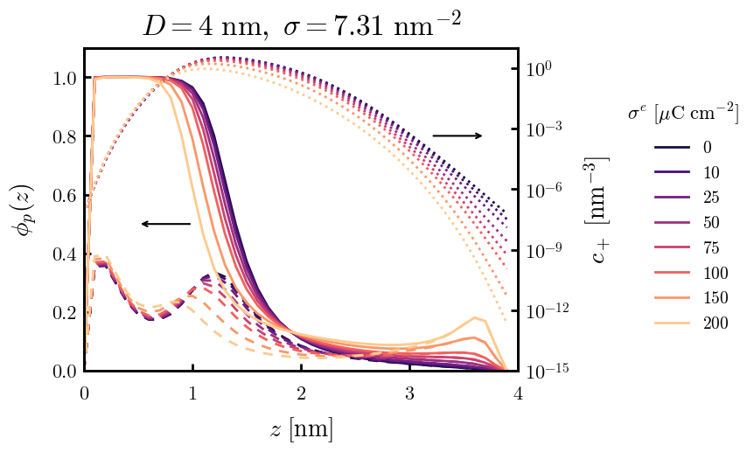
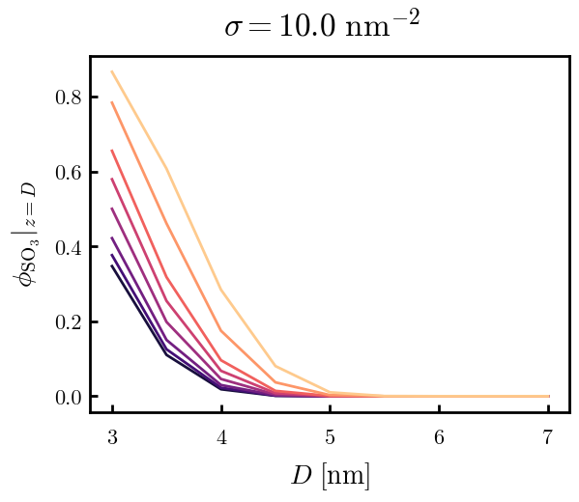
Other
1e−07 M (pH 7)
Stretching to 4 nm shouldn’t be possible—artifact of CGC?

