Slide 1
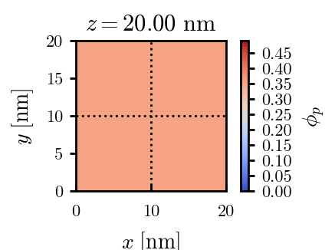
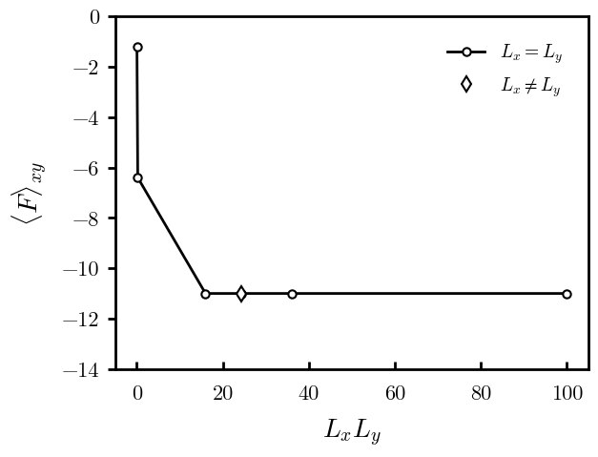
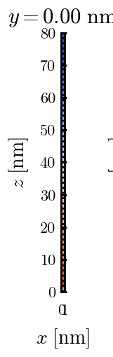
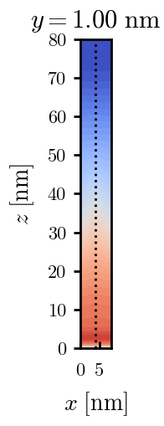
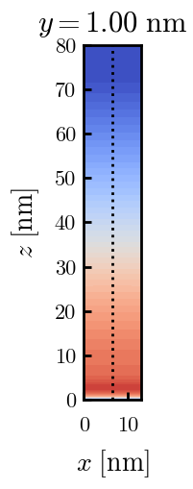
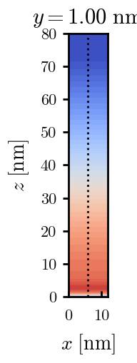
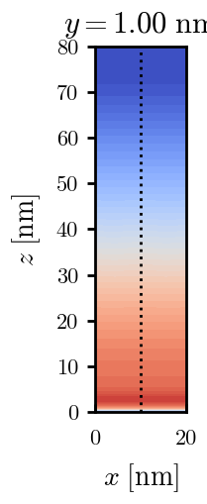
a040x100 relaxation

Slide 2
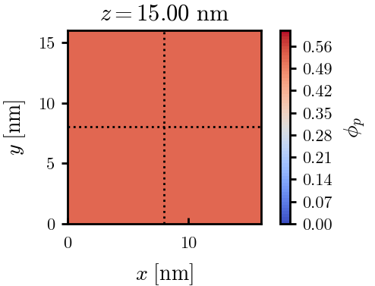
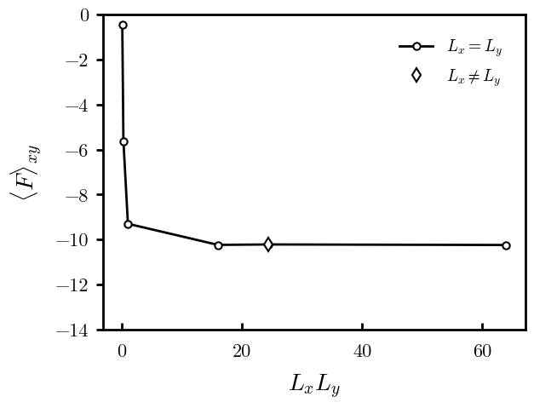
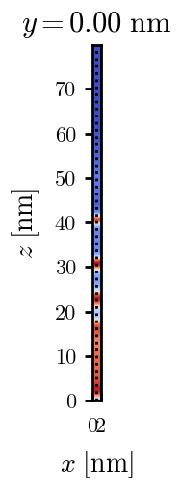
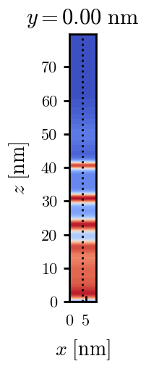
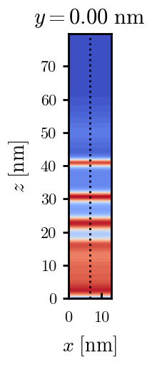
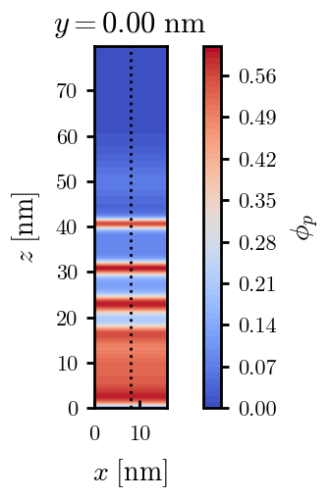
a040x120 relaxation

Slide 3
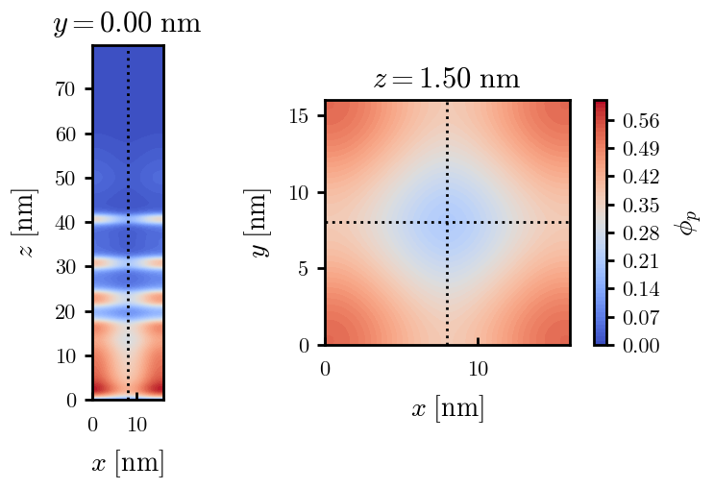
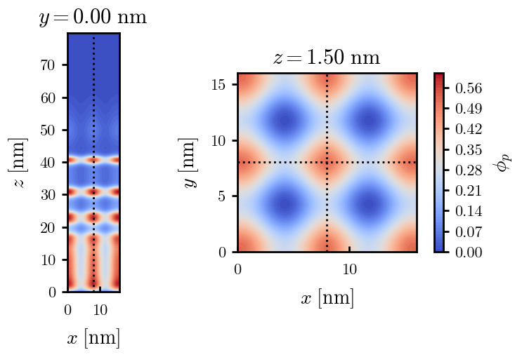
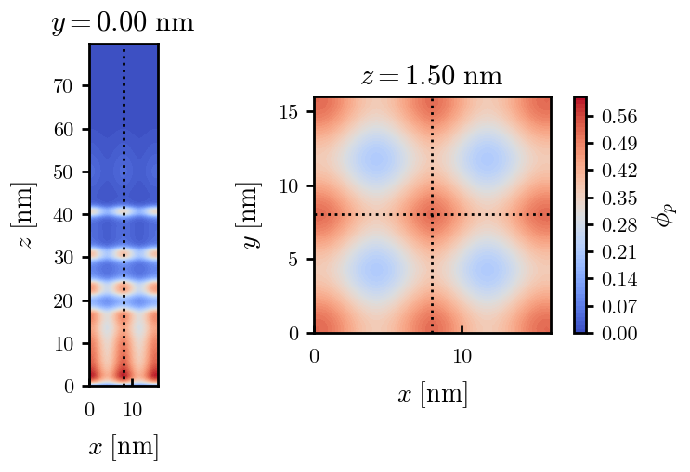
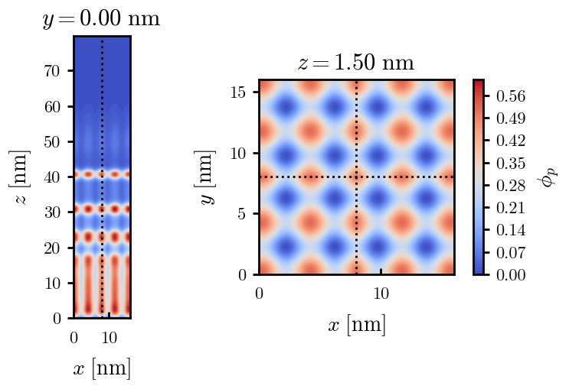
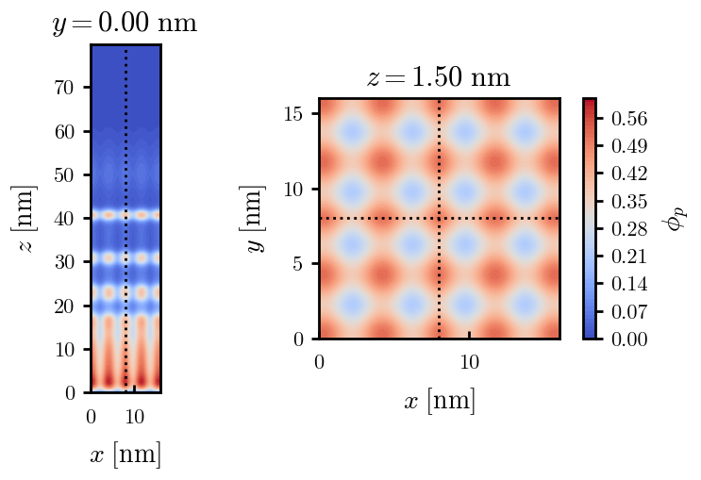
a040x120 seed

Slide 4
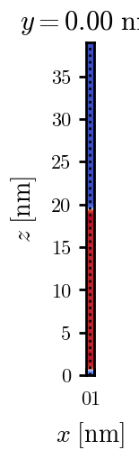
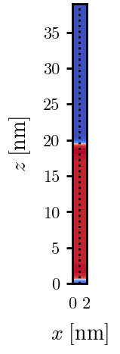
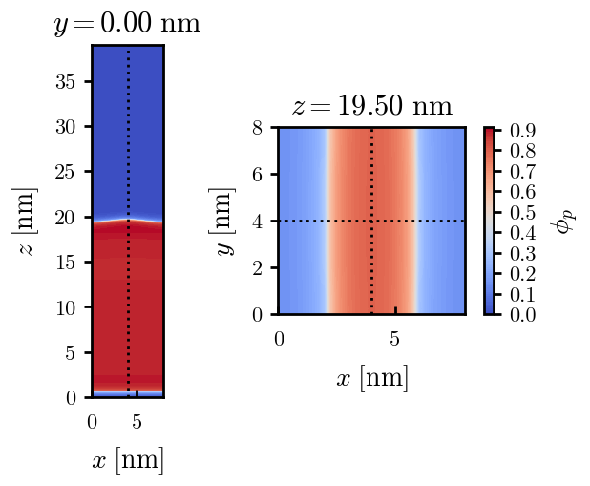
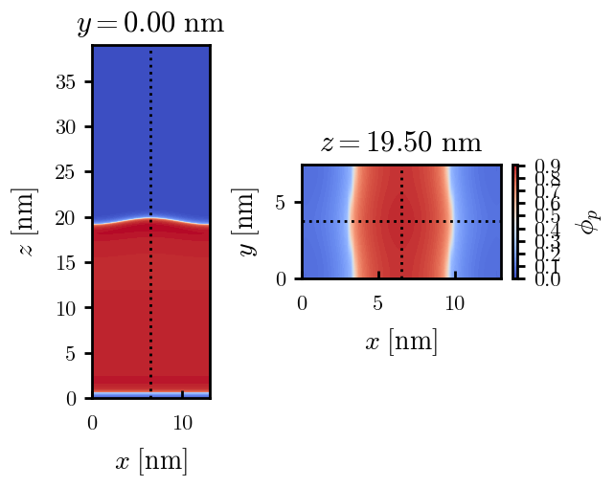
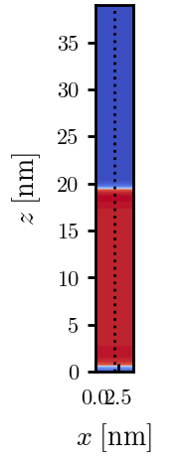
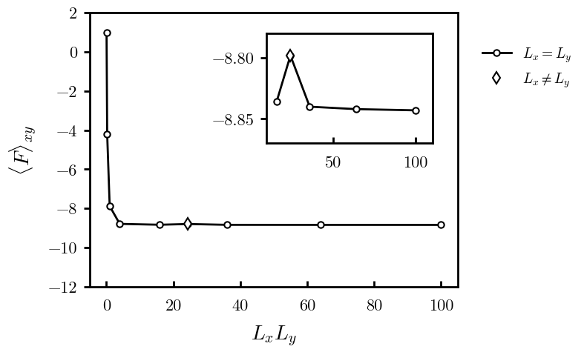
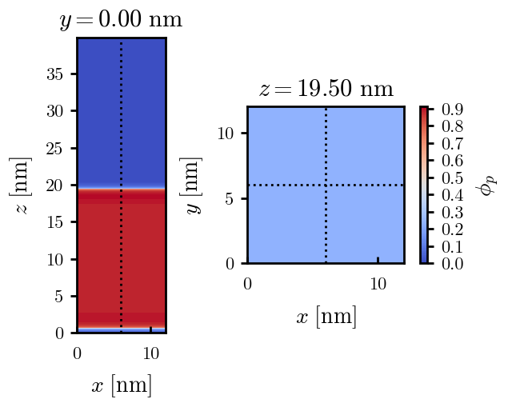
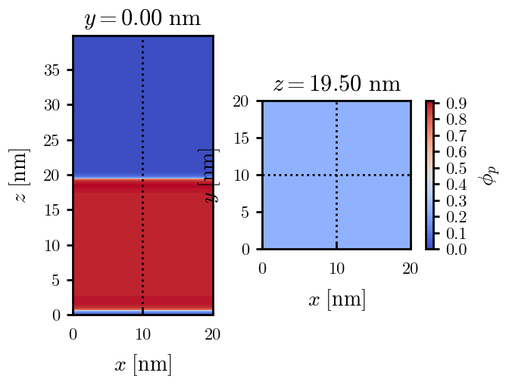
a040x200 relaxation

Slide 5
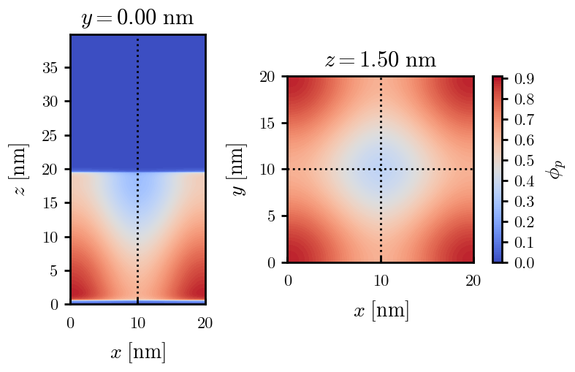
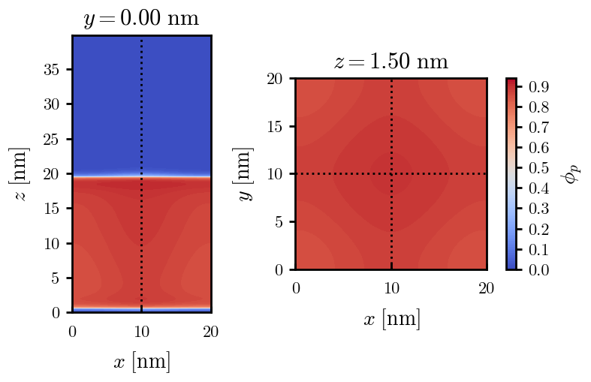


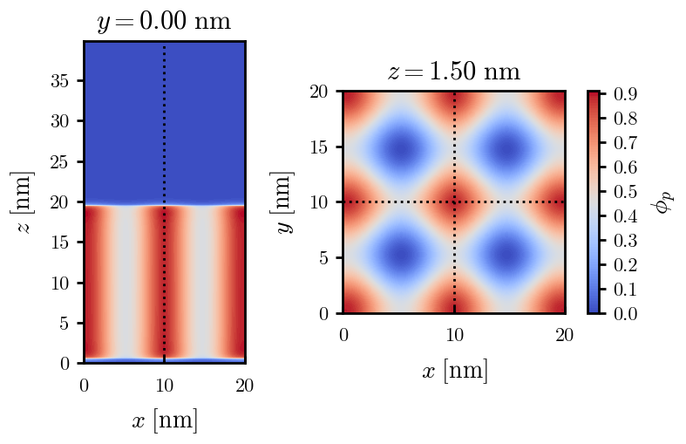
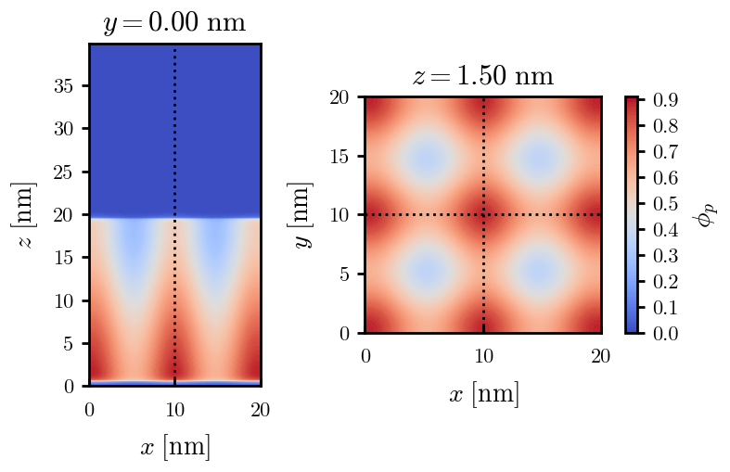
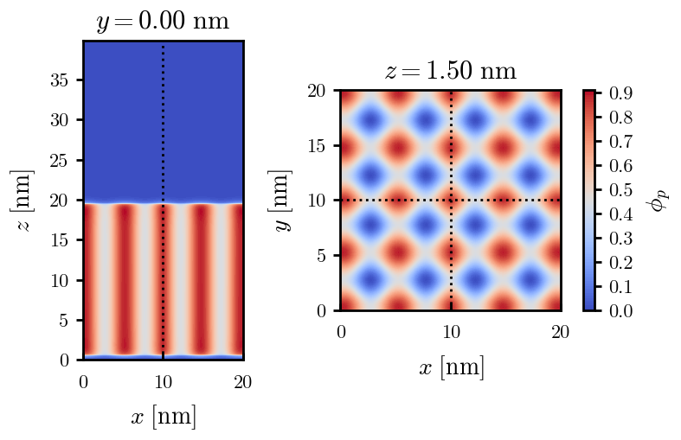
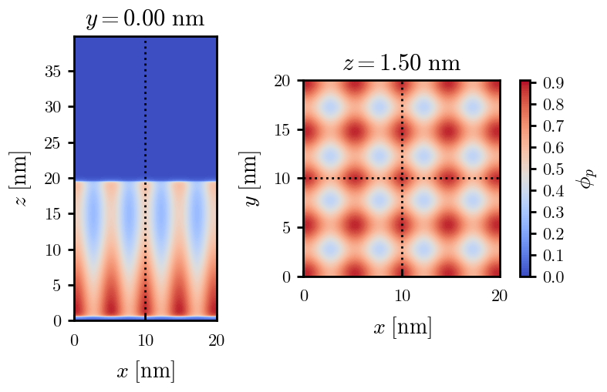

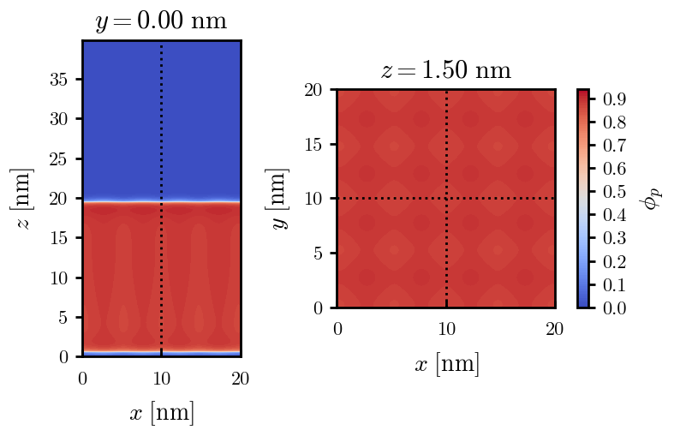
a040x200 seed
All PROG

Slide 6
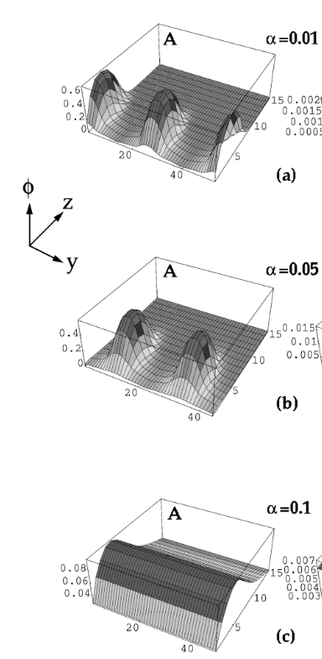
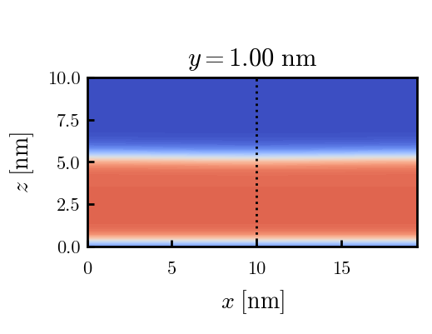



Zhulina JCP 1998
a = 0.01
0.1 mM
1 mM
May need to init using sine
10 mM
25 mM
Zhulina NVT; current GCE runs at Lz = 20

Slide 7
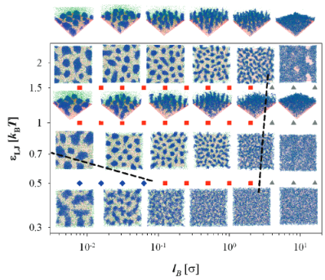
Carrillo Langmuir 2009

Slide 8
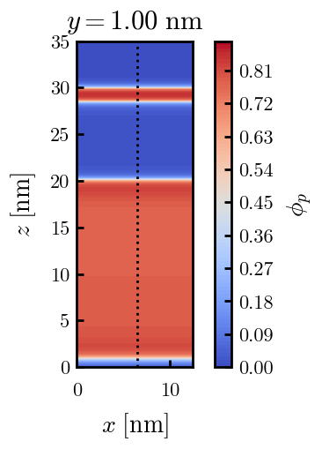
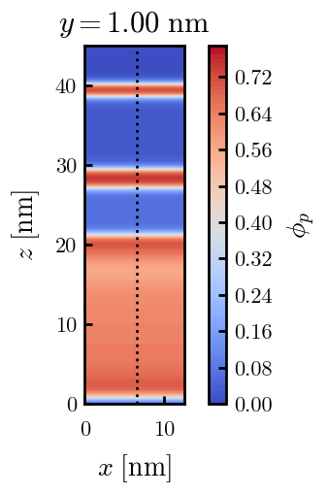
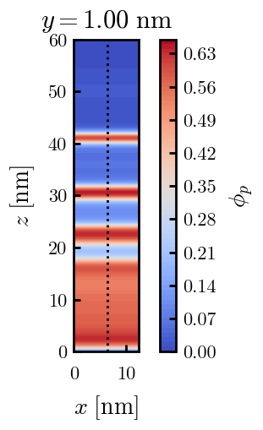
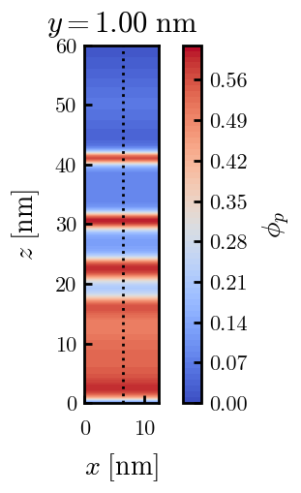
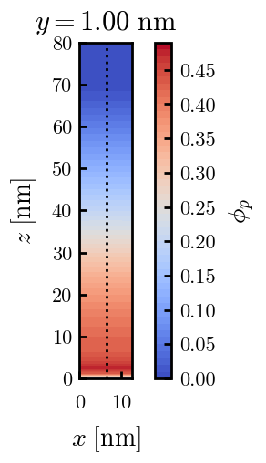
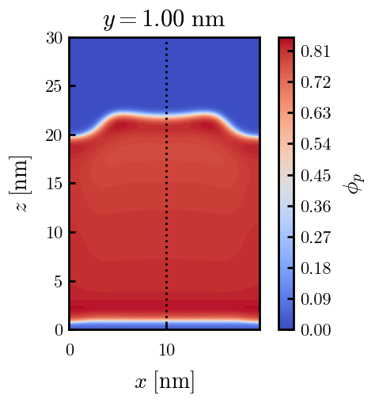
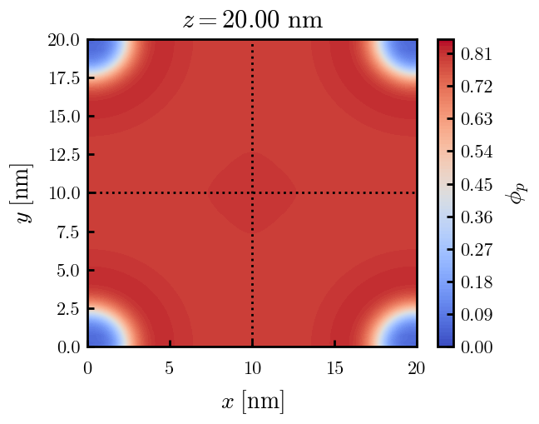
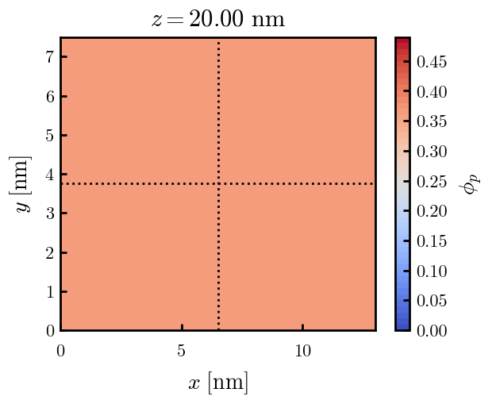
X200 x170 x145 x130 x120 x100

Slide 9
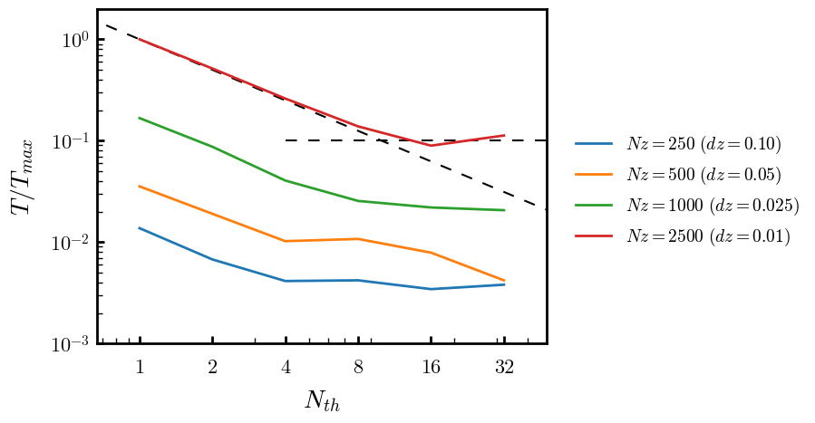
Parallelization

Slide 10
Equations
Quenched average, np, A --> \inf ; np/A → \sigma
Discrete Gaussian chain

Slide 11
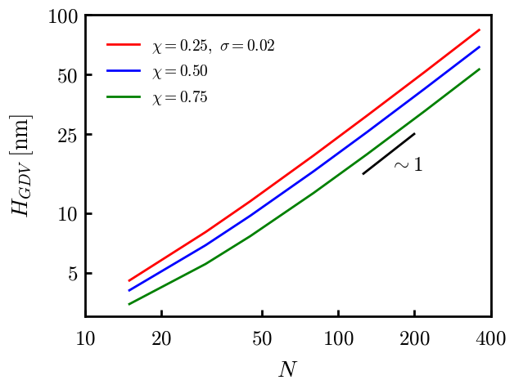
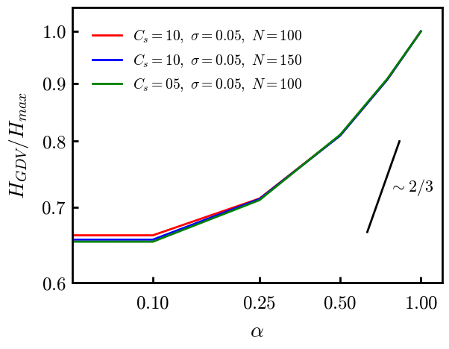
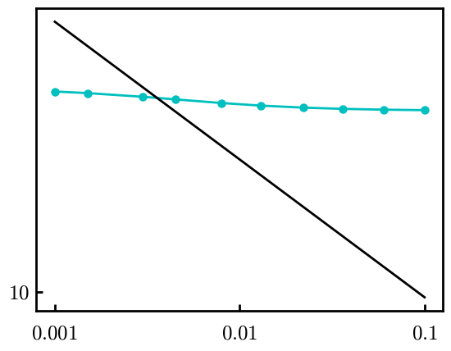
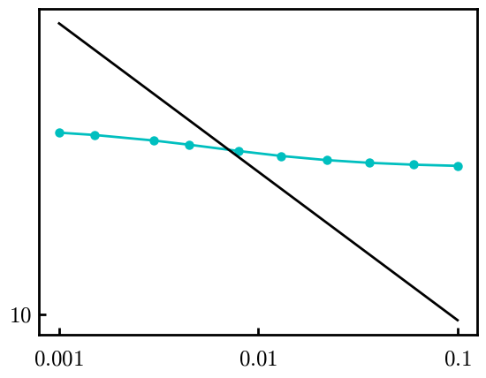
Scaling (Alexander—de Gennes brush)
V = 4.2; H = 27.5 – 30.5
V = 2; H = 39 – 45.5

Slide 12
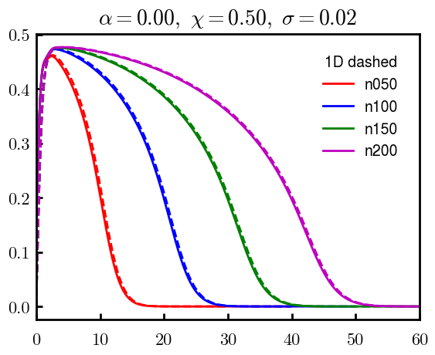






$φ_{p}$: DGC (3D; NxNy=1) vs MDE (1D)
Ns/sigs: dz = 0.10, Ngz_2 = 4$σ$; Chis/bs: dz = 0.25, Ngz_2 = 3.5$σ$

Slide 13


Numericals
Ys
Possibly do Ngz for multiple dzs

Slide 14








3D
Lxy = 1
Lxy = 10
Lxy = 5
Lxy = 15
y-z heatmaps for $φ_{p}$ at constant x

Slide 15





z-FFT vs z-FD (MDE) – REDFT01 xy(z)
Lx = 5, Ly = 5, Lz = 50. s = 0.02. x = 0.75. a = 0.00, N = 50
3D vs 1D (dashed): dz = 0.5, ds = 0.20; dz_1D = 0.113, ds_1D = 0.083
FFT (xyz)
FFT (yz vs pha)
FD (xyz)
FD (yz vs pha)
Diff btw 1D/3D should just be dz, ds, etc.

Slide 16
Specifying Grafted Points

Slide 17
Strategy
2D binary array for surface sites of homogeneously grafted polymer given grafting density, simulation box size, and discretization (and assuming dx = dy)
Fullspace must be periodic on x0 = xL, y0 = yL
Halfspace must be even on xL/2 and yL/2 (overlap of boundary following REDFT00) and periodic on x0 = xL, y0 = yL.
Homogeneous spacing as determined by regular hexagon, where grafting point at centroid of hexagon
In case there are edge effects, try shifting the centroids away from the boundaries of the xy-plane (only did for fullspace)
Make sure no edge effects by comparing results of full FFT with cos FFT

Slide 18
Test conditions
Sigma = 0.05 c/nm2
Lx = 15 nm
Ly = 15 nm
dx = 0.4 nm
Cast in terms of dx (for rounding and PBC for grafting points):
Sigma = 0.0668 c/nm2
Lx = 14.80 nm
Ly = 11.20 nm
(Sigma error decrease with dx)

Slide 19

Padded PBC (Full FFT)
Hexagons drawn for illustration of hexagon approach

Slide 20

Unpadded PBC (Full/Cos FFT)

Slide 21






Other conditions (full and half results overlapped to show match)
s = 0.0241 (20.28%; dx=0.4), Lx, Ly = 12.40, 20.80
s = 0.0208 (4.08%; dx=0.1), Lx, Ly = 12.90, 22.30
s = 0.1332 (11%; dx=0.1), Lx, Ly = 20.50, 20.40

Slide 22


