Slide 1
Test conditions
Sigma = 0.05 c/nm2
Lx = 15 nm
Ly = 15 nm
dx = 0.4 nm
Cast in terms of dx (for rounding and PBC for grafting points):
Sigma = 0.0668 c/nm2
Lx = 14.80 nm
Ly = 11.20 nm
(Sigma error decrease with dx)

Slide 2
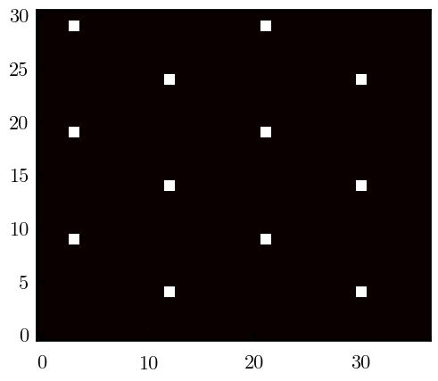
Padded PBC (Full FFT)

Slide 3
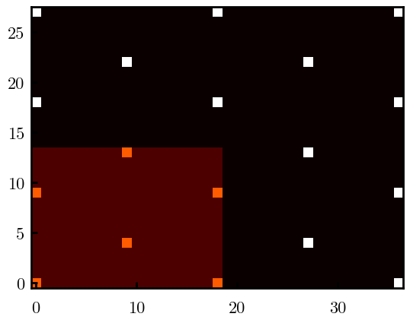
Unpadded PBC (Full/Cos FFT)
Inner boundary compressed by 1*dx due to REDFT00 overlap

Slide 4
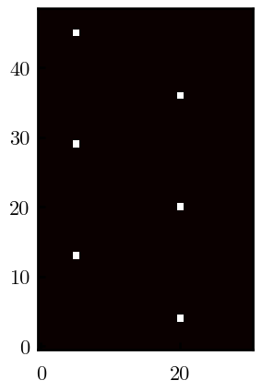
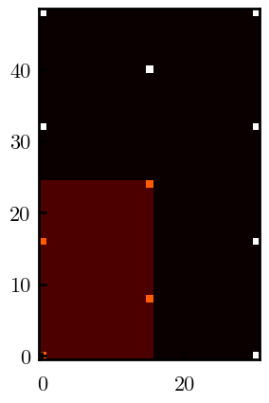
Other conditions
s = 0.0241 (0.02), Lx, Ly = 12.40, 19.60

