Slide 1
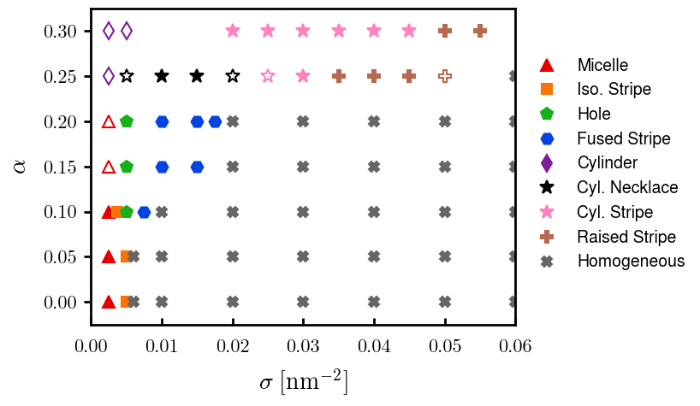
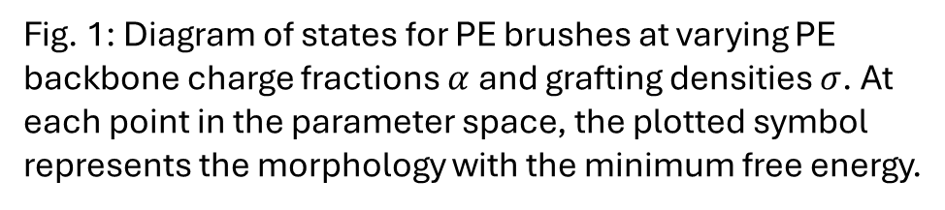
Fig. 1: Diagram of states for PE brushes at varying PE backbone charge fractions $α$ and grafting densities $σ$. At each point in the parameter space, the plotted symbol represents the morphology with the minimum free energy.

Slide 2
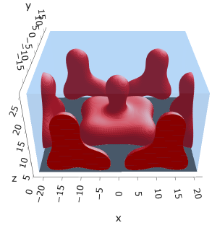
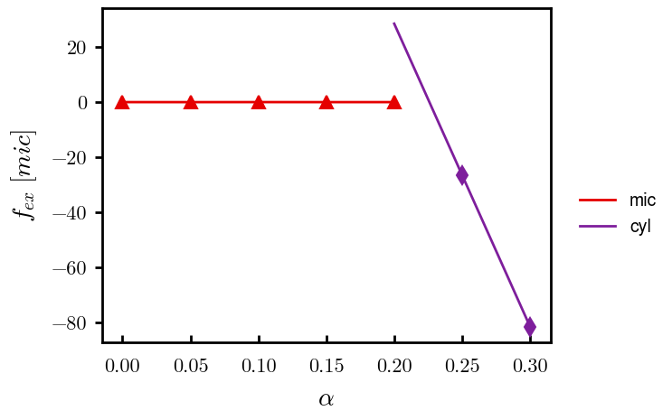
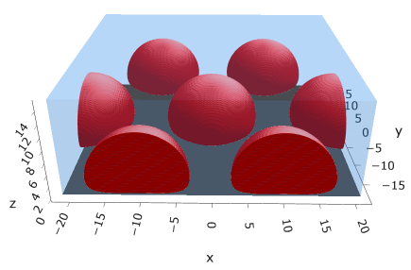


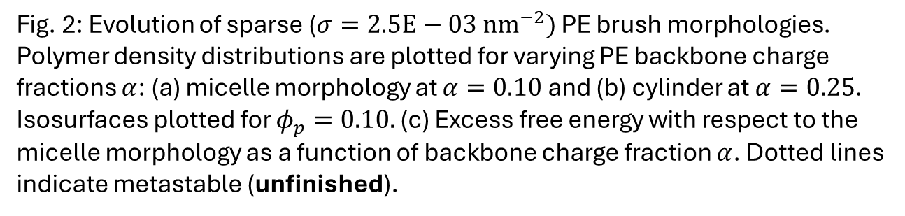
(a)
(b)
(c)
$$α=0.10$$
$$α=0.25$$
Need to finalize
Fig. 2: Evolution of sparse ($σ=2.5E−03 {nm}^{−2})$ PE brush morphologies. Polymer density distributions are plotted for varying PE backbone charge fractions $α$: (a) micelle morphology at $α=0.10$ and (b) cylinder at $α=0.25$. Isosurfaces plotted for $φ_{p}=0.10.$ (c) Excess free energy with respect to the micelle morphology as a function of backbone charge fraction $α$. Dotted lines indicate metastable (unfinished).

Slide 3
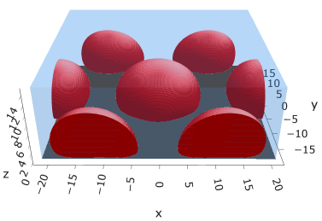
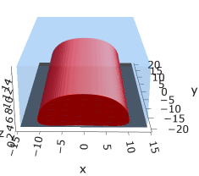
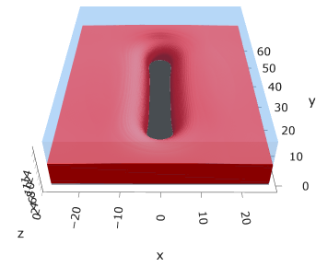
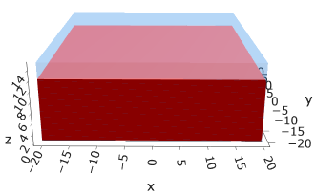
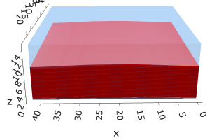
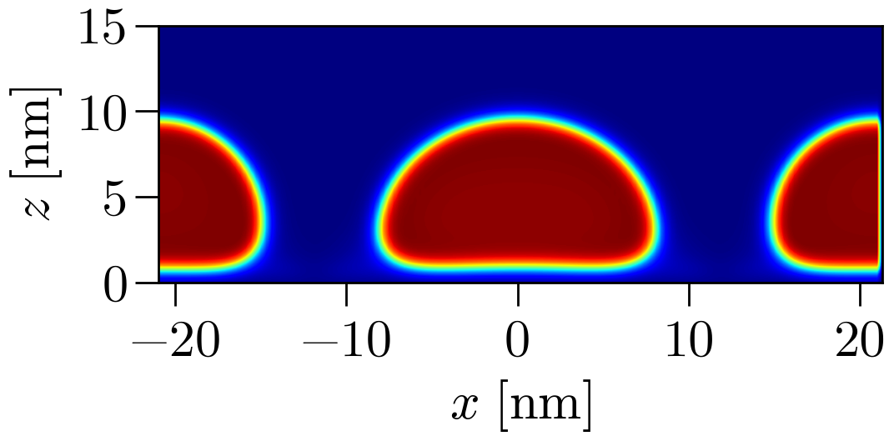
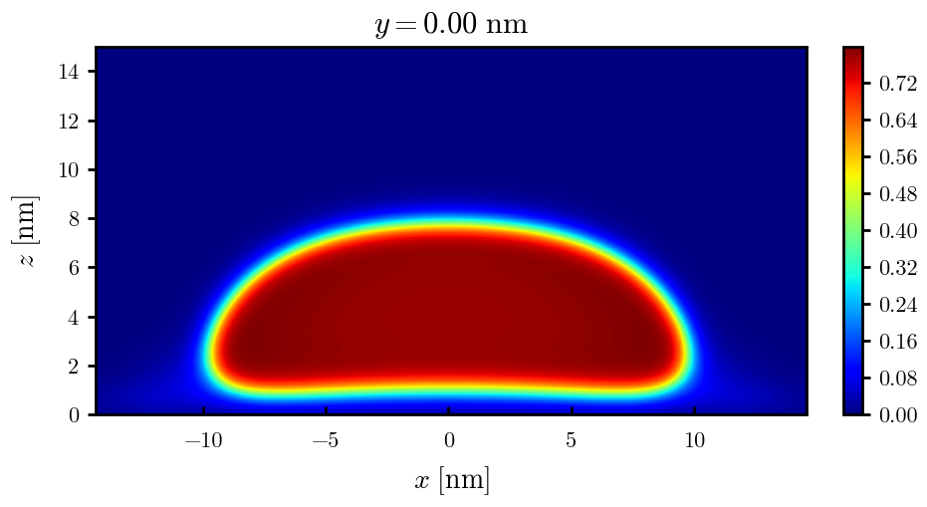
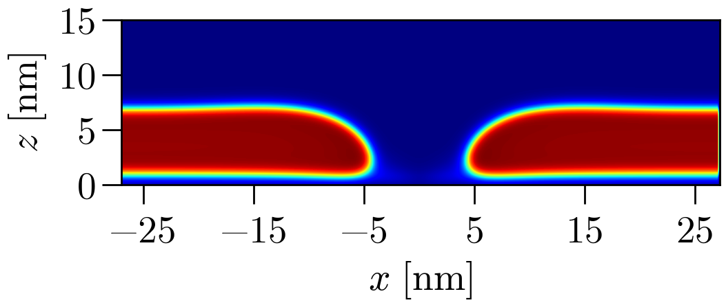
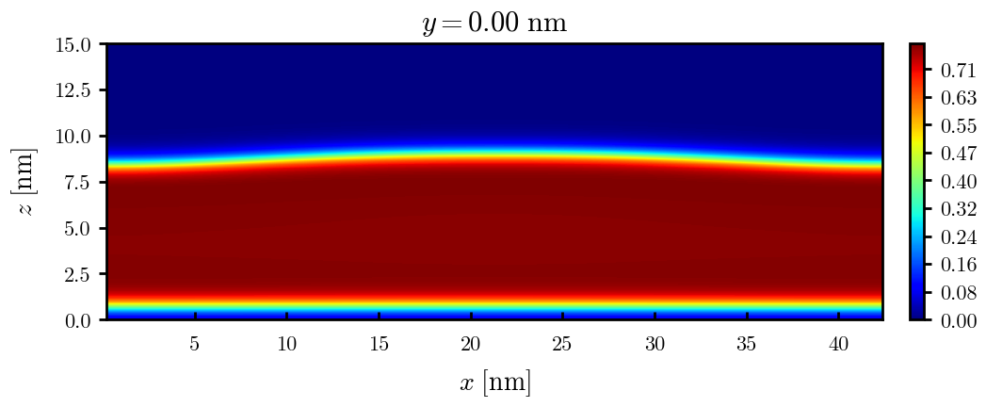
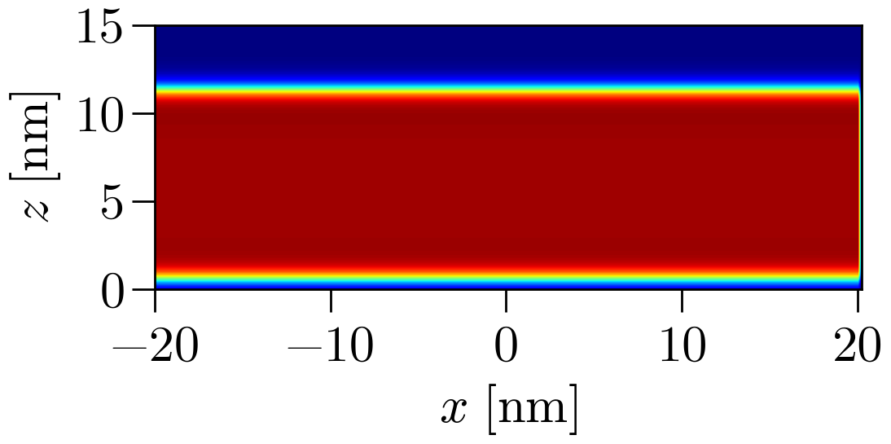

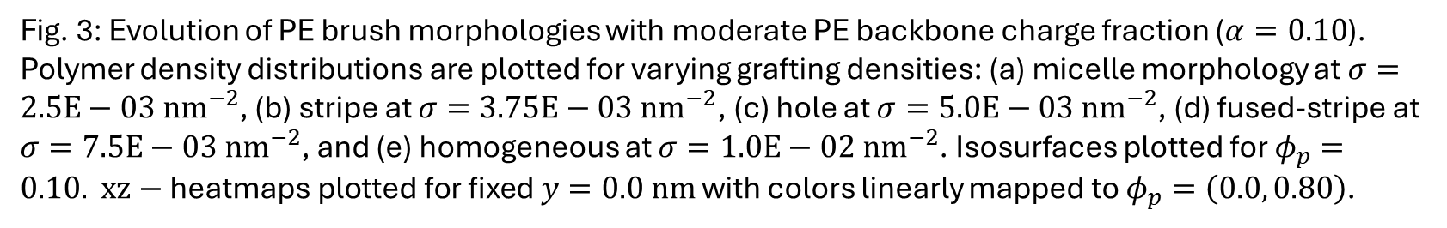




(a)
(b)
(c)
(d)
(e)
$$σ=2.5E−03$$
$$σ=3.75E−03$$
$$σ=5.0E−03$$
$$σ=7.5E−03$$
$$σ=1.0E−02$$
Maybe 6.25 look better
Fig. 3: Evolution of PE brush morphologies with moderate PE backbone charge fraction ($α=0.10$). Polymer density distributions are plotted for varying grafting densities: (a) micelle morphology at $σ=2.5E−03 {nm}^{−2}$, (b) stripe at $σ=3.75E−03 {nm}^{−2}$, (c) hole at $σ=5.0E−03 {nm}^{−2}$, (d) fused-stripe at $σ=7.5E−03 {nm}^{−2}$, and (e) homogeneous at $σ=1.0E−02 {nm}^{−2}$. Isosurfaces plotted for $φ_{p}=0.10.$ $xz−\text{heatmaps} \text{plotted} \text{for} \text{fixed} y=0.0 nm$ with colors linearly mapped to $φ_{p}=\left(0.0, 0.80\right)$.

Slide 4
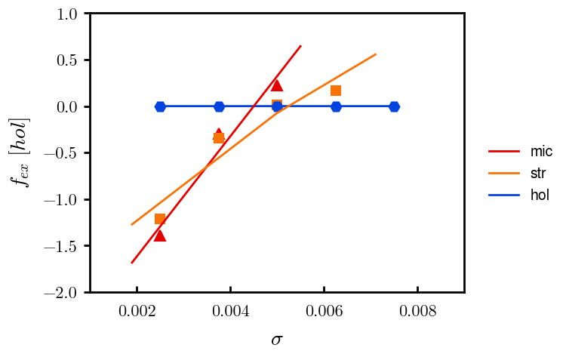
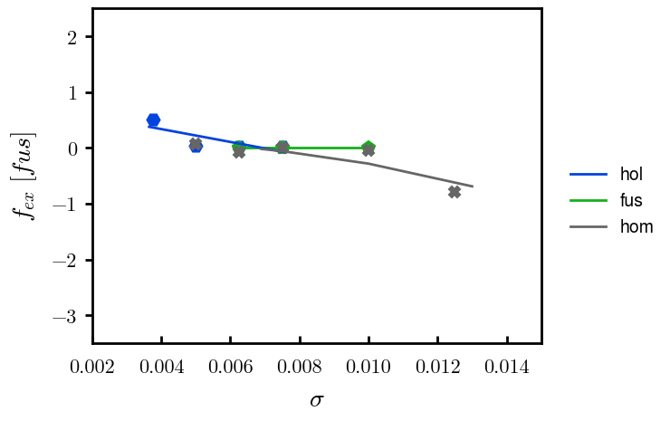
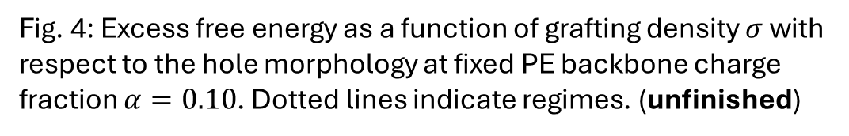
Fig. 4: Excess free energy as a function of grafting density $σ$with respect to the hole morphology at fixed PE backbone charge fraction $α=0.10$. Dotted lines indicate regimes. (unfinished)

Slide 5
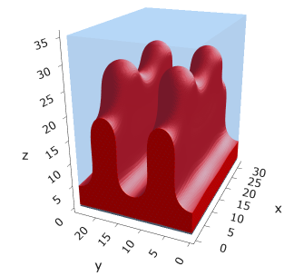
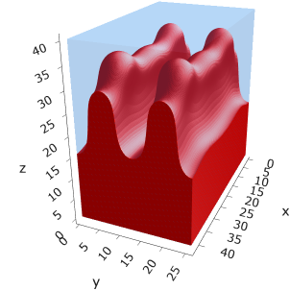
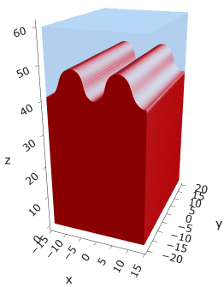
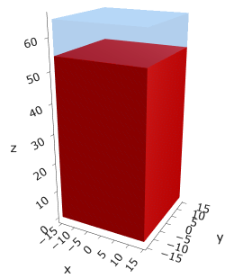
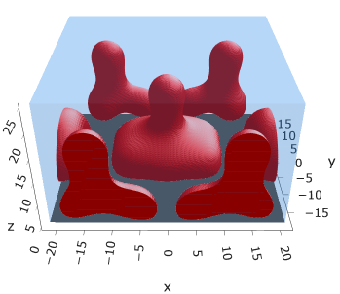
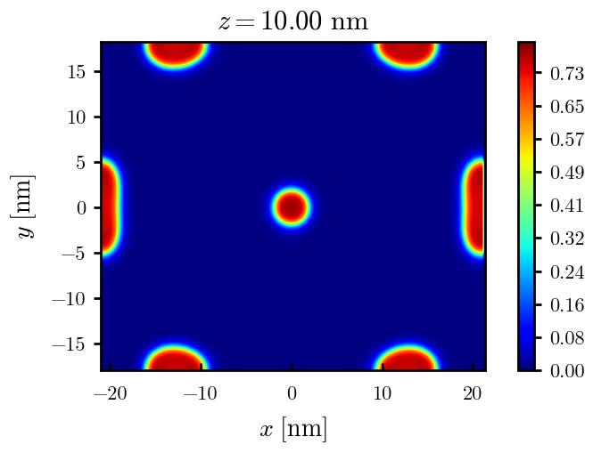
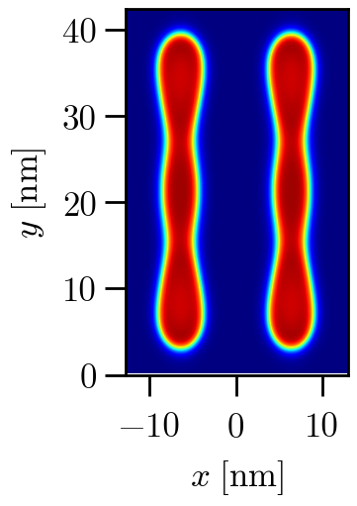
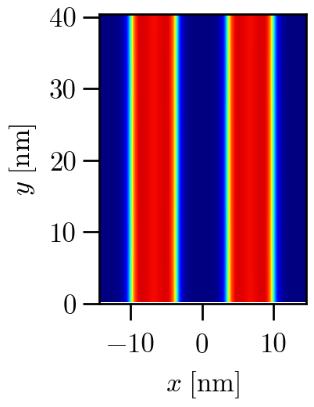
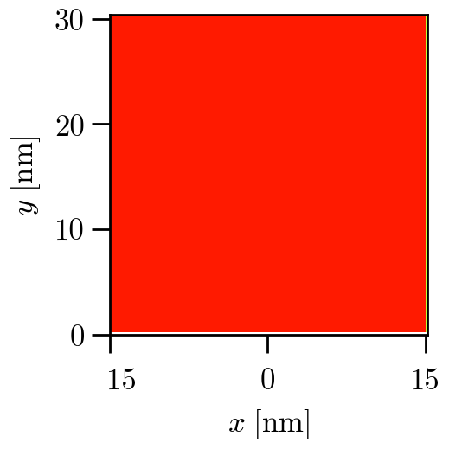
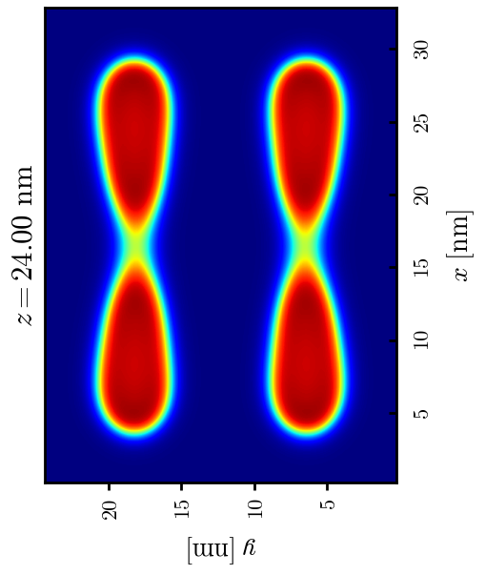


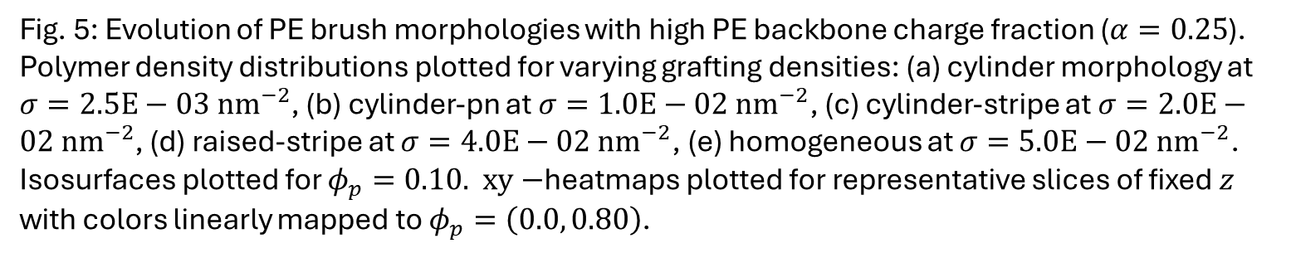






(a)
(b)
(c)
(d)
(e)
$$σ=2.5E−03$$
$$σ=1.0E−02$$
$$σ=2.0E−02$$
$$σ=4.0E−02$$
$$σ=5.0E−02$$
Keep const. Lz?
Need to finalize
$$z=32.0 nm$$
$$z=45.0 nm$$
$$z=50.0 nm$$
Fig. 5: Evolution of PE brush morphologies with high PE backbone charge fraction ($α=0.25$). Polymer density distributions plotted for varying grafting densities: (a) cylinder morphology at $σ=2.5E−03 {nm}^{−2}$, (b) cylinder-pn at $σ=1.0E−02 {nm}^{−2}$, (c) cylinder-stripe at $σ=2.0E−02 {nm}^{−2}$, (d) raised-stripe at $σ=4.0E−02 {nm}^{−2}$, (e) homogeneous at $σ=5.0E−02 {nm}^{−2}$. Isosurfaces plotted for $φ_{p}=0.10.$ $xy−$heatmaps plotted for representative slices of fixed $z$ with colors linearly mapped to $φ_{p}=\left(0.0, 0.80\right)$.

Slide 6
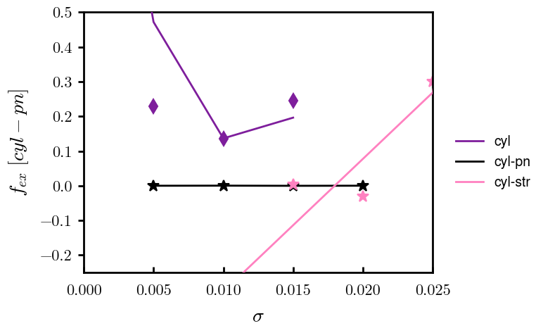
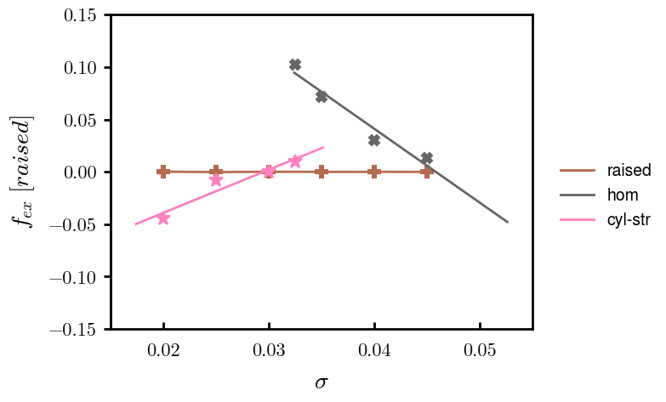
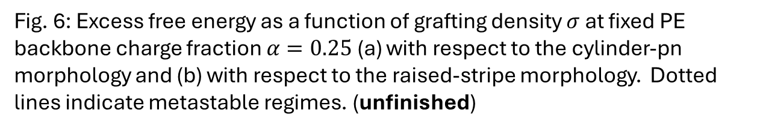
(a)
(b)
Fig. 6: Excess free energy as a function of grafting density $σ$ at fixed PE backbone charge fraction $α=0.25$ (a) with respect to the cylinder-pn morphology and (b) with respect to the raised-stripe morphology. Dotted lines indicate metastable regimes. (unfinished)

Slide 7
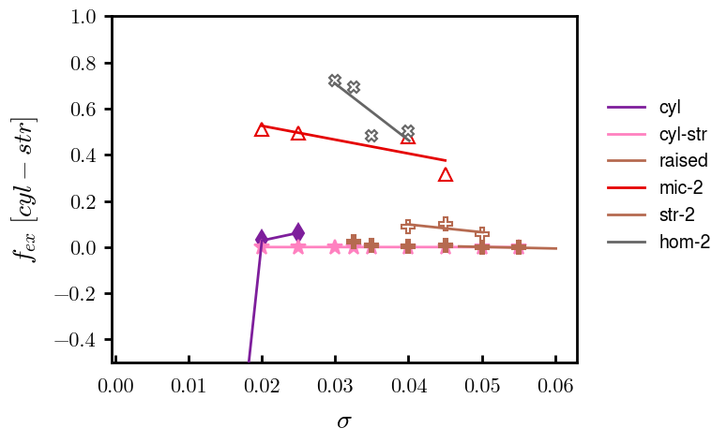
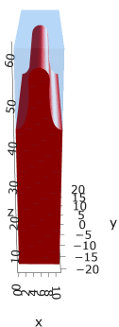
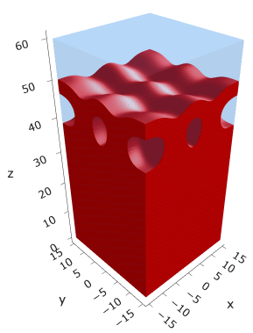
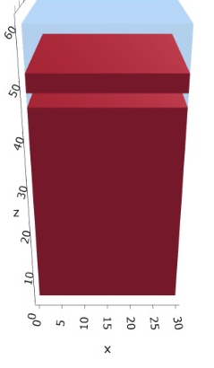
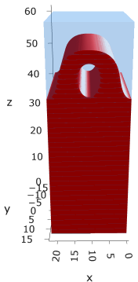

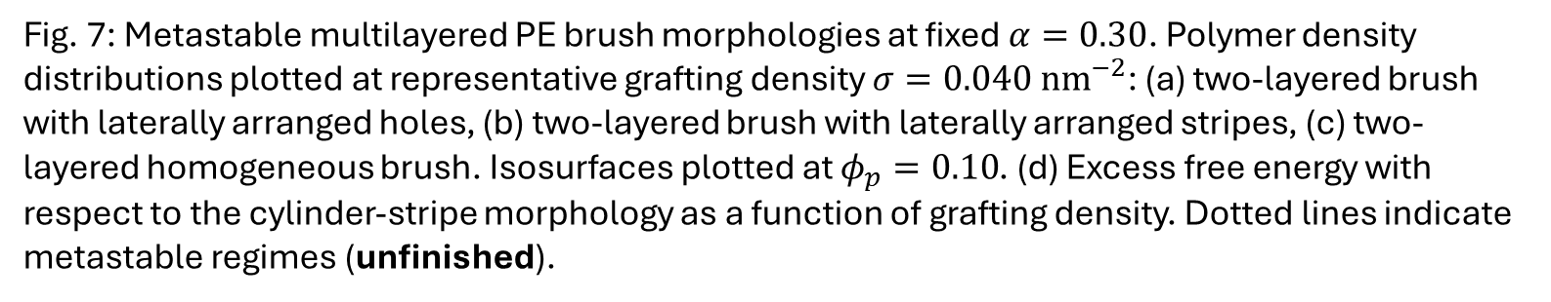


Inc. F, less lateral
(a)
(b)
(c)
(d)
$$σ=4.0E−02$$
$$σ=4.0E−02$$
$$σ=4.0E−02$$
Fig. 7: Metastable multilayered PE brush morphologies at fixed $α=0.30$. Polymer density distributions plotted at representative grafting density $σ=0.040 {nm}^{−2}$: (a) two-layered brush with laterally arranged holes, (b) two-layered brush with laterally arranged stripes, (c) two-layered homogeneous brush. Isosurfaces plotted at $φ_{p}=0.10$. (d) Excess free energy with respect to the cylinder-stripe morphology as a function of grafting density. Dotted lines indicate metastable regimes (unfinished).

