Slide 1
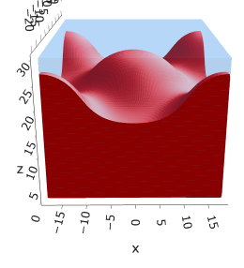
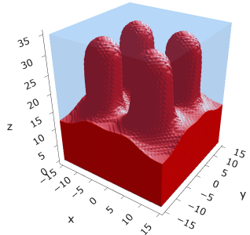
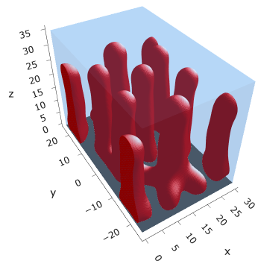
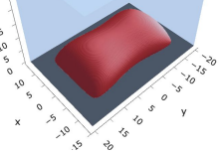
Fig 1: Mic → Cyl in sparse PE by increasing alpha
Example iso mic @ (0.10, 0.0025)
Example fused mic @ (0.20, 0.0175)
Example fused cyl @ (0.25, 0.015)
Example iso cyl @ (0.3, 0.005)
Need to finalize
Actual @ (0.15, 0.0025)?
Actual @ (0.25, 0.0025)?
Actual @ (0.3, 0.0025)

Slide 2
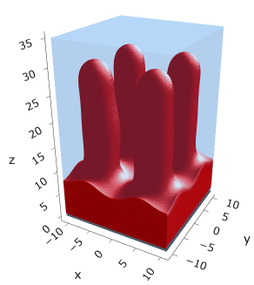
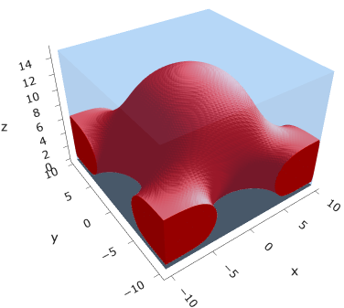
Fig 2: freeE for Mic → Cyl

Slide 3
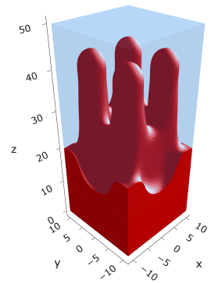
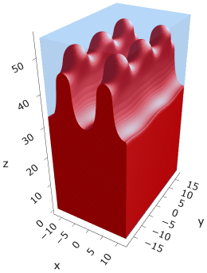
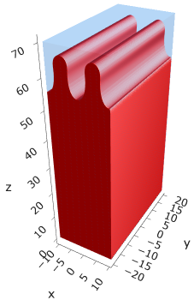
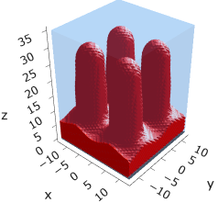
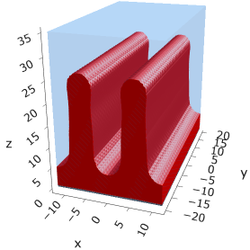
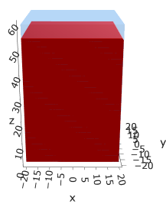
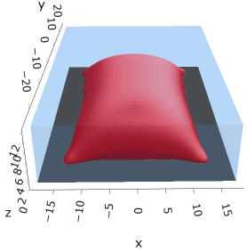
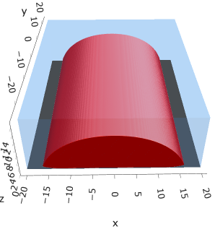
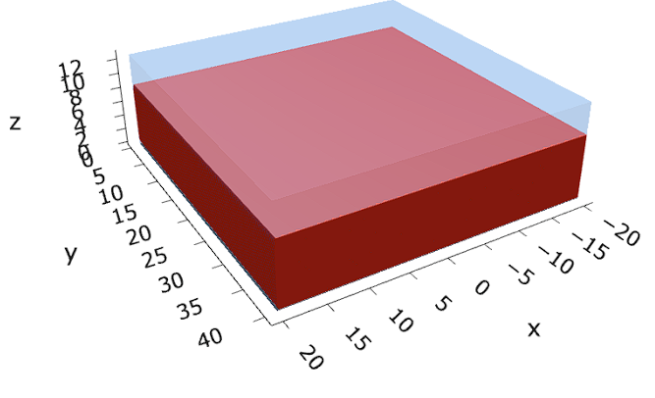












Fig 3: Cyl to Cyl-str to Str by increasing sigma
$$σ=0.005$$
$$σ=0.020$$
$$σ=0.030$$
$$σ=0.055$$
$$α=0.30$$
Need to finalize
Need to finalize/switch
$$σ=0.010$$
$$σ=0.050$$
$$α=0.25$$
Need to finalize
$$σ=0.003$$
$$σ=0.005$$
$$σ=0.007$$
$$α=0.05$$
Need to finalize

Slide 4





Fig 4: freeE for at least $α=0.30$
$$σ=0.005$$
$$σ=0.020$$
$$σ=0.030$$
$σ=0.05$5
$$α=0.30$$
Need to finalize
Need to finalize
$$σ=0.003$$
$$σ=0.005$$
$$σ=0.007$$
$$α=0.30$$
Need to finalize

Slide 5
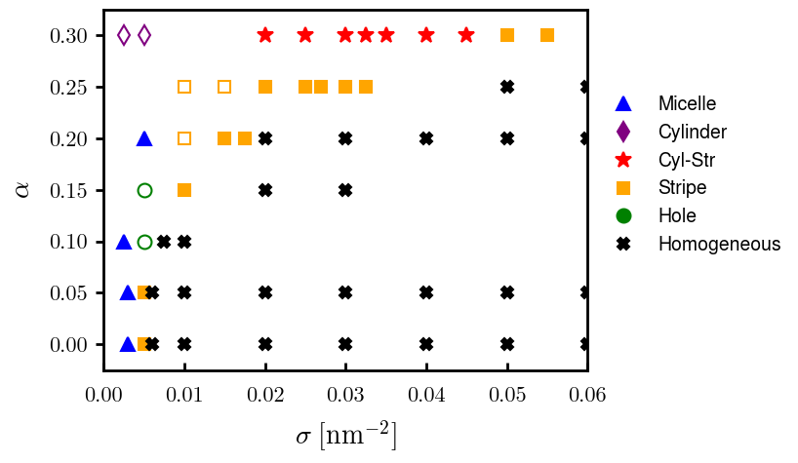
Fig 5: phase diagram
Need to finalize

Slide 6
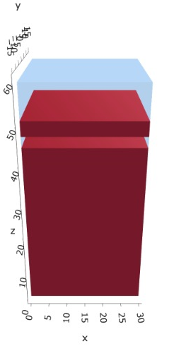
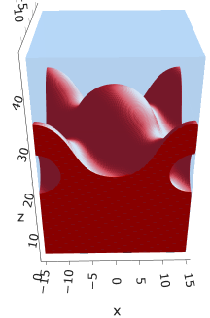
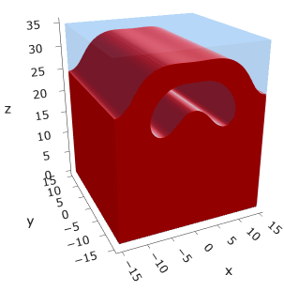


Fig 6: Metastable multilayered morphologies with freeE
$$σ=0.025$$
$$σ=0.040$$

