Slide 1
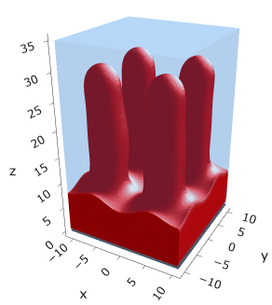
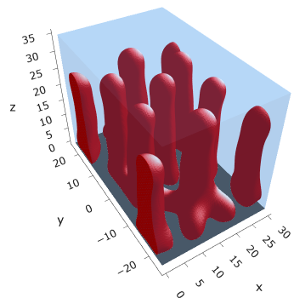
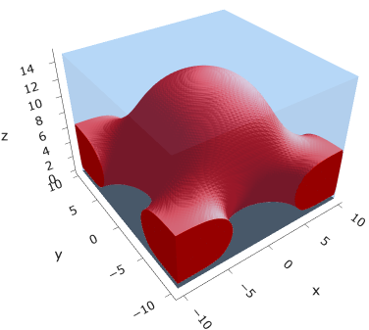
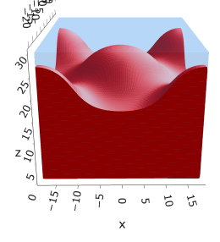
Fig 1: Mic → Cyl in sparse PE by increasing alpha
Example iso mic @ (0.20, 0.005)
Example fused mic @ (0.20, 0.0175)
Example fused cyl @ (0.25, 0.010)
Iso cyl @ (0.3, 0.005)
Actual @ (0.15, 0.005)?
Actual @ (0.225, 0.005)?
Actual @ (0.25, 0.005)?
Need to finalize

Slide 2
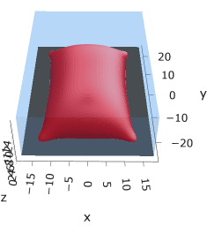
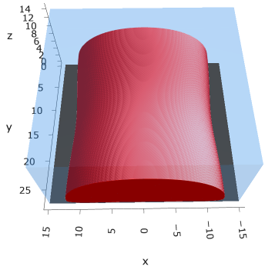
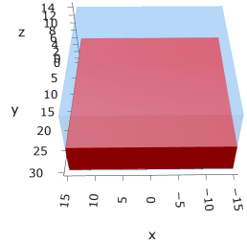
Uncharged:
Hydrophobicity promotes lateral segregation
Grafting density (chain spacing) increases length scale of segregation
Hole metastable
Fig 2: lateral segregation in neutrally charged brushes
Do larger box eg (45 x 45)
Do larger box eg (30 x 30)

Slide 3
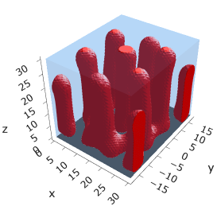

Inc. charge, sparse: decrease lateral segregation length scale
Low charge pinned micelle
Intrachain repulsion (more charge) cylinder
Fig 3: Micelle to cylinder transition in spare PE brushes as a result of increasing intrachain repulsion
$$σ=2.5E−03 ??$$
Do s25e4 & larger box eg (45 x 45)
Do larger box eg (45 x 45)

Slide 4
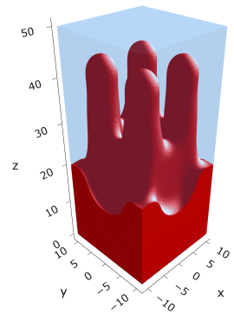
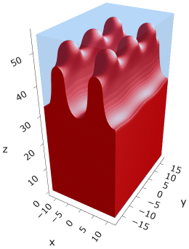
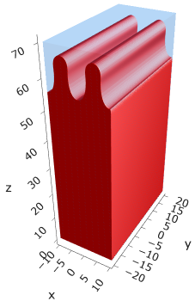
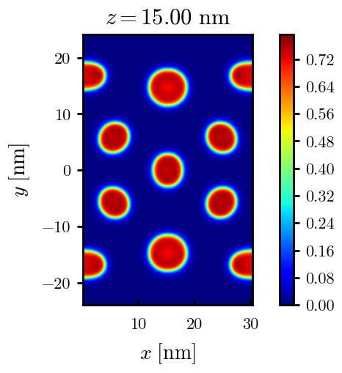
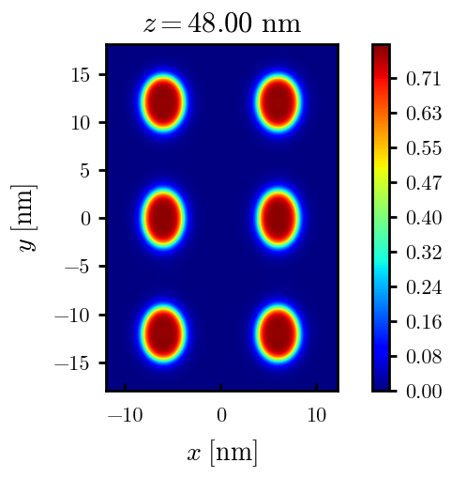
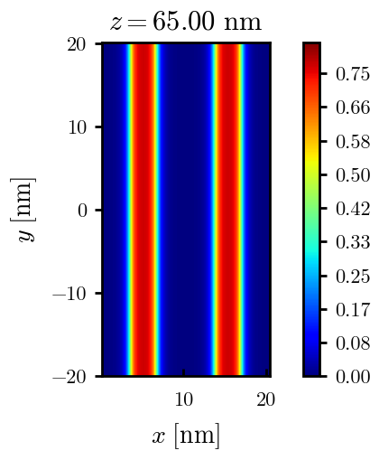
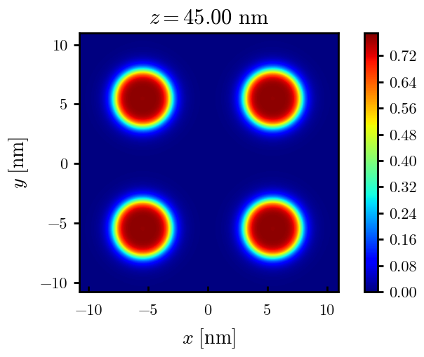




Fig 5: Elevated lateral segregation at high charge fractions with increasing grafting density
$$σ=0.005$$
$$σ=0.020$$
$$σ=0.030$$
$σ=0.05$5

Slide 5
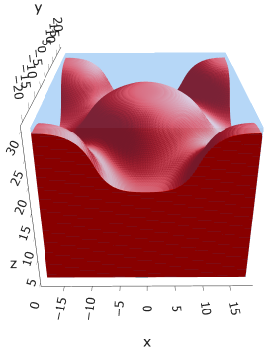
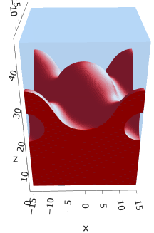
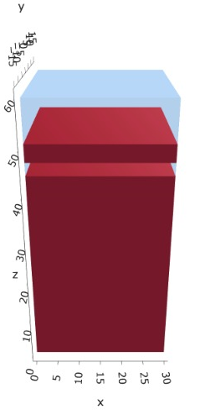
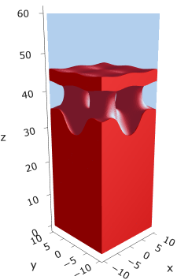
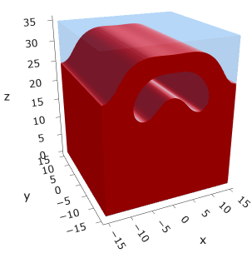






Fig 5: Interesting other morphologies?
$$σ=0.020$$
$$α=0.20$$
(meta)
$$α=0.25$$
(meta)
$$σ=0.025$$
$$σ=0.040$$
$$α=0.30$$
(meta)

Slide 6


Fig 5: Interesting other morphologies?
$$σ=0.025$$
$$σ=0.040$$

Slide 7
