Slide 1
Big tasks (affects overall story):
a10s5e3: Hoping for pinned pn, otherwise why not stripe?
Pinned pn may be too large of box (e.g., 40 x 80)
a20s020: cyl? If not, why a20 so short?
a25
Stability of pn/str
s < 027: Get mic -> cyl?
Get homogeneous sigma
a30:
Get homogeneous sigma
Any layered morphologies stable?
Fine tuning boundaries:
a05s6e3: Looking like will be hole (Terran?)
a10s75e4: Probably hole, if not, get hole for a10
a15: Terran started
a20s5e3: TODO, only mic run once

Slide 2
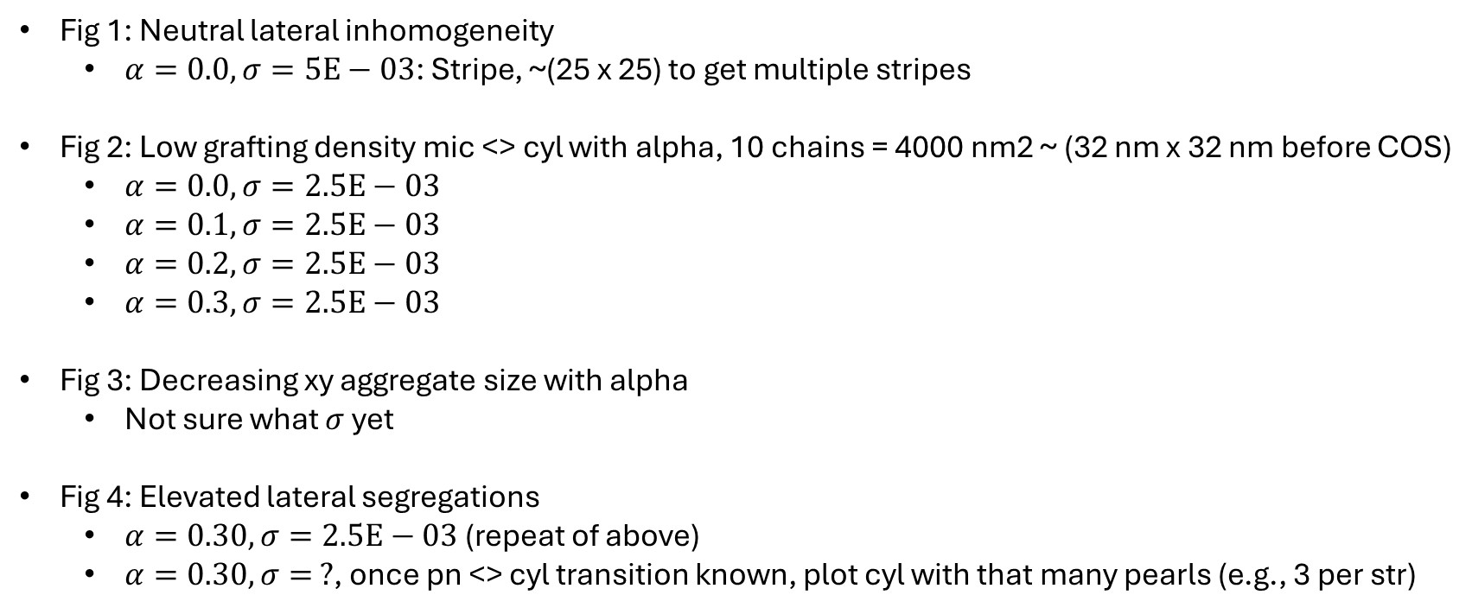
Fig 1: Neutral lateral inhomogeneity
$α=0.0, σ=5E−03$: Stripe, ~(25 x 25) to get multiple stripes
Fig 2: Low grafting density mic <> cyl with alpha, 10 chains = 4000 nm2 ~ (32 nm x 32 nm before COS)
$α=0.0, σ=2.5E−03$
$α=0.1, σ=2.5E−03$
$α=0.2, σ=2.5E−03$
$α=0.3, σ=2.5E−03$
Fig 3: Decreasing xy aggregate size with alpha
Not sure what $σ$ yet
Fig 4: Elevated lateral segregations
$α=0.30, σ=2.5E−03$ (repeat of above)
$α=0.30, σ= ?$, once pn <> cyl transition known, plot cyl with that many pearls (e.g., 3 per str)
Plotting codes needed
Heatmap reflect box code bugfix: calculating sizes for nxny
Orca for Plotly go to get consistent camera setups, or X11 forwarding from Anvil to use memory?

Slide 4
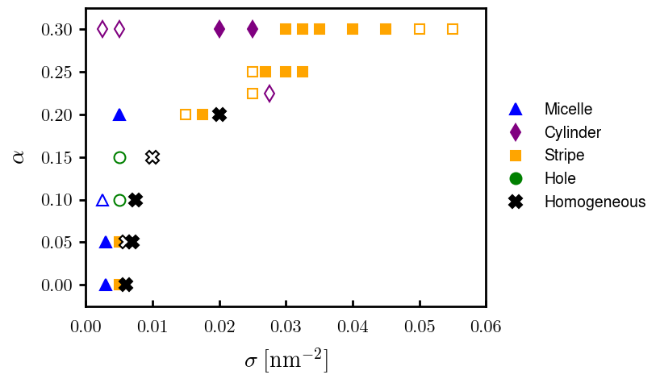
Fig 1: Phase diagram

Slide 5
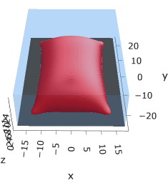
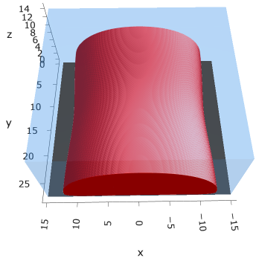
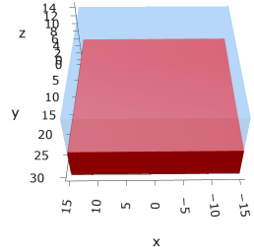
Uncharged:
Hydrophobicity promotes lateral segregation
Grafting density (chain spacing) increases length scale of segregation
Hole metastable
Fig 2: lateral segregation in neutrally charged brushes
Do larger box eg (45 x 45)
Do larger box eg (30 x 30)

Slide 6
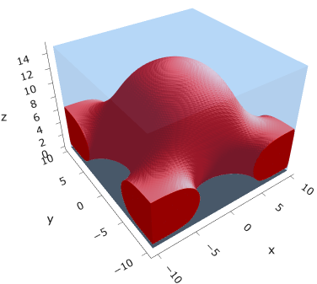
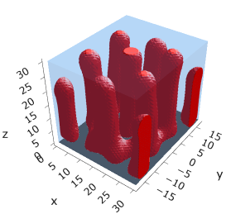

Inc. charge, sparse: decrease lateral segregation length scale
Low charge pinned micelle
Intrachain repulsion (more charge) cylinder
Fig 3: Micelle to cylinder transition in spare PE brushes as a result of increasing intrachain repulsion
$$σ=2.5E−03 ??$$
Do s25e4 & larger box eg (45 x 45)
Do larger box eg (45 x 45)

Slide 7

Inc. charged, medium density: decrease lateral segregation length scale
Low charge little segregation (stripe)
Little charge more segregation (pinned pn)
Med charge (pinned mic / cyl)
High charge, intrachain dominated (cyl)
Fig 4: Increasing lateral segregation (decrease in aggregate size) with increasing intrachain repulsion
Hole (If possible, will probably by elong)
Hom
Str
Pn
Mic
Cyl
$σ$ = 0.0075? 0.010?

Slide 8
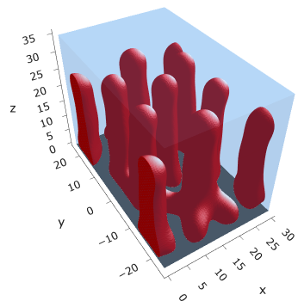
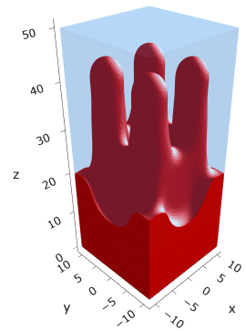
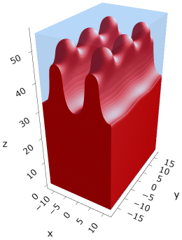
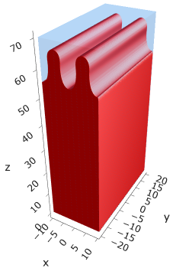
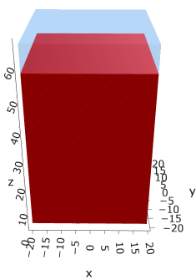
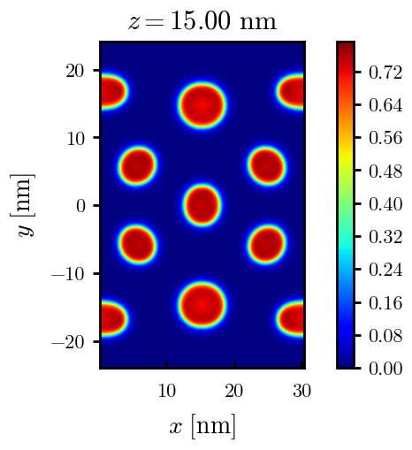
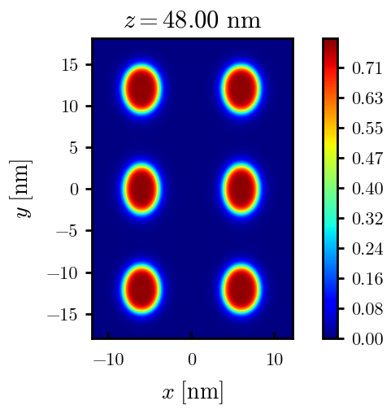
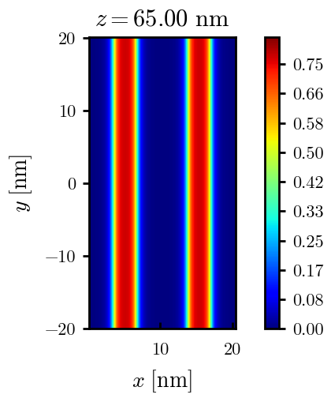
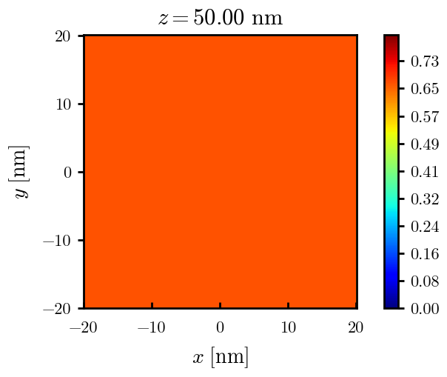
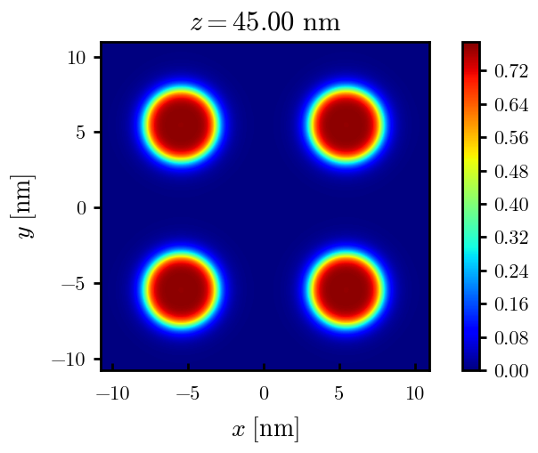





Fig 5: Elevated lateral segregation at high charge fractions with increasing grafting density
$$σ=0.005$$
$$σ=0.020$$
$$σ=0.030$$
$σ=0.05$5
$$σ= ?$$

Slide 9
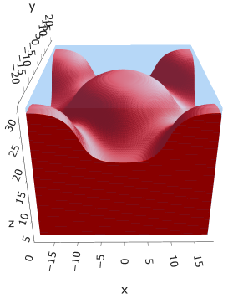
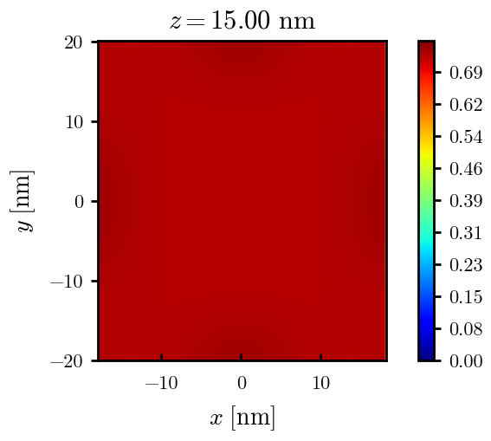
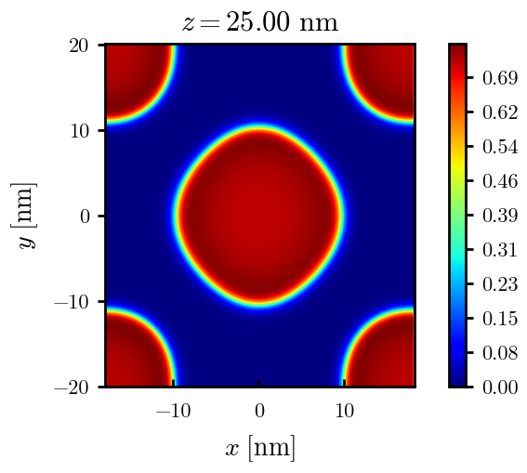
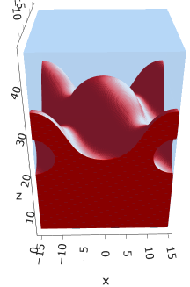
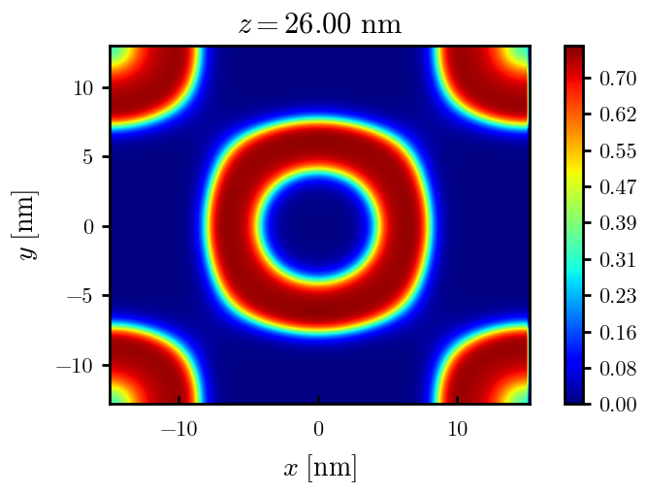
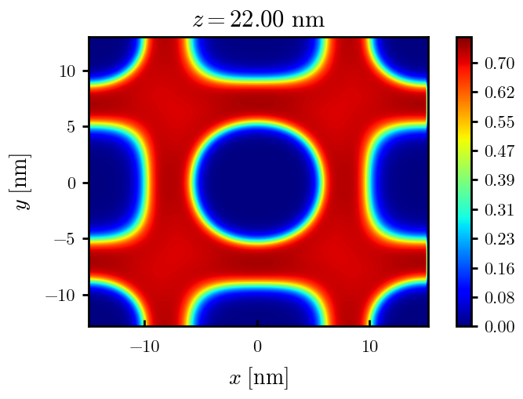
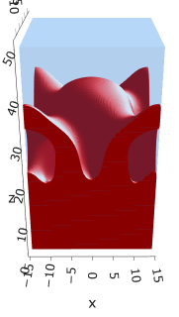
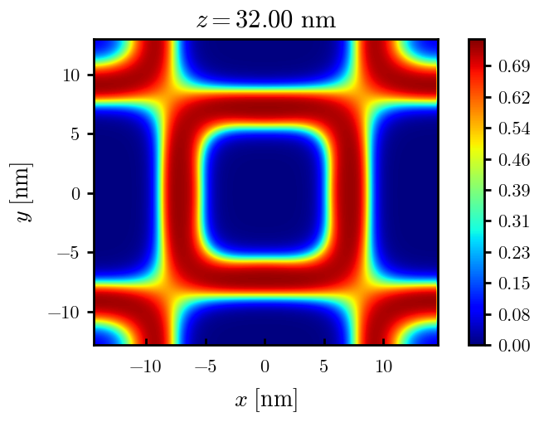
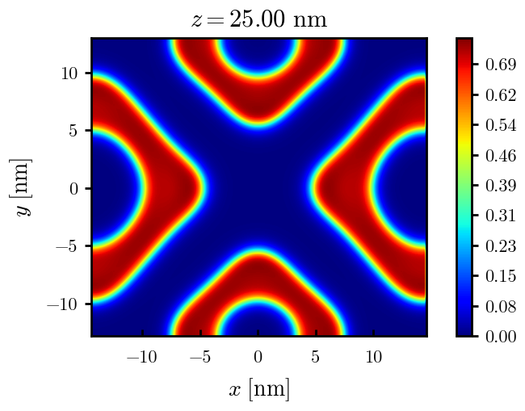




Fig 5: Interesting other morphologies?
$$σ=0.020$$
$$α=0.20$$
(meta)
$$α=0.25$$
(meta)
$$α=0.30$$
(meta)

Slide 10
