Slide 1
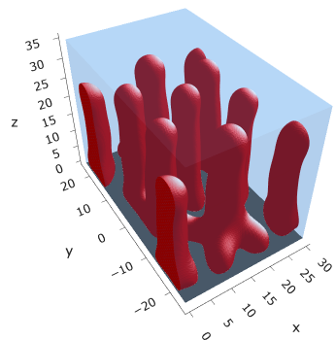
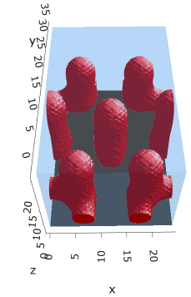
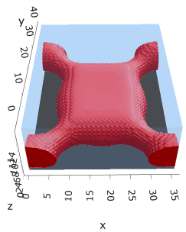
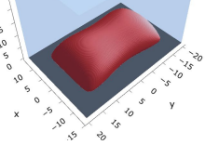
Fig 1: Mic → Cyl in sparse PE by increasing alpha
Iso mic @ (0.10, 0.0025)
Fused mic @ (0.15, 0.0025)
Fused cyl @ (0.25, 0.0025)
Example iso cyl @ (0.3, 0.005)
Need to finalize – increase box size for multiple mic
Need to finalize
Need to finalize – actually fused?
Actual @ (0.3, 0.0025)

Slide 2
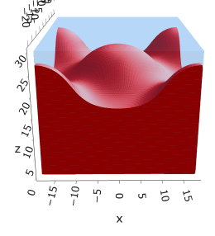
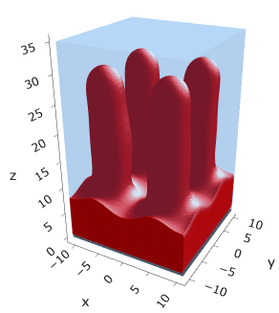
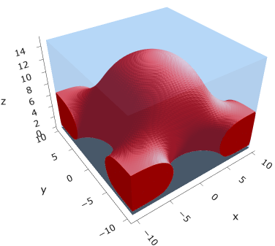
Fig 2: freeE for Mic → Cyl

Slide 3
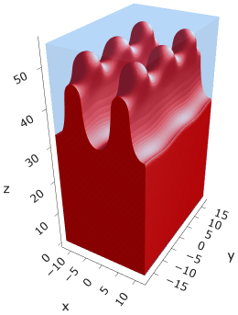
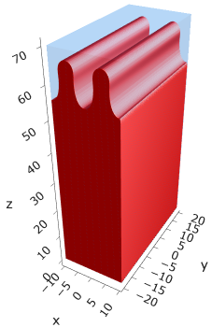
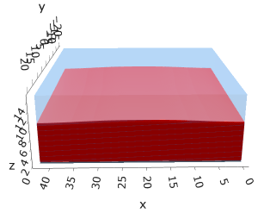
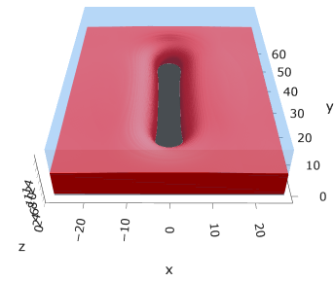
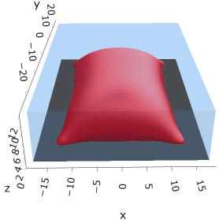
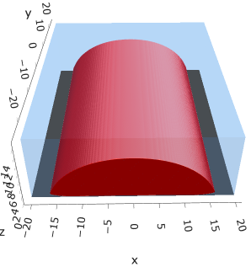
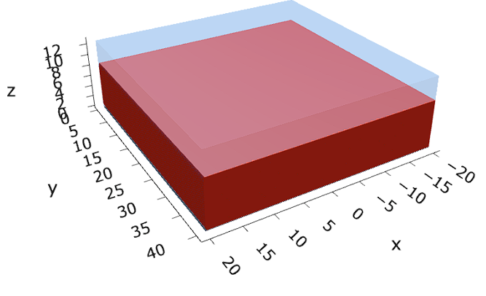












Fig 3: Cyl to Cyl-str to Str by increasing sigma
$$σ=0.005$$
$$σ=0.030$$
$$σ=0.055$$
$$α=0.30$$
Need to finalize
$$σ=0.0025$$
$$σ=0.005$$
$$σ=0.005$$
$$α=0.10$$
$$σ=0.003$$
$$σ=0.005$$
$$σ=0.007$$
$$α=0.05$$
Need to finalize

Slide 4
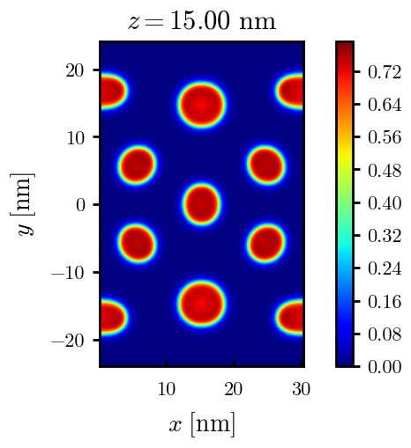
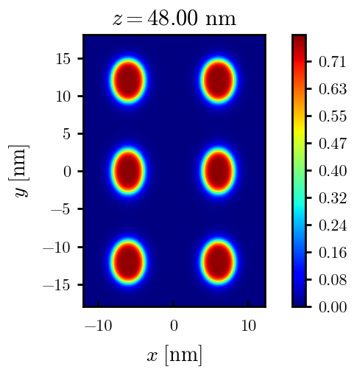
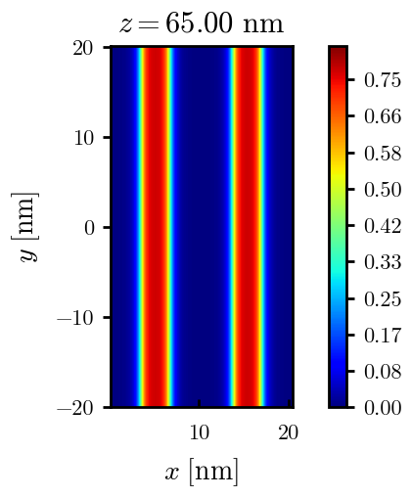
Fig 3: Cyl to Cyl-str to Str by increasing sigma
$$σ=0.005$$
$$σ=0.030$$
$$σ=0.055$$
$$α=0.30$$
Need to finalize

Slide 5
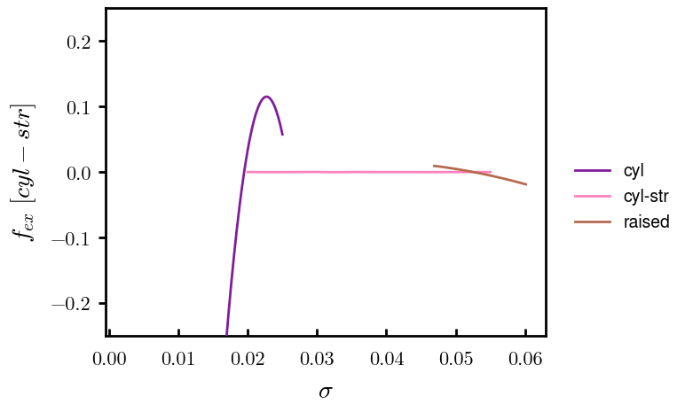
Fig 4: freeE for at least $α=0.30$
Supplemental?

Slide 6
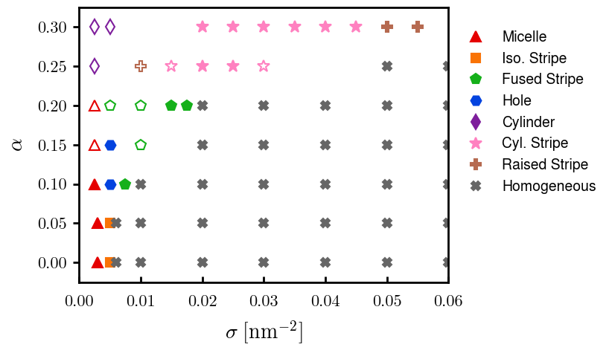
Fig 5: phase diagram
Need to finalize

Slide 7
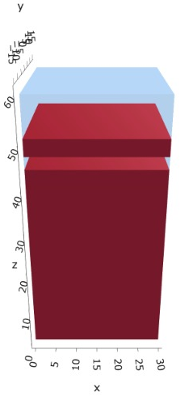
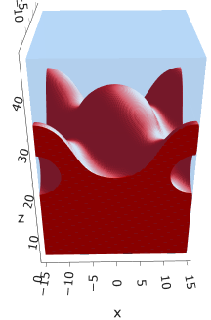
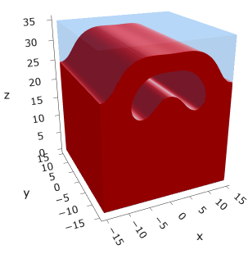


Fig 6: Metastable multilayered morphologies with freeE
$$σ=0.025$$
$$σ=0.040$$

