Slide 1
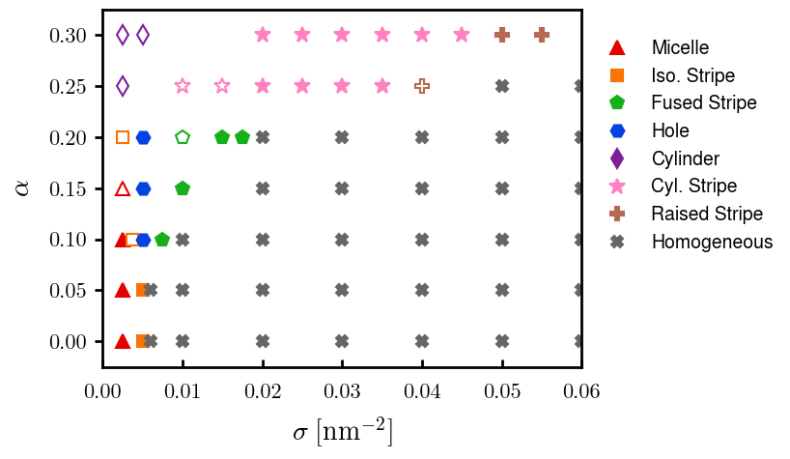
Fig 1: phase diagram
06/22
06/22
06/22
06/22
Need to finalize

Slide 2
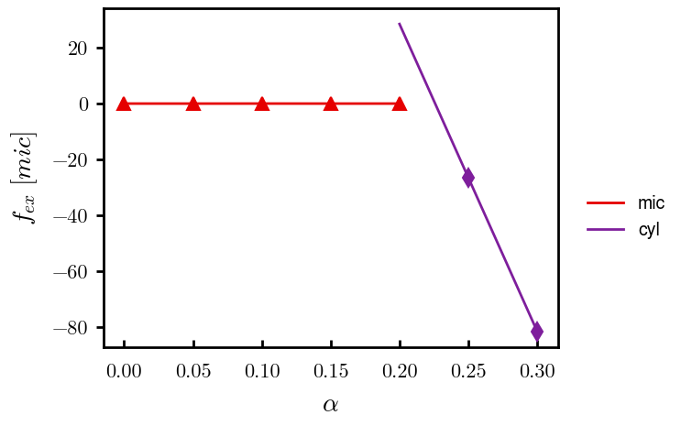
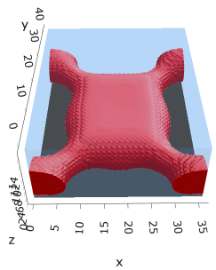
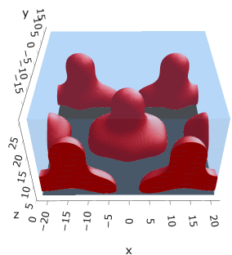
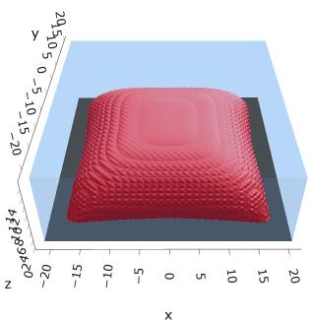
Fig 2: Mic → Cyl, with freeE. Sigma = 0.0025
Still trying to determine if intermediate step (e.g., fusing of multiple micelles)
Need to finalize – init from alpha = 0.25 when done
Need to finalize – fusing 1st order?
Need to finalize
Iso mic @ (0.10, 0.0025)
Fused mic @ (0.15, 0.0025)
Cyl @ (0.25, 0.0025)

Slide 3
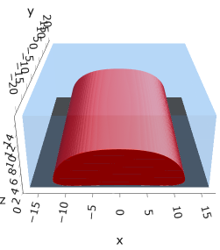
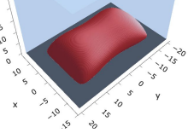
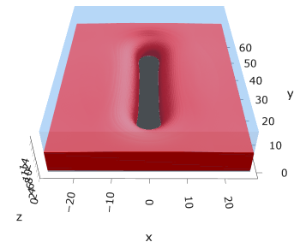
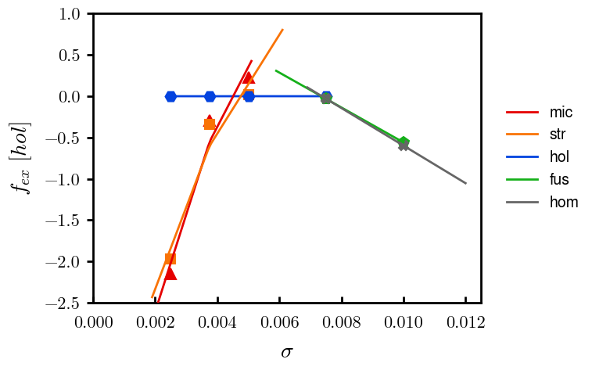
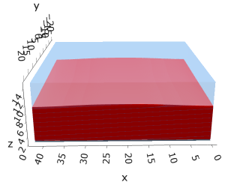
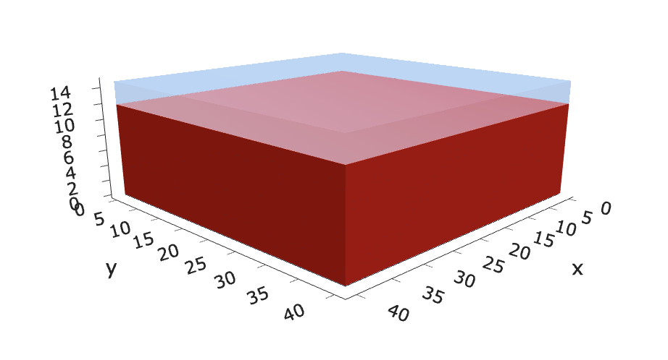
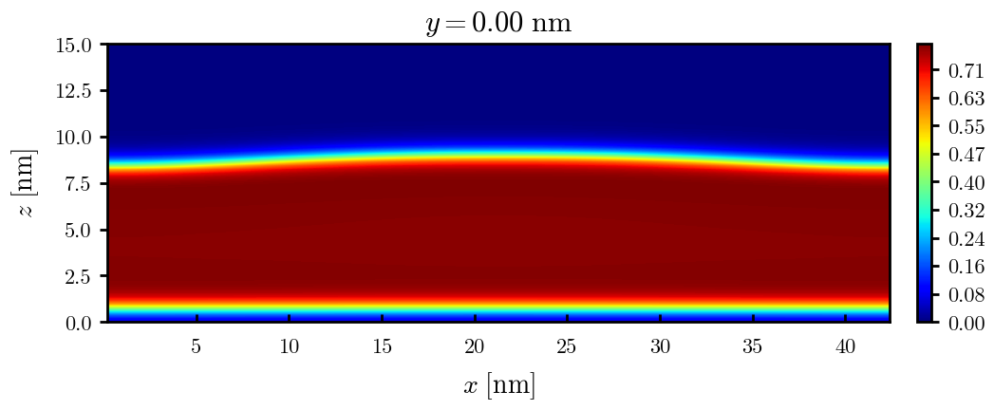
Fig 3: mic → hom. Alpha = 0.10 with freeE
Need to finalize – see slide 2
Need to finalize
Iso str @ (0.10, 0.00375??)
Hol @ (0.10, 0.005)
Iso mic @ (0.10, 0.0025)
Need to finalize
Hom @ (0.10, 0.010)
Fus @ (0.10, 0.0075)

Slide 4
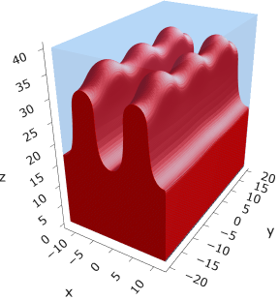
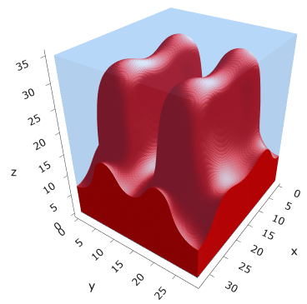
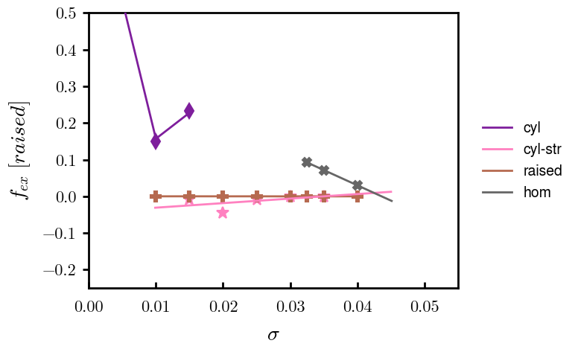
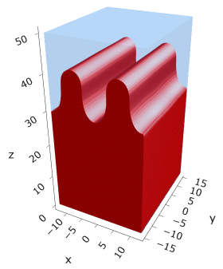
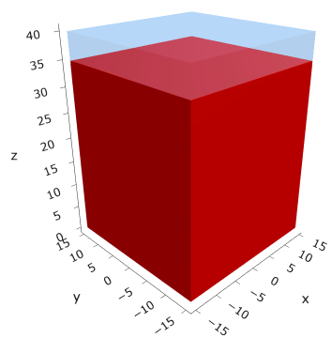

Fig 4: cyl → hom. Alpha = 0.25
Need to finalize
Need to finalize
$$α=0.25$$
Cyl @ (0.25, 0.0025)
? @ (0.25, 0.015)
Cyl-str @ (0.25, 0.020)
Rai-str @ (0.25, 0.035??)
Hom? @ (0.25, 0.050???)

Slide 5
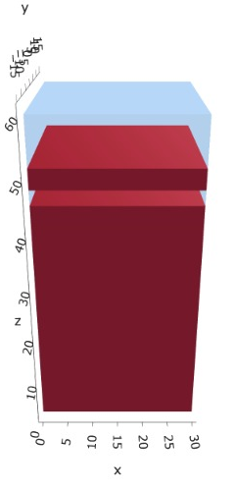
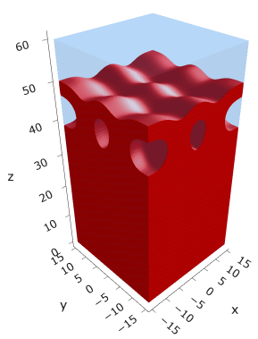
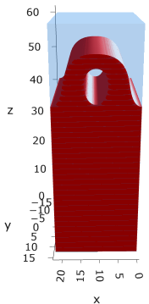
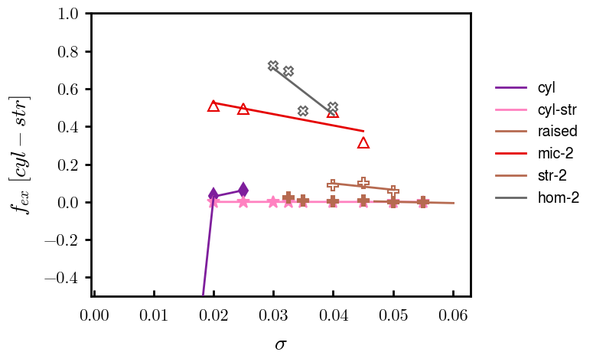
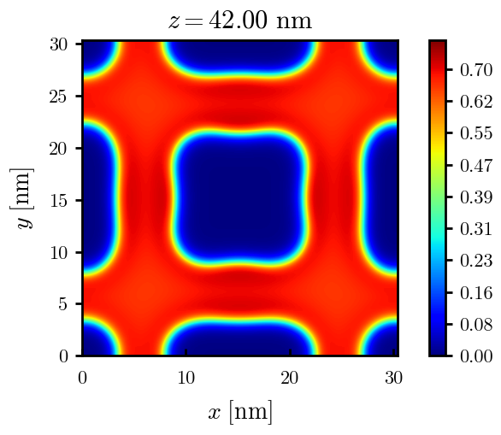
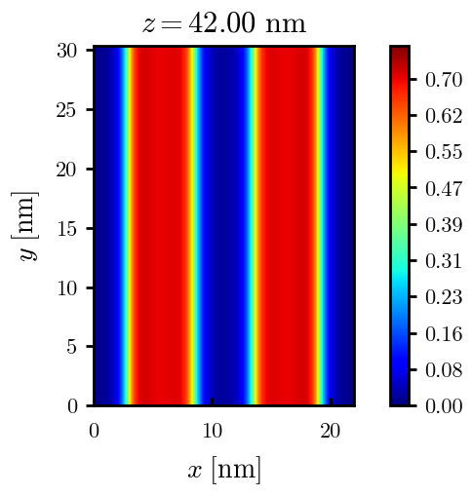

Fig 5: Metastable multilayered morphologies with freeE
$$α=0.30$$
@ (0.30, 0.040)
@ (0.30, 0.040)
@ (0.30, 0.040)

