Slide 1
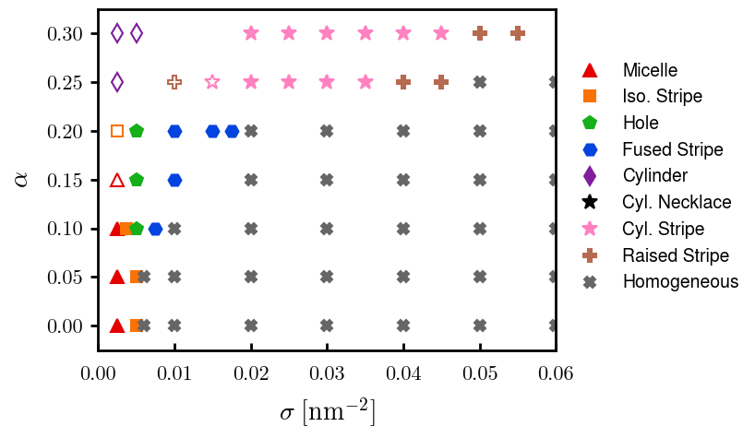
Fig 1: phase diagram
06/23
06/23
06/23
Need to finalize

Slide 2
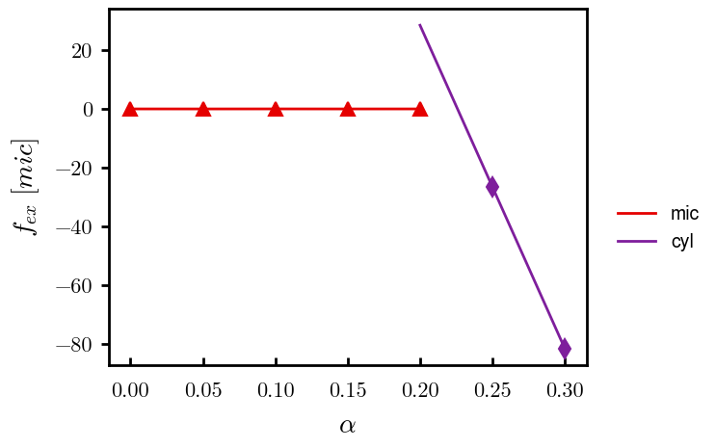
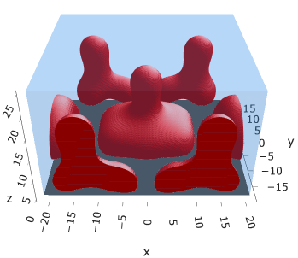
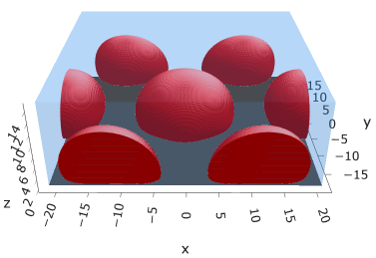
Fig 2: Mic → Cyl, with freeE. Sigma = 0.0025
Need to finalize
Need to finalize
Mic @ (0.10, 0.0025)
Cyl @ (0.25, 0.0025)

Slide 3
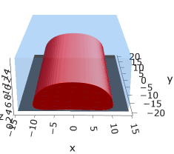
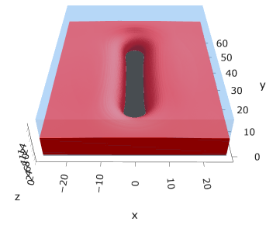
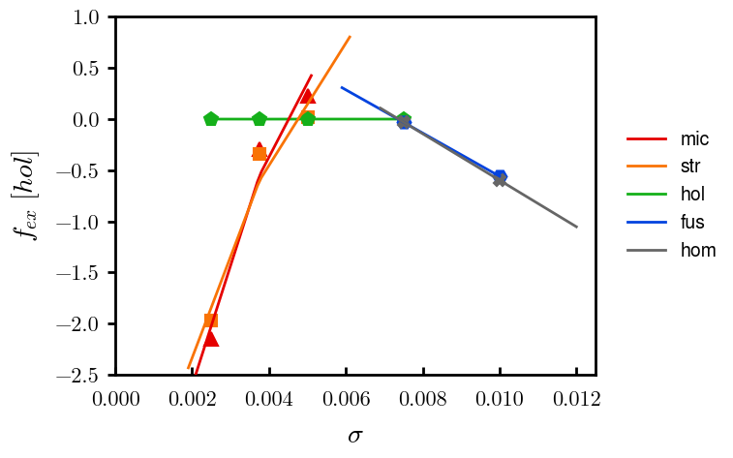
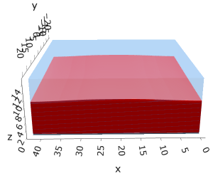
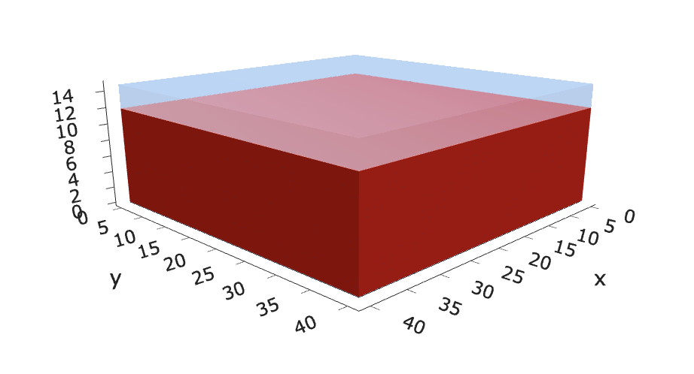
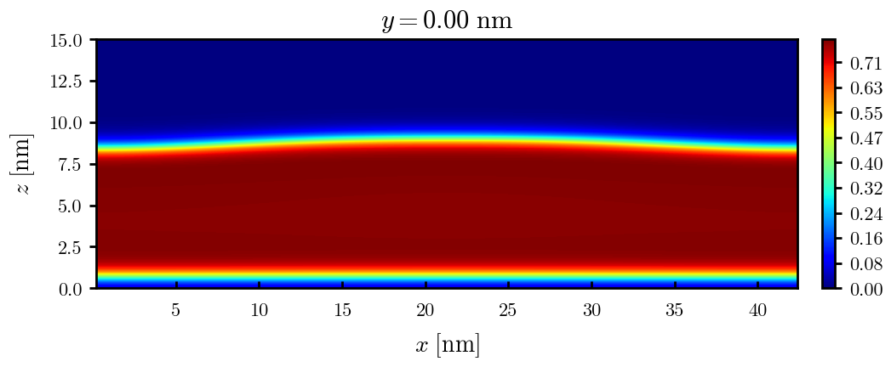
Fig 3: mic → hom. Alpha = 0.10 with freeE
Need to finalize
Iso str @ (0.10, 0.00375)
Hol @ (0.10, 0.005)
Iso mic @ (0.10, 0.0025)
Hom @ (0.10, 0.010)
Fus @ (0.10, 0.0075)

Slide 4
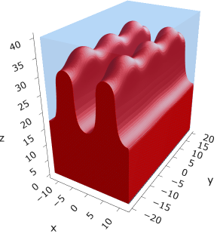
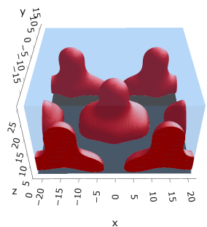
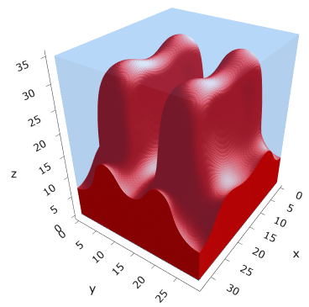
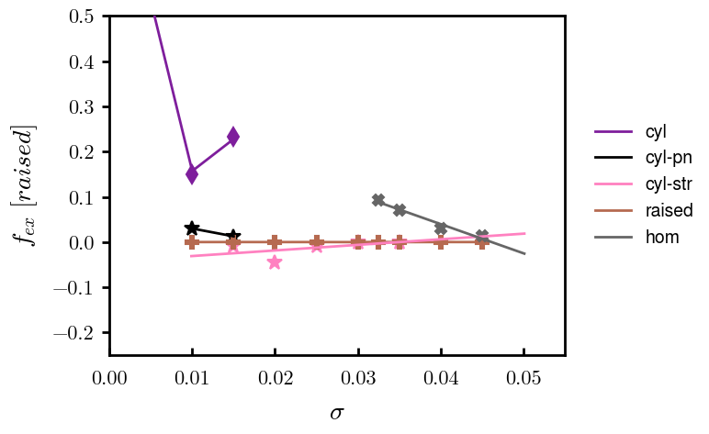
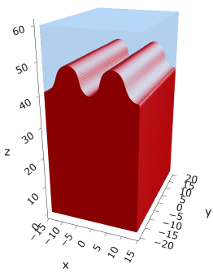
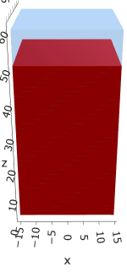

Fig 4: cyl → hom. Alpha = 0.25
Need to finalize
Need to finalize
$$α=0.25$$
Cyl @ (0.25, 0.0025)
Cyl-pn @ (0.25, 0.010??)
Cyl-str @ (0.25, 0.020)
Rai-str @ (0.25, 0.040)
Hom? @ (0.25, 0.045)

Slide 5
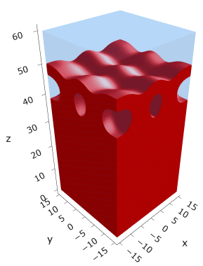
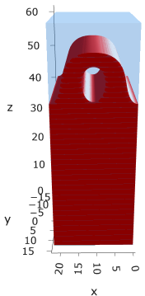
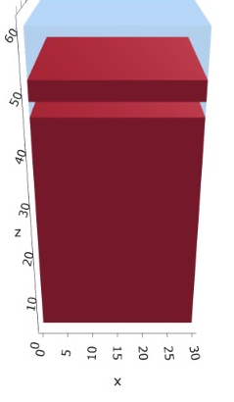
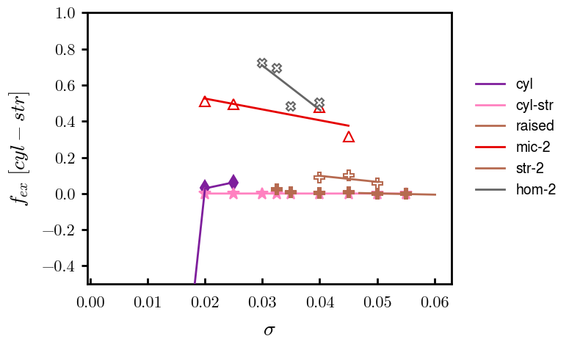
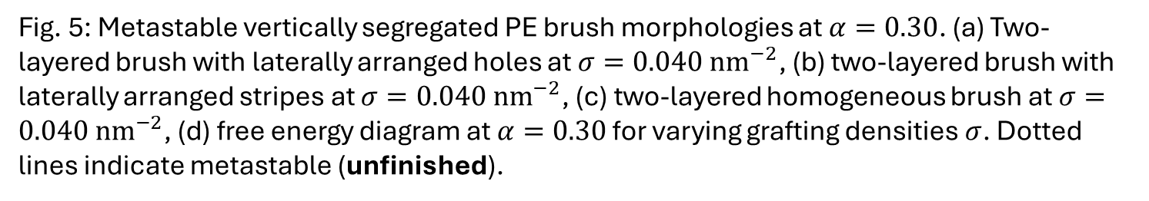
Fig 5: Metastable multilayered morphologies with freeE
(a)
(b)
(c)
(d)
Fig. 5: Metastable vertically segregated PE brush morphologies at $α=0.30$. (a) Two-layered brush with laterally arranged holes at $σ=0.040 {nm}^{−2}$, (b) two-layered brush with laterally arranged stripes at $σ=0.040 {nm}^{−2}$, (c) two-layered homogeneous brush at $σ=0.040 {nm}^{−2}$, (d) free energy diagram at $α=0.30$ for varying grafting densities $σ$. Dotted lines indicate metastable (unfinished).

