Slide 1
FINAL PROJECT PRESENTATION MOCKUP
AI acceptance depends on whether AI is chosen or imposed.
Core case
AI agents in rental and sharing-economy platforms
Text mining Reddit and Trustpilot to understand trust, frustration, and adoption of AI agents in sharing-economy service moments.
4,269
3,912
1.89★
Reddit comments
Trustpilot reviews
AI penalty
discussion baseline
star-labelled verification
2.32★ AI vs 4.21★ non-AI
AI Acceptance in the Sharing Economy
01

Slide 2
ASSIGNMENT FIT
The project meets the brief, with comparison contexts used as guardrails.
Present the sharing-economy rental case as the center; AI-native and support contexts explain why acceptance changes by role.
Brief requirement
Our implementation
What to say in class
Primary data route
Route 2: scraped/web-collected text
Reddit archive + Trustpilot reviews
Two classes
Positive vs. negative acceptance
Reddit inferred by lexicon; Trustpilot from stars
Required methods
Frequency, clouds, networks, sentiment, LDA, embeddings
All implemented in analysis.R
Business synthesis
Actionable design and marketing implications
Transparent, escapable, role-matched AI
Caveat: Reddit is discussion context, not direct review evidence
AI Acceptance in the Sharing Economy
02

Slide 3
DATA DESIGN
Two corpora give us both open discussion and behavioural validation.
Reddit captures how people talk about AI. Trustpilot adds star ratings from actual service encounters.
2,027
Why this is stronger than one source
AI-native comments
Reddit
Trustpilot
context where AI is the product
The Reddit labels are inferred, so Trustpilot tests whether the same sentiment logic agrees with real ratings before we use it as evidence.
discussion baseline
text-mining depth
context comparison
transaction reviews
1-5 star labels
rental-platform proof
1,715
Rental comments
sharing-economy core case
527
Support comments
AI at the service desk
AI Acceptance in the Sharing Economy
03

Slide 4
METHOD STACK
The analysis pipeline covers the brief and ends in a decision rule.
Each method has a role: describe the vocabulary, reveal structure, test sentiment, and translate findings into AI-agent design.
1
2
3
4
5
6
Clean
Explore
Structure
Model
Validate
Synthesize
lowercase, remove punctuation/numbers/stop words, lemmatise
top words, commonality cloud, comparison clouds
bigram network + NRC emotions
LDA topics + GloVe neighbours
compare inferred class with Trustpilot stars
role gradient + strategic recommendations
Presentation hook: methods become evidence for when users accept AI agents.
AI Acceptance in the Sharing Economy
04

Slide 5
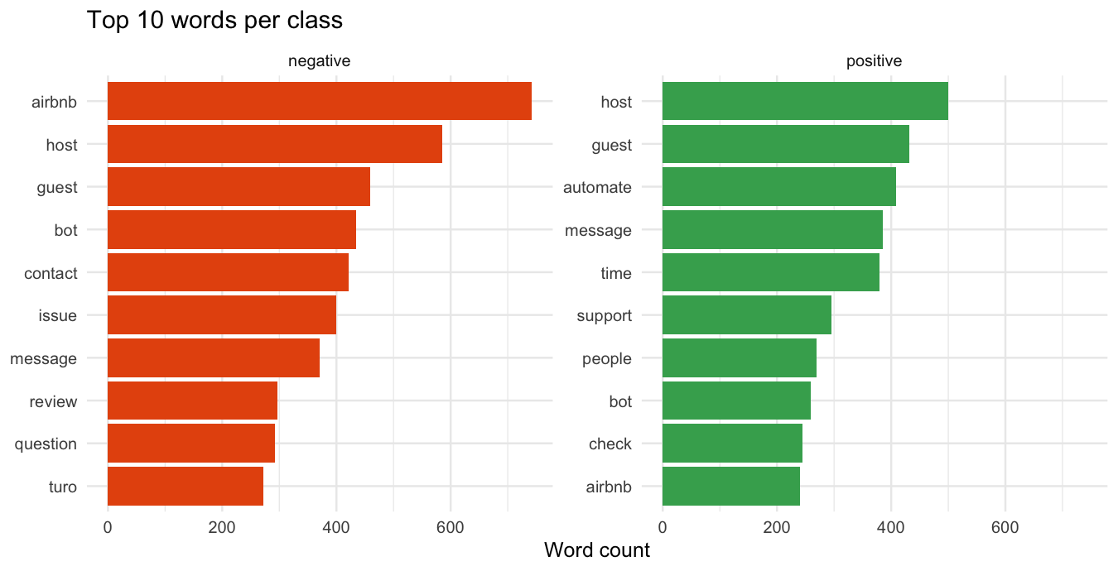
VOCABULARY SPLIT
Positive text praises useful automation; negative text gets stuck at contact friction.
Top words make the acceptance contrast visible before the more advanced models.
What to say
Automation is not automatically bad. The positive class also mentions automation, message, support and checks. The difference is whether automation saves time or blocks resolution.
Classroom caveat
Airbnb and Turo dominate the rental language, so frame professional gear platforms as part of the broader sharing-economy marketplace sample.
AI Acceptance in the Sharing Economy
05

Slide 6
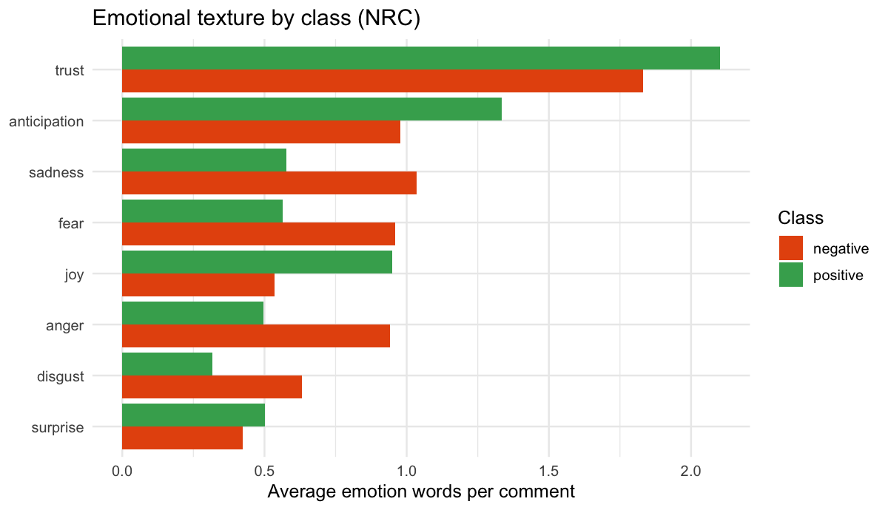
SENTIMENT
The emotional gap is really a trust gap.
NRC emotions add nuance beyond the positive/negative split: positive comments show trust, anticipation and joy; negative comments show anger, fear and sadness.
Trust
widest visible gap
the sharing-economy currency
Anger
negative-class signal
where escalation breaks
Fear
negative-class signal
where safety feels uncertain
AI Acceptance in the Sharing Economy
06

Slide 7
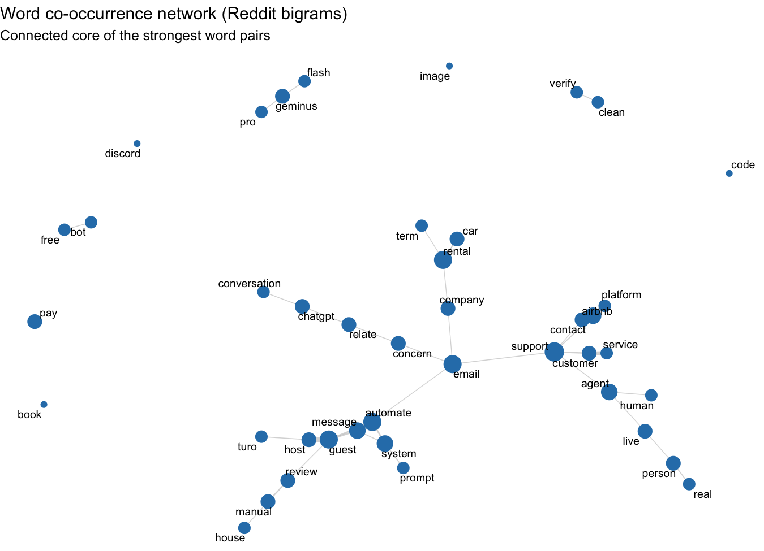
WORD NETWORK
The network exposes the human-exit problem.
Bigrams show which words travel together, revealing the structure behind isolated frequency counts.
Reading the network
Contact, support, customer, bot, human, real and person cluster around the same failure mode: users want a real route out when automation cannot solve the case.
Slide note
For the final deck, export this chart with a white background and slightly larger labels if it will be projected in a bright room.
AI Acceptance in the Sharing Economy
07

Slide 8
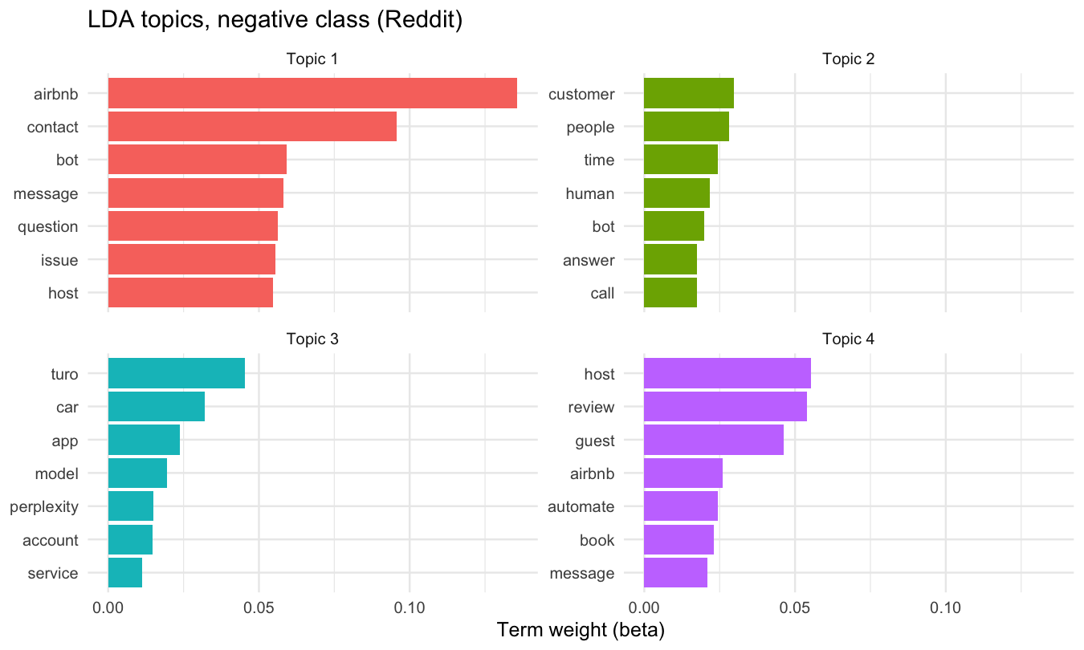
TOPIC MODELLING
LDA turns thousands of comments into service-design themes.
The negative class repeatedly returns to support contact, bots, platform accounts, and host/guest automation.
Negative T1
Airbnb contact, bots, messages, issues
Negative T2
customer, people, human, bot, call
Positive T3
host, guest, automate, message, review
Positive T4
model, Claude, prompt, system, write
AI Acceptance in the Sharing Economy
08

Slide 9
EMBEDDINGS
GloVe independently rediscovers the human-versus-automation tension.
Nearest neighbours show semantic context learned from the corpus, not a hand-built theme dictionary.
Seed term
Nearest neighbours in corpus
Why it matters
trust
safety, people, stop, relationship, customer, design
The embeddings support the same story from a different method: bot language sits near support/contact, while human sits near real, agent, automation and support.
bot
contact, question, phone, support, issue, customer
human
real, agent, customer, replace, automation, support
host
guest, Airbnb, platform, communication, Turo, automate
Class line
This is the difference between AI as a helpful tool and AI as a barrier in a high-trust transaction.
automate
message, guest, set, check, system, send, book
AI Acceptance in the Sharing Economy
09

Slide 10
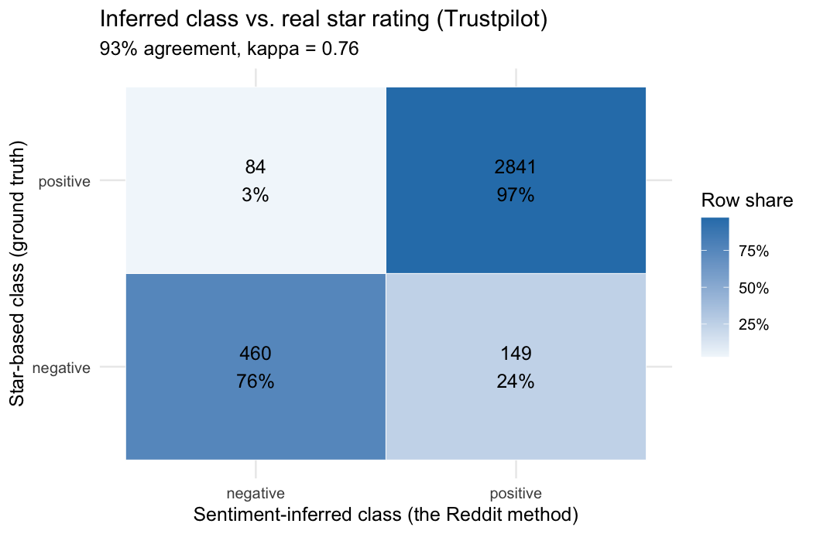
VALIDATION
Trustpilot gives the sentiment split a reality check.
Reddit has no ground-truth label, so the same lexicon logic is tested against Trustpilot stars.
93.4%
agreement
Use this to defend the Reddit labels as directional, not perfect.
lexicon class vs star class
0.76
Cohen's kappa
substantial agreement
3,534
validation reviews
neutral labels removed
AI Acceptance in the Sharing Economy
10

Slide 11
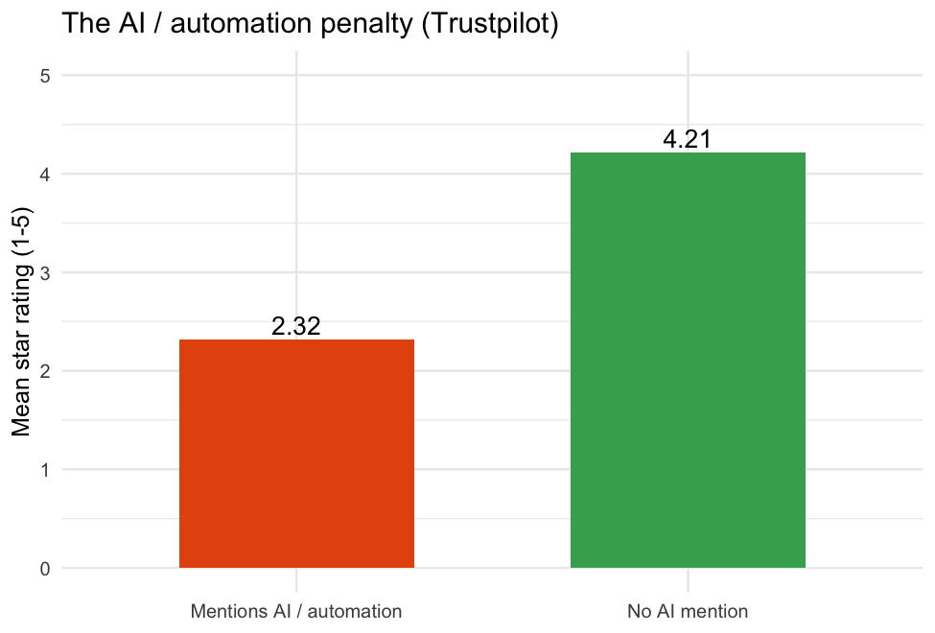
ROLE GRADIENT
Same technology, different reception: users punish AI when it feels imposed.
Reddit shows the role gradient; Trustpilot shows the rental-platform AI penalty in stars.
Reddit positive share by AI role
AI-native
58%
AI is the product
Support desk
56%
AI handles service
Rental add-on
49%
AI mediates a transaction
Headline line
Acceptance is highest when AI is chosen; it drops when AI is unavoidable in a trust-heavy exchange.
AI Acceptance in the Sharing Economy
11

Slide 12
CLOSE
The design answer: transparent, escapable, role-matched AI.
1
Keep a human one click away
Escalation is the strongest recurring trust repair.
Say this in Q&A
2
Disclose the AI and its limits
The broadened AI-native and support contexts are comparison lenses. The rental/sharing-economy finding is the core contribution and is validated with Trustpilot stars.
Accuracy complaints spike when AI overclaims.
3
Optimise first-contact resolution
Support and resolution language drives negativity.
4
Match persona to role
Warmth works for AI products; efficiency wins in transactions.
Final thesis: control creates acceptance.
5
Show price and refund rules upfront
Rental frustration often starts before AI appears.
AI Acceptance in the Sharing Economy
12

