Slide 1
BlockLand: A Blockchain-Based Land Registry and Management System for Zimbabwe
A capstone thesis submitted in partial fulfilment of the requirements for the degree of
BACHELOR OF TECHNOLOGY in INFORMATION SECURITY AND ASSURANCE
by
Tinotenda James
H220349M
h220349m@hit.ac.zw
Under the guidance of
Ms Chavhunduka
LECTURER
School of Information Sciences and Technology
Harare Institute of Technology
BE277, Ganges Road, Belvedere, Harare
May 2026
DEPARTMENT OF INFORMATION SECURITY AND ASSURANCE
HARARE INSTITUTE OF TECHNOLOGY
1

Slide 2
BlockLand: Blockchain-Based Land Registry System for Zimbabwe
Overview
❑ Introduction
❑ Problem Statement
❑ Objectives
❑ Related Works
❑ Proposed Solution
❑ System Design & Smart Contract
❑ Security Analysis
❑ Results & Evaluation
❑ Conclusion and Future Work
❑ References
HIT
Harare Institute of Technology
DEPARTMENT OF INFORMATION SECURITY AND ASSURANCE
HARARE INSTITUTE OF TECHNOLOGY
2

Slide 3
BlockLand: Blockchain-Based Land Registry System for Zimbabwe
Introduction
Land Administration in Zimbabwe
• Land is the most significant asset class in Zimbabwe, yet the Deeds Registry operates under a paper-based, centralised system (Deeds Registries Act [Chapter 20:05]).
• Physical title deeds are vulnerable to forgery, loss, and manipulation with no cryptographic proof of authenticity.
• No public mechanism exists for citizens, banks, or lawyers to independently verify property ownership without a formal Registry inquiry.
Why Blockchain?
• Immutability — ownership records cannot be silently altered once committed on-chain.
• Transparency — any party can audit the full chain of ownership independently.
• Programmability — smart contracts enforce multi-party transfer workflows, eliminating procedural fraud.
• Bitcoin-anchored security — BlockLand uses the Stacks blockchain, which settles each block to Bitcoin via Proof of Transfer (PoX).
HIT
Harare Institute of Technology
DEPARTMENT OF INFORMATION SECURITY AND ASSURANCE
HARARE INSTITUTE OF TECHNOLOGY
3

Slide 4
BlockLand: Blockchain-Based Land Registry System for Zimbabwe
Problem Statement
Zimbabwe's land administration system relies on paper-based title deeds and a centralised manual ledger, creating five critical vulnerabilities:
1. Title Deed Forgery: Physical documents can be duplicated or falsified with no cryptographic reference for verification.
2. Opacity of Ownership History: No publicly accessible, tamper-evident record of who owned a property and when.
3. Single Point of Failure: The centralised Deeds Registry is the sole authority — its integrity cannot be independently verified by any external party.
4. Slow Transfer Process: Property transfers require physical document exchange and in-person approvals, taking days to weeks.
5. No Public Verification: Citizens, banks, and legal practitioners cannot instantly confirm ownership without a formal inquiry to the Registry.
HIT
Harare Institute of Technology
DEPARTMENT OF INFORMATION SECURITY AND ASSURANCE
HARARE INSTITUTE OF TECHNOLOGY
4

Slide 5
BlockLand: Blockchain-Based Land Registry System for Zimbabwe
Objectives
This project aims:
✔ Objective 1 — Digital Registration Workflow
To provide a digital submission, review, and approval workflow for property title registrations — eliminating paper-based processes and reducing registration time from weeks to minutes.
✔ Objective 2 — On-Chain Unique Token ID
To assign each property a unique on-chain token identifier, making it cryptographically impossible to register the same plot twice under different ownership records.
✔ Objective 3 — Public Verification Portal
To expose a public verification portal where any citizen can instantly confirm property ownership by plot number, deed number, or National ID — without requiring a registered account or government inquiry.
HIT
Harare Institute of Technology
DEPARTMENT OF INFORMATION SECURITY AND ASSURANCE
HARARE INSTITUTE OF TECHNOLOGY
5

Slide 6
BlockLand: Blockchain-Based Land Registry System for Zimbabwe
Related Works
Kombe et al. (2017): First formal model proposing a three-party workflow (seller, buyer, registrar) for blockchain land registration — the pattern BlockLand enforces on-chain.
Alam et al. (2022): Ethereum-based land title system for Bangladesh. Demonstrated feasibility but highlighted gas cost as a prohibitive barrier — absent on Stacks.
M. Zein & Twinomurinzi (2023): Systematic review of 47 papers — fewer than a third provided any formal threat modelling. Identified security analysis as the key gap in the literature.
Mansoor et al. (2023): Recommended hybrid architectures (blockchain + relational database) as the most practically deployable approach for developing economy contexts.
Paavo et al. (2025): Namibian pilot study — identified registrar workflow integration as the binding success factor, directly motivating BlockLand's registrar finalisation step.
Konashevych (2020): Identified the oracle problem — gap between on-chain digital state and physical reality — as the most fundamental limitation of blockchain in land administration.
HIT
Harare Institute of Technology
DEPARTMENT OF INFORMATION SECURITY AND ASSURANCE
HARARE INSTITUTE OF TECHNOLOGY
6

Slide 7
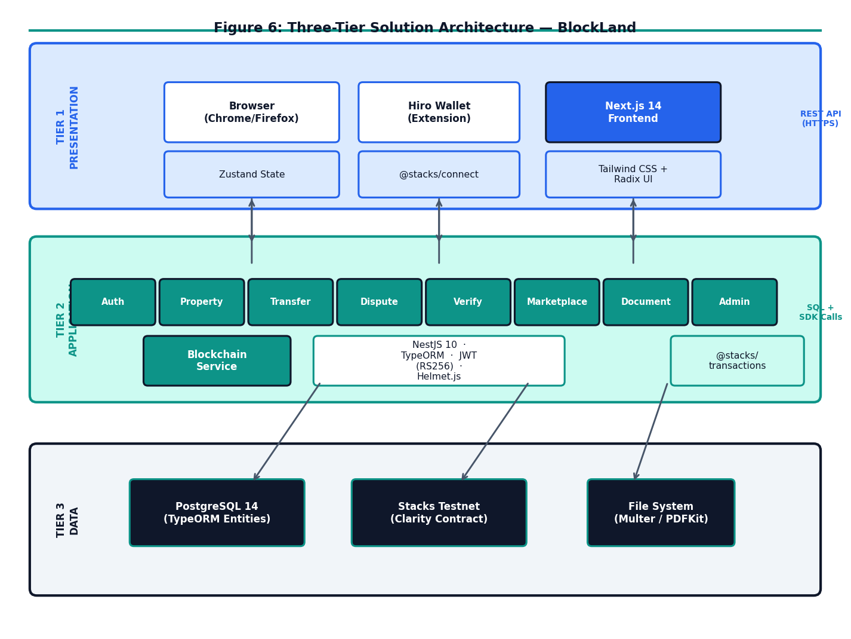
BlockLand: Blockchain-Based Land Registry System for Zimbabwe
Proposed Solution
Three-Tier Architecture
▶ Presentation: Next.js 14 — Role-specific dashboards, Hiro Wallet integration, public /verify portal.
▶ Application: NestJS 10 REST API — JWT RS256 auth, RBAC guards, BlockchainService adapter.
▶ Persistence: PostgreSQL — operational metadata. Stacks Blockchain — immutable ownership ground truth via Clarity smart contract.
Dual-Ledger Invariant
Blockchain = canonical ownership ground truth. PostgreSQL = queryable operational cache. If the two ever diverge, the blockchain record takes precedence.
IPFS Document Anchoring
Title deed documents stored on IPFS. Content hash committed on-chain — any document substitution is cryptographically detectable.
HIT
Harare Institute of Technology
DEPARTMENT OF INFORMATION SECURITY AND ASSURANCE
HARARE INSTITUTE OF TECHNOLOGY
7

Slide 8
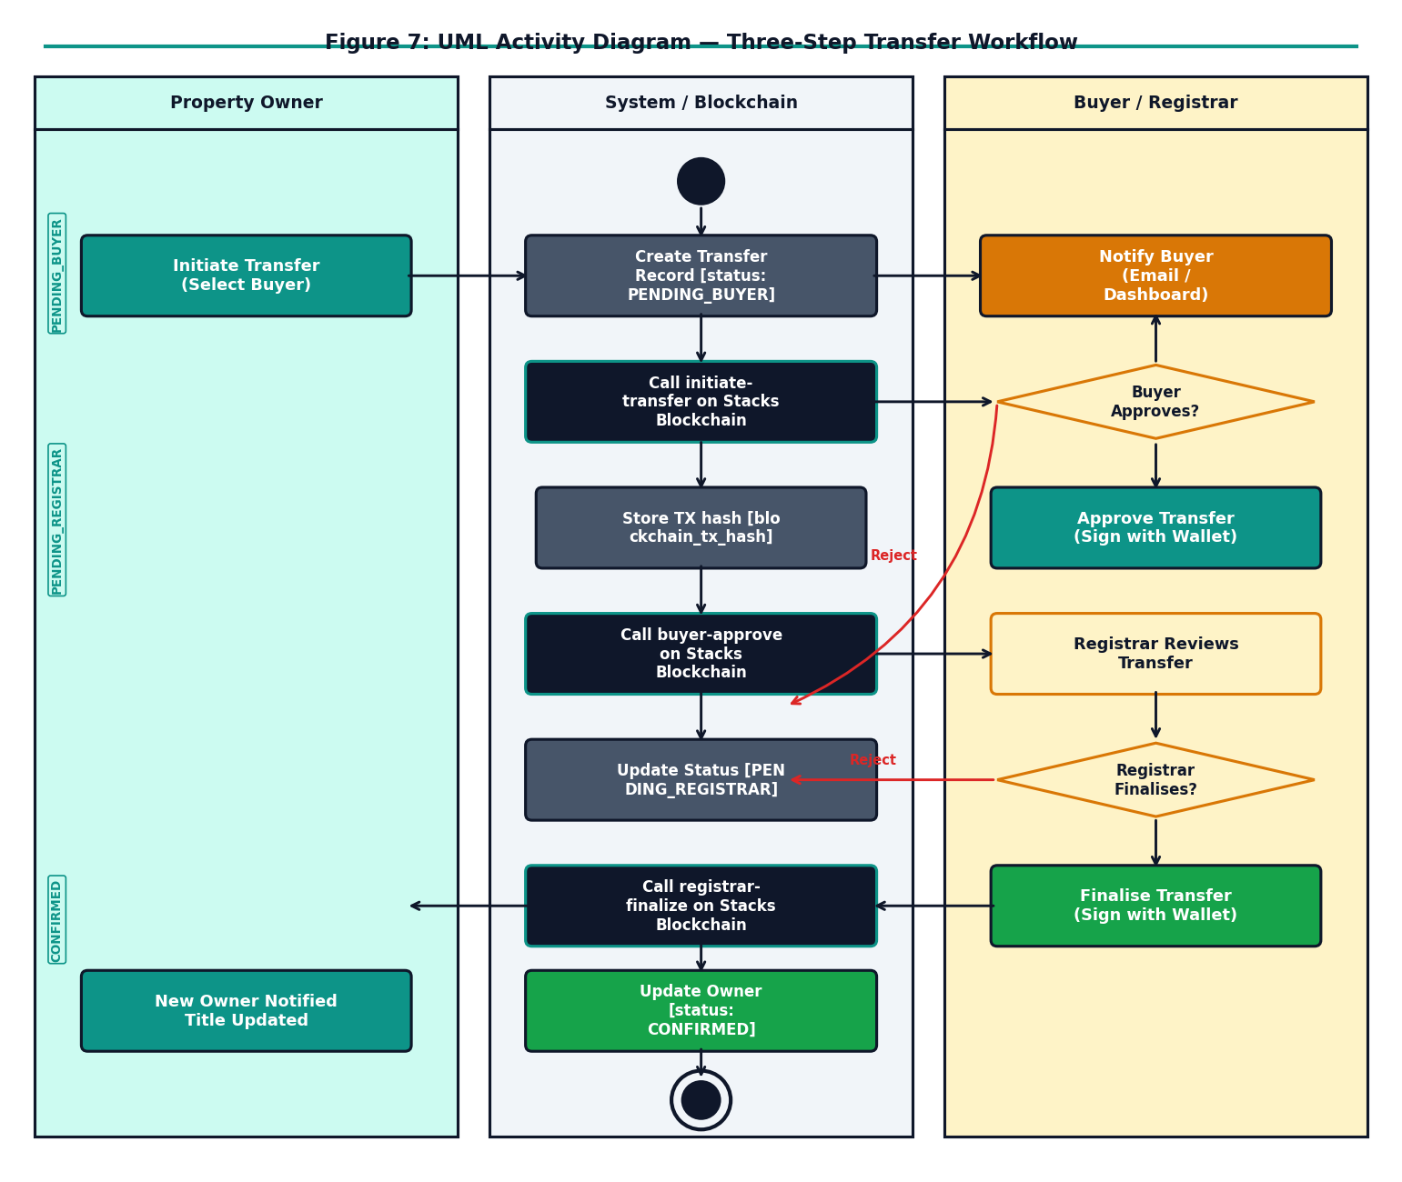
BlockLand: Blockchain-Based Land Registry System for Zimbabwe
System Design & Smart Contract
blockland.clar — On-Chain Data Maps
property-registry uint → {owner, title-deed-hash, status, ipfs-hash}
title-deed-index (buff 32) → uint [fraud prevention reverse lookup]
transfer-requests uint → {seller, buyer, buyer-approved, registrar-approved}
ownership-history {property-id, seq} → {owner, acquired-at}
authorized-registrars principal → bool [registrar whitelist]
Three-Step Transfer Workflow
✔ Step 1 — Owner: Calls initiate-transfer — property locked to "pending-transfer"
✔ Step 2 — Buyer: Calls buyer-approve-transfer — sets buyer-approved = true
✔ Step 3 — Registrar: Calls registrar-finalize-transfer — ownership atomically reassigned
HIT
Harare Institute of Technology
DEPARTMENT OF INFORMATION SECURITY AND ASSURANCE
HARARE INSTITUTE OF TECHNOLOGY
8

Slide 9
BlockLand: Blockchain-Based Land Registry System for Zimbabwe
Security Analysis
STRIDE Threat Model — Applied to BlockLand
S — Spoofing: JWT RS256 asymmetric signing + on-chain registrar whitelist prevent identity impersonation.
T — Tampering: Blockchain is canonical — DB inconsistency detectable by querying contract state. IPFS hash prevents document substitution.
R — Repudiation: Every transfer step is a signed Stacks transaction — immutable on-chain record with block height timestamp.
I — Information Disclosure: JWT-gated API; RBAC restricts financial data to parties in each transaction.
D — Denial of Service: Rate limiting at API gateway; blockchain operates independently of API availability.
E — Elevation of Privilege: Dual-layer enforcement — NestJS RolesGuard AND Clarity contract tx-sender check. Both must be bypassed simultaneously for escalation to succeed.
Clarity language eliminates reentrancy and unbounded-loop vulnerabilities by design — all execution paths are statically analysable before deployment.
HIT
Harare Institute of Technology
DEPARTMENT OF INFORMATION SECURITY AND ASSURANCE
HARARE INSTITUTE OF TECHNOLOGY
9

Slide 10
BlockLand: Blockchain-Based Land Registry System for Zimbabwe
Results & Evaluation
Adversarial Security Tests
• JWT replay after 15-min expiry PASS — 401
• JWT HS256 downgrade forgery PASS — 401
• Horizontal privilege escalation PASS — 403
• Double-transfer same plot PASS — err u106
• Direct contract call (non-registrar) PASS — err u101
• IPFS hash substitution via contract PASS — err u101
Functional Requirements
All 7 FRs derived from the Deeds Registries Act verified via Clarinet unit tests and adversarial integration testing.
Performance Metrics (50 concurrent users)
GET /properties: p95 = 45 ms
Public /verify portal: p95 = 28 ms
POST /properties: p95 = 89 ms
Blockchain initiate-tx: p95 = 2,100 ms
End-to-end transfer: < 30 seconds
Key Findings
✔ title-deed-index map makes duplicate plot registration cryptographically impossible.
✔ Clarity's non-Turing-complete design eliminates reentrancy by language specification.
✔ Three-step workflow confirmed end-to-end on Stacks testnet — no unilateral transfer possible.
✔ Public /verify portal returns ownership status in < 50 ms with no login required.
HIT
Harare Institute of Technology
DEPARTMENT OF INFORMATION SECURITY AND ASSURANCE
HARARE INSTITUTE OF TECHNOLOGY
10

Slide 11
BlockLand: Blockchain-Based Land Registry System for Zimbabwe
Conclusion and Future Works
Conclusion
• BlockLand demonstrates that targeted blockchain integration — anchoring only ownership assertions on-chain — delivers meaningful security guarantees for Zimbabwe's land administration context.
• The Clarity smart contract enforces the three-party consent model required by the Deeds Registries Act [Chapter 20:05] at the blockchain layer — no application code can bypass it.
• IPFS document hashing and the title-deed-index reverse lookup map prevent document substitution and duplicate plot registration respectively.
• All 7 functional requirements and 6 adversarial security tests verified.
Future Work
▶ Client-Side Wallet Signing: Integrate Hiro Wallet openContractCall() so individual users sign their own blockchain transactions — creating non-repudiable per-user records.
▶ Stacks Mainnet Deployment: Deploy to Stacks mainnet, transferring the full Bitcoin security guarantee to the ownership record.
▶ Zero-Knowledge Identity Proofs: Replace National ID transmission with ZK proofs — verifiable without exposing the citizen's raw identity data.
▶ Legislative Engagement: Support amendment of the Electronic Transactions Act to formally recognise blockchain land records as legally binding.
HIT
Harare Institute of Technology
DEPARTMENT OF INFORMATION SECURITY AND ASSURANCE
HARARE INSTITUTE OF TECHNOLOGY
11

Slide 12
BlockLand: Blockchain-Based Land Registry System for Zimbabwe
References
Alam, K.M. et al. (2022). A Blockchain-based Land Title Management System for Bangladesh. J. King Saud University — Computer and Information Sciences, 34(6), pp. 3096-3110.
Ameyaw, P.D. & de Vries, W.T. (2023). Blockchain technology adaptation for land administration services: The importance of socio-cultural elements. Land Use Policy.
Dwivedi, R. et al. (2023). Blockchain-Based Transferable Digital Rights of Land. arXiv:2308.05950.
Kimathi, K.T. (n.d.). A Land Administration Model Based on Blockchain Technology. [Unpublished thesis]. Harare Institute of Technology.
Kombe, C. et al. (2017). Design of Land Administration and Title Registration Model Based on Blockchain Technology.
Konashevych, O. (2020). General Concept of Real Estate Tokenization on Blockchain: The Right to Choose. European Property Law Journal, 9(1), pp. 21-66.
M. Zein, R. & Twinomurinzi, H. (2023). Blockchain Technology in Lands Registration: A Systematic Literature Review. JeDEM, 15(2), pp. 1-36.
Mansoor, M.A. et al. (2023). Blockchain Technology for Land Registry Management in Developing Countries. 2023 ETECTE Conference, Lahore.
Nakamoto, S. (2008). Bitcoin: A Peer-to-Peer Electronic Cash System.
Paavo, J.P. et al. (2025). Practicality of Blockchain Technology for Land Registration: A Namibian Case Study. Land, 14(8), p. 1626.
HIT
Harare Institute of Technology
DEPARTMENT OF INFORMATION SECURITY AND ASSURANCE
HARARE INSTITUTE OF TECHNOLOGY
12

