Slide 1
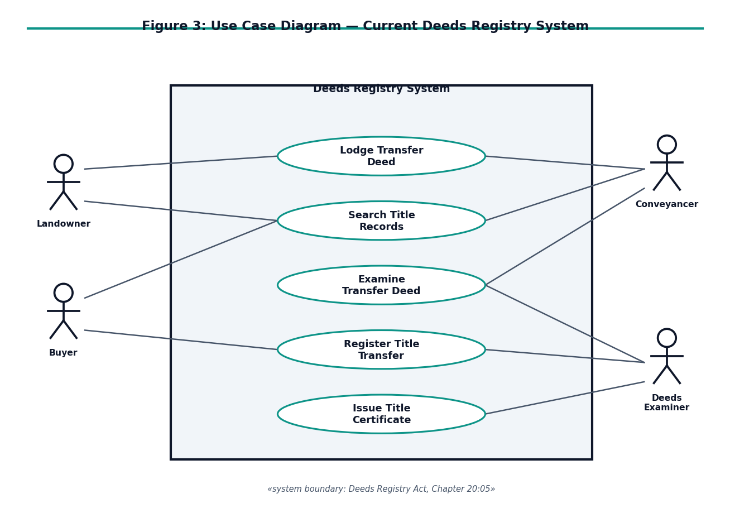
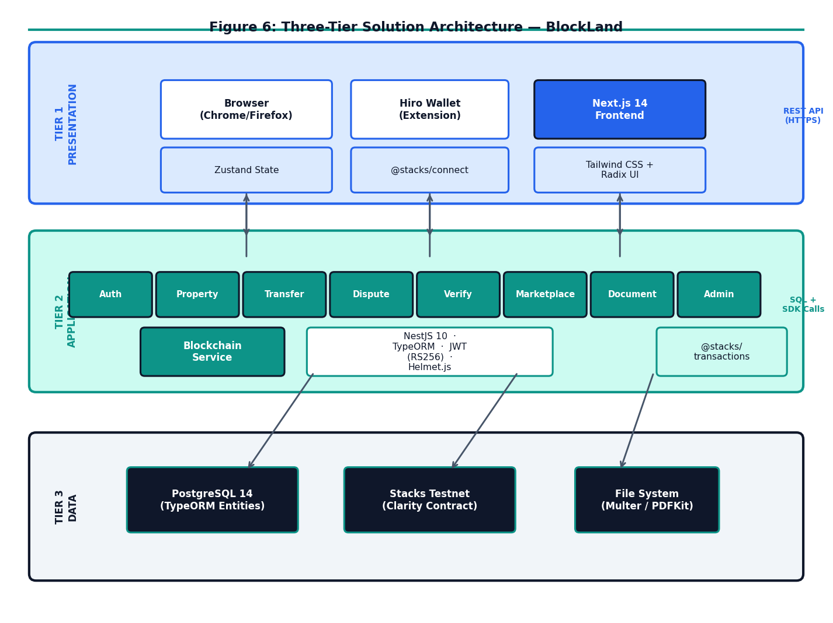
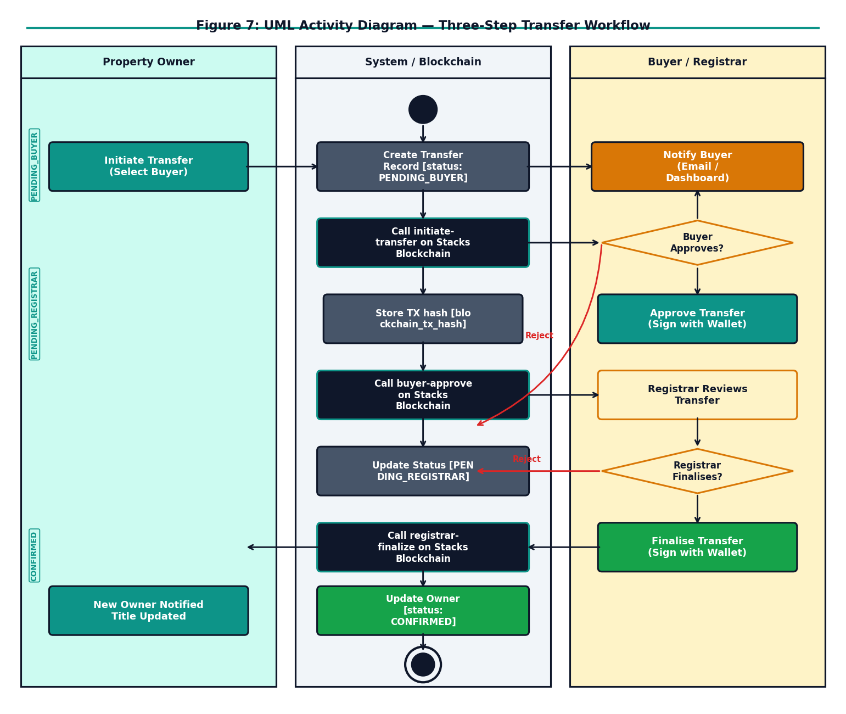
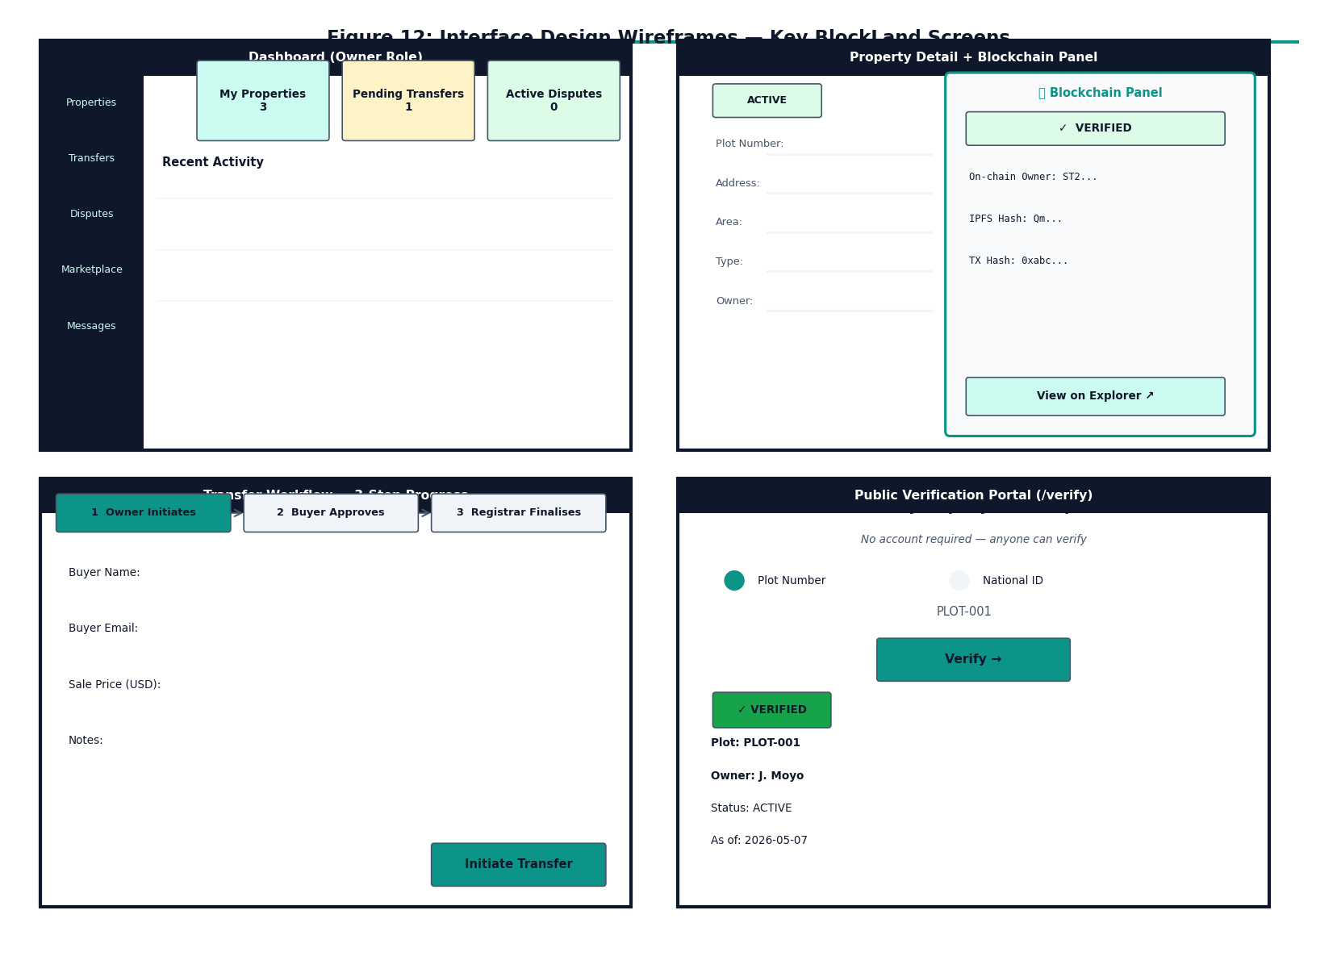
Harare Institute of Technology
BlockLand: A Blockchain-Based Land Registry and Management System for Zimbabwe
1,2 Department of Information Security and Assurance, School of Information Sciences and Technology, Ganges Rd, Box BE 277, Belvedere, Harare, Zimbabwe
1 Tinotenda James (H220349M), 2 Ms Chavhunduka
1 h220349m@hit.ac.zw, 2 chavhunduka@hit.ac.zw
Abstract
Use Cases
Architecture Diagram
Conclusion
BlockLand is a dual-ledger land registry system that anchors property ownership on the Stacks blockchain while maintaining a PostgreSQL database for operational metadata. The system eliminates paper-based title deed fraud through cryptographic ownership assertions, enforces a legally-aligned three-step transfer workflow via a Clarity smart contract, and provides a public verification portal accessible to any citizen without registration. JWT RS256 authentication, four-role RBAC (Admin, Registrar, Owner, Buyer), and IPFS document hashing provide defence-in-depth access control. Security testing confirmed resistance to replay attacks, privilege escalation, and double-transfer attempts. The system delivers sub-100 ms API response times at p95 under 50 concurrent users, with blockchain-confirming transfers completing in under 30 seconds on the Stacks testnet.
Key actor-system interactions
Three-tier solution architecture
BlockLand demonstrates that targeted blockchain integration — anchoring only ownership assertions on-chain while preserving relational databases for operational richness — delivers meaningful security guarantees for Zimbabwe's land administration context. The Clarity smart contract enforces the legally-required three-party transfer consent model (seller, buyer, registrar) as required by the Deeds Registries Act [Chapter 20:05], with independent signature verification at each step. No single party can unilaterally reassign ownership. IPFS document hashing commits title deed content on-chain, making silent document substitution cryptographically detectable. The title-deed-index map makes duplicate plot registration impossible. All seven principal functional requirements and six adversarial security test cases are verified. The system achieves sub-100 ms response times for non-blockchain operations, demonstrating practical deployability within Zimbabwe's infrastructure context.
Introduction
Zimbabwe's Deeds Registry operates under the Deeds Registries Act [Chapter 20:05], maintaining physical title deeds and manual ledgers that are vulnerable to forgery, loss, and deliberate falsification. No public ownership verification mechanism exists — citizens, banks, and legal practitioners must submit formal inquiries to the Registry to confirm ownership. Land fraud costs Zimbabwean families their most significant asset with little recourse. Blockchain technology offers immutability, transparent auditability, and programmable multi-party workflows through smart contracts — properties directly applicable to land administration. BlockLand applies these capabilities to Zimbabwe's specific legal and administrative context without requiring a wholesale replacement of existing institutions.
System Overview
Future Work
BlockLand follows a three-tier architecture: Presentation — Next.js 14 (React, TypeScript, TailwindCSS). Role-specific dashboards for Admin, Registrar, Owner, and Buyer. Public /verify portal requires no login. Application — NestJS 10 REST API with JWT RS256 authentication and RBAC guards. BlockchainService adapts @stacks/transactions for all on-chain interactions. Persistence — PostgreSQL 15 stores operational metadata. Stacks Blockchain (Clarity smart contract) stores immutable ownership assertions as canonical ground truth. IPFS stores title deed documents; content hash committed on-chain. The dual-ledger invariant: blockchain is authoritative; database is a queryable cache that must remain consistent with on-chain state.
Planned improvements:
• Client-side Hiro Wallet signing — individual users sign their own blockchain transactions for non-repudiable per-user records.
• Stacks mainnet deployment — transfer full Bitcoin security guarantees to the ownership record.
• Zero-knowledge identity proofs — replace National ID transmission with ZK proofs to protect citizen privacy.
• Legislative engagement — support amendment of the Electronic Transactions and Electronic Commerce Act to legally recognise blockchain land records.
• National ID and owner name search on the public /verify portal to replace the current internal UUID-based lookup.
Problem Statement
Zimbabwe's land administration system relies on paper-based title deeds and a centralised manual ledger, creating five critical vulnerabilities:
• Title deeds can be forged without any cryptographic reference.
• Ownership history is opaque — no tamper-evident audit trail exists.
• The centralised Deeds Registry is a single point of failure whose integrity cannot be independently verified by any external party.
• Property transfers require slow, paper-dependent in-person processes taking days to weeks.
• No public verification mechanism exists — ownership cannot be instantly confirmed by citizens, banks, or legal practitioners.
Results and Screenshots
Security Test Results (all adversarial tests PASS):
JWT replay after 15-min expiry ✔ PASS — 401 Unauthorized
JWT HS256 downgrade forgery attempt ✔ PASS — 401 Unauthorized
Horizontal privilege escalation ✔ PASS — 403 Forbidden
Double-transfer same plot ✔ PASS — (err u106)
Direct contract call, non-registrar ✔ PASS — (err u101)
IPFS hash substitution via contract ✔ PASS — (err u101)
Performance Metrics (50 concurrent users):
Property listing (GET /properties): p95 = 45 ms
Public verify portal (/verify/:plot): p95 = 28 ms
Blockchain transfer (initiate): p95 = 2,100 ms
End-to-end transfer (testnet): < 30 seconds
Functional Verification:
• All 7 FRs derived from Deeds Registries Act verified via Clarinet test suite.
• Three-step transfer workflow confirmed end-to-end on Stacks testnet.
• Duplicate plot registration rejected at contract level (ERR-TITLE-DEED-EXISTS).
• Public /verify portal returns ownership status in < 50 ms, no login required.
References
M. Zein, R. & Twinomurinzi, H. (2023). Blockchain Technology in Lands Registration: A Systematic Literature Review. JeDEM, 15(2), pp. 1-36.
Mansoor, M.A. et al. (2023). Blockchain Technology for Land Registry Management in Developing Countries. ETECTE Conf., Lahore.
Alam, K.M. et al. (2022). A Blockchain-based Land Title Management System for Bangladesh. J. King Saud Univ., 34(6), pp. 3096-3110.
Paavo, J.P. et al. (2025). Practicality of Blockchain for Land Registration: A Namibian Case Study. Land, 14(8), p. 1626.
Konashevych, O. (2020). General Concept of Real Estate Tokenization on Blockchain. European Property Law Journal, 9(1), pp. 21-66.
Dwivedi, R. et al. (2023). Blockchain-Based Transferable Digital Rights of Land. arXiv:2308.05950.
Kombe, C. et al. (2017). Design of Land Administration and Title Registration Model Based on Blockchain Technology.
Kimathi, K.T. (n.d.). A Land Administration Model Based on Blockchain Technology. [Unpublished thesis]. HIT, Harare.
Ameyaw, P.D. & de Vries, W.T. (2023). Blockchain technology adaptation for land administration: socio-cultural elements. Land Use Policy.
Nakamoto, S. (2008). Bitcoin: A Peer-to-Peer Electronic Cash System.
Use Cases / Transfer Workflow (UML)
Objectives
Three-step on-chain transfer workflow
This project aims to:
1. To provide a digital submission, review, and approval workflow for property title registrations — eliminating paper-based processes.
2. To assign each property a unique on-chain token identifier, making it cryptographically impossible to register the same plot twice under different ownership records.
3. To expose a public verification portal where any citizen can instantly confirm property ownership by plot number, deed number, or National ID — without requiring a registered account or government inquiry.
2025
Harare Institute of Technology P.O. Box BE 277, Belvedere, Harare, Zimbabwe success through innovation

