Slide 1
Capstone Project
Fake Review Classification
Hyungjun Kang

Slide 2
1. Problem Statement
Table
Of
Contents
2. Objective
3. Methodology
4. Limitations
5. Conclusion
6. Future Works

Slide 3
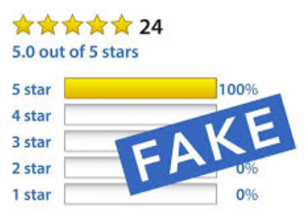
Problem Statement
Of Consumers say online reviews impact their purchasing decisions.
93%
70%
Hotel industry sales gets affected by negative online reviews.
82%
$25 T
USD
Of consumers have read fake review in the last year.
World wide eCommerce annual sales in 2019.
Of consumers would not buy a product if they suspected it to have fake reviews.
54%
$61 B
USD
US eCommerce annual Sales in 2019.

Slide 4
Objective
Developing Predictive Model
Utilizing various machine learning methods, predictive classification model will be developed.
Testing Developed Model with Unseen Data
Developed Machine Learning model will be tested with unseen Data
Developing Semi-Supervised Model
With combined labeled and unlabeled data, semi-supervised model will be developed.

Slide 5
Methodology
1
2
3
Supervised Learning
Supportive Vector Machine
Multinomial
Naïve Bayse Model
Gradient Boosting
Etc.
Neural Network
Word2Vec
- Word embeddings using shallow neural network
- Words with similar context occupy close spatial positions
Semi Supervised
Learning
Label Propagation
- Iterative algorithm
where it assign labels to unlabeled points by propagating labels through data set
Name Here
Name Here
Name Here
Programmer
Programmer
Programmer

Slide 6
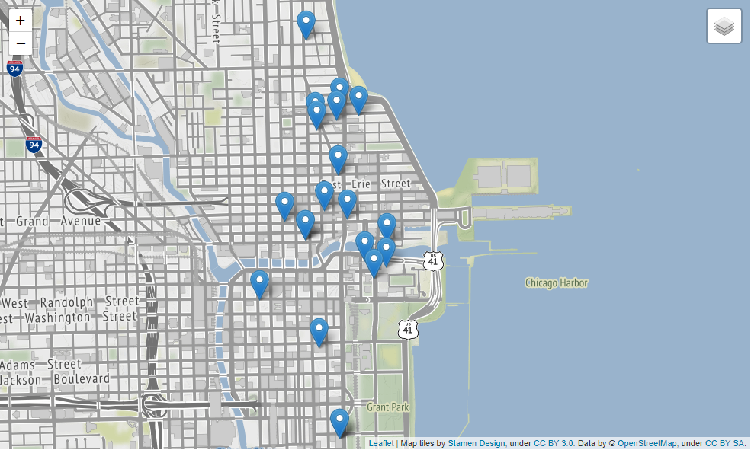
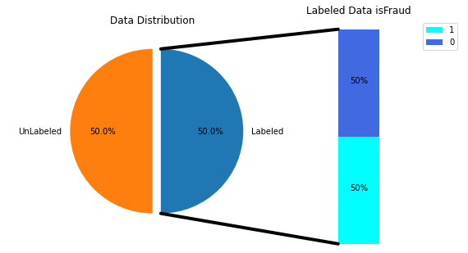
Methodology cont.
- About the Data
1600 labeled data was sourced from Myle Ott’s research
1600 Unlabeled data was web-scrapped from TripAdvisor
Accumulated data was sourced from 20 different Chicago area hotels

Slide 7
Limitations
This project only works to identify fake reviews written in English.
Labeled data is from 2013. Techniques might be different current days.

Slide 8
Conclusion
Supportive Vector Machine model had 87.7% of accuracy.
Word2Vec model had 53% accuracy.
3. Pre-trained Multinomial Naïve Bayse model with unlabeled test data had accuracy of 51.2%.
4. Label propagation model had 50% accuracy.

Slide 9
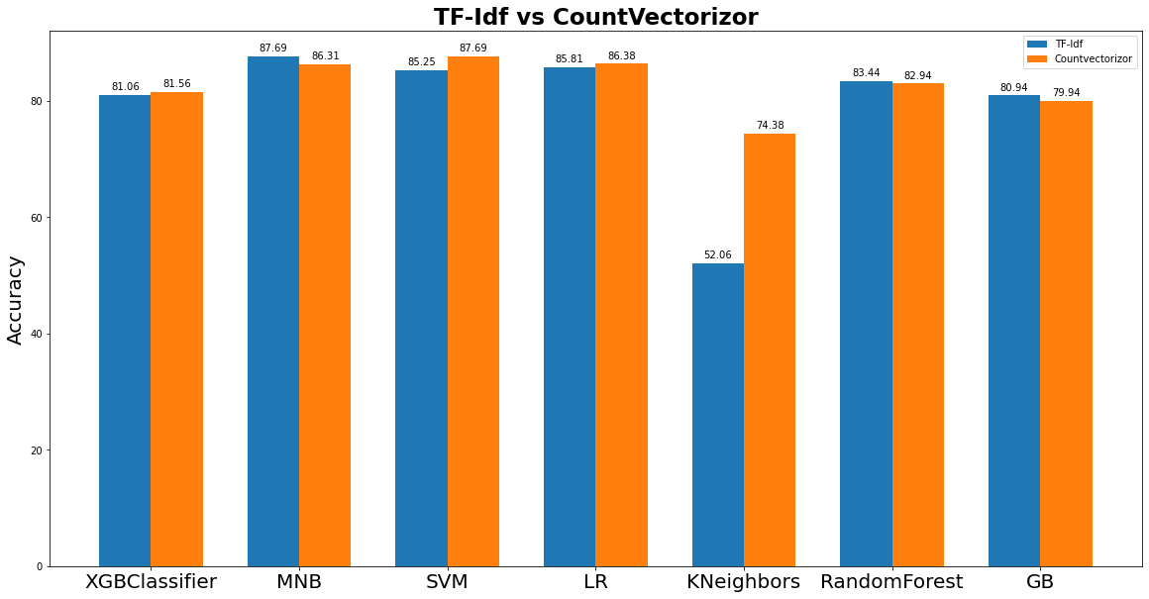
Conclusion

Slide 10
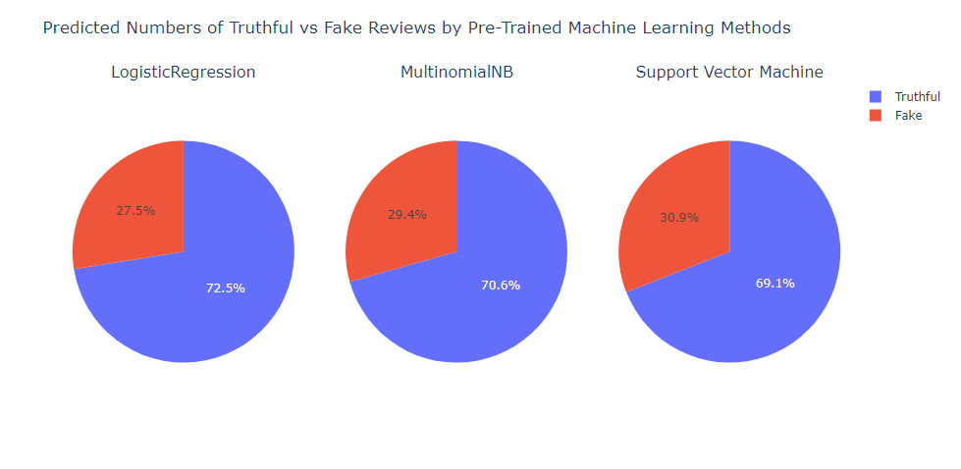
Conclusion

Slide 11
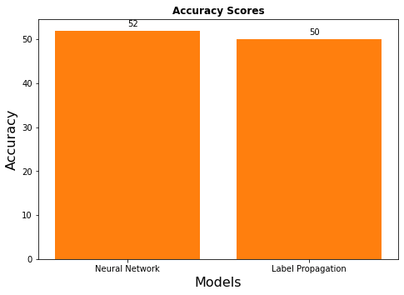
Conclusion

Slide 12
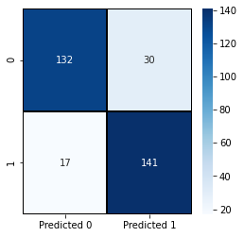
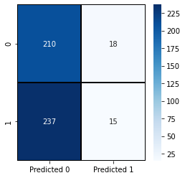
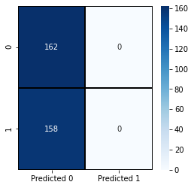
Conclusion
Support Vector Machine
Confusion Matrix
Neural Network
Confusion Matrix
Semi Supervised Model
Confusion Matrix

Slide 13
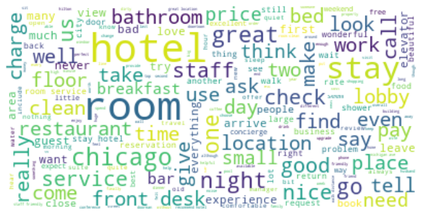
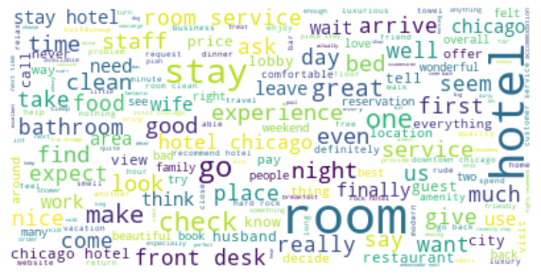
Conclusion
Truthful Reviews
Word Cloud Model
Fake Reviews
Word Cloud Model

Slide 14
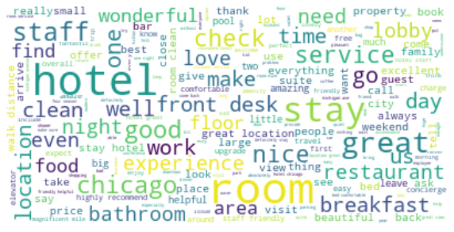
Conclusion
Unlabeled
Word Cloud Model

Slide 15
Business Recommendations
Keep the data up to date.
Periodically feed new data to the predictive learning model .
Filtering reviews using machine learning method is more accurate.

Slide 16
Future Works
Finding better model for semi supervised model.
Applying deep learning method.
Developing unsupervised model.

Slide 17


Q&A

Slide 18
References
https://websitebuilder.org/blog/online-review-statistics/
https://www.business2community.com/infographics/how-harmful-are-fake-online-reviews-infographic-02316083
https://myleott.com/
4. TripAdvisor.com

Slide 19
Thank you
Hyungjun Kang

