Slide 1

MOD 5 Final Project
IEEE CIS Fraud Detection Project
Hyungjun Kang
Notes:
Hi, I’m Hyungjun Kang and today, I’m going to over my Module 5 final project, IEEE CIS Fraud Detection.

Slide 2


Table of Contents
Problem Statement
Objective
Methodology
Conclusion
Future Work
Notes:
Going over table of contents: One, problem statement, two, objective, three, methodology, four, conclusion, and five future work

Slide 3
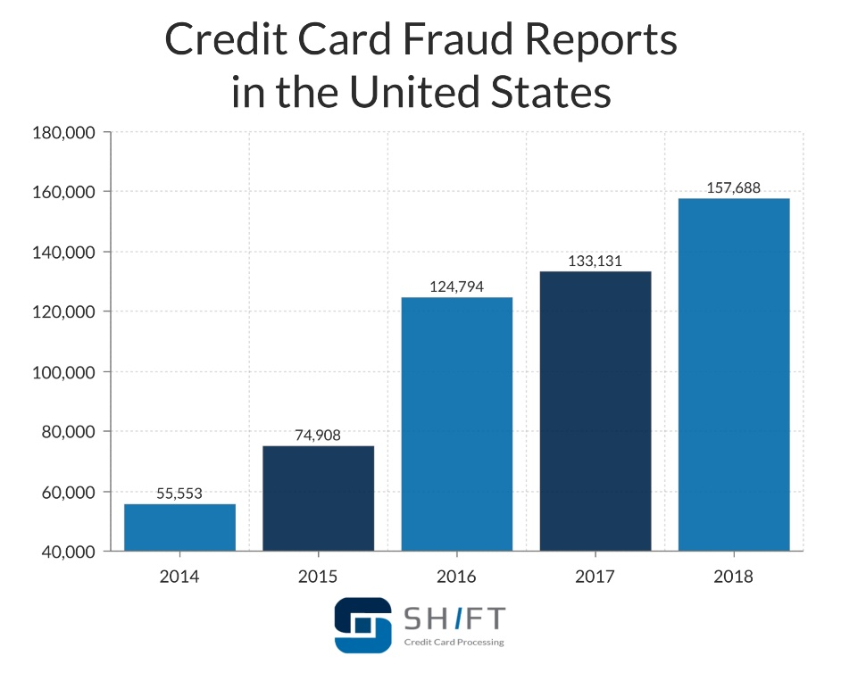
Problem Statement
Credit card fraud is the unauthorized use of a credit/debit card, fraudulently obtaining money or property.
Cases of Credit Card Fraud are increasing every year in the US.
Credit Card fraud costs consumers and financial companies billions of dollars every year.
Developing a fraud detection system is important to prevent losses across the various parties.

Slide 4

Objective
Developing a data science project based on IEEE CIS dataset
Benchmarking machine learning models on large scale dataset to predict fraudulent customers.

Slide 5
Methodology
1
2
3
Light Gradient Boosting
Gradient boosting method.
Tree leaf-wise.
Solving regression or classification problems.
Extreme Gradient Boosting
Gradient Boosting.
Decision Tree based ensemble Machine Learning.
CAT Boosting
Gradient Boosting.
Great results with default parameters.
Faster Predictions.
Ordered boosting
Notes:
I used three different gradient boosting methods to solve the binary clarification problem. If you have any questions about these methods, I can go over with you after the presentation with my jupyter notebook in details.

Slide 6
Results
Catboost presented with the best accuracy at 94.9%.
Catboost: 94.9%
Extreme Gradient Boosting: 83.9%
Light Gradient Boosting: 83.5%
1
2
3
Extreme Gradient Boosting
Gradient Boosting.
Decision Tree based ensemble Machine Learning.
CAT Boosting
Gradient Boosting.
Great results with default parameters.
Notes:
As a result, I could achieve 94% with catboost method and the other two results were very close to each other around 84%.

Slide 7
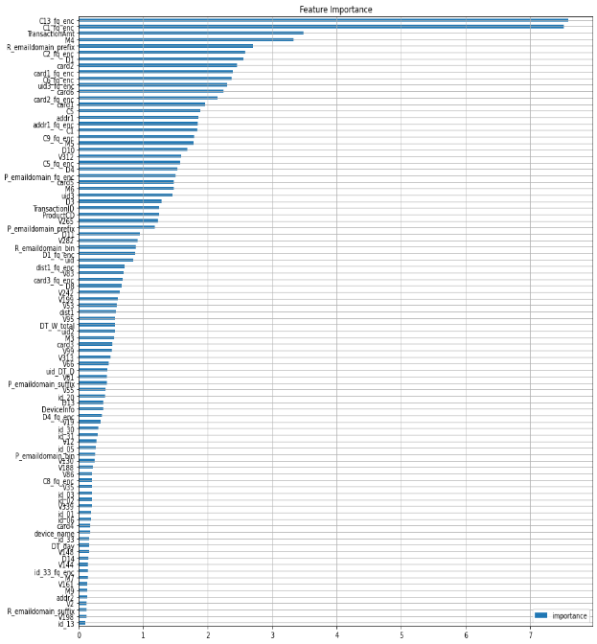
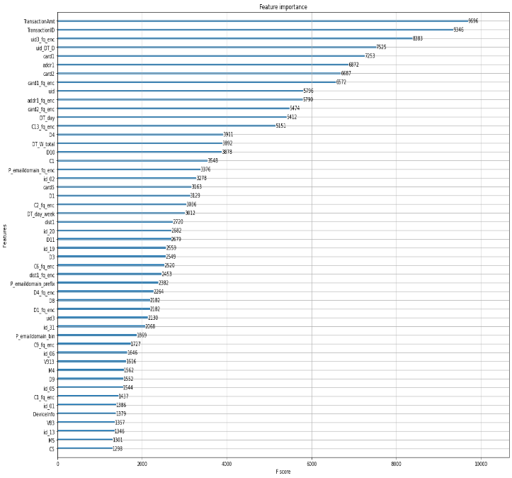
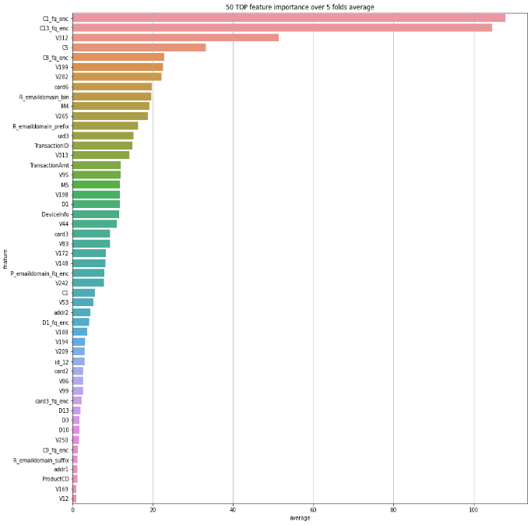
Results
Different result for feature importance for each models
Notes:
These are feature importance from each model from left, cat boost, Extreme gradient Boost, and light gradient boost. Each machine learning method had slightly different weights for each features.

Slide 8
Conclusion – Continual Learning
Feed new dataset
Feature Engineering
Monitor & Repeat
New customer data would come in everyday. It’s always important to keep the data up to date
Clean up the data and feed good data into machine learning models for greater results.
Make sure everything is working correctly and repeat the cycle.
1
2
3
Extreme Gradient Boosting
Gradient Boosting.
Decision Tree based ensemble Machine Learning.
CAT Boosting
Gradient Boosting.
Great results with default parameters.
01
02
03
04
05
Obtain insights
ML Modeling/Validation
New data exploration and get the insights for the differences
Build a machine learning model based on new data and pre-existing dataset.
Notes:
As a conclusion, I got 94% accuracy which is pretty good result. But, the model was built on relatively small portion of data compare to 103 trillion annual card transactions. Machine learning model needs to be updated constantly to catch up with new fraudulent methods and scams. I recommend continual learning process for the machine learning program. The process would be the same as developing regular data science project but it needs to be done over every cycle of time.

Slide 9
Future Works
1
2
Real Time Data Pipeline
3
Deep Learning Machine Learning Model
Extreme Gradient Boosting
Gradient Boosting.
Decision Tree based ensemble Machine Learning.
CAT Boosting
Gradient Boosting.
Great results with default parameters.
Reducing False Positives
Unsupervised
Model
Notes:
For future works, I would like to develop deep learning, unsupervised machine learning model for the method. I also would like to minimize false positives. False positives can be real problem for the business who’s trying to secure the customers and the sales. Minimizing false positive is very important for fraudulent detection programs. I would like to explore ways of updating the machine learning model with real time data.

Slide 10
Questions and Answers
1
2
3
Extreme Gradient Boosting
Gradient Boosting.
Decision Tree based ensemble Machine Learning.
CAT Boosting
Gradient Boosting.
Great results with default parameters.
Q&A

Slide 11
THANK YOU !
Hyungjun Kang

