Slide 1

MOD 5 Final Project
IEEE CIS Fraud Detection Project
Hyungjun Kang

Slide 2


Table of Contents
Problem Statement
Objective
Methodology
Conclusion
Future Work

Slide 3

Problem Statement
Credit card fraud is the unauthorized use of a credit/debit card, fraudulently obtaining money or property.
Cases of Credit Card Fraud have increased every year in US.
Credit Card fraud costs consumers and financial companies billions of dollars every year.
Developing a fraud detection system is important to prevent losses across the various parties.

Slide 4

Objective
Developing a data science project based on IEEE CIS dataset
Benchmarking machine learning models on large-scare dataset to predict fraudulent customers.

Slide 5
Methodology
1
2
3
Light Gradient Boosting
Gradient boosting method.
Tree leaf-wise.
Solving regression or classification problems.
Extreme Gradient Boosting
Gradient Boosting.
Decision Tree based ensemble Machine Learning.
CAT Boosting
Gradient Boosting.
Great results with default parameters.
Faster Predictions.
Ordered boosting

Slide 6
Results
Catboost presented with the best accuracy at 94.9%.
Catboost: 94.5%
Extreme Gradient Boosting: 83.9%
Light Gradient Boosting: 83.5%
1
2
3
Extreme Gradient Boosting
Gradient Boosting.
Decision Tree based ensemble Machine Learning.
CAT Boosting
Gradient Boosting.
Great results with default parameters.

Slide 7
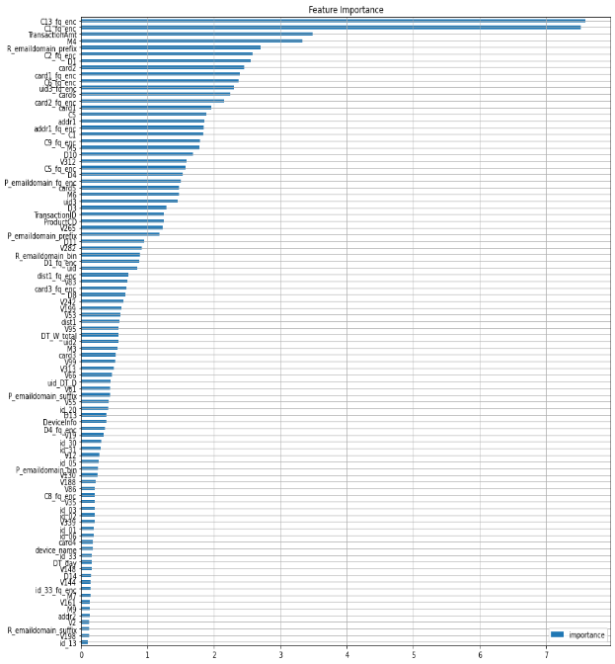
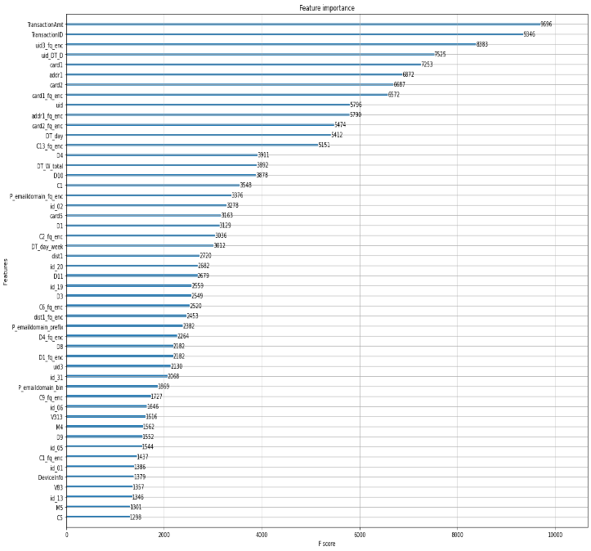
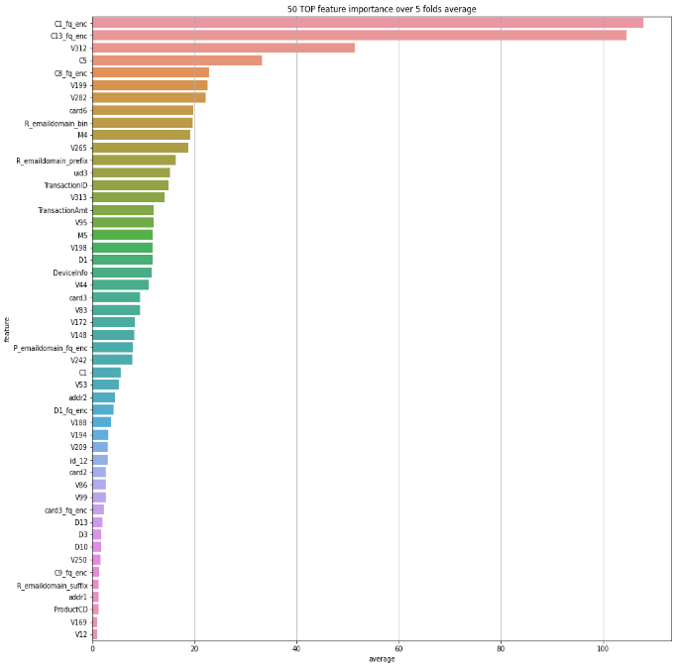
Results
Different result for feature importance for each models

Slide 8
Conclusion – Continual Learning
Feed new dataset
Feature Engineering
Monitor & Repeat
New customer data would come in everyday. It’s always important to keep the data up to date
Clean up the data and feed good data into machine learning models for greater results.
Make sure everything is working correctly and repeat the cycle.
1
2
3
Extreme Gradient Boosting
Gradient Boosting.
Decision Tree based ensemble Machine Learning.
CAT Boosting
Gradient Boosting.
Great results with default parameters.
01
02
03
04
05
Obtain insights
ML Modeling/Validation
New data exploration and get the insights for the differences
Build a machine learning model based on new data and pre-existing dataset.

Slide 9
Future Works
1
2
Real Time Data Pipeline
3
Deep Learning Machine Learning Model
Extreme Gradient Boosting
Gradient Boosting.
Decision Tree based ensemble Machine Learning.
CAT Boosting
Gradient Boosting.
Great results with default parameters.
Reducing False Positives
Unsupervised
Model

Slide 10
Questions and Answers
1
2
3
Extreme Gradient Boosting
Gradient Boosting.
Decision Tree based ensemble Machine Learning.
CAT Boosting
Gradient Boosting.
Great results with default parameters.
Q&A

Slide 11
THANK YOU
Hyungjun Kang

