Slide 1
Housing Market Prediction
Connor Mignone
Tonnar Castellano
Ty Painter

Slide 2
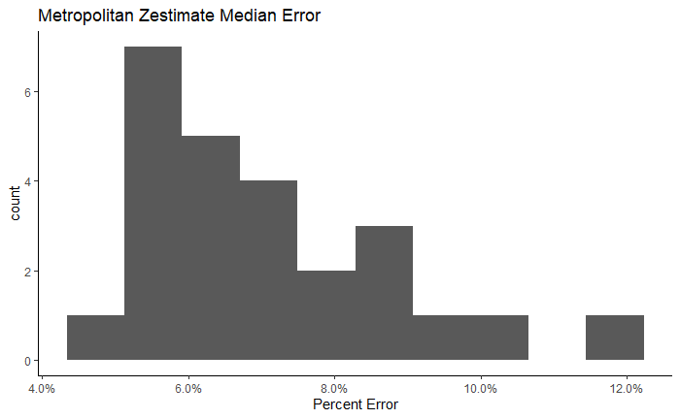
Motivation
Highly profitable market
Housing market currently skyrocketing
Continuous Failed Attempts

Slide 3
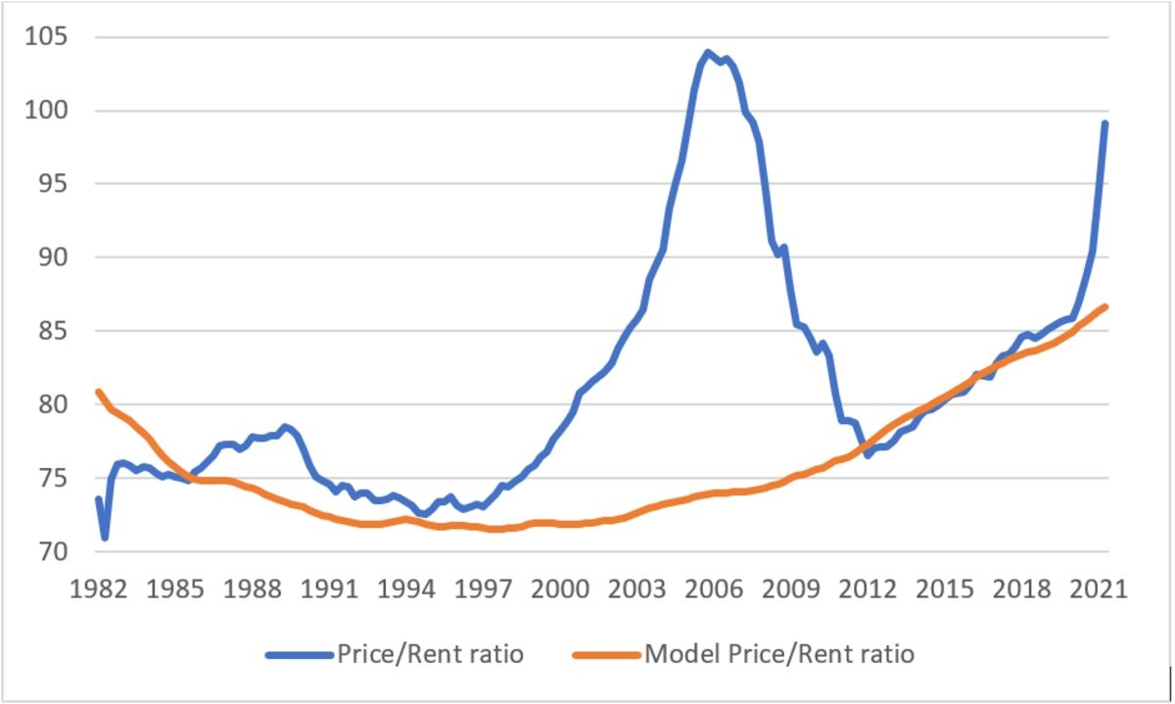
Challenges
Ever changing market
Detailed data is highly coveted
Very difficult modeling
Corporations looking to move into the space
Credit: https://www.bloomberg.com/opinion/articles/2022-04-05/the-housing-market-is-hot-but-certainly-not-unhinged

Slide 4
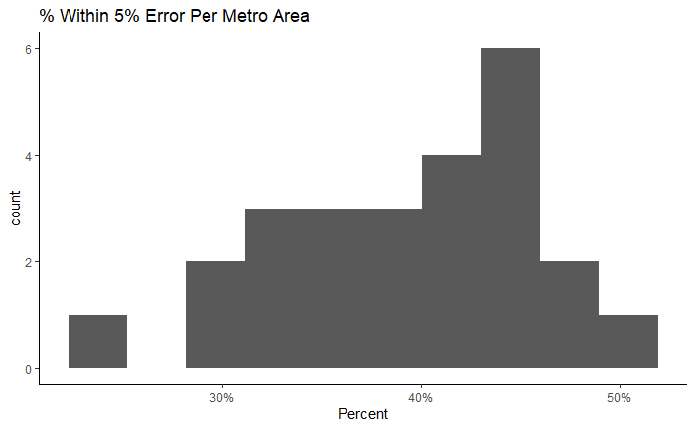
Problem
Analyze the housing market in the Pacific Northwest
Find where model is making poor predictions
Find any arbitrage opportunities

Slide 5
Methods
Data Cleaning:
Look through the data to ensure usability
Removing prices with zero
Checking rows with duplicate addresses

Slide 6
Methods
Feature Engineering:
PySpark Pipeline
Tokenize
HashingTF
One Hot Encoding Cities and Zip Codes

Slide 7
Methods
Modeling:

Slide 8
Results

Slide 9
Results

Slide 10
Results

Slide 11
Results

Slide 12
Thank You

