Slide 1
Deriving Stock Alpha From News
Ty Painter
Master’s Capstone Project
Vanderbilt Data Science Institute

Slide 2
Framework
01
02
03
04
Data Collection
Data Processing
Where does the data come from?
What to do with the data?
Portfolio Construction
Results
How is the data used to select stocks?
How did the portfolio perform?

Slide 3
Data Collection
Rank | Website | Count
1 | iheart.com | 161,187
2 | msn.com | 81,981
3 | medium.com | 48,707
4 | reuters.com | 37,931
5 | yahoo.com | 28,885
6 | indiatimes.com | 26,354
7 | prnewswire.com | 22,544
8 | dailymail.co.uk | 18,859
9 | texasguardian.com | 18,031
10 | apnews.com | 17,731
11 | sandiegosun.com | 16,727
12 | newyorktelegraph.com | 16,668
13 | ianslive.in | 13,846
14 | sfgate.com | 12,787
15 | chron.com | 12,676
16 | marketwatch.com | 12,166
17 | washingtontimes.com | 11,970
18 | onenewspage.com | 11,206
19 | thenews.com.pk | 10,850
20 | thehindu.com | 10,523
GDELT 2.0 GKG Database
Files produced every 15 minutes
135K records per day, 4.1M per month
26 columns → 3 columns
Filtered based on website
Yahoo Finance
2021 S&P 500 individual stock daily returns
Notes:
Website criteria
High financial news volume
No paywall
Consistent webpage format for repeated webscraping

Slide 4


Data Processing
Roberta Financial sentiment and readability
Weekends, holidays, no news, etc.
Web scrape
NLP
Volume
Cleaning
Article tagging

Slide 5
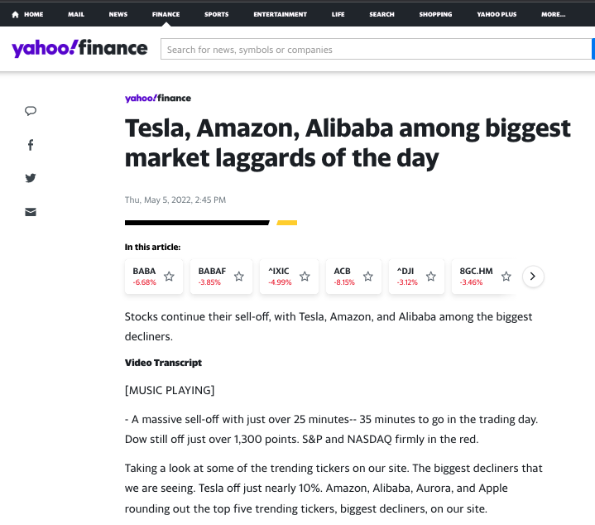
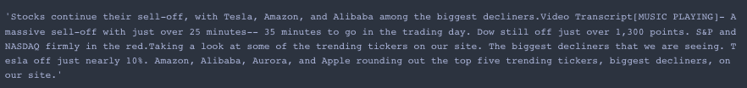
Data Processing
Web Scraping
Daily open & close prices
Selenium, ChromeDriverManager
News articles
BeautifulSoup
~65K articles per month
Example Link
Notes:
3 templates for each website
Error handling for dead URLs, remove from dataset

Slide 6
Data Processing
NLP
Sentiment Analysis
HuggingFace → distilroberta-financial-news-sentiment-analysis model
Notes:
Financially tuned version of the distillroberta-base model
Works best when sentences are passed in one by one
Sentiment add to 1
aggregate score

Slide 7
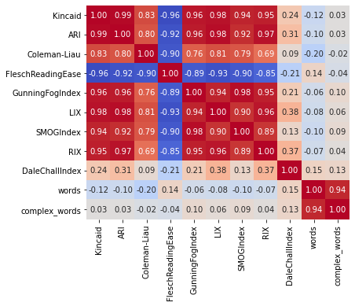

Data Processing
NLP
Readability
Notes:
Explain priors.. More complex read is worse scores
flesch scale works in opposite direction

Slide 8
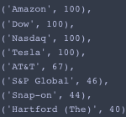
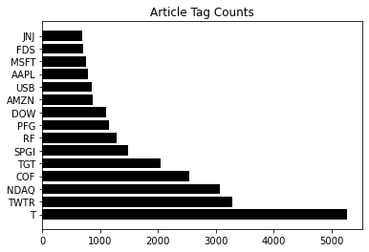
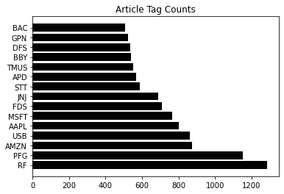
Data Processing
Volume
Importance factor
Fuzzywuzzy → token set ratio
Notes:
Token set ratio is useful when comparing text of different lengths
> 90 threshold

Slide 9
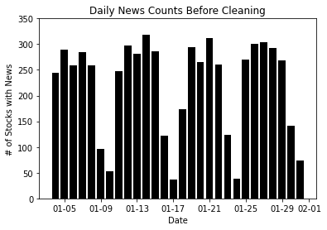
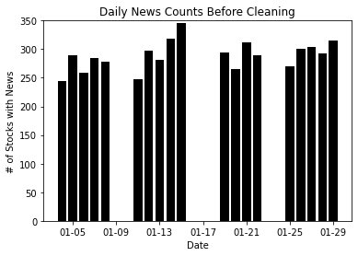
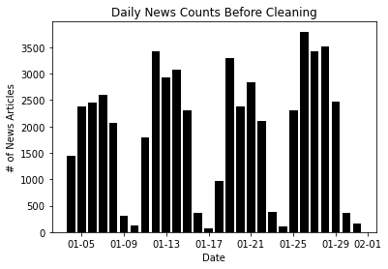
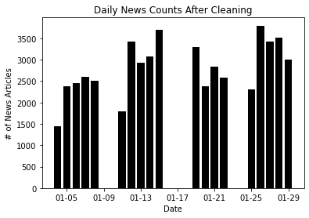
Data Processing
Data Cleaning
Weekends & Holidays
Notes:
Stock coverage (250-300)
Article volume (2000-3000)

Slide 10
Data Processing
Data Cleaning
No news days
Decayed lagging days
70% → 1 day prior
20% → 2 days prior
10% → 3 days prior

Slide 11
Data Processing
Finalized Data Columns
Descriptions | News | Financials
date tags ticker | volume pos_mean pos_median pos_min pos_max neg_mean neg_median neg_min neg_max neu_mean neu_median neu_min neu_max net_mean net_median net_min net_max read_score | same_day_raw next_day_raw sp_avg_return next_day_sp same_day_relative next_day_relative

Slide 12
Portfolio Construction
Long-Short Portfolio
Ranked based on scaled, aggregate feature scores
3, 5, 10 bins
Equally-weighted
Sentiment Scores
News Volume
Readability Scores
Notes:
Explain long-short
Fundamental priors flipping negative sentiment

Slide 13
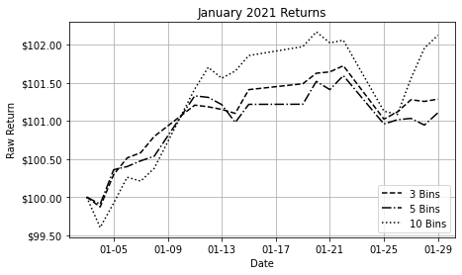
Results
Portfolio | Raw Return
3 Bins | +1.28%
5 Bins | +1.11%
10 Bins | +2.12%

Slide 14
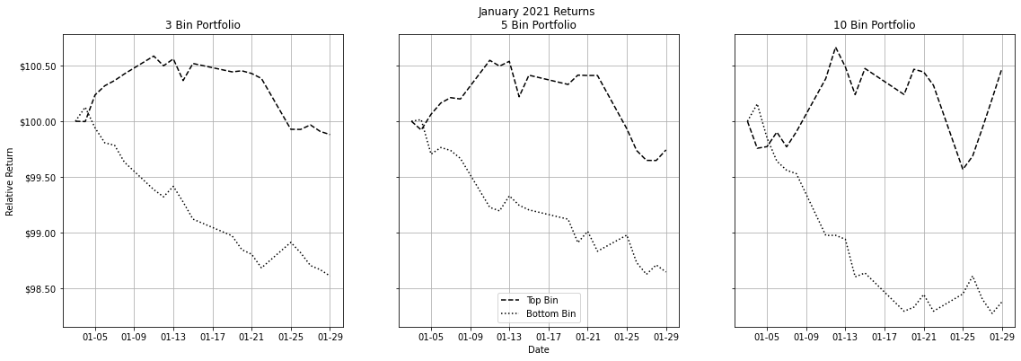
Results
3 Bins | Relative Return
Top | -0.12%
Bottom | -1.39%
5 Bins | Relative Return
Top | -0.26%
Bottom | -1.35%
10 Bins | Relative Return
Top | +0.48%
Bottom | -1.62%
Notes:
Top: 43% daily turnover
Bottom: 30% daily turnover

Slide 15

Thank you!
Acknowledgements
Andrew Chin
Michael Li
Dr. Jesse Blocher
Check back for final results!
Contact Information:
Ty Painter
tydpaint@gmail.com

