Slide 1
Deriving Alpha from News: GDELT
Ty Painter
Capstone Update #9
4/27/22

Slide 2
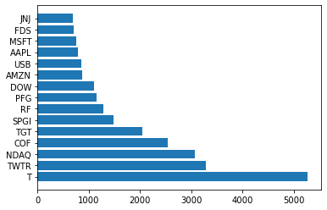
Data Processing
Weekend news → assigned to Friday
Holiday news → assigned to previous market day
No news → Lookback period
70%: 1 day prior
20%: 2 days prior
10%: 3 days prior

Slide 3
Portfolio Construction
Long-short portfolio
3 bins (338 total stocks)
5 bins (202 total stocks)
10 bins (100 total stocks)
Ordered by aggregated feature score
Multiplied negative sentiment scores by -1
Scaled sentiment scores, read score, and volume count
Aggregate mean

Slide 4
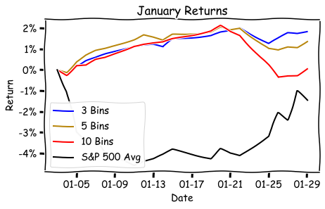
Performance
Portfolio | Raw Return | Relative Return
S&P 500 Avg | -1.48% | ----------------
3 Bins | +1.85% | +3.33%
5 Bins | +1.38% | +2.86%
10 Bins | +0.07% | +1.55%

Slide 5
Next Steps
February and March are running on EC2
Q1 should be finished by next Wednesday
Use GPUs to finish all of 2021
Construct additional portfolios
Order by net sentiment score
Factor weighted by % of absolute sum of scores
Finish final paper & presentation
Organize GitHub

