Slide 1
Deriving Alpha from News: GDELT
Ty Painter
Capstone Update #1
1/13/21

Slide 2
Data Sources
GDELT 2.0 Database
Online News Summary (API/Dashboard)
Google Big Query

Slide 3
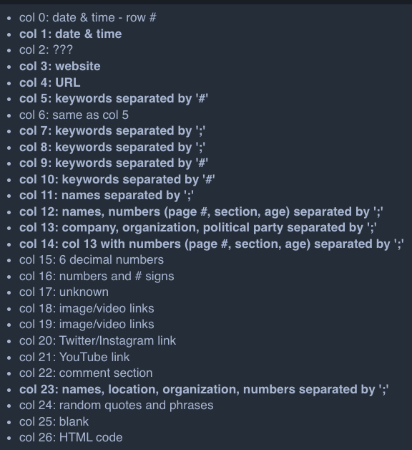
GDELT 2.0 Event Database
Use the .gkg.csv.zip file
Messy
No column names (manually labeled)
27 columns
Keywords, phrases, people, organizations, political party, etc.
The other ‘export’ and ’mentions’ files do provide a URL
Only 5 columns
Run analysis on these columns and/or navigate to URL and run analysis?
Filter for S&P 500 companies?

Slide 4
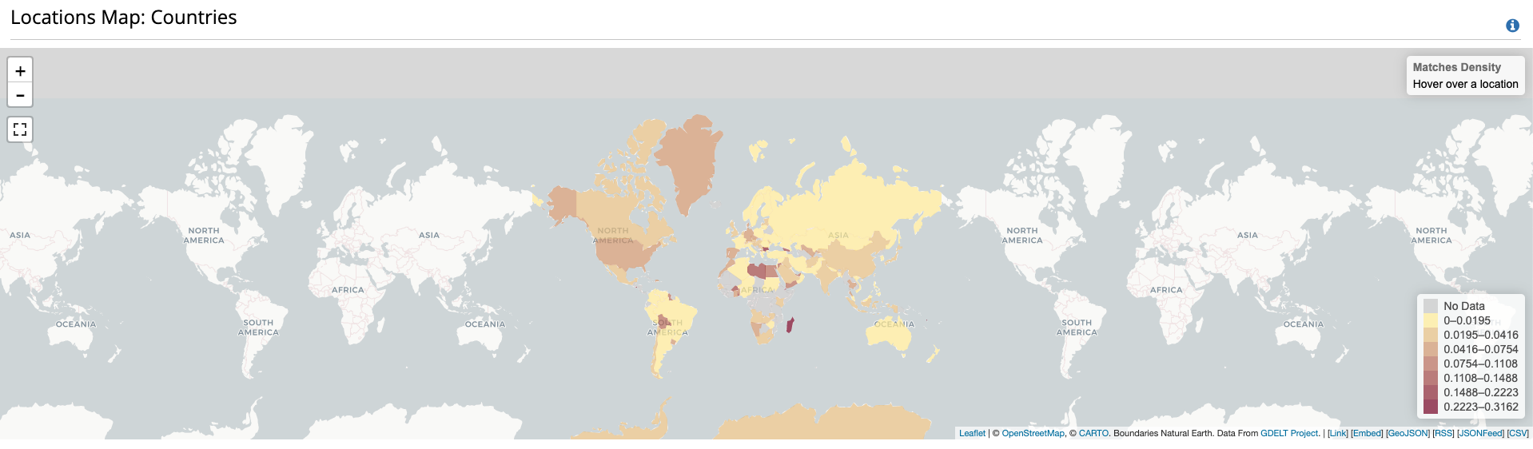
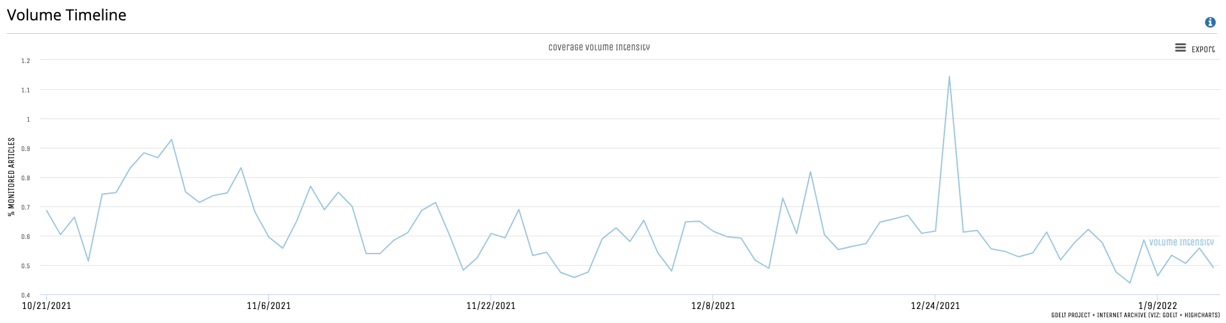
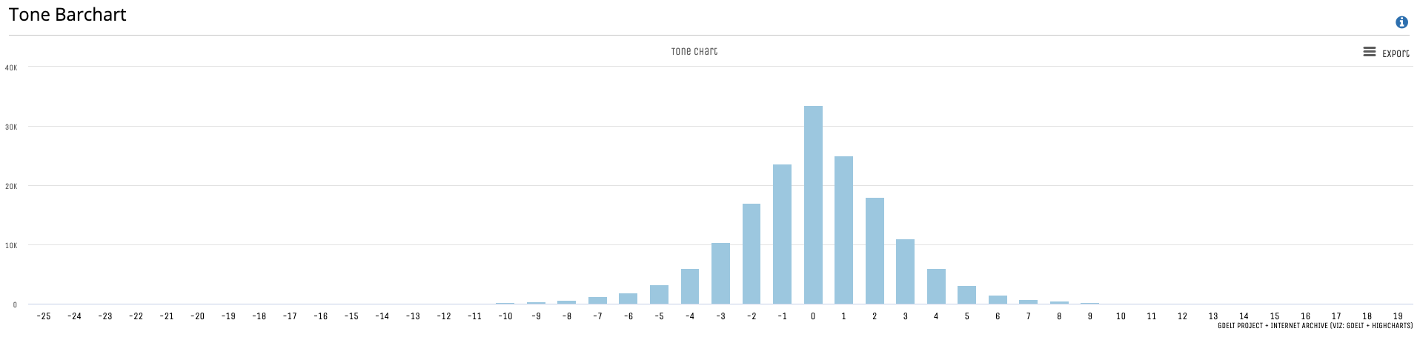
Online News Summary (API/Dashboard)
MUST specify a keyword
Can limit results
Can specify time period
Provides a URL link
Volume, tone, location charts
Could be useful as a reference/comparison for specific companies/industries

Slide 5
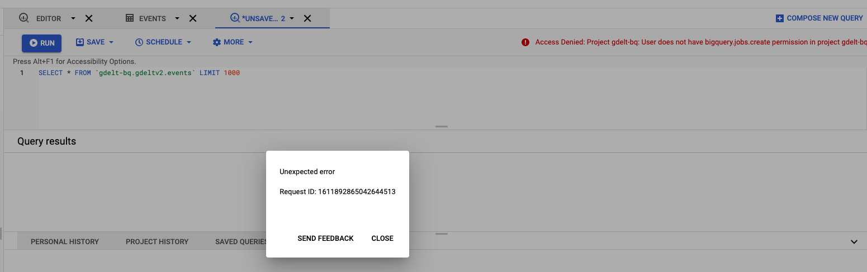
Google BigQuery
3 databases
Events
Mentions
Global Knowledge Graph
Do not have permission to run queries

Slide 6

How to Collect Data?
GDELT 2.0 Event Database
Write a script to…
Navigate to the ”Master” file (Feb 2015 – Current)
Updated every 15 minutes
Retrieve most recent files based on timestamp
Run every day/week?
Append to a single master file of my own?

Slide 7
NLP
HuggingFace

Slide 8

HuggingFace
NLP library with various pre-trained models with hosted inference APIs
PEGASUS for Financial Summarization: Summarizes articles into 1-2 sentences
distilRoberta-financial-sentiment: Produces a sentiment score for positive, neutral, and negative
ProsusAI/finbert: Produces a sentiment score for positive, neutral, and negative
Write a script to pass in either full article text or summary text (produced by PEGASUS) into one or both sentiment APIs to assign a rating.
Potentially develop my own sentiment model.

Slide 9
Financial Data

Slide 10
Financial Data
Assess any correlation between the timestamped sentiment scores and the real-time stock performance
Free data sources???

Slide 11
Updates

Slide 12
Updates
Current work
Import and parse data file to collect date and timestamp
Collect all data files dating back to ???
Initial EDA to gather volume count for specific sectors and companies
Connect HuggingFace APIs to run on keywords
Next steps
Write a script to navigate to URL
Web scrape entire news article to run through sentiment analysis
Questions
Readability (complexity, structure, characteristics)
GitHub

