Slide 1
Deriving Alpha from News: GDELT
Ty Painter
Capstone Update #2
1/27/21

Slide 2
GDELTA Data
Automated a script to download all the gkg.csv files for 2021
Trouble handling data (~25+ days of data)
Parallel processing

Slide 3
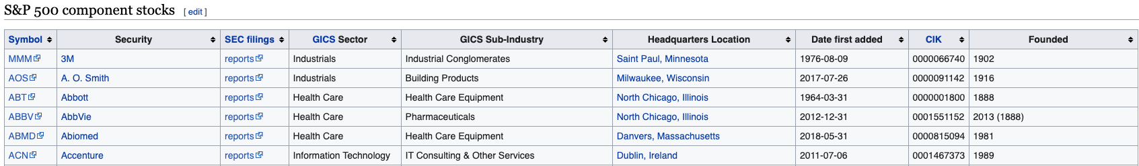
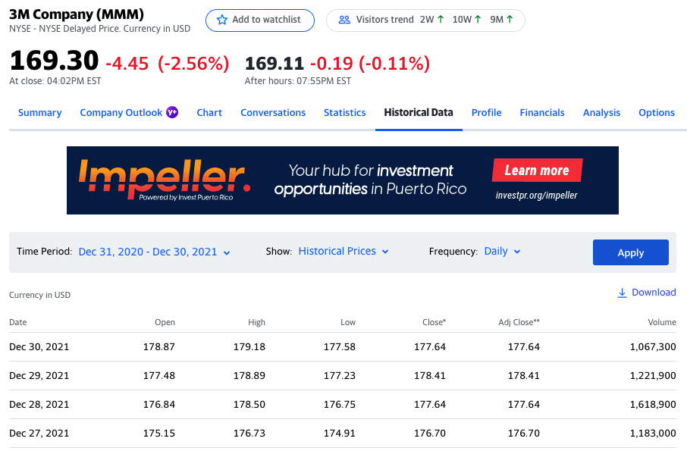
Stock Data
Gathered S&P 500 companies (Wikipedia)
Pass ticker into Yahoo Finance
Historical Data (12/31/20 – 12/30/21)

Slide 4
NLP - Readability
smjsindustry
Client library of Amazon SageMaker Jumpstart
“process financial text documents with features such as summarization and scoring for sentiment, litigiousness, risk, and readability”
TextDescriptives
Python library
“used to calculate several descriptive statistics, readability metrics, and metrics related to dependency distance”

Slide 5
Next Steps
Finished loading all GDELT data
Initial EDA on GDELT data
Filter most popular websites
Volume count for keywords, companies, sectors (Michael’s code)
Start developing web scraping templates
How many websites?
Connect HuggingFace API (distilRoberta-financial-sentiment)
GitHub

