Slide 1
Deriving Alpha from News: GDELT
Ty Painter
Capstone Update #3
2/10/21

Slide 2

GDELT Data
 | website | counts
0 | iheart.com | 161187
1 | msn.com | 81981
2 | medium.com | 48707
3 | reuters.com | 37931
4 | yahoo.com | 28885
5 | indiatimes.com | 26354
6 | prnewswire.com | 22544
7 | dailymail.co.uk | 18859
8 | texasguardian.com | 18031
9 | apnews.com | 17731
10 | sandiegosun.com | 16727
11 | newyorktelegraph.com | 16668
12 | ianslive.in | 13846
13 | sfgate.com | 12787
14 | chron.com | 12676
15 | marketwatch.com | 12166
16 | washingtontimes.com | 11970
17 | onenewspage.com | 11206
18 | thenews.com.pk | 10850
19 | thehindu.com | 10523
20 | tmcnet.com | 10394
21 | finanznachrichten.de | 9590
22 | business-standard.com | 9512
23 | upstract.com | 9483
24 | investegate.co.uk | 9434
25 | chinadaily.com.cn | 9295
Can now read in monthly data
Each month is ~12 GB
Storage…
Zipped files are ~3 GB
January 2021 value counts
Websites
Keywords
Topics

Slide 3
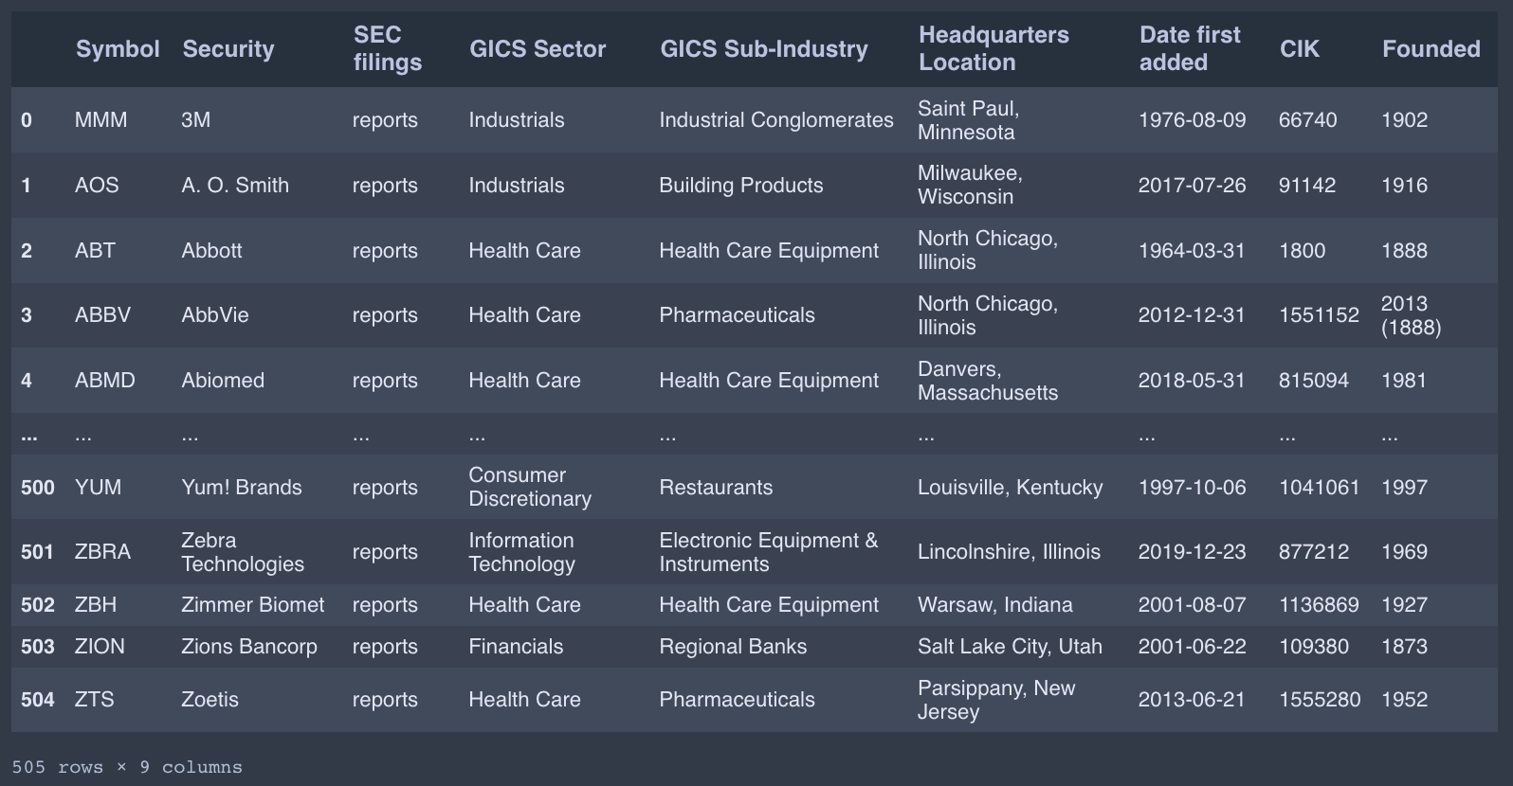
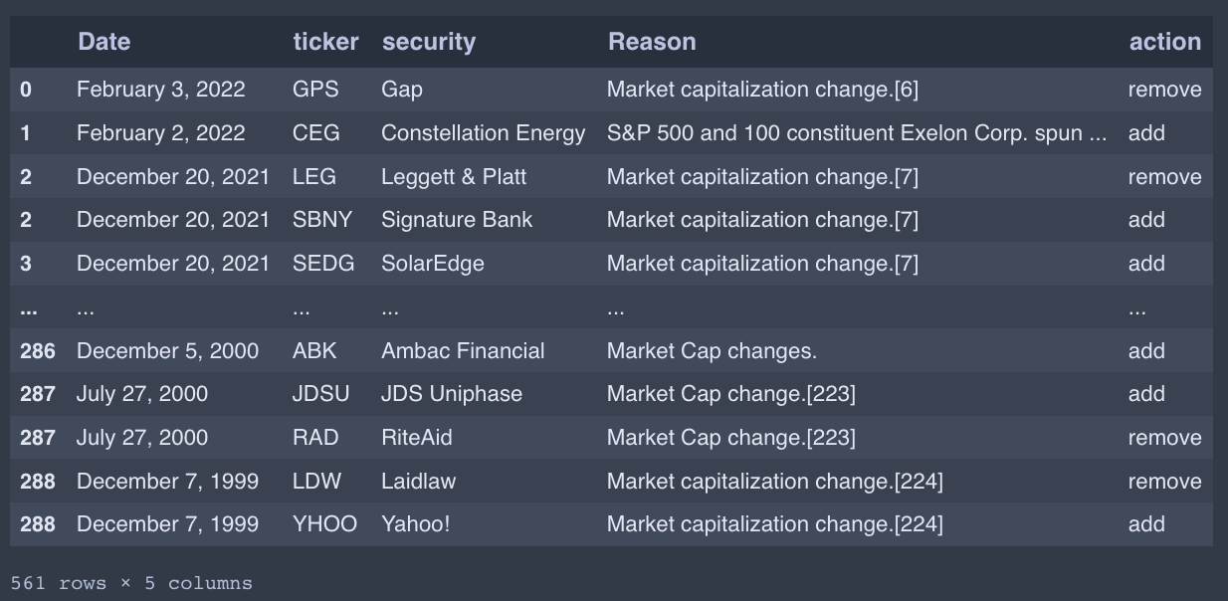
Stock Data
Gathered dates of addition/removal from S&P 500, sector, and industry
Market cap

Slide 4

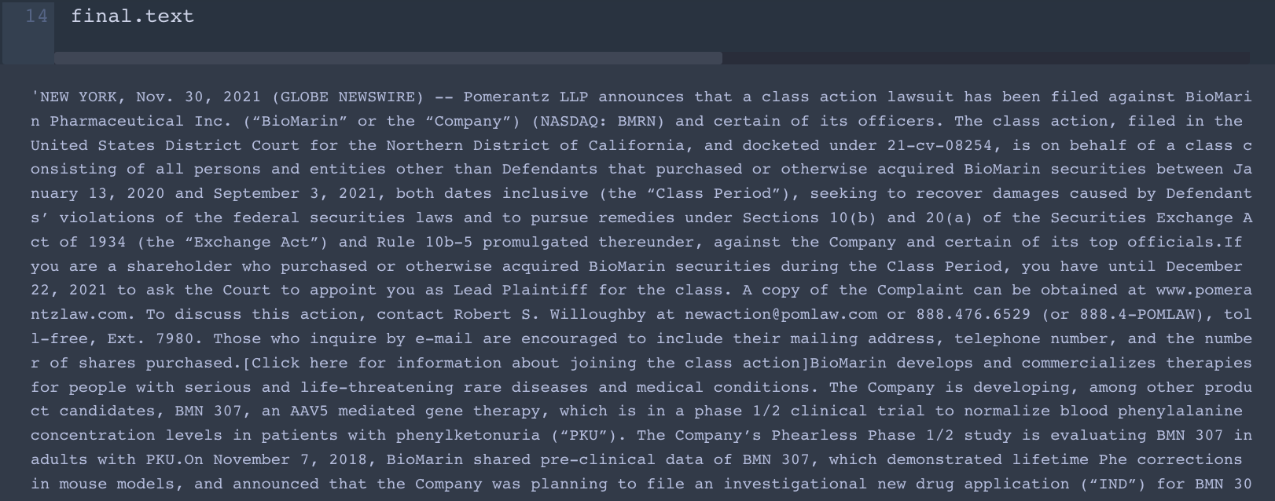
Web Scraping
List of 100 most popular websites for January 2021
Foreign websites
Website subscriptions
Created a template for yahoo.com URLs
Some dead URLs

Slide 5
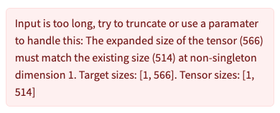
NLP
distilRoberta-financial-sentiment
Entire article is too big to pass in
PEGASUS for Financial Summarization

Slide 6
Next Steps
GDELT data storage
Additional web scraping templates
Adjust HuggingFace API parameters
GitHub

