Slide 1
Deriving Alpha from News: GDELT
Ty Painter
Capstone Update #6
3/31/22

Slide 2

NLP
Sentiment scores
Added net scores (positive – negative)
Roberta is producing many neutral scores
Single sentence could skew results
Focus on mean/median rather than max/min?
Article Tags
Fuzzywuzzy package
Token_set_ratio()
split the tokens into two groups: intersection and remainder; use those sets to build a comparison string.
Filter based on what value?
Readability scores
Readability package
What metrics are most useful?

Slide 3
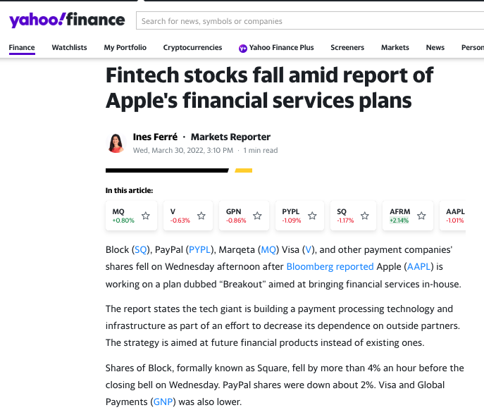
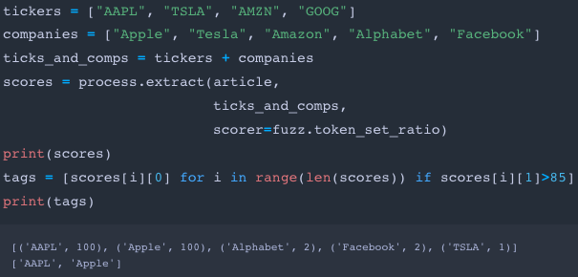
Fuzzywuzzy
Notes:
Test JPMorgan Chase or multiple word companies
Use 90 as score cutoff

Slide 4
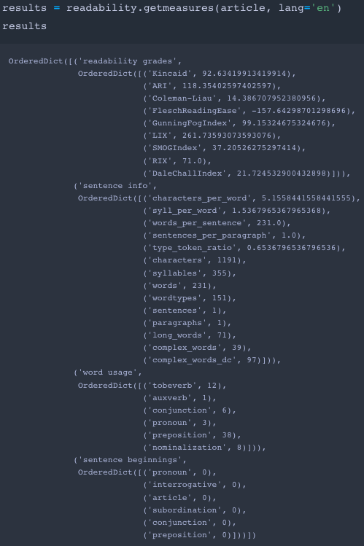
Readability
Notes:
All Readability scores
Complex words, word count

Slide 5
Next Steps
Find computation environments
Apply article tags and readability scores to the rest of the data
Merge historical stock price and market cap data with sentiment scores, article tags, and readability scores
Begin modeling
Notes:
Filter articles based on words/sentence
Quantile portfolios, factor weighted portfolios
Understand coverage of article tags, distribution of article tags

