Slide 1
Deriving Alpha from News: GDELT
Ty Painter
Capstone Update #7
4/7/22

Slide 2
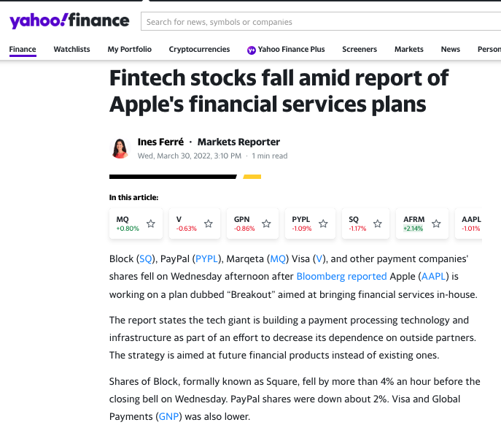
NLP
Sentiment scores
Roberta is producing many neutral scores
Single sentence could skew results
Focus on mean/median rather than max/min?
pos_mean | pos_median | pos_min | pos_max | neg_mean | neg_median | neg_min | neg_max | neu_mean | neu_median | neu_min | neu_max | net_mean | net_median | net_min | net_max
0.23 | 0 | 0 | 1 | 0.46 | 0.01 | 0 | 1 | 0.31 | 0 | 0 | 1 | -0.23 | 0 | -1 | 1

Slide 3
NLP – Sentence by Sentence

Slide 4

NLP
Article Tags
Fuzzywuzzy package
Used company names, not tickers
Token_set_ratio() > 90
Dropped articles with no tags
Issues with AT&T
How to label tags?
Multiple rows? Merge tables?
Readability scores
Readability package
All ‘readability grades’
Filter?
Sentence info
Word count
Complex words
[('Apple', 100), ('Global Payments', 100), ('Goldman Sachs', 100), ('PayPal', 100), ('Visa', 100), ('PNC Financial Services', 90), ('S&P Global', 89), ('DXC Technology', 83), ('SVB Financial', 82), ('TJX Companies', 82), ('Air Products', 80), ('Lincoln Financial', 69), ('AT&T', 67), ('Republic Services', 64), ('Ameriprise Financial', 62),...............]

Slide 5
Next Steps
AWS EC2
Merge historical stock price and market cap data with sentiment scores, article tags, and readability scores
Begin modeling
Notes:
Quantile portfolios, factor weighted portfolios
Understand coverage of article tags, distribution of article tags

