Slide 1
Deriving Alpha from News: GDELT
Ty Painter
Capstone Update #9
4/27/22

Slide 2
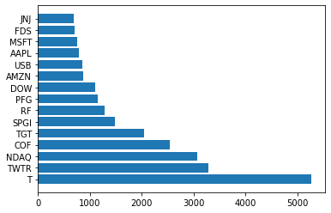
Data Processing
Weekends news → assigned to Friday
Holiday news → assigned to previous market day
No news → Lookback period
70%: 1 day prior
20%: 2 days prior
10: 3 days prior

Slide 3
Portfolio Construction
Long-short portfolio
3 bins (338 total stocks)
5 bins (202 total stocks)
10 bins (100 total stocks)
Ordered by aggregated feature score
Multiplied negative scores by -1
Scaled all sentiment scores, read scores, and volume count
Aggregate mean

Slide 4
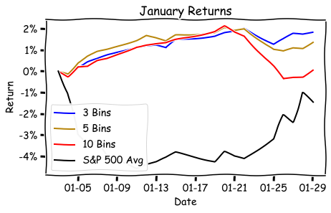
Performance
Portfolio | Raw Return | Relative Return
S&P 500 Avg | -1.48% | ----------------
3 Bins | +1.85% | +3.33%
5 Bins | +1.38% | +2.86%
10 Bins | +0.07% | +1.55%

Slide 5
Next Steps
February and March are running on EC2
Q1 should be finished by next Wednesday
Construct additional portfolios
Order by net sentiment score
Factor weighted by % of absolute sum of scores
Finish final paper & presentation
Organize GitHub

