Slide 1
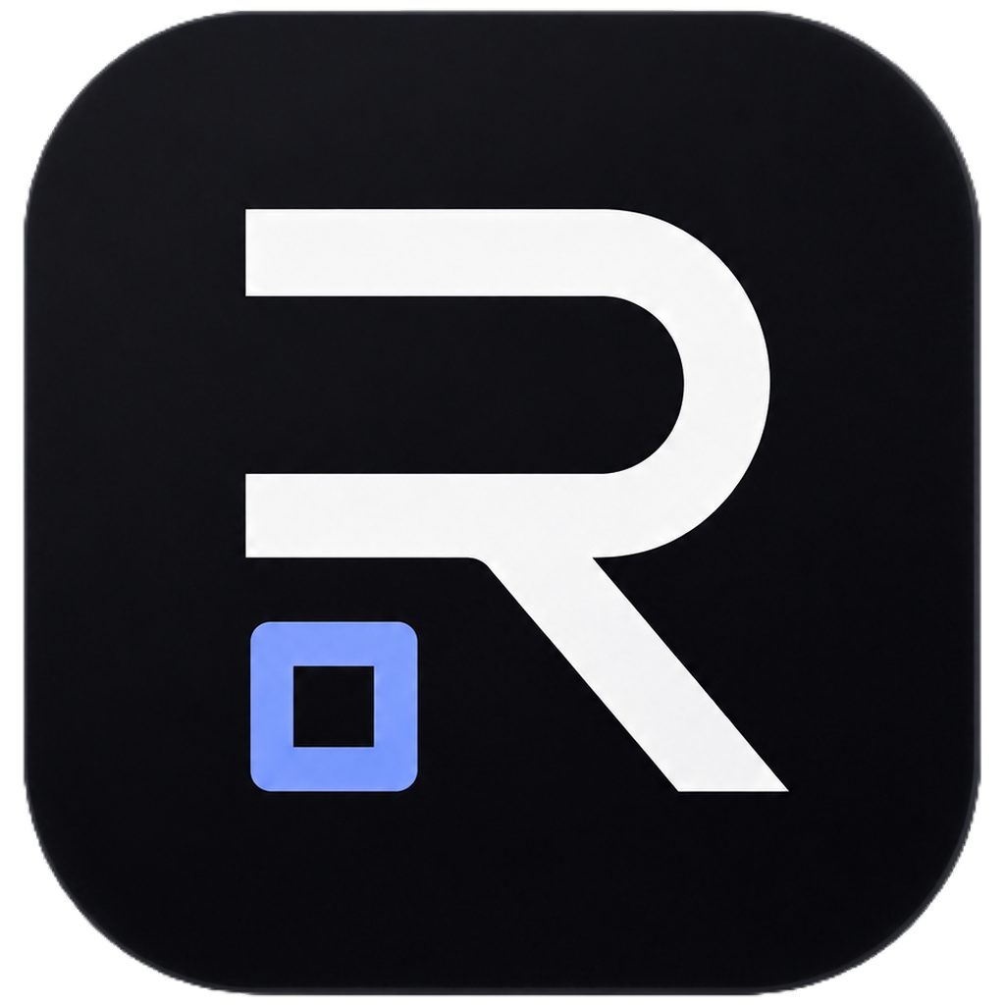
ReiOps
AI AGENT OPERATIONS
ReiOps Control Plane
Business-ready AI agents need a trust layer.
Trace
Sandbox
ReiOps turns raw agents into managed workflows with secure sandboxes, approval gates, live traces, audit logs, and Telegram operator control.
Policy
Approve
Audit
Live demo: reiops.xyz/demo
reiops.xyz • 1/8

Slide 2
ReiOps
The problem: agents are cheap, trust is scarce.
Businesses do not lack access to AI agents. They lack safe operational control.
Raw agents get broad access
No reliable audit trail
No business owner for failure
Scripts, CLIs, and chatbots often need credentials, repositories, internal tools, and customer data before teams can see value.
When something changes, teams need to know what happened, which tools ran, what files changed, and who approved it.
SMBs and enterprises want outcomes, support, permissions, and accountability — not another ungoverned automation stack.
The shift
Old question
New question
“Can an agent do the task?”
“Can a business safely trust it?”
reiops.xyz • 2/8

Slide 3
ReiOps
ReiOps packages agents as managed workflows.
A control plane + managed marketplace for business-ready AI agents.
1
2
3
4
5
Vetted workflow
Secure sandbox
Live trace
Approval gate
Audit trail
Curated agent flows for repeatable business tasks
Scoped execution environment and limited tool access
Every step, file, command, cost, and decision visible
Policy blocks risky actions until a human approves
Workflow result stays reviewable and accountable
GTM wedge: start as a tech-enabled service, productize repeatable deployments into a managed agent workflow marketplace.
reiops.xyz • 3/8

Slide 4
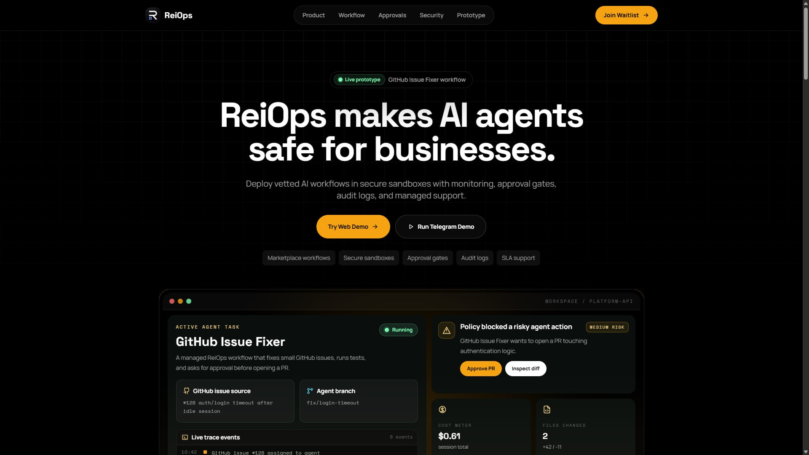
ReiOps
Live demo: GitHub Issue Fixer.
A familiar workflow that shows sandboxing, traces, approvals, and auditability.
Input
GitHub Issue #128: flaky login timeout test
Execution
Agent inspects code, edits files, runs tests
Policy
Touches auth/session logic → PR creation blocked
Approval
Human approves from web dashboard or Telegram
Output
PR result + trace stored as audit trail
This is a simulated public demo — no production repository is modified.
reiops.xyz • 4/8

Slide 5
ReiOps
Why now: agent supply is exploding.
The adoption bottleneck moves from model capability to business trust and operations.
Open-source agents
Tool access grows
Business risk grows
Every team will have access to capable agent frameworks and coding assistants.
Agents increasingly connect to repos, SaaS apps, CRMs, infra, and internal data.
More capability means more need for permissions, approvals, logs, cost controls, and support.
ReiOps is not betting that one agent wins.
We are betting that every business needs a trusted layer to run many agents safely.
reiops.xyz • 5/8

Slide 6
ReiOps
Business model: managed workflows first, platform second.
Start close to customers; productize what repeats.
SMB managed workflows
Enterprise deployments
Marketplace take rate
Monthly managed packages for common workflows: issue fixing, support drafts, research, invoices, internal ops.
Custom agent workflows with sandbox profiles, policy gates, audit logs, integrations, support, and SLA.
Long-term curated distribution layer where vetted builders publish business-ready workflows on ReiOps.
Service learning
Repeatable templates
Control plane
Marketplace
reiops.xyz • 6/8

Slide 7
ReiOps
Team: technical builder + operations credibility.
A family team combining agent system building with real-world infrastructure operations.
Vsevolod Malakhov
Vadim Solovev
Technical founder
Operations / business lead
18-year-old Information Systems student at OmSU. Built Rei, a Telegram-first internal agent operating system, and previously built OpenKey, an end-to-end encrypted messenger. Focus: distributed systems, security, agent orchestration, and human-in-the-loop interfaces.
15+ years across critical infrastructure, construction, consulting, and data center operations. Brings enterprise process design, budgets, stakeholder management, and real-world operational discipline.
Proof today: live domain + Telegram bot + public demo repo + working web/API/bot deployment.
reiops.xyz • 7/8

Slide 8
ReiOps
What we are building next.
From prototype to design partners and repeatable managed workflows.
1
Design partners
Run controlled workflows with small teams that need safe automation.
2
Real integrations
GitHub first, then support, sales research, and internal ops workflows.
3
Policy engine
Configurable permissions, risky-action detection, approval roles, audit export.
4
Managed marketplace
Turn repeated deployments into curated business-ready agent workflows.
ReiOps: trusted distribution and operations layer for business-ready AI agents.
reiops.xyz • 8/8

