Slide 1
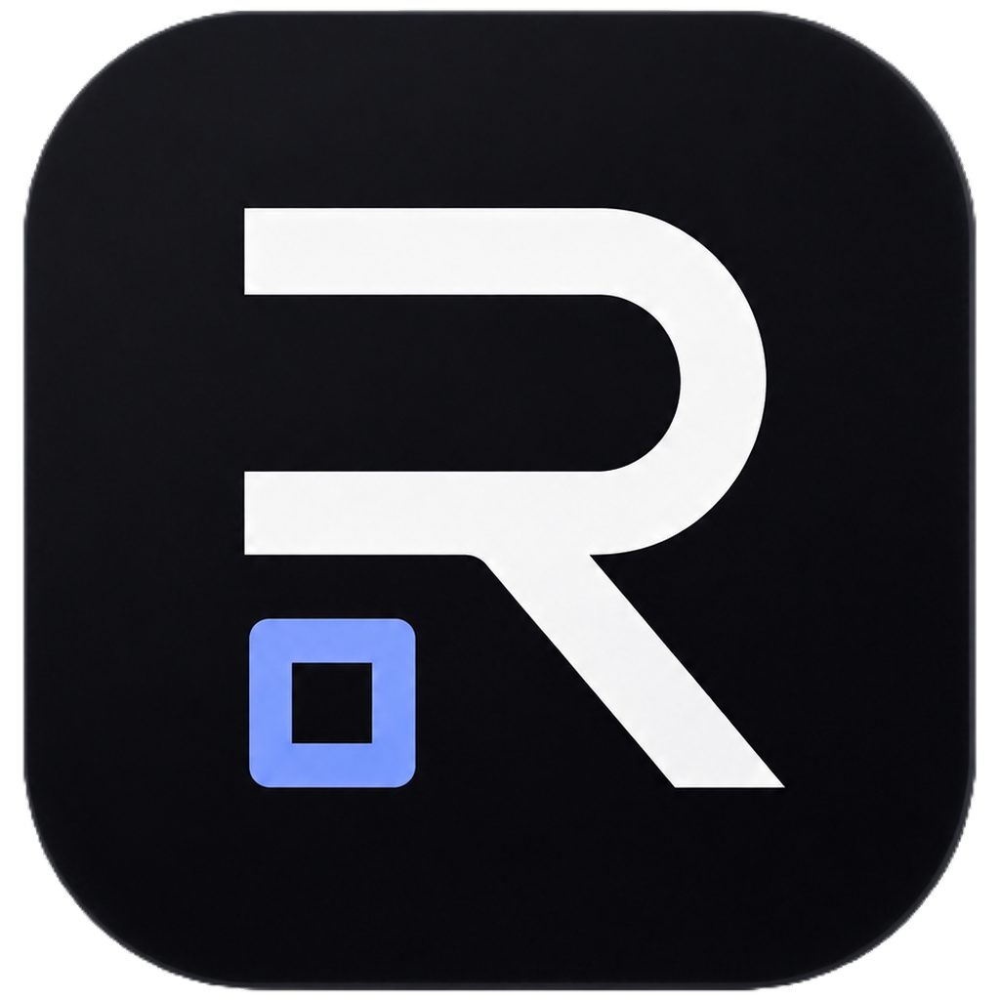
ReiOps
ReiOps makes AI agents safe for businesses.
Managed workflows with sandboxes, approval gates, live traces, audit logs, and Telegram operator control.
The product thesis
Agents are becoming abundant. Businesses will pay for the trusted layer that lets them run agents safely.
Live demo: reiops.xyz/demo
GitHub: github.com/typakon4/reiops-demo
1/8

Slide 2
ReiOps
Problem: raw agents are hard to trust.
Companies do not just need more agents. They need control, accountability, and support.
Agents need access to codebases, CRMs, infra, customer data, and internal tools.
Teams need to know what an agent did, what changed, and what it cost.
Risky actions need human approval before PRs, deployments, or external messages.
SMBs and enterprises want reliable outcomes, not unmanaged scripts.
The scarce layer is no longer the agent. The scarce layer is trust.
2/8

Slide 3
ReiOps
Solution: managed agent workflows.
ReiOps packages agents into vetted, observable, human-approved business workflows.
1. Vetted workflow
2. Control plane
3. Human approval
4. Audit trail
Repeatable workflows for specific business tasks, not generic agent chaos.
Sandboxing, tool permissions, live trace, costs, and policy gates.
Operators approve critical actions from the web dashboard or Telegram.
Every run becomes reviewable: inputs, actions, approvals, and outcome.
ReiOps = managed marketplace + control plane for business-ready agents.
3/8

Slide 4
ReiOps
Demo: GitHub Issue Fixer.
A concrete workflow that shows how ReiOps controls agent execution.
A GitHub issue is assigned to an AI workflow.
The agent runs in a sandbox, edits code, and runs tests.
ReiOps records a live execution trace with files, commands, risk, and cost.
PR creation is blocked until a human approves it.
Approval can happen in the web dashboard or Telegram bot.
Live: reiops.xyz/demo • Telegram: @ReiOps_bot
4/8

Slide 5
ReiOps
Why now: agent capability is crossing into real work.
As agents get tool access, businesses need governance before adoption can scale.
Agent supply is exploding
Tool access creates risk
Trust becomes the bottleneck
Open-source and commercial agents are rapidly becoming available to every team.
Agents increasingly touch repos, SaaS apps, databases, tickets, and infrastructure.
The winning layer is permissions, monitoring, approvals, and support.
We are not betting on one agent. We are building the layer that runs many agents safely.
5/8

Slide 6
ReiOps
Business model: start managed, then productize.
A tech-enabled service wedge that becomes a workflow marketplace and control plane.
SMB packages: monthly managed workflows for common tasks.
Enterprise: custom deployments with policy, audit, integrations, and SLA.
Platform: repeatable deployments become workflow templates.
Marketplace: curated distribution for vetted business-ready agents.
Services teach us what businesses trust. Software scales the repeatable workflows.
6/8

Slide 7
ReiOps
Team: technical builder + operations credibility.
A family team combining agent system building with real-world infrastructure operations.
Vsevolod Malakhov — technical founder
Vadim Solovev — operations / business lead
18-year-old Information Systems student. Built Rei, a Telegram-first internal agent operating system, and OpenKey, an end-to-end encrypted messenger. Focus: security, distributed systems, agent orchestration, and human-in-the-loop UX.
15+ years across critical infrastructure, consulting, construction, and data center operations. Brings enterprise process design, budgets, stakeholder management, and operational discipline.
Proof today: live demo, Telegram bot, public repo, deployed web/API/bot stack.
7/8

Slide 8
ReiOps
Next: turn the demo into design partner workflows.
The goal is to learn from real teams and productize repeatable safe automation.
Run controlled GitHub workflows with design partners.
Add real integrations with scoped permissions and audit export.
Build policy engine for risky actions and approval roles.
Expand into a curated marketplace of managed business workflows.
ReiOps is the trusted operations layer for business-ready AI agents.
8/8

