Slide 1
Satellite Foundational Course for JPSS (SatFC-J)

Slide 2
Influence of Clouds and Precipitation

Slide 3
Learning Objectives
Understand how microwave sensors provide moisture, cloud properties, and precipitation information against different surface backgrounds (land vs. ocean).
Interpret Total Precipitable Water (TPW), Cloud Liquid Water (CLW), Rain Rate (RR), and Liquid Equivalent Snowfall Rate (SFR) products from example imagery.
Describe how blended microwave and infrared precipitation products are used to improve coverage of significant precipitation events.

Slide 4
Advantage of Microwave Remote Sensing
Non-precipitating clouds are transparent
Microwave detects moisture at all levels
Infrared can detect moisture at different levels, but only in cloud-free regions

Slide 5
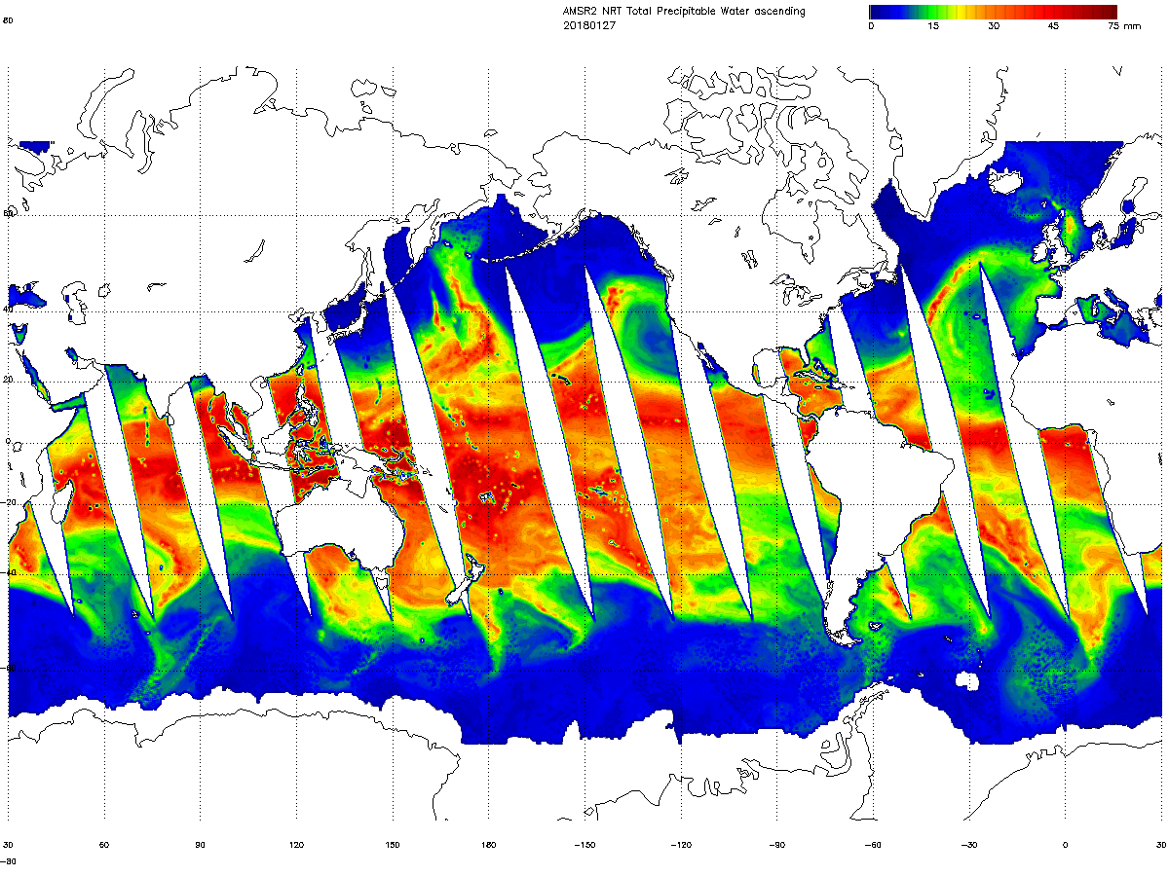
Total Precipitable Water (TPW)
AMSR-2 Total Precipitable Water: 2018/01/27
Definition:
Liquid water equivalent if all the water vapor were condensed within a column of the atmosphere
Observation Region:
global, over the oceans
excluding areas of sea ice and precipitation
Observation Range:
0-75 mm
0-75 kg/m²
0 15 30 45 75 (mm)
NOAA Operational GCOM-W1 AMSR-2 Product Maps
http://www.ospo.noaa.gov/Products/atmosphere/gpds/maps.html?GPLCT#gpdsMaps

Slide 6
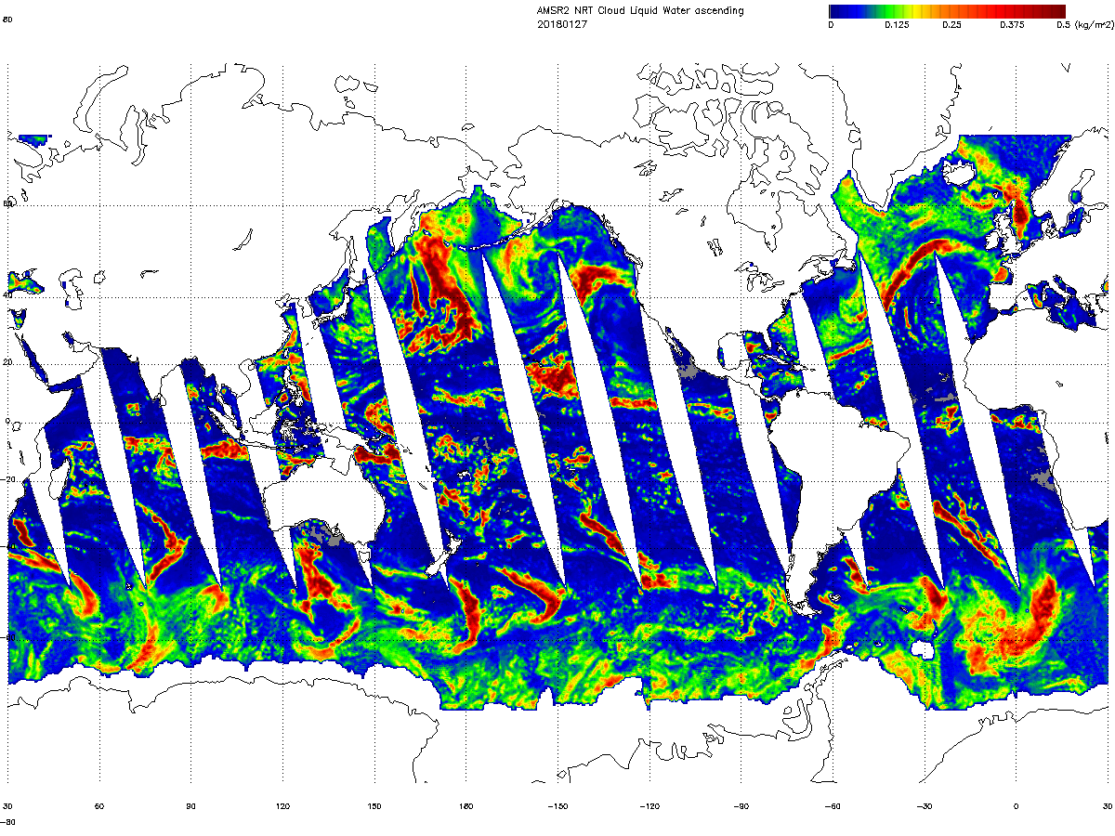
Cloud Liquid Water (CLW)
AMSR-2 Cloud Liquid Water: 2018/01/27
Definition:
Depth of water if all the cloud droplets were accumulated within a column of the atmosphere
Observation Region:
global, over the oceans
excluding areas of sea ice and precipitation
Observation Range:
0-1.0 mm
0-1.0 kg/m²
0 0.125 0.25 0.375 0.5 (mm)
NOAA Operational GCOM-W1 AMSR-2 Product Maps
http://www.ospo.noaa.gov/Products/atmosphere/gpds/maps.html?GPLCT#gpdsMaps

Slide 7
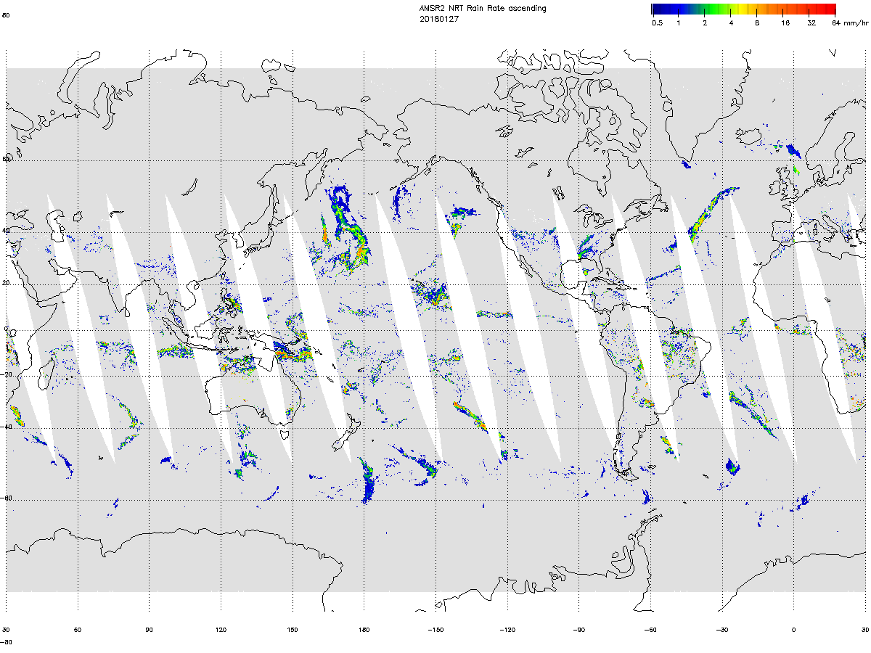
Rain Rate (RR)
AMSR-2 Rain Rate: 2018/01/27
Definition:
Depth of hourly rainfall at the ground surface
Observation Region:
tropical to mid-latitude
higher accuracy over ocean than over land
Observation Range:
0-50 mm/hr
0.5 1 2 4 8 16 32 64 (mm/hr)
NOAA Operational GCOM-W1 AMSR-2 Product Maps
http://www.ospo.noaa.gov/Products/atmosphere/gpds/maps.html?GPLCT#gpdsMaps

Slide 8
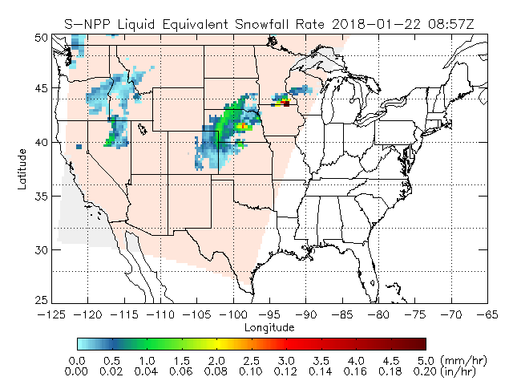
Liquid Equivalent Snowfall Rate (SFR)
S-NPP Liquid Equivalent Snowfall Rate: 2018/01/22 08:57Z
Definition:
Depth of hourly liquid equivalent of snowfall in the atmospheric column
Observation Region:
temperatures >7 °F
mid and high latitudes
Observation Range:
0.0012-0.2 in/hr (liquid)
https://cics.umd.edu/sfr/

Slide 9
Rain Rate from Infrared
Basic assumptions for opaque mid-latitude clouds:
Cloud-top temperature (IR) is related to cloud-top height
Cloud-top height is related to the strength of the updraft and rain rate
T_{b}= -73 °C
T_{b}= -61 °C
T_{b}= -50 °C
T_{b}= -43 °C
SatFC-G: GOES-R Rainfall Rate product (modified)
-70
-20
20
Warmer cloud tops ≈ lighter (or no) rain
Colder cloud tops ≈ heavier rain
Temperature (°C)

Slide 10

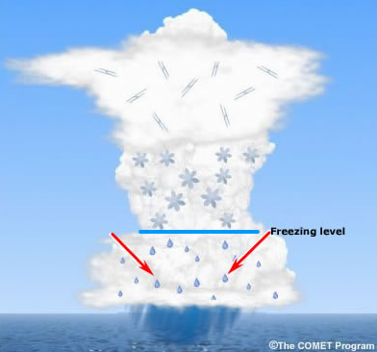
Microwave Interaction with Rain Cloud
36 GHz
89 GHz
Ice particles
Liquid raindrops
Scattering
ice particles
Higher frequencies (> 60 GHz)
hail / graupel
Absorption / emission
freezing level
Lower frequencies (< 22 GHz)
raindrops
(modified)
Displacement due to viewing geometry (parallax error) is greater for ice than for raindrops.
parallax error (raindrop)
parallax error (ice particle)

Slide 11
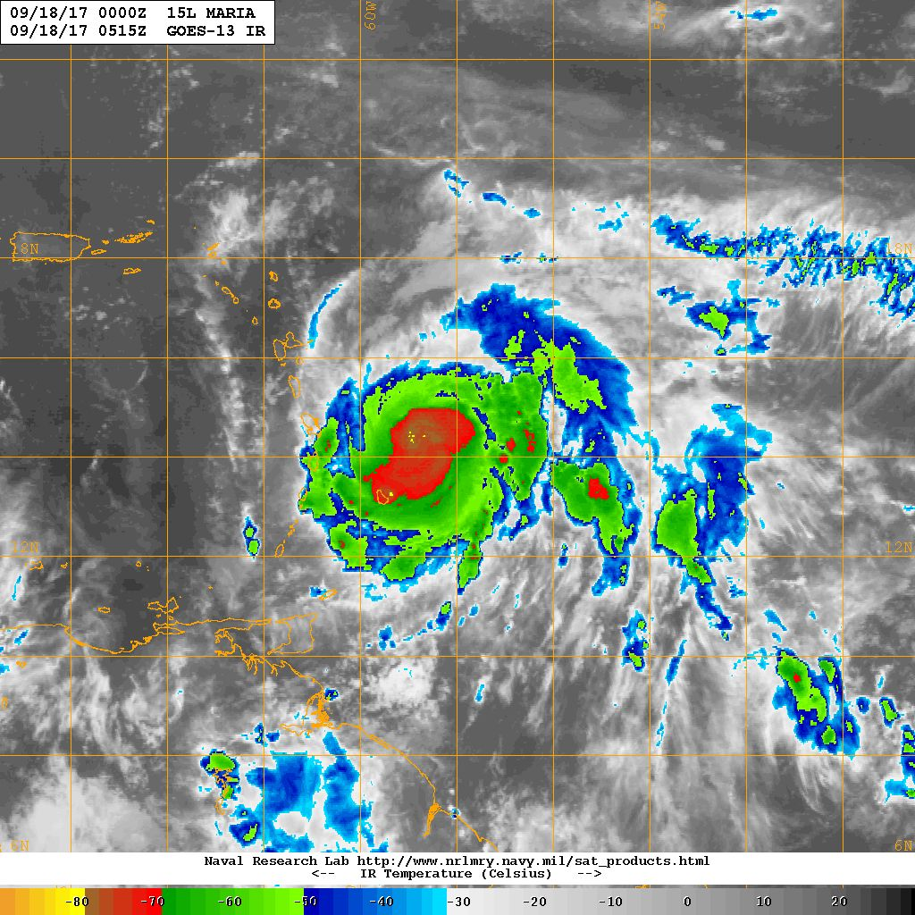
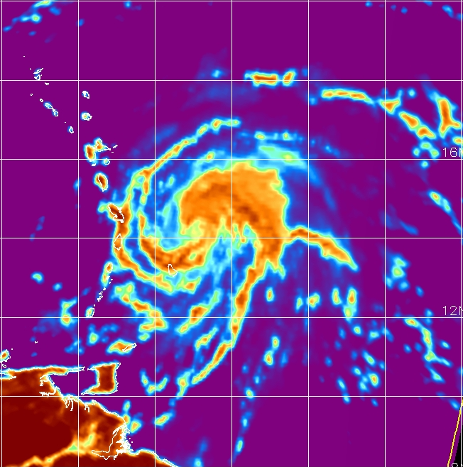
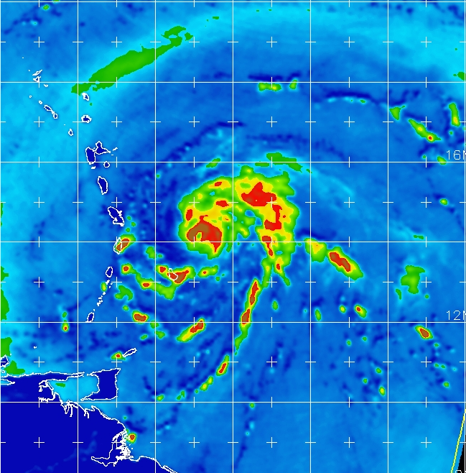
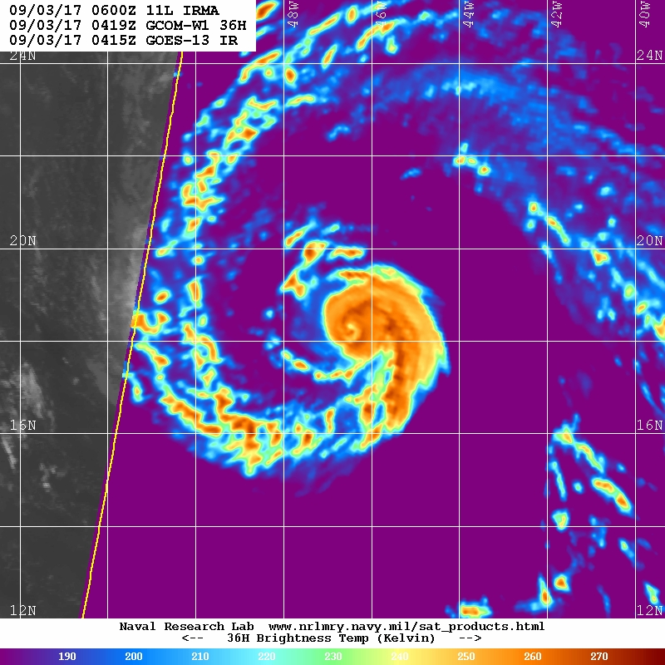
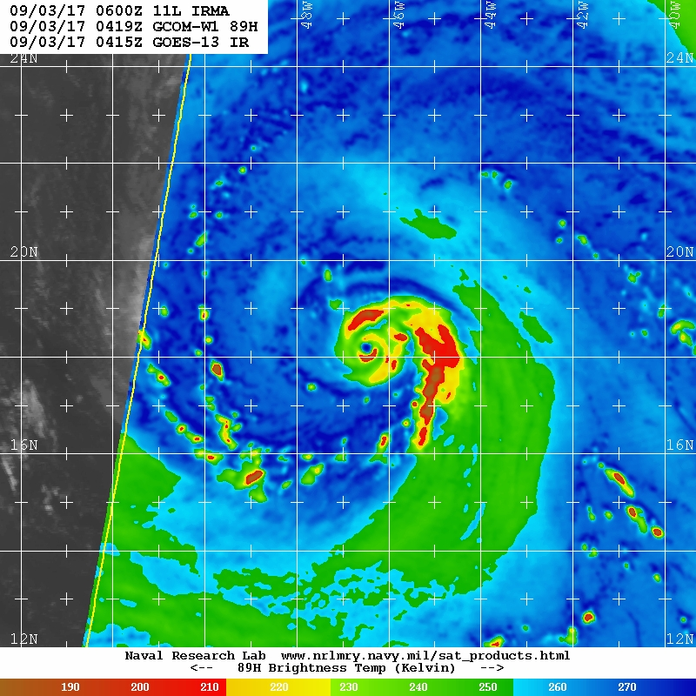
Tropical Cyclone Analysis
The low-level center and convective rain bands directly related to tropical cyclone intensity are often obscured by high clouds in visible, infrared, and water vapor imagery
~36 GHz able to sense clouds and moisture close to the surface
~89 GHz sensitive to both rain and ice rates
https://www.nrlmry.navy.mil/TC.html
Hurricane Maria: 18 September 2017
GOES-13 Infrared
AMSR-2 36 GHz H-pol
AMSR-2 89 GHz H-pol
60 W
56 W
16 N
12 N
0515 UTC
0516 UTC
0516 UTC
190 210 230 250 270 290
190 210 230 250 270
190 210 230 250 270
Brightness Temperature [K]
Brightness Temperature [K]
Brightness Temperature [K]

Slide 12
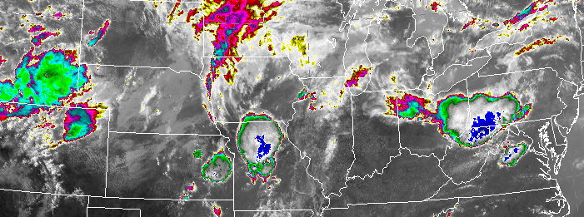
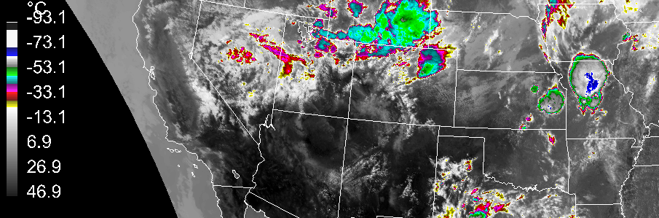
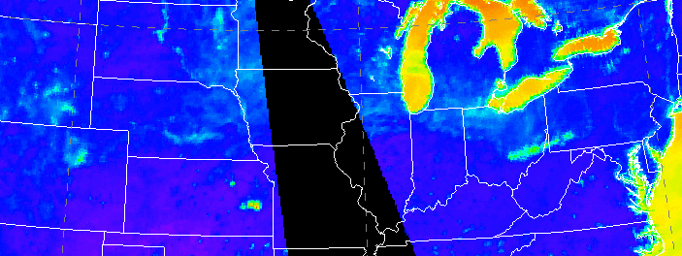
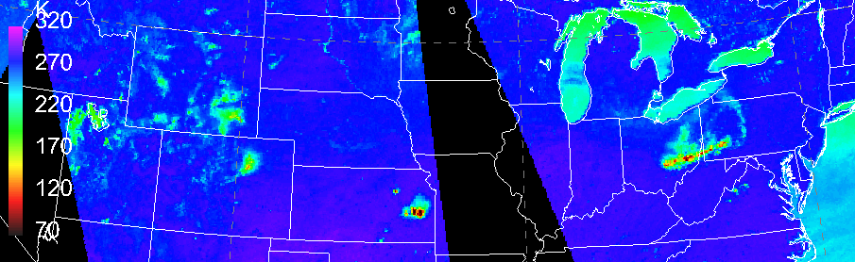
Thunderstorms
14 May 2018
Brightness Temperature
GOES-16 10.3 µm Infrared
-75
-50
-25
0
25
50
Precipitating clouds are not transparent
What makes brightness temperatures cooler over land surfaces?
36 GHz:
rain and wet ground
89 GHz:
rain, ice, and wet ground
2007 UTC
AMSR-2 36 GHz H-pol
[°C]
swath
gap
320
270
220
170
120
70
wet ground
60 W
56 W
predominantly
rain signature
2000 UTC
1822 UTC
AMSR-2 89 GHz H-pol
cold ice signature
[K]
2000 UTC
1822 UTC

Slide 13
Summary
Microwave products related to atmospheric moisture include:
Total Precipitable Water
Cloud Liquid Water
Rain Rate
Liquid Equivalent Snowfall Rate
The best precipitation estimation algorithms use a combination of:
infrared data from geostationary satellites (temporal advantage)
microwave data from polar-orbiting satellites (higher accuracy)
Precipitation estimation is more reliable over the ocean, which provides a cold contrasting background.

Slide 14

Resources
Microwave Remote Sensing: Clouds, Precipitation, and Water Vapor
https://www.meted.ucar.edu/training_module.php?id=226
A First Course in Atmospheric Radiation, 2nd Ed. (Petty 2006)
SatFC-G: GOES-R Rainfall Rate
http://rammb.cira.colostate.edu/training/visit/training_sessions/goes_r_rainfall_rate/
Questions? Email: Bernie.Connell@colostate.edu
Narrator: Erin Dagg
Editors: Erin Dagg, Bernie Connell
Other Contributors: Jorel Torres, Bob Kuligowski, Roger Edson

