Slide 1
WMO VLab GEONETCast Event
Introduction
Stephan Bojinski
World Meteorological Organization (WMO)
sbojinski@wmo.int
December 2013, GEONETCast Virtual Event Week
WMO; OBS/SAT
Notes:
It includes an introduction to WMO and its programmes; provides a description of the WMO Space Programme and its coordination of international data dissemination and product generation; introduces WMO-supported training in satellite meteorology through the VLab; describes efforts by WMO to improve user preparation to the new generation of satellites 2014-2018; sets in context the Event in the Americas and internationally; presents results of a recent WMO survey on the use of satellite data for the Americas; summarizes online resources provided by WMO for informing and guiding satellite data users.

Slide 2
Outline
Brief on WMO
Why this Event?
WMO Space Programme Coordination in:
  Data dissemination
  Requirements definition
  Training
  User preparation for new generation satellites
Online resources
Current challenges
WMO
Notes:
Brief on WMO – what important (brief) aspects of WMO we want the user to know.
Why are we having this event?
How does WMO help?
(Current challenges was left on this list, although I don’t think there is a slide on it anymore – BC)

Slide 3
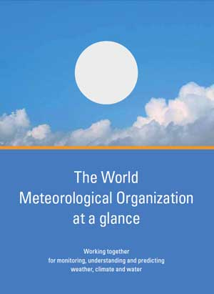
WMO at a glance
Specialized agency of the U.N. for meteorology (weather and climate), operational hydrology, and related geophysical sciences
Established in 1950
Membership of 191 states/territories
Governed by the Members
  Represented through the National Meteorological Service
Six Regional Associations
Secretariat located in Geneva
  ~ 250 staff
Notes:
Predecessor International Organization for Meteorology – 1873
A few states are membersof the UN but not the WMO, mostly because they do not have a meteorological service, on the other hand some territories (Hong Kong, ) are members of WMO but not the UN
Members – usually represented by presidents of the meteorological services,
Contrary to other UN organization, no great field presence, we have some regional offices

Slide 4
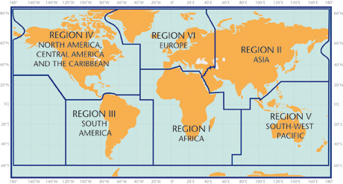
WMO at a glance
Notes:
This training focuses on WMO Regions III and IV. To make sure you are aware what we are talking about, this graph shows the various designations.

Slide 5
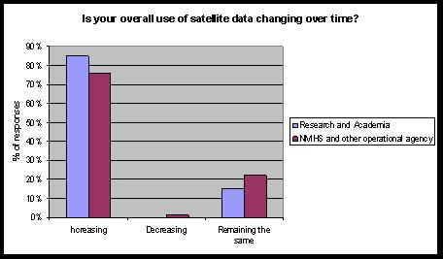
Why this event?
RA III/IV (Americas): Task Team on Satellite Data Requirements 2009-2011
http://satelite.cptec.inpe.br/geonetcast/es/datareq.html
Developed detailed requirements for satellite data access and exchange.
Identified high priority needs in the short term
Recommendations for sustainable response to needs in the long term
WMO 2012 Survey on the Use of Satellite Data
http://www.wmo.int/pages/prog/sat/documents/SAT-PUB_SP-9-Survey-Report-2012.pdf
Notes:
This talk focuses on some of the results of the survey, results from the task team will be presented next by Luis Machado.

Slide 6
WMO 2012 Survey Focus
3 Major Topics
Access to satellite data and products
Application and use of satellite data
Training on satellite data utilisation
227 responses from 95 countries
127 (56%) by National Meteorological and Hydrological Services (NMHS)
31 ((14%) from other operational government institutions
60 (26%) from research/academic institutions
9 (4%) from other non-government, commercial, and individuals.
Notes:
The 3 major areas that the survey addressed…
Although a majority of the responses were from Nat. Met. And Hydro. Services, input was received from other government institutions, research/academic institutions, and other entities.

Slide 7
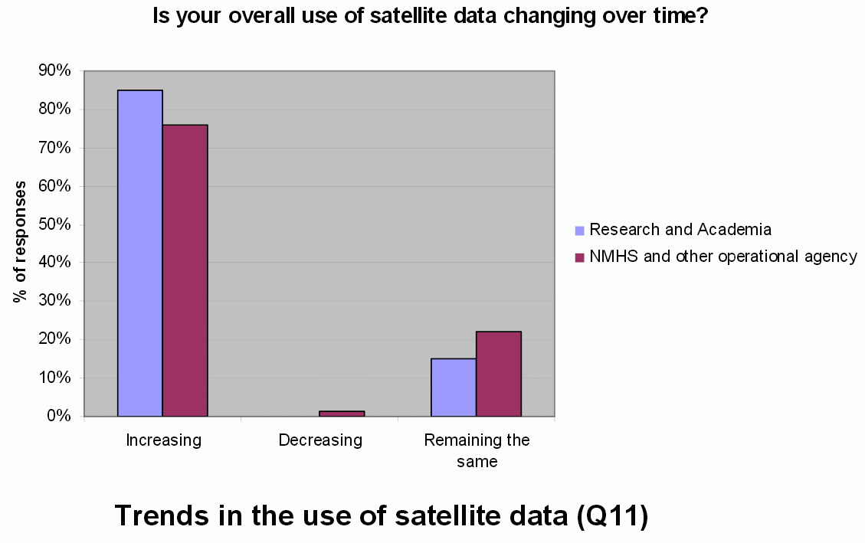
WMO 2012 Satellite User Survey
Notes:
Not surprisingly, most answered that their satellite data use is increasing over time.

Slide 8
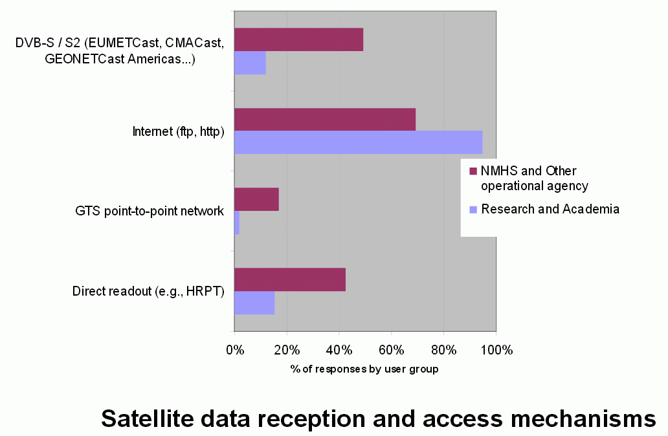
WMO 2012 Satellite User Survey
Notes:
What the acronyms mean:
DVB – S Digital Video Broadcast is used for GEONETCast
GTS – Global Telecommunication System
HRPT – High Resolution Picture Transmission
Highest usage is through the Internet, there is significant usage of some sort of rebroadcast or direct readout, particularly the NMHS that rely on the data. As we focus on GEONETCast for the Americas, we’ll revisit this slide.

Slide 9
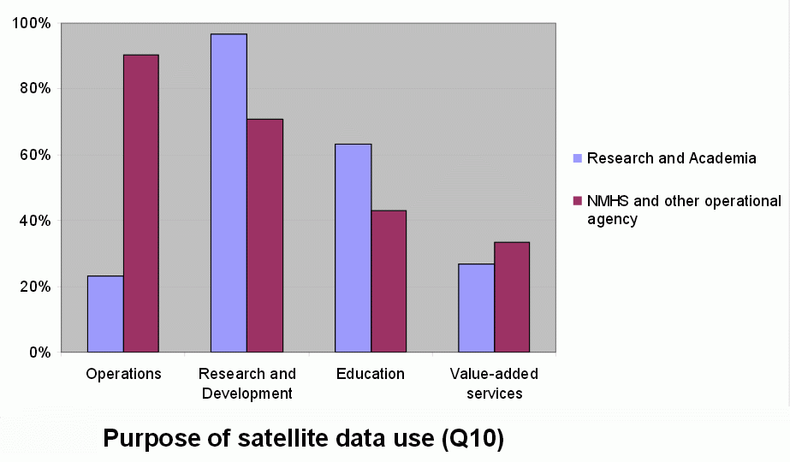
WMO 2012 Satellite User Survey
Notes:
Not surprising that the main purpose of satellite data for NMHS and operational agencies is operations, and the main purpose of satellite data for Reearch and Academia is Research and development. But it is interesting that many NMHS and operational agencies do quite a bit of R&D.

Slide 10
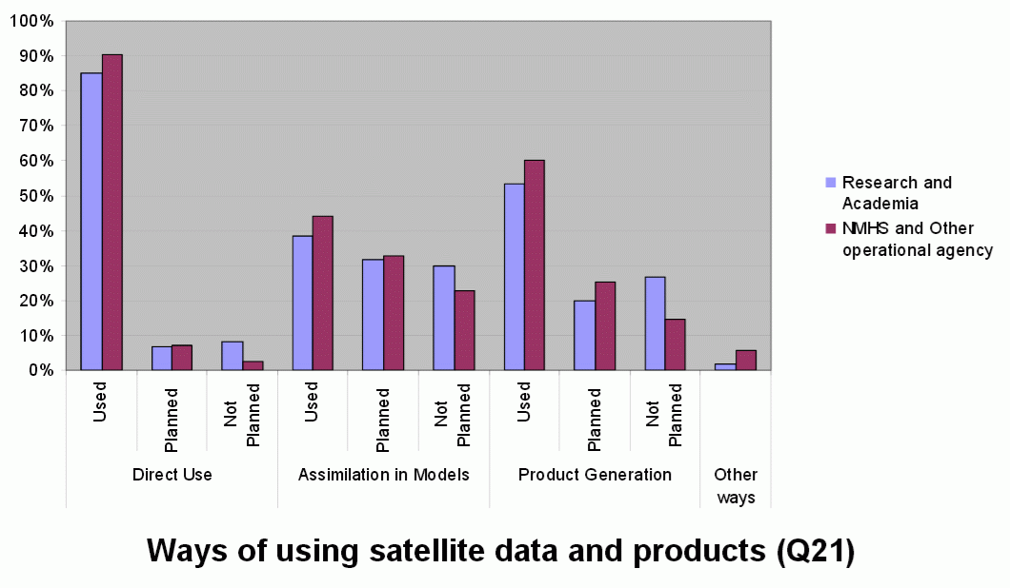
WMO 2012 Satellite User Survey
Notes:
Not sure if this was a trick question – what does direct use mean for Research and Academia – does it also include assimilation in Models? Nonetheless, the interesting aspect is that many NMHS are using satellite data to assimilate into models.

Slide 11
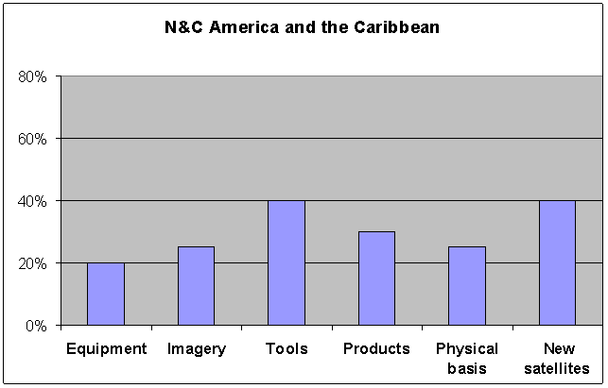
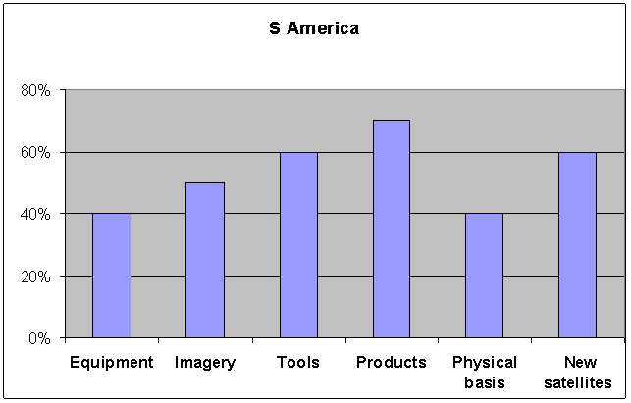
WMO 2012 Satellite User Survey: Regions III and IV
58 responses from 39 countries
Unmet training needs (NMS/operational users):
Notes:
The survey helps document that there are unmet training needs in a number of areas and this is where the work of the Regional Requirements documentation as well as the Vlab can step in.

Slide 12
WMO at a glance
Cooperation areas:
between National Meteorological and Hydrological Services, and partners
Observations
Applications
International standards
Data exchange
Research
Training and capacity building
Notes:
Meteorology and Hydrology are truly global issues and are more and more important for saving lives and property
« Weather and climate do not respect borders »
That is why one of the foremost objectives is to foster and support cooperation
This includes in particular observation networks
Defines standards for conducting measurements so that they can be comparable, publishes guides and manuals, defines standards for data exchange
Free data exchange is of course an ideal – as met data has an economical value and some is even relevant for national security, in practice we can

Slide 13



WMO at a glance
WMO carries out its work through its scientific and technical programmes.
Space Programme
World Weather Watch Programme
Hydrology
and water resources
Met applications
Climate applications
& services
Atm research
Disaster Risk Reduction Programme
Training and Education Programme
…
Notes:
Work of WMO is mostly carried out through programmes, which are sometimes more of a technical, or a scientific nature
Some of the programmes are focusing on specific aspects of WMOs mandate, such as…
Other programmes are by nature cross-cutting, which use input and / or support to other WMO programmes
In addition WMO also has a number of co-sponsored programmes, joint undertakings by WMO and other UN and scientific entities, the most well-known is certainly the IPCC
Should be noted that this is only showing a selection of main programmes

Slide 14
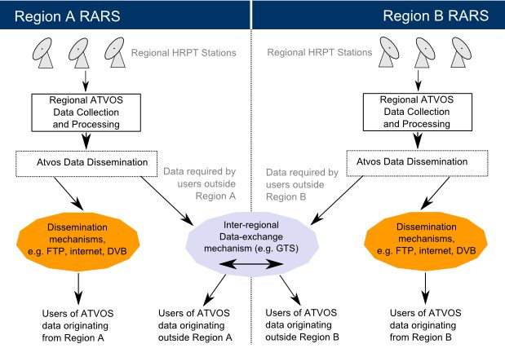
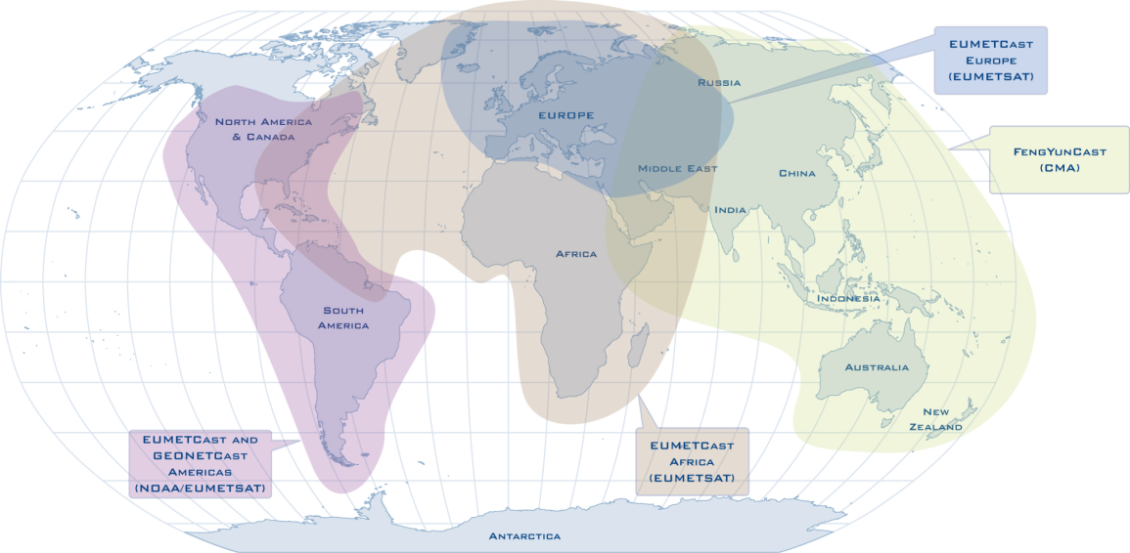
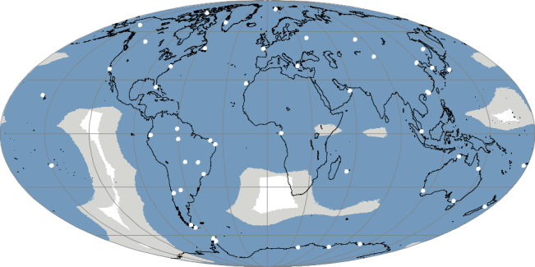
Data dissemination and access systems
Promote integrated dissemination services (e.g. GEONETCast; RARS)
Support standardization of Direct Readout services
Assist in utilizing receiving / processing equipment and software tools
Identify requirements for additional data to be disseminated
IGDDS
WIS
06/25/2009
Notes:
(IGDDS – Integrated Global Data Dissemination Service)
(WIS – Wmo Information System)
Manual on the WMO Information System: ftp://ftp.wmo.int/Documents/MediaPublic/Publications/Manual_on_WMO_Information_System_WMO_No_1060/1060_Manual_on_WIS_en.pdf
Guide to the WMO Information System:
http://www.wmo.int/pages/prog/www/WIS/documents/Guide-to-WIS-en.pdf

Slide 15
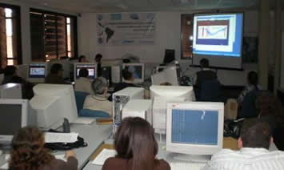

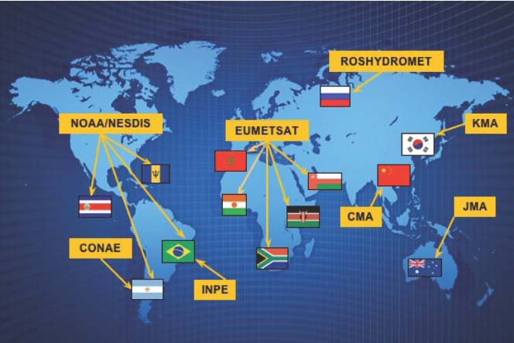
Education and Training
Capacity building
http://vlab.wmo.int
A network of 13 Centres of Excellence sponsored by 8 satellite operators
■ To provide training on meteorological and environmental satellite systems, data, products and applications;
■ To foster research and the development of applications for societal benefit at the local level by the National Met Services.
Notes:
The monthly focus group sessions that many of you attend are included under this umbrella. This GEONETCast training is under the Vlab umbrella.

Slide 16
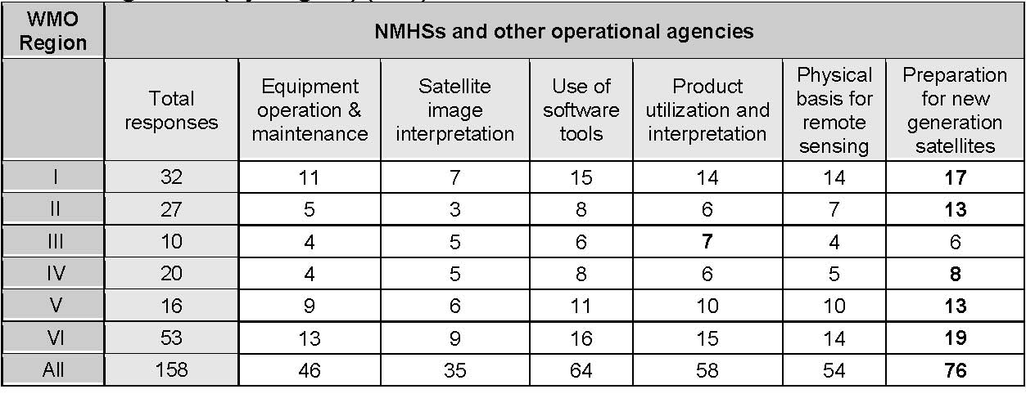
User preparation for new generation satellites
New generation of GEO imagers 2014-2018 on: Himawari-8/9, GOES-R, GEO-KOMPSAT, MTG
WMO 2012 Global Survey:
  48% of NMS/operational users feel inadequately prepared for new satellites
Notes:
CBS GUIDELINE FOR ENSURING USER READINESS FOR NEW GENERATION SATELLITES, CBS-15 Report (WMO-No. 1101)
http://www.wmo.int/pages/prog/sat/documents/SAT-GEN_CBS-15-GuidelineUserReadiness.pdf
It is a very appropriate time to address preparations for new satellites!

Slide 17
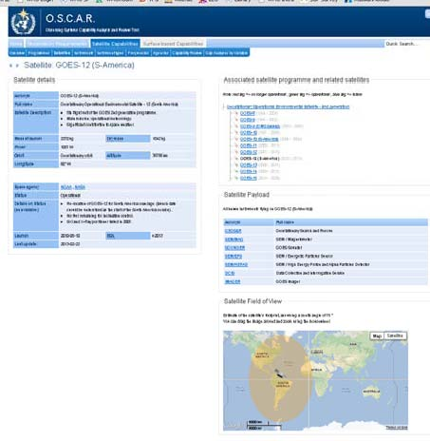
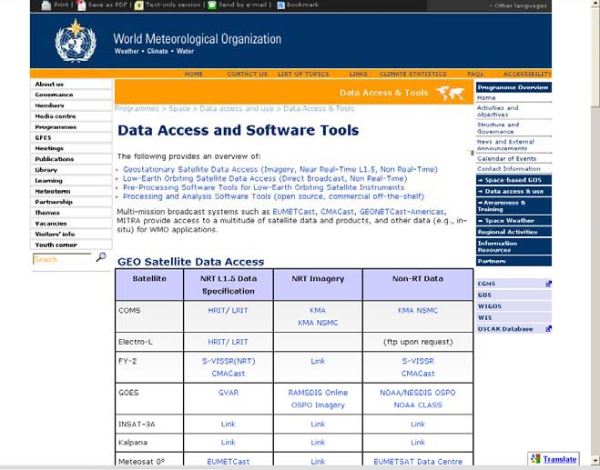
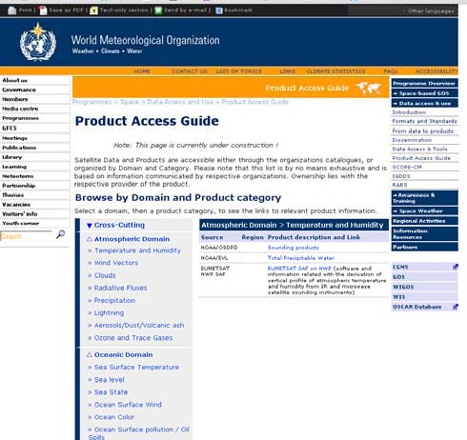
WMO Space Program online resources http://www.wmo.int/sat
OSCAR Observing
Systems Capability
Analysis and Review Tool
wmo.int/oscar
⇒Data access & use
Product Access Guide
(under development)
On right hand side, choose:
⇒Data access & use
Data Access & Tools
Notes:
BC comments – I went to the first link and easily found oscar, but didn’t easily find the other links, so I added comments on finding them.

Slide 18
Thank you for your attention
sbojinski@wmo.int
www.wmo.int/sat

