Slide 1
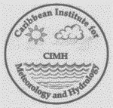
GEONETCast in the Caribbean
Training and Disaster Preparedness Activities

Slide 2
GEONETCast
The proposal for NOAA to support the installation of GEONETCast ground station has been long in coming;
The initial proposal suggested a second ground station at Caribbean Disaster and Emergency Management Agency (CDEMA)
The ground station will be installed at CIMH by early 2014;
Products available via GEONETCast; the applications are utilizing the existing ISCS antenna and modem;
Data resource site
a source of real time satellite data for the Member states of CMO
Education
GEONETCast products will be used in ALL CIMH courses.
Research
Products will be fully utilized in CIMH’s various research projects
Disaster Risk Management
GNC data for monitoring, response and recovery in disaster management
Notes:
the February Satellite Data Requirements Workshop held at the INPE facilities in Brazil, you had expressed an interest in participating in the proposal seeking funding for GEONETCast ground stations. I have attached information about the proposal and what you need to do in order to participate in it. We will need your information back to us by April 2 in order to submit the proposal by the due date.

Slide 3
Data resource site
GEONETCast (GNC) is a low cost alternative and risk-reducing backup for global satellite data access;
A possible good alternative to the reliance on the Internet.
GOES-R data is HR satellite data will mean traditional reliance on internet is not advisable
GOES –R receiving systems are expensive 250K to 400K
GNC is a possible solution but support from the region is needed to ensure NOAA ‘s continued and further support.
GNC does had real bandwidth issues:
GNC will aid as a CIMH data resource but not the main of satellite data;
In reality the volume of data proposed for future disseminated may be more than any system can handle (bandwidth, frequency, antenna size, cost etc.)
There is a 'loud' call for training.
Regional users to speak up and voice their needs and concerns.
Notes:
GEONETCast (GNC)- risk-reducing backup for global data access in case of failure of any one satellite system.
The onset of GOES-R data mean a great deal of HR satellite data will be available and traditional reliance on internet is not advisable
The new GOES –R receiving systems are expensive 250K to 400K plus –
GNC is a possible solution but support from the region is needed have NOAA ‘s continued and further support.
GHC does had real bandwidth issues
In reality the volume of data proposed for future disseminated may be more than any system can handle (bandwidth, frequency, antenna size, cost etc.)
There is a 'loud' call for training.

Slide 4
Education
Installation at CIMH is key to Training
CIMH will receive images and products for use by for staff and students to keep up on weather and other environmental aspects. .
Transfer of various satellite products
Transfer of CIMH products
Training is transitioning to GOES R and usage of data
Use in the growing number of CIMH’s on-line courses
Notes:
There are 2 aspects of GEONETCast - you can receive images and products to use at CIMH ( ie for staff and students to keep up on weather and other environmental aspects). As an institute of learning and partner in disaster efforts, you can also be a provider of products (which you currently provide through the Internet?) to be sent through GEONETCast as well as a provider of training resources.

Slide 5
Research
Products already available can aid in Climate variability research;
Model verification and integration of model data overlay on satellite imagery;
New research in tandem with the new radar network;

Slide 6
Disaster Risk Management
Applications GNC data in Disaster Management should be focused in the response and recovery phases.
The GNC can be important in the provision of near real time information on hazards
GNC Information can assist with hazard assessment, environmental monitoring and developmental planning.
will enhance the static and dynamic hazard specific geo-spatial data available on the Platform hence improving decision support systems in the region for a wide range of stakeholders including disaster management.
At CIMH data from GNC may be integrated on the DEWETRA Platform
Notes:
Based on the my understanding of Geonetcast I believe the applications for
disaster management are focused in the response and recovery phases.
The GeoNetCast may be important to disaster management through the
provision of near real time information on hazards to assist with hazard
assessment and providing a forum for enhanced environmental monitoring and
developmental planning.
The GeoNetCast can contribute to the response and recovery phases of the
disaster management cycle by providing additional information on the
impacted zone and other potential areas of impact, determining the type of
impact. This information will be critical for planning response actions
like prioritising aid, prepositioning teams and providing preliminary
estimates for emergency supplies,
If it can be directly uploaded to the DEWETRA Platform it will enhance the
static and dynamic hazard specific geo-spatial data available on the
Platform hence improving decision support systems in the region for a wide
range of stakeholders including disaster management.
I hope this helps, I have registered for 2 of the sessions next week so
that I can understand GeoNetCast a bit more.

Slide 7
Disaster Management Weather Briefing -Dewetra
The Caribbean Dewetra Platform –
a real-time data and information integrated system for hydro-meteorological risk forecasting and disaster risk mitigation.
It allows for the combination of data, forecast tools, procedures and expertise;
It provides decision makers with high resolution and up-to-date information of the expected and observed risk and vulnerability.

Slide 8
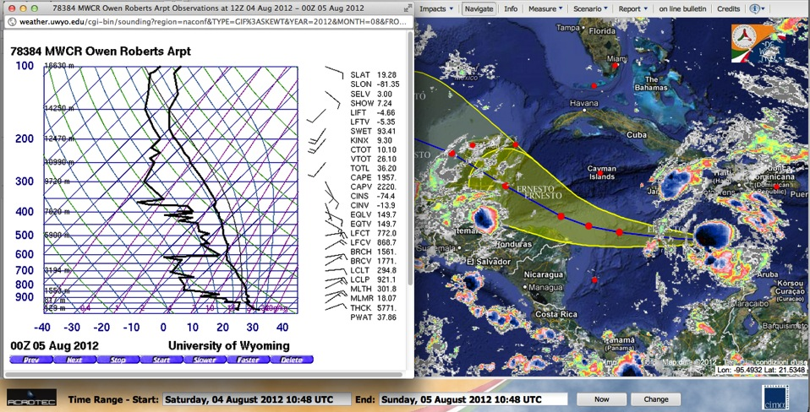
TS Ernesto : Cayman Islands Sounding 00UTC, 5 August 2012

Slide 9
Regional Issues
Funding is questionable
Resolving the bandwidth issues
Regional players unsure of the advantages of GNC;
Need to grow a GNC focal team

