Slide 1
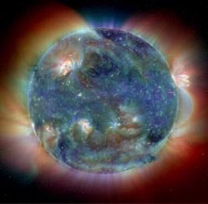
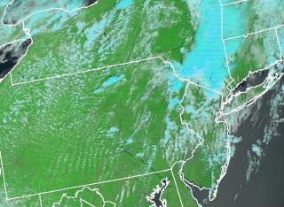
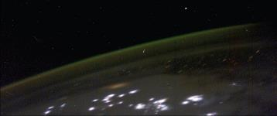
GOES-R highlights
NASA image ISS006-E-48196
Bernie Connell
bernie.connell@colostate.edu
Cooperative Institute for Research in the Atmosphere
Colorado State University
December 2013
Notes:
This presentation is designed to give a brief overview of what is coming for GOES-R. When we talk about GOES-R we are talking about the series. At this point the series consists of GOES R, S, T, and U. This presentation does not cover all the aspects of GOES-R. I hope to give you enough information so that you have a better idea of what is on the horizon and know where to look when you have questions.

Slide 2
Outline
Why and When?
How are we evaluating them now?
What Sensors and Capabilities?
What major changes are expected?
Examples – RGB viewing of ice cloud, water cloud, dust, ash, and airmass
Information Links
Notes:
We hope to briefly address:
Why are there changes and when will they happen?
How can we get ready for them now?
What sensors are we talking about and what are the expected major changes?
Just a few examples for the imager and of course, some information links.

Slide 3
Why GOES-R?
To replace the GOES N/O/P (13/14/15) series
To maintain continuity of the GOES mission
To provide significant increases in spatial, spectral, temporal, and radiometric resolution of products
Notes:
We are at the end of the GOES NOP series and we need to have something in place to maintain the continuity of the GOES mission. Over the last 10-15 years we’ve seen a dramatic increase in many aspects of technology, so it in not a surprise that we will see significant increases in spatial, spectral, temporal, and radiometric resolution of resolution of products. Before we move on to the next slide, I’d like to point out that before a satellite is launched, we refer to it with a letter. After it is launched, we give it a number. So you are more familiar with GOES-13 which is our east satellite (which was GOES N before it was launched)

Slide 4
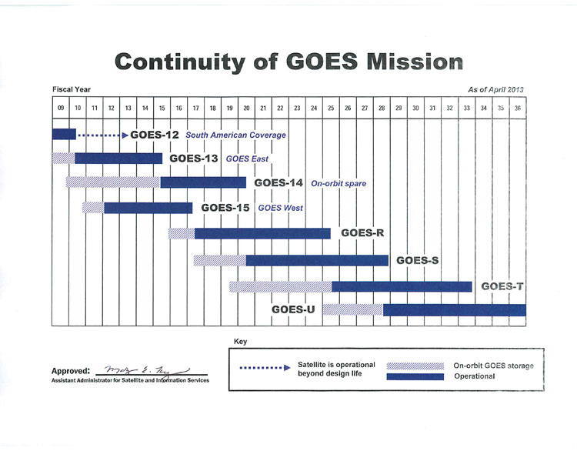
When?
http://www.nesdis.noaa.gov/FlyoutSchedules.html
Notes:
4
GOES R will be launched in ~ 2 years (end of 2015 or early 2016).
GOES S is scheduled for launch in 2017.
GOES-12 ran out of fuel and was decomissioned this past August (2013)
GOES-13 is the east satellite and GOES-15 is the west satellite. GOES-14 is the spare.

Slide 5
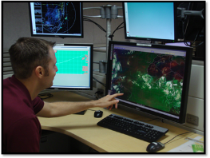
How is the USA getting ready? Proving Ground + Training
research operations
Infuse GOES-R like channels, products and techniques into NWS operations
Encourage dialogue and feedback between developers and users.
http://cimss.ssec.wisc.edu/goes_r/proving-ground.html
Notes:
Through training and through an activity called the Proving Ground.
When GOES-8 was launched, the imagery did not getting into forecast offices right away. The satellite is a significant investment and a valuable resource to use. This time for the new GOES series, effort is being put into research and development to make sure the end user is prepared to use the new data and products. But it is not stopping there, the user is looking at what is being presented to them and giving feedback to the developer.
Picture – Hurricane specialist Eric Blake

Slide 6
GOES-R
Which Sensors and Capabilities?
Communication Capabilities
HRIT/EMWIN, DCS, SARSAT, GRB
Solar and Space Environment
SUVI, EXIS, SEISS, MAG
Geostationary Lightning Mapper (GLM)
Advanced Baseline Imager (ABI)
Notes:
Here is a list of the sensors that will be on GOES-R. Some of these components may not be familiar to you but are very important to ensure the flow of data and products that you and your customers and others have come to depend on. Did you know that the current GOES already has communication capabilities and Space Environment monitoring? In the future, these capabilities will be enhanced.
This is the first time there will be a lightning sensor on a geostationary platform. And our new imager will be called the advanced baseline Imager or ABI for short.

Slide 7
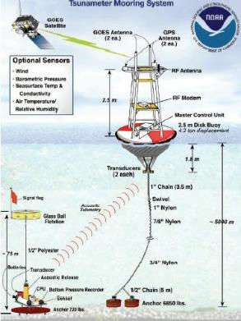
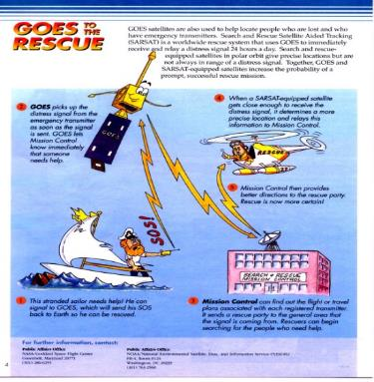
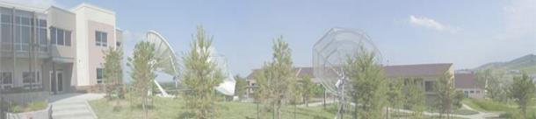
Communication Capabilities
Improved user services for direct readout:
GOES-R services include:
HRIT/EMWIN – High Rate Information Transmission / Emergency Managers
Weather Information Network
DCS--Data Collection System
GRB – GOES Rebroadcast
Follow on of L-Band GVAR
SARSAT--Search and Rescue Satellite
Aided Tracking
Notes:
Many people are unaware of these auxiliary services that GOES provides. Currently there is a Low Rate Information Transmission which will be increased to a High Rate. There will be a continuation of the Emergency Managers Weather Information Network (EMWIN) and the Data Collection System (DCS) – again at higher data rates than currently. GOES will also continue to have the capability to relay distress signals activated from emergency beacons for SARSAT
Higher Data Rates for LRIT, EMWIN, DCS, and GRB
EMWIN/LRIT Combination
Desired Growth Requirements for GOES-R:
EMWIN: 19.2 → 128 Kbps
LRIT: 128 → 256 Kbps
Proposed GOES-R solution:
EMWIN and LRIT combined with a data rate of 400 Kbps

Slide 8
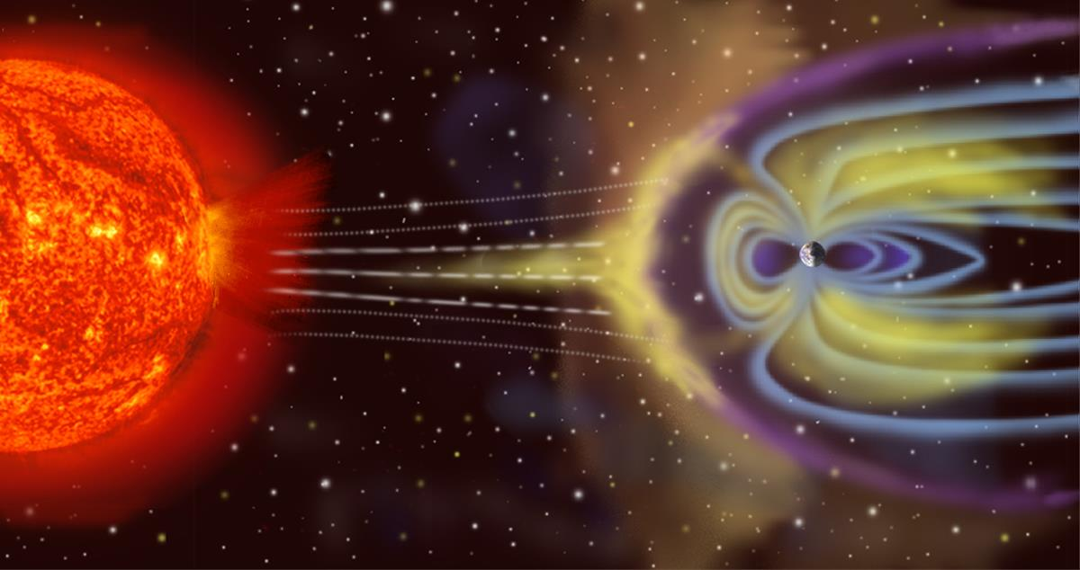
Why are we interested in Space Weather?
Earth-Space Activities disrupted by solar and geomagnetic events
Satellite operations
Navigation
Space Station activities
High-altitude polar flights
Electric power distribution
Long-line telephone communication
HF radio communications
Pipeline operations
Geophysical exploration
NOAA/NWS Space Weather Prediction Center
http://www.swpc.noaa.gov/ check out the Education/Outreach link
Notes:
Why are we interested in the Sun and in Space Weather? Because it can and does affect many day to day satellite operations as well as other aspects of “technology” that we rely on. If significant solar events are detected, equipment can be put in “safe”mode. If GPS measurements are disrupted, navigation will be off. Increased radiation poses health problems for space station activities as well as polar air flights – these can be minimized when extra solar activity is detected.
GOES Satellite Instruments: X-ray, Proton, Electron, Magnetometer, Solar X-ray Imager
Space Environment TOPICS SE-11 - Navigation: http://www.swpc.noaa.gov/info/Navigation.pdf Interesting brief article on how terrestrial and satellite based navigation systems are affected by solar and geomagnetic activity.
Space Environment TOPICS SE-10 – Radio Wave Propagation

Slide 9
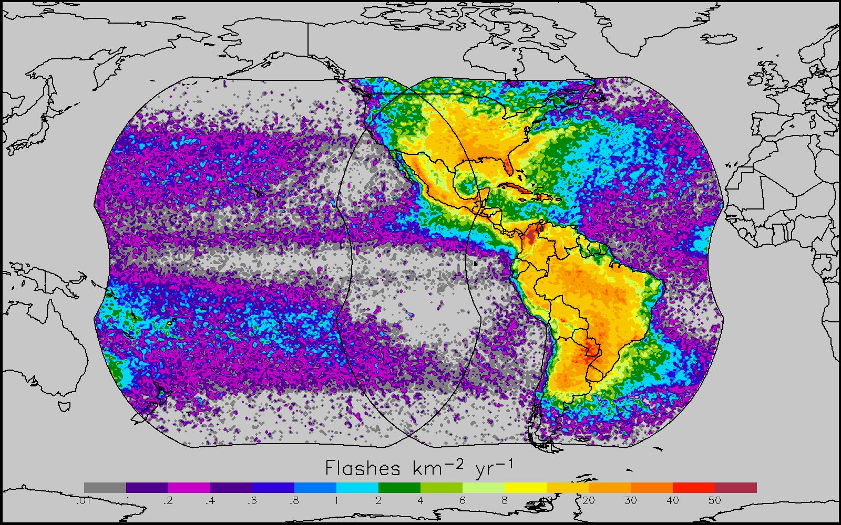
Geostationary Lightning Mapper (GLM)
An estimate of the annual climatological lightning density in the GLM viewing areas.
Notes:
This is an estimate of the annual climatological lightning density in the GLM viewing areas. Values are estimated from polar orbiting sensors: the Lightning Imaging Sensor (LIS) on TRMM and Optical Transient Detector (OTD) Both visibly detect lightning. After we get a geostationary sensor, it will be interesting to compare with this image to see what we have been missing.

Slide 10
GLM
Detects total strikes: in cloud, cloud to cloud, and cloud to ground
Compliments today’s land based systems that only measure cloud to ground lightning (about 15% of the total)
Compliments today’s research based polar orbiting systems.
Increased coverage over oceans and dead zones over land
Beneficial for aviation convective weather hazards
Notes:
The GLM will detect total strikes
It will compliment todays land based and polar orbiting systems
It will increase coverage over oceans and in areas where there are currently no measurements.
Dr. Steve Goodman, the program scientist for GOES-R mentions that one of the selling points for the sensor was that it will help with aviation convective weather hazards over the oceans.

Slide 11
ABI: Advanced Baseline Imager
Increased resolution
temporal
spatial
spectral
radiometric
Better navigation
Notes:
You will most notice the increased temporal, spatial and spectral coverage. If you are research orientated, you will appreciate the increased radiometric resolution even more. There will also be better navigation capabilities.

Slide 12
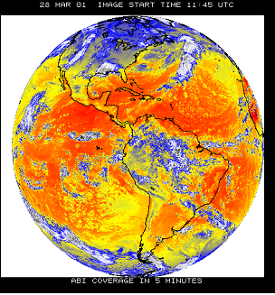
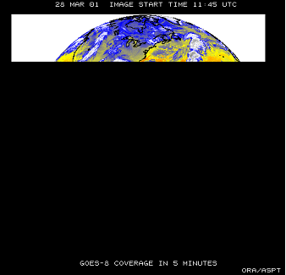
Increased Imaging Capability
5 Minute Coverage
Current GOES-I/P
GOES-R
ABI Scan Modes
15 minute cycle
1 Full Disk
3 CONUS
1000km x 1000km every 30 seconds
Continuous 5 minute
Full Disk
1/5 Disk
Full Disk
Notes:
It currently takes 26 minutes (26:06) for the current GOES to make a full disk scan. With GOES-R , a full disk scan will take only 5 minutes. Schedules are not fully determined yet, but at the minimum, there will be a full disk scan every 15 minutes.
Current ABI
Full disk Every 3 hours Every 15 min.
CONUS ~Every 15 min. Every 5 min.
Mesoscale n/a Every 30 sec.
Mode 3 vs Mode 4
Mode 3 – in 15 minutes: on FD, CONUS 3 times (every 5 minutes) and 1000km x 1000km every 30 seconds
Mode 4 – 5 minute FD

Slide 13
The Advanced Baseline Imager:
MAJOR changes in spectral coverage AND spatial resolution
ABI Current
Spectral Coverage
16 bands 5 bands
Spatial resolution at nadir
0.64 μm Visible 0.5 km Approx. 1 km
Other Vis/near-IR 1.0 & 2.0 km n/a
SW, WV & LW IR 2.0 km Approx. 4 km
(bands > 2µm)
Notes:
We will go from the current 5 bands to 16 bands: In the visible and near infrared region, we will go from 1 band to 6 bands; In the short wave, water vapor, and long wave infrared, we will go from 4 to 10 channels. Currently our visible resolution is 1 km – that will increase to 0.5 km for the same wavelength. In the SW, WV, and LW region, we will go from 4km resolution down to 2 km resolution.

Slide 14
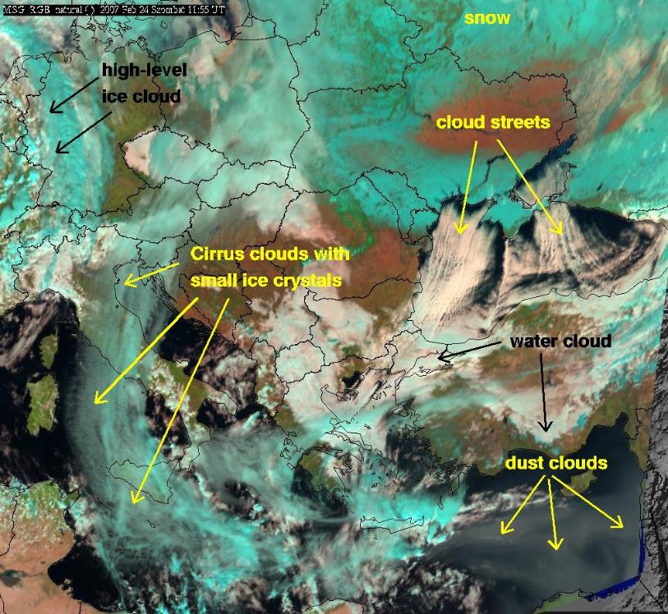
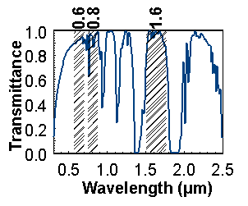
METEOSAT
Second
Generation
24 Feb. 2007
11:55 UTC
RGB:
NIR 1.6
VIS 0.8
VIS 0.6
MSG RGB 2007 Feb. 24: 11:55 UTC
water
Copyright 2007 EUMETSAT
Cloud streets over the Black Sea (24 February 2007) by Mária Putsay, Kornél Kolláth and
Ildikó Szenyán, Hungarian Meteorological Service
Notes:
Now a few examples that highlight some of the capabilities of the ABI:
This is a color image that is called an RGB image : different channels are put on the red, green, and blue colors to create it. If you want to know more about this, COMET has a module on RGBs and the reference is at the end of this Presentation. The European satellite has many of the same channels that we will have with GOES-R, so one of the first things we are doing is becoming familiar with what is already available. This one is often called natural color. It uses 2 visible channels and one near IR channel. As you can see, vegetated areas are green, the water is dark, low clouds are white, high ice clouds and snow are cyan.
Cloud streets over the Black Sea (24 February 2007) by Mária Putsay, Kornél Kolláth and Ildikó Szenyán (Hungarian Meteorological Service)

Slide 15
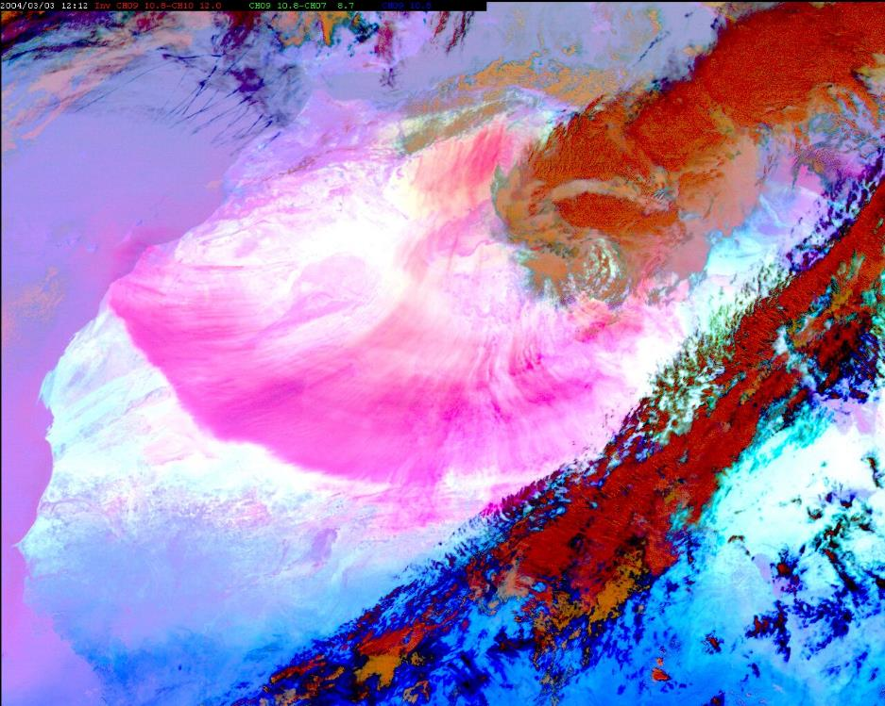
METEOSAT-8
3 March 2004 12:00 UTC
RGB Composite
IR12.0 – IR10.8
IR10.8 – IR8.7
IR10.8
EUMETSAT Satellite Image of the Month
Dust storm over Western Africa and the Canary Islands
Copyright 2004 EUMETSAT
Notes:
There is at least 1 MODIS pass on the west coast of Africa for this event. (March 3 at 1415 UTC). No individual author listed on the web pages.

Slide 16
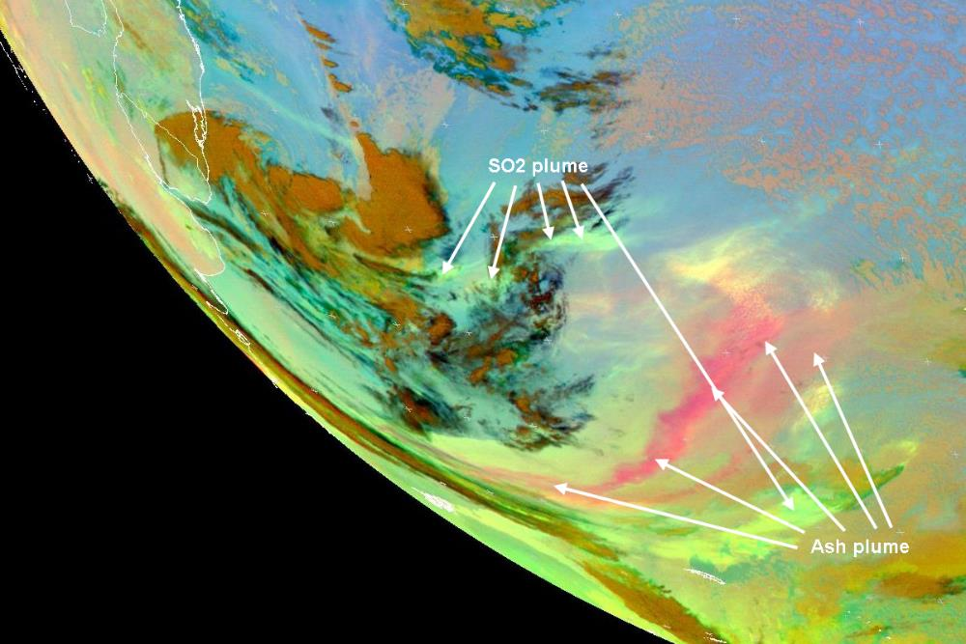
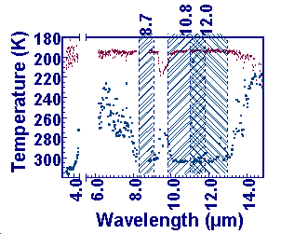
Source: EUMETSAT Satellite Image of the Month
Eruption of the Chaitén volcano in Chile (2-9 May 2008)
HansPeter Roesli and
Jochen Kerkmann
RGB composite
12-10.8
10.8-8.7
10.8
Copyright 2008 EUMETSAT

Slide 17
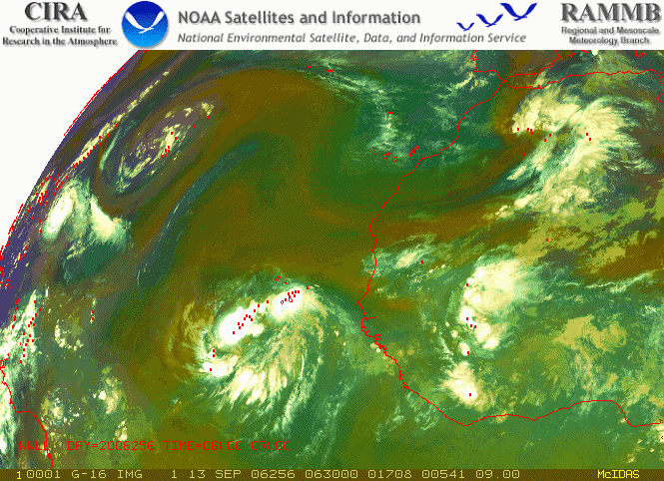
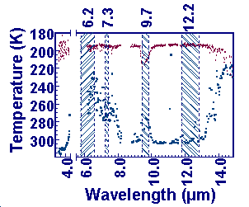
RGB Air Mass Product
RGB composite
6.2-7.3
9.7-12.2
6.2
Example courtesy of John Knaff, NOAA/NESDIS/STAR/RAMMB
Notes:
This is an example of the ABI-based AIR MASS product again patterned after similar products available from MSG. The green areas are tropical air masses characterized by low ozone levels, the red colors are associated with dryer regions and the blue colors indicate the temperature associated with cold air.
This ABI – based product is created by
Red – shows the difference between Channel 8 (6.2um) and Channel 10 (7.3um) scaled from -29C to -4C
Green – shows the difference between channel 11 (9.7um) and channel 15 (12.2um)
Blue – is the channel 8 scaled from 243 K to 208 K
Hourly lightning from WWLLN is show in red.

Slide 18
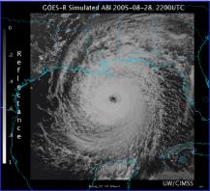
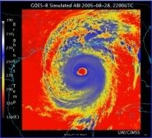
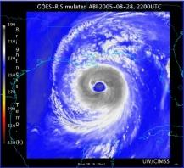

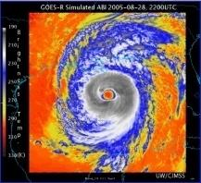
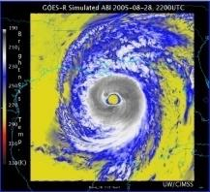
Corresponding current Imager bands of Hurricane Katrina
0.65 μm
NOAA/NESDIS STAR and
GOES-R Imagery Team
3.9 μm
6.5 μm
10.7 μm
13.3 μm
Notes:
Currently there are 5 channels on GOES

Slide 19
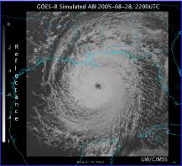
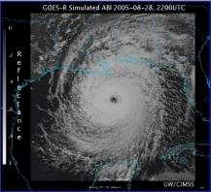
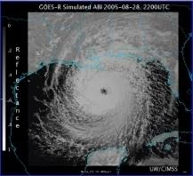
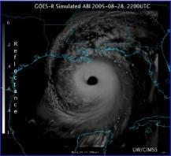
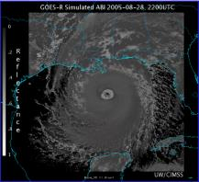
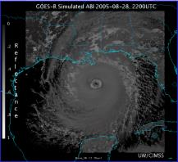
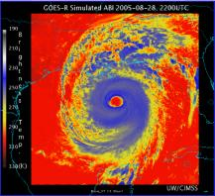

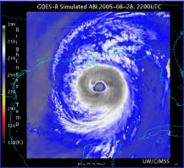
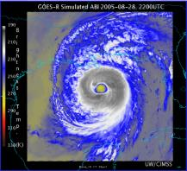
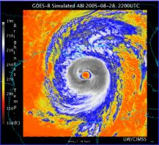
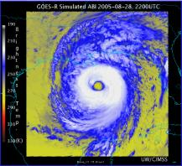
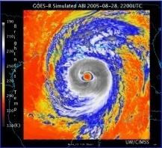
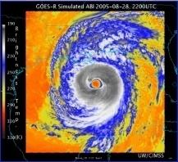

AWG Proxy ABI Simulations of Hurricane Katrina
0.47 μm
0.64 μm
0.86 μm
1.38 μm
NOAA/NESDIS STAR and
GOES-R Imagery Team
1.61 μm
2.26 μm
3.9 μm
6.19 μm
6.95 μm
7.34 μm
8.5 μm
9.61 μm
10.35 μm
11.2 μm
12.3 μm
13.3 μm
Notes:
With GOES-R, there will be 16 channels!

Slide 20
Summary
New instruments and capabilities:
Solar, Communication,
Geostationary Lightning Mapper (GLM),
and Advanced Baseline Imager (ABI)
Launch in late 2015
Operational 2017 or beyond
GOES-R Home Page http://www.goes-r.gov/

Slide 21
Links
GOES-R Home Page
http://www.goes-r.gov/
GOES-R Proving Ground
http://cimss.ssec.wisc.edu/goes_r/proving-ground.html
SHyMet module: GOES-R 101
http://rammb.cira.colostate.edu/training/shymet/forecaster_goesr101.asp
COMET module: Benefits of GOES-R
https://www.meted.ucar.edu/training_module.php?id=509
COMET module: GOES-R ABI
https://www.meted.ucar.edu/training_module.php?id=987
COMET module: RGB Products Explained
https://www.meted.ucar.edu/training_module.php?id=568
EUMETSAT Image Gallery
http://www.eumetsat.int/Home/Main/Image_Gallery/index.htm?l=en
Near Real Time MODIS images:
http://lance-modis.eosdis.nasa.gov/cgi-bin/imagery/realtime.cgi

Slide 22
ABI Visible/Near-IR Bands
GOES-R imager band | Wavelength range (µm) | Central wavelength (µm) | Nominal subsatellite IGFOV (km) | Comments for daytime viewing
1 | 0.45-0.49 | 0.47 | 1 | “blue” visible Aerosol over land
2 | 0.59-0.69 | 0.64 | 0.5 | GOES heritage “red” visible High res animations
3 | 0.846-0.885 | 0.865 | 1 | Vegetation state Aerosol over water
4 | 1.371-1.386 | 1.378 | 2 | Cirrus/upper level cloud
5 | 1.58-1.64 | 1.61 | 1 | Cloud-top phase and particle size Snow distinction
6 | 2.225-2.275 | 2.25 | 2 | Distinguish land, cloud, snow, and ice properties
Schmit et al, 2005
Notes:
Information for this table was gleaned from Schmit, T. J., M. M. Gunshor, W. P. Menzel, J. J. Gurka, J. Li, and A. S. Bachmeier, 2005: Introducing the next-generation Advanced Baseline Imager on GOES-R. Bull. Amer. Meteor. Soc., 86, 1079-1096.
ABI will have 16 channel. This table shows the first 6. From our geostationary perspective, 5 of these channels will be new.
As we get more channels, it becomes a little more difficult to summarize in a table such as this the sample or primary uses because there are many uses depending on what you want to see. We can say that all these channels will view clouds, the exception being that channel 4 will not generally see the lower cloud or surface features because of water vapor absorption in this region. We can make a few general comments. The 2nd channel at 0.64 micrometers is very close to what is currently on GOES and is a “heritage” channel. It is most closely associated with the “red” portion of the visible regions. I say this because the visible spectrum is continuous and therefore there are no clear boundaries between one color and the next. The ranges for various colors are an approximation and sometimes will be different depending on the source of information. Band 1 with a central wavelength of 0.47 um associates most closely with the blue portion of the visible spectrum. The other channels are beyond the visible part of the spectrum that our eyes can detect. ABI will not have a “green” band so we cannot create a “true” color image. Experimental work by Steve Miller indicates that we can simulate the “green” band from correlation between the red, blue, and the 0.865 channel and what results when compared with the true RGB from other satellites that have the channels such as is on MODIS.. The channels in this tables have very similar counterparts on MODIS, the polar orbiting satellite, and most of the channels depicted here have counterparts on the Severi instrument of Meteosat Second Generation (MSG), which is the Geostationary European Meteorological Satellite. This allows us to see and experiment with what our European counterparts have discovered and also take advantage of what MODIS has available at higher spatial resolution, but lower temporal resolution. If you have not seen Scott Bachmeier’s VISIT session on MODIS products in AWIPS, I recommend you check it out. The Europeans now use many color composites of the various channels for interpretation and we’ll throw in a few here. One other item they have commented on is the high resolution visible imagery at 1 km (they went from 3 km to 1 km? ) Notice that we will have increased resolution for the GOES “heritage” channel (from the current 1 km to half km). This is one channel that we will not be able to get real-time examples of, but from what I see at half km MODIS imagery, I look forward to half km geostationary imagery. To help explain better what we will be seeing with these various channels and why they are important, I will use examples from other multispectral and hyperspectral platforms. .. A quick definition of the difference between the two:

Slide 23
ABI IR Bands
Schmit et al, 2005
GOES-R imager band | Wavelength range (µm) | Central wavelength (µm) | Nominal subsatellite IGFOV (km) | Comments
7 | 3.80-4.00 | 3.90 | 2 | GOES imager heritage
8 | 5.77-6.6 | 6.19 | 2 | GOES imager heritage
9 | 6.75-7.15 | 6.95 | 2 | GOES sounder heritage
10 | 7.24-7.44 | 7.34 | 2 | GOES sounder heritage with spectral modifications
11 | 8.3-8.7 | 8.5 | 2 | Cloud-top phase Ash/dust, SO₂, sulfates
12 | 9.42-9.80 | 9.61 | 2 | Ozone. GOES sounder heritage with spectral modifications
13 | 10.1-10.6 | 10.35 | 2 | Surface and cloud temperatures, low level moisture, dust and volcanic ash
14 | 10.8-11.6 | 11.2 | 2
15 | 11.8-12.8 | 12.3 | 2
16 | 13.0-13.6 | 13.3 | 2 | Heritage from GOES imager and sounder: temperature, cloud characteristics.
Notes:
Information gleaned from Schmit, T. J., M. M. Gunshor, W. P. Menzel, J. J. Gurka, J. Li, and A. S. Bachmeier, 2005: Introducing the next-generation Advanced Baseline Imager on GOES-R. Bull. Amer. Meteor. Soc., 86, 1079-1096.
These are the short wave to mid-wave infrared channels.

