Slide 1
McIDAS-V
The 5th Generation of McIDAS
by
Tom Whittaker
Space Science and Engineering Center
University of Wisconsin-Madison
USA
with contributions from
HansPeter Roesli
EUMETSAT
Germany
December, 2013

Slide 2
McIDAS
Man-computer Interactive Data Access System
More than 30 years of evolution
  “A” is transitioning from “Access” to “Analysis”
Originally developed for satellite-derived winds
Was the first “GIS” system and longest lived
Now in its 5th generation, named: McIDAS-V
  Based on the IDV from Unidata
  Core is VisAD from Bill Hibbard
  Freely available for download and use
  Multi-platform (Windows, Linux, OS-X)
  On-line User Support Forum, Documentation, Tutorials

Slide 3
Many Types of Display and Analyses
Data plots
Contour & streamlines
Color-filled contours
Vertical cross sections and transects
Data probes – vertical, time, etc.
3D surfaces
Python scripting and background processing
…and many more….

Slide 4
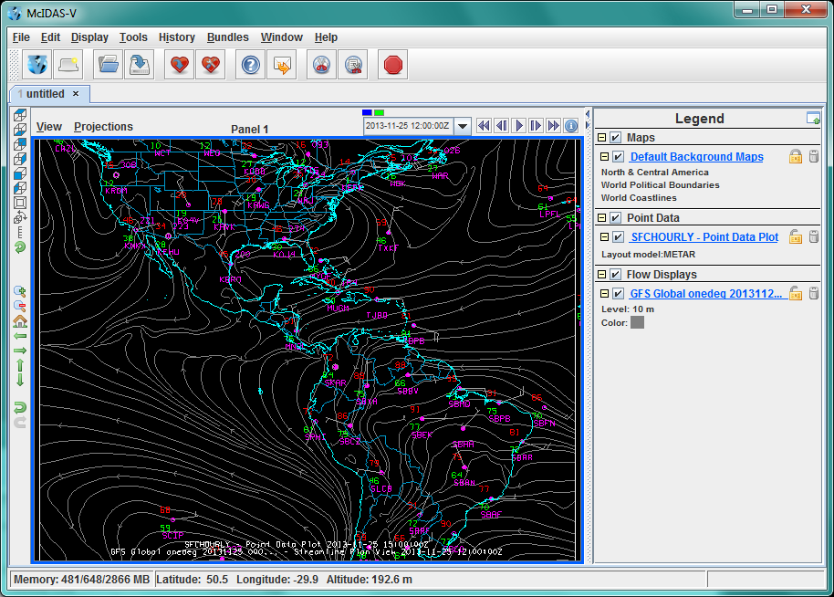
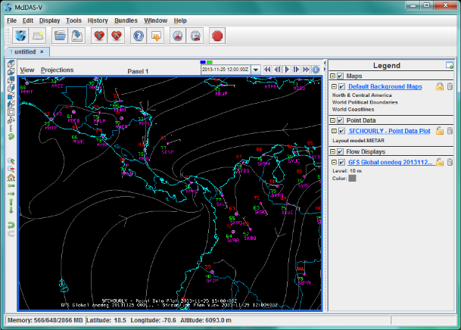
Surface
Data
Plot
…and Streamlines

Slide 5
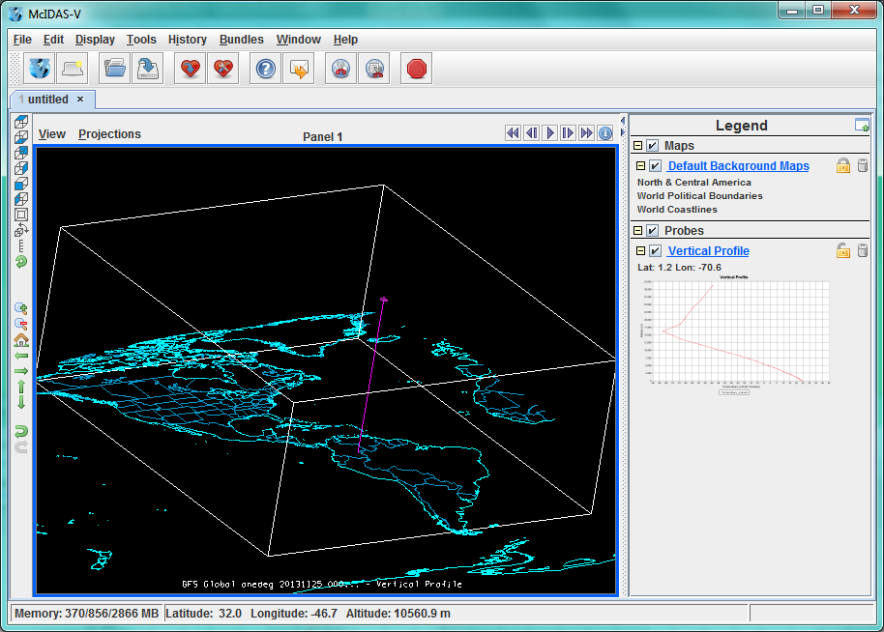
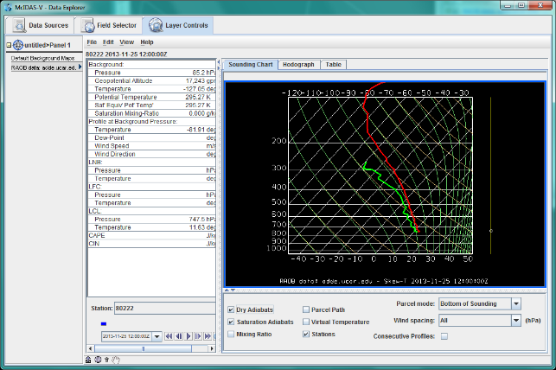
Vertical Data Probe
Of Model Temperature
Field
Skew-T plot
from Sounding

Slide 6
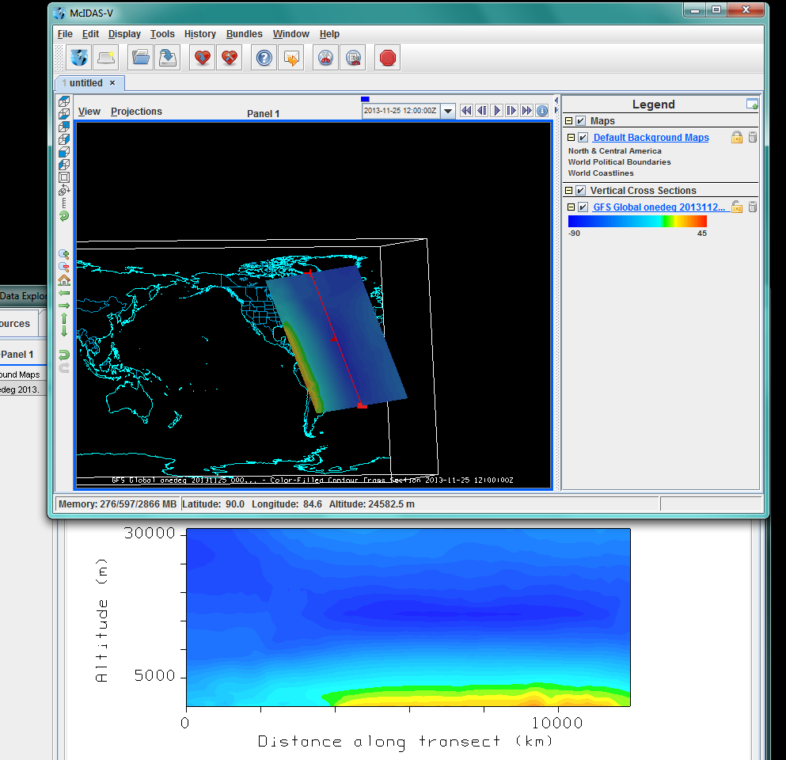
Vertical
Cross
Section

Slide 7
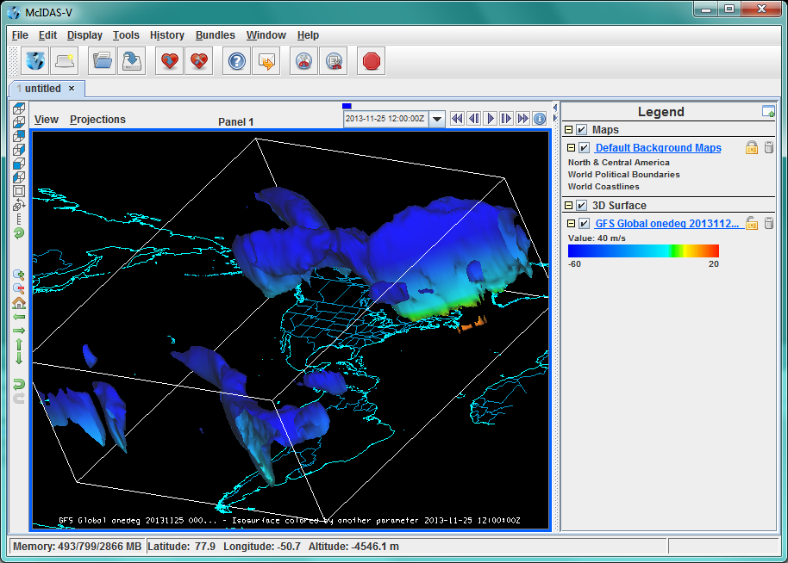
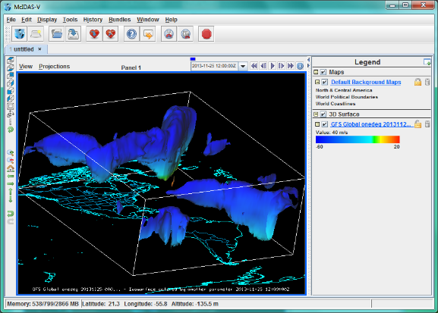
3D Isosurface of wind speed
…colored by temperature

Slide 8
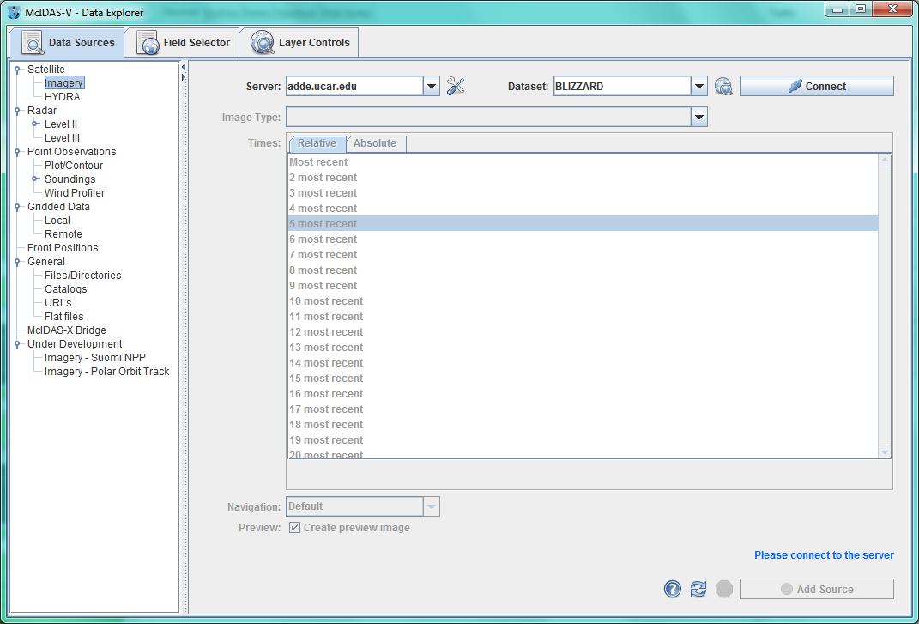
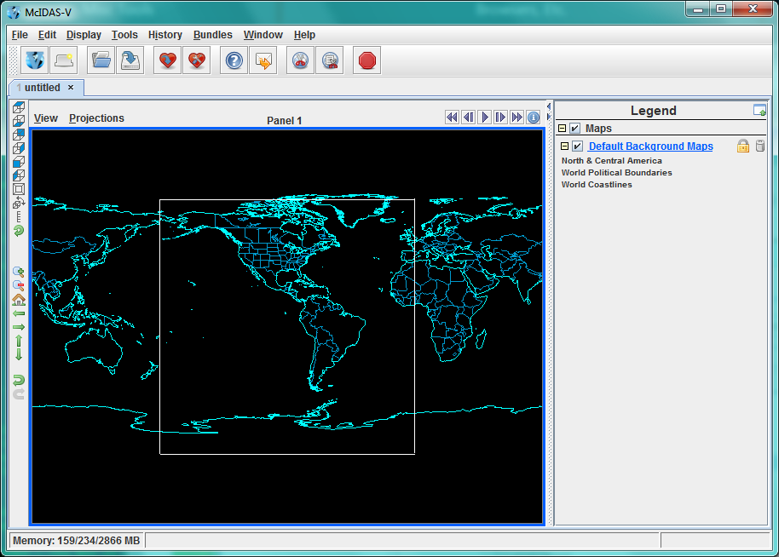
McIDAS-V Overview
The Main Display Window

Slide 9
The Data Explorer Window

Slide 10
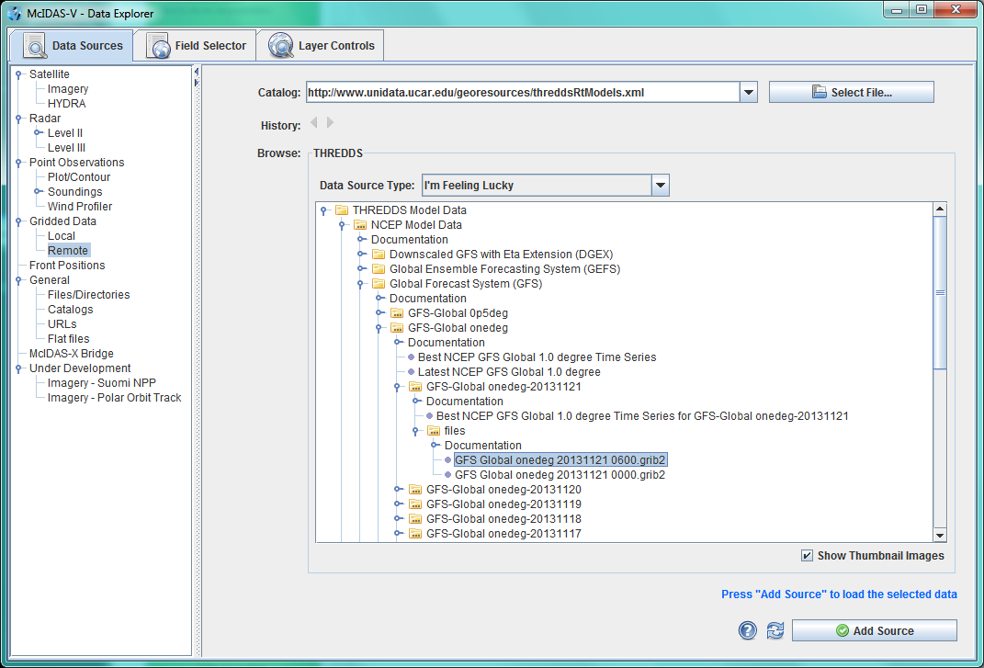
First Step: Select Data Source

Slide 11
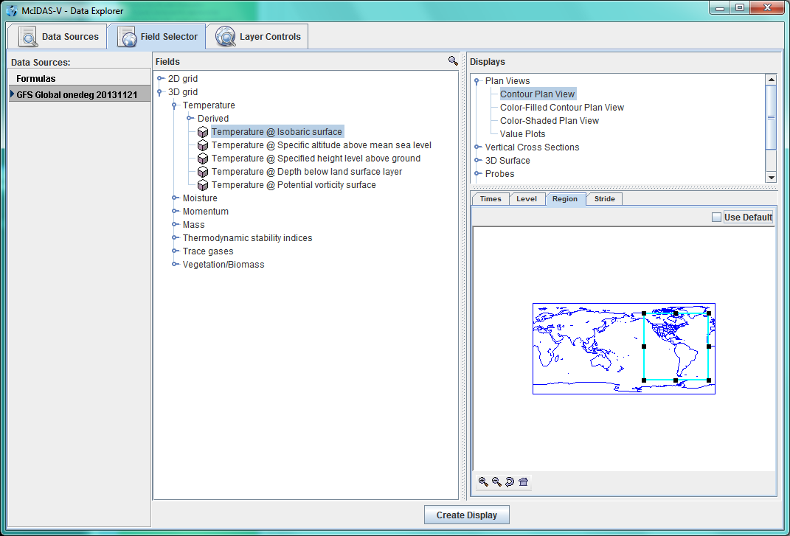
Next: the Field Selector
Parameter(s), Display type, Times, Levels, Regions

Slide 12
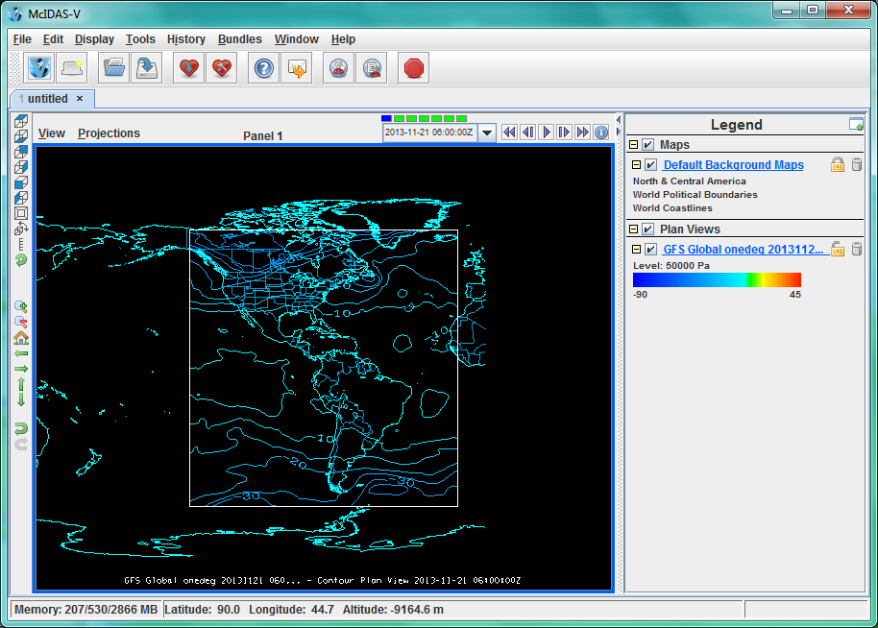
Create Display

Slide 13
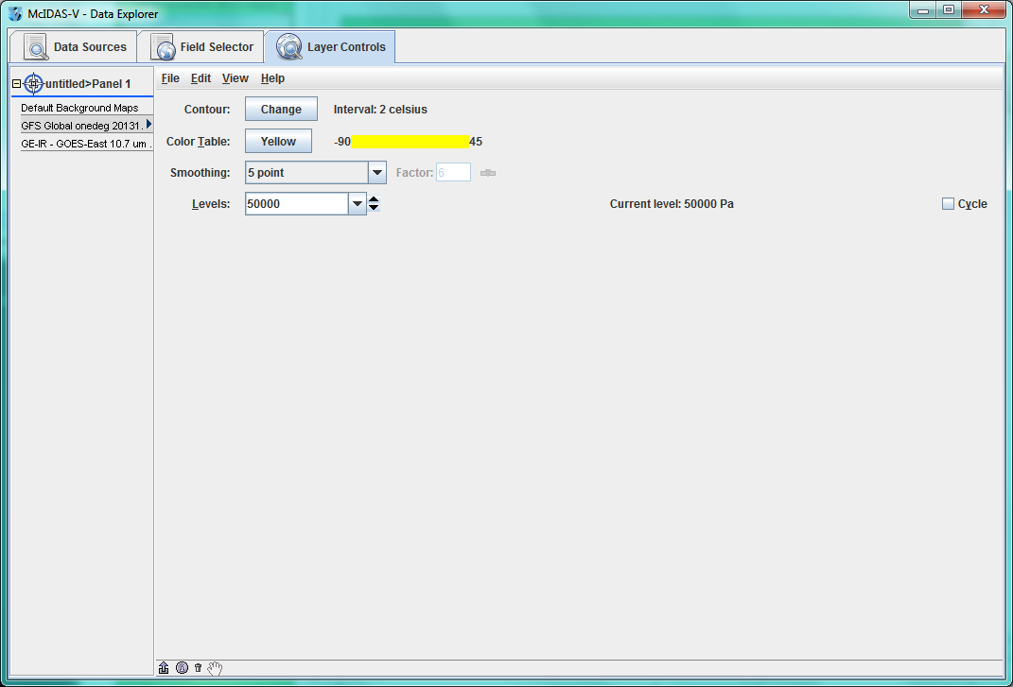
Layer Control Panel

Slide 14
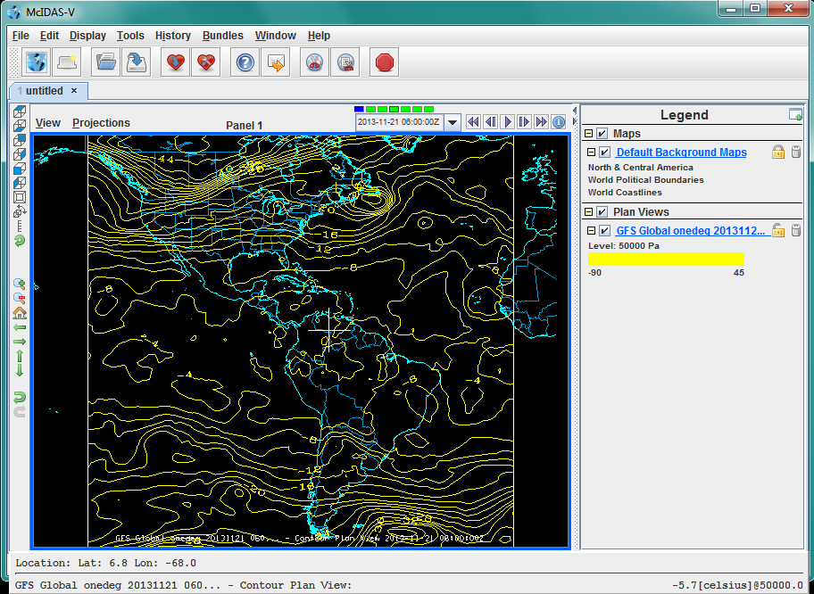
Zoom, Roam, Animate, Probe, Capture

Slide 15
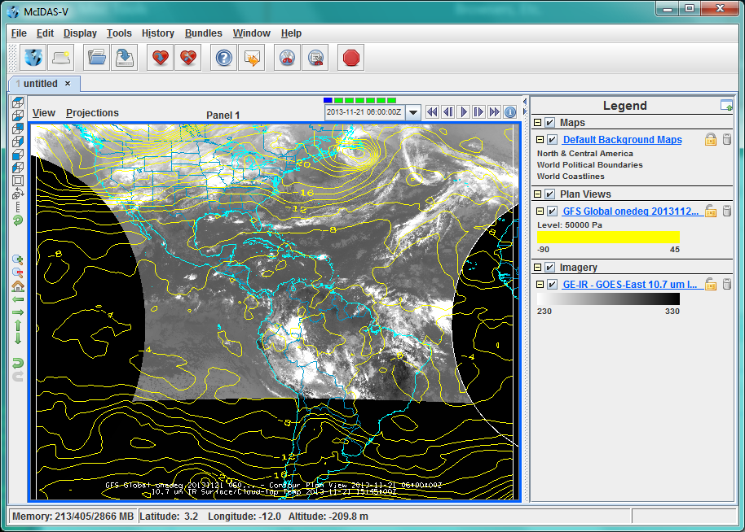
Add other data

Slide 16
Data Integration
Model and other grids
Point data
  Plots and contouring
Imagery
  Geostationary
  Polar and hyper-spectral
Miscellaneous types
  WMS, Text files
  JPG/PNG/GIF images and Web Cams
  Base maps and other ShapeFiles
Integration in display and computations

Slide 17
Data Formats
Image
  McIDAS AREA (via ADDE servers local and remote)
  NetCDF (CF Conventions), HDF5 (some)
  TIFF, JPG, PNG, etc.
Grids
  GRIB and GRIB2
  NetCDF, HDF (CF Conventions)
  Flat Binary
Point (in situ)
  BUFR (common tables)
  McIDAS point (via remote ADDE servers)
  NetCDF (CF conventions)
  ASCII Text files

Slide 18
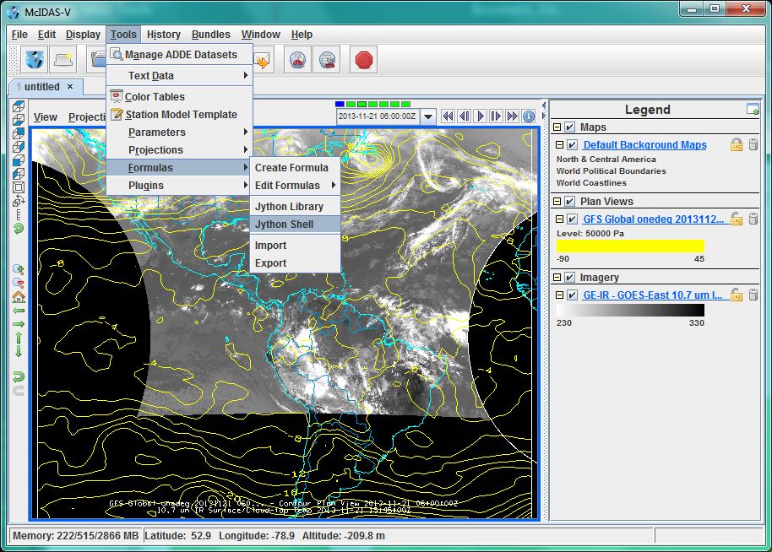
Formulas, Menus, Scripting, etc.

Slide 19
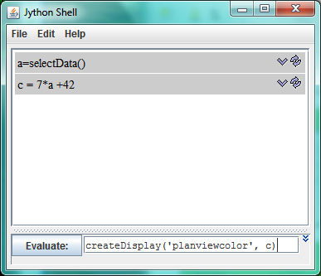
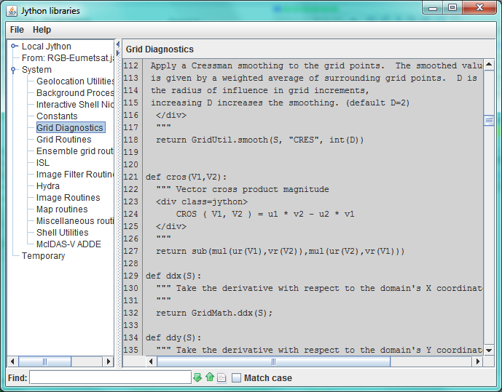
Tools for Analysis and Computation

Slide 20
Making Derived Products
Jython (Python for Java) formulas and functions
Can be integrated into Field Selector
Save as a plug-in to share with others
HansPeter Roesli made a plug-in for MSG and Metop data
Here is an example of an RGB:

Slide 21
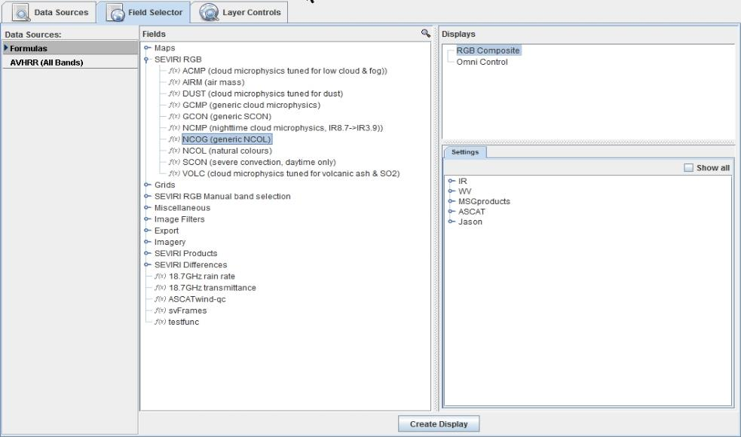
Add the Data Source(s) and then select type

Slide 22
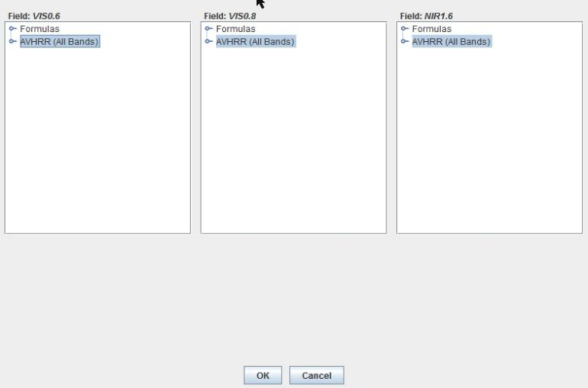
Choose the appropriate channels

Slide 23
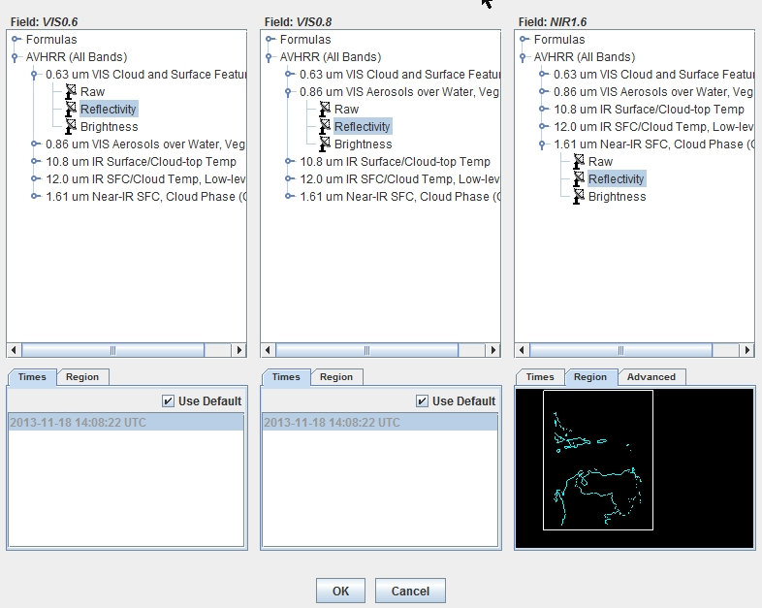
Select type, region, times, etc.

Slide 24
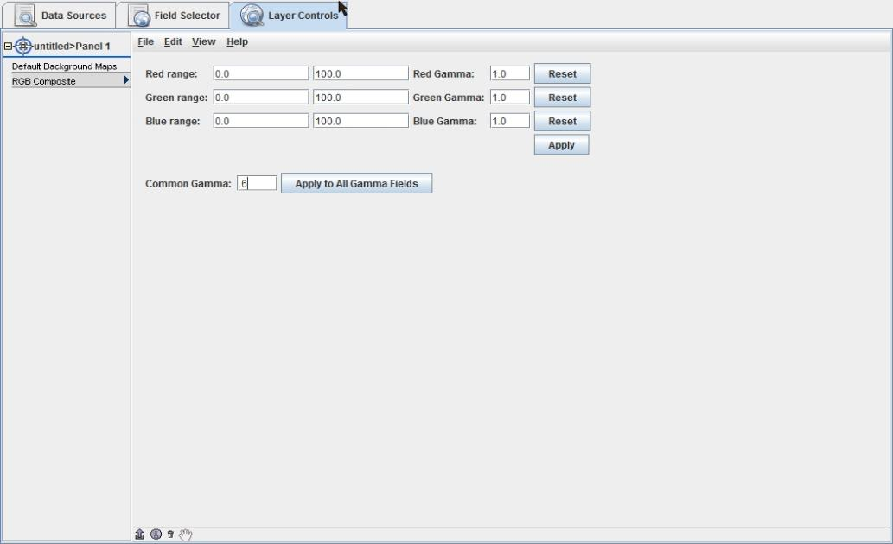
Create Display and Set Gamma

Slide 25
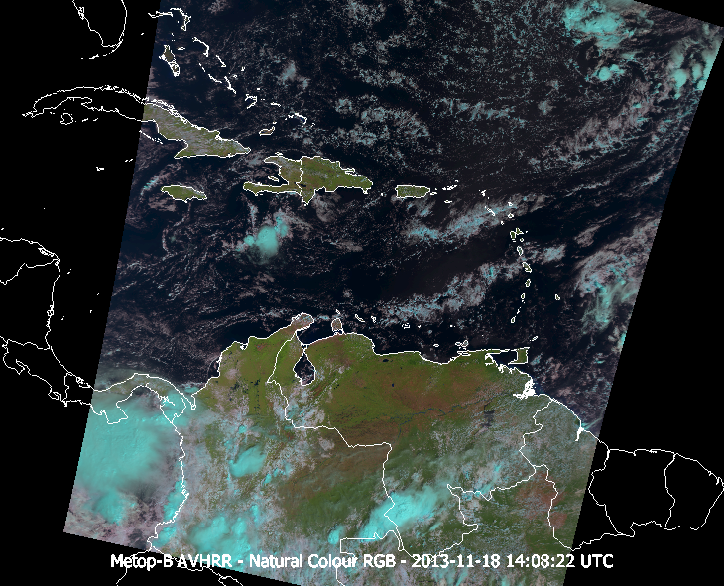
Beautiful!! (And meaningful!)

Slide 26
McIDAS-V + EUMETCast
= McVCast
Long relationship between EUMETSAT and SSEC
McIDAS-V is very flexible in dealing with satellite (and other) data
McIDAS-V is freely available, world-wide
Much work by EUMETSAT to create servers and plug-ins for McIDAS-V
Gives end-users a powerful analysis system at low cost
  Pre-configured for Africa region
  Some user-interaction options pre-set for convenience
  RGB plug-in provided
  Test / sample dataset
  Installation and Getting Started tutorial

Slide 27
Using EUMETCast to Distribute Code and Data
Only Windows version being distributed in the broadcast
Send software installer and Installation Guide via the broadcast
End-user set up is mostly to connect to broadcast data files on local systems
EUMETSAT providing user support
Sites with Internet can get other data

Slide 28
Where to get McIDAS-V
Download at:
www.ssec.wisc.edu/mcidas/software/v/download.html
(or just Google “mcidas-v download”)
There are also links to:
Support Forums
User Guide
Tutorials

