Slide 1
Satellite Data Requirements
in RA III / RA IV

Slide 2
Outline
Data Access
What need to be Defined
Data Requirements
.

Slide 3
Data Access
Direct Readout
Old Satellite Generation
New Satellite Generation – NPP and GOES-R, I guess also for METOP - user need to be ready
FTP
Nearly all countries – slow access to high resolution data, only products. Need near real time data.(Nowcasting)
GeonetCast
Growing - possible solution but need to have also raw data and Data Requirement , standardization and sustainable dissemination system.

Slide 4
Define the Scope of the user What Communities data requirements should be considered?
The users having direct readout, rather specialized users who are dealing with “raw data”
The users who are mainly interested in receiving satellite products (the majority of users).
Data Assimilation

Slide 5
The Use of Satellite Data in RA III/IV What the Region Needs
Real Time Data – Data and Products Access of Different Satellite
Training – practical training on
How to receive the data
Data Pre-Process
Product Access Guide
New Satellites GOES-R and NPP (practical training)
South American Desk for new satellite generation - the use of Satellite Data

Slide 6
Training
USER PREPAREDNESS PLAN FOR THE TRANSITION TO THE NEW SATELLITE GENERATIONS
Hands on – objective training on:
How to receive the data, how pre-process, what Applications software and stations, the satellite data will be available trough…., product visualization. The use of multichannel and products does not seem to be a great issue – right now!

Slide 7
Suggestion
Concentrated Effort Towards the Use of Satellite New Generation
Regular virtual meetings with the region.
Participation of Vlab, Comet, Regional Focus Group, CoE, ……
Region presents the needs and doubts.
Vendors Presentation of the proposal solutions
Help to solve technical problems
Specific Training Sections

Slide 8
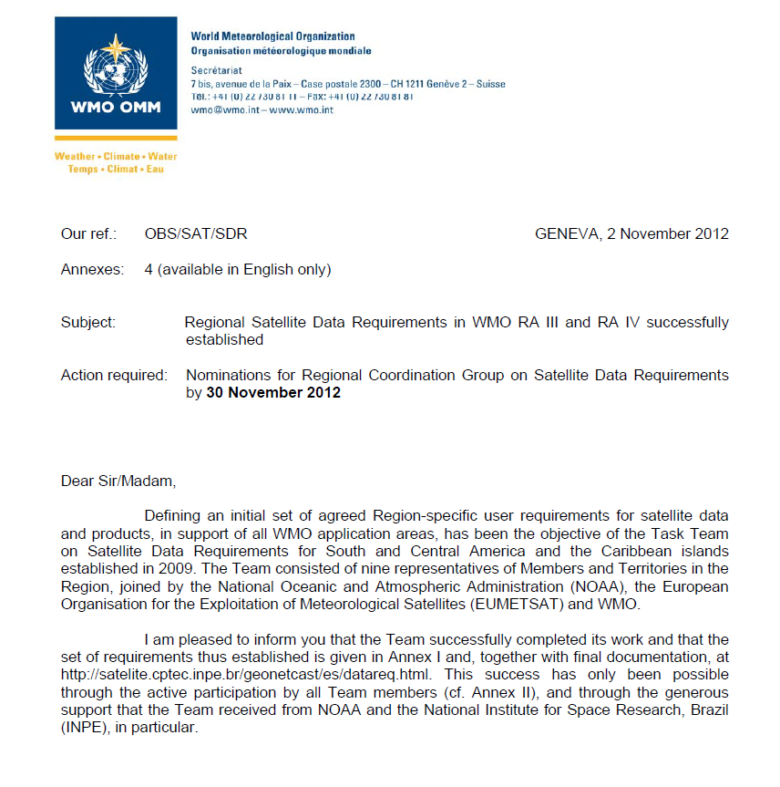

Slide 9
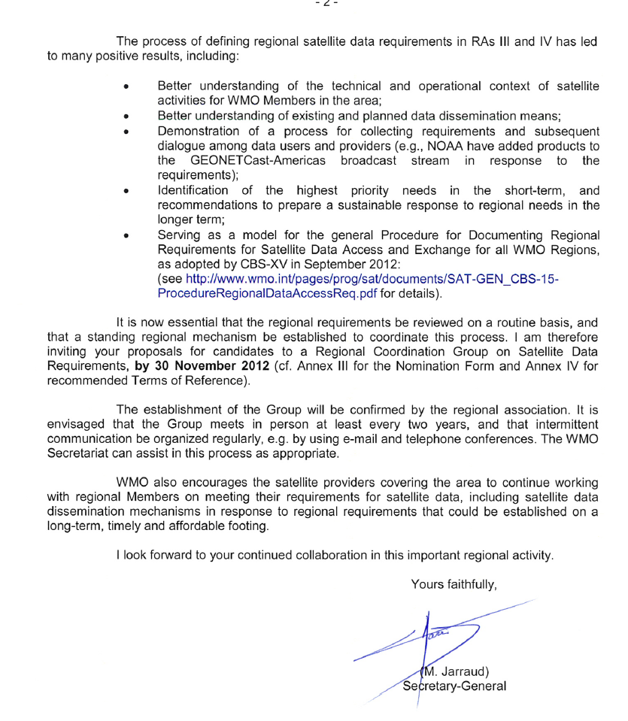

Slide 10
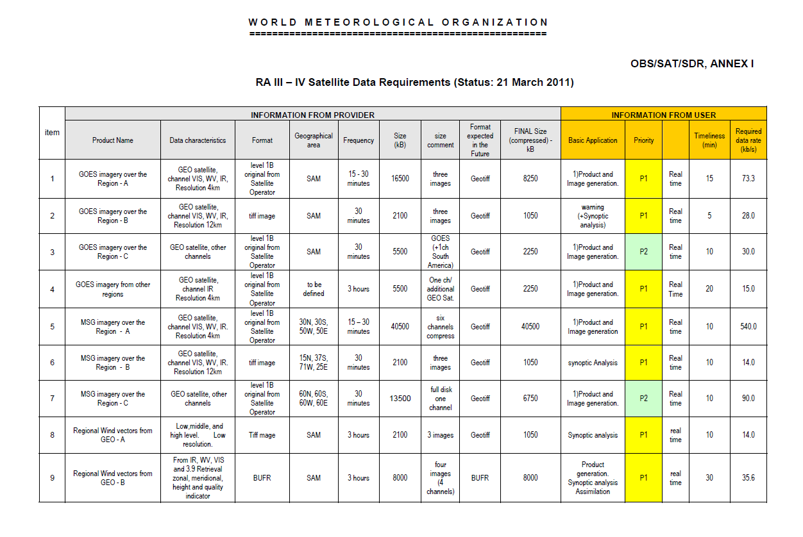
Example of Data Requirements 52 different products are presently on the list (distributed in 3 Priority levels: P1; P2; and P3). All the products would require, at least, a 2.1Mbps data rate for broadcasting. http://satelite.cptec.inpe.br/geonetcast/br/datareq.html

Slide 11
Data Requirements
Countries need to participate in the discussion and indicate the participant to WMO.
The Data Requirements need to be put in operation.
A sustainable system should be designed to make data available
A Panel describing all the different solutions/limitations , infrastructure necessary and associated costs to receive new satellite generation and timetables will great help users in the region.

Slide 12
Thank you

