Slide 1
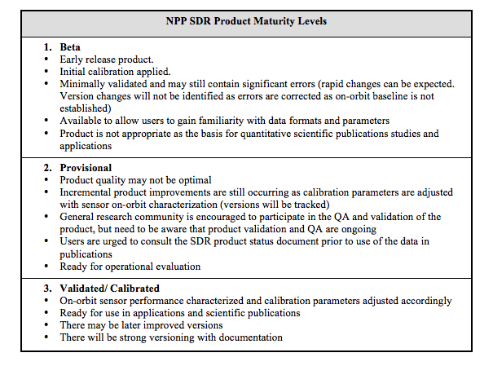
Data Product Maturity Definitions

Slide 2
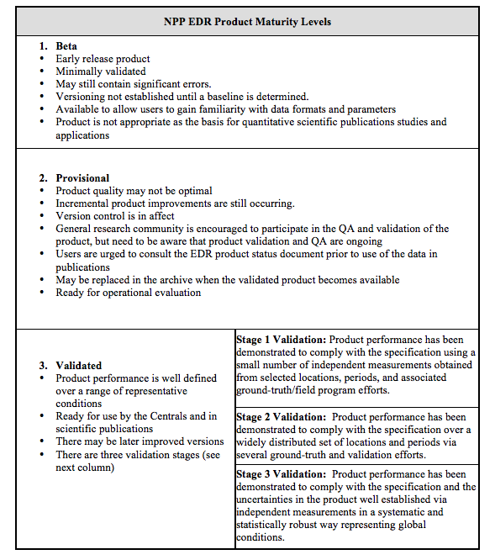
Data Product Maturity Definitions (cont.)

