Slide 1
Composing contracts
An adventure in financial engineering
Simon Peyton Jones and Julian Seward,
Microsoft Research
and
Jean Marc Eber, LexiFi Technologies

Slide 2


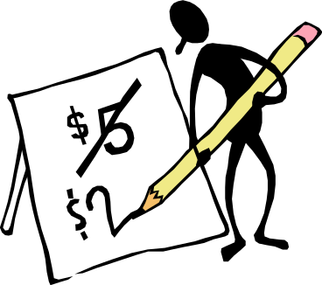
The big picture
Jean Marc
Simon
and
Julian
Financial engineering
Programming language design and implementation

Slide 3
The big picture
Swaps, caps, options, european, bermudan, straddle, floors, swaptions, swallows, spreads, futures
Jean Marc
Simon
and
Julian
Financial engineering
Programming language design and implementation

Slide 4



Combinatorlibrary
Denotational semantics
Operational semantics

Slide 5
What we want to do
Scheduling for back office
Precise description of a contract
Valuation and hedging
Legal and documentation
etc….

Slide 6
What we want to do
Compute sugar content
Precise description of a pudding
Estimate time to make
Instructions to make it
etc….

Slide 7
What we want to do
Precise description of a pudding
Compute sugar content
Estimate time to make
Bad approach
List all puddings (trifle, lemon upside down pudding, Dutch apple cake, Christmas pudding)
For each pudding, write down sugar content, time to make, instructions etc
Instructions to make it

Slide 8
What we want to do
Precise description of a pudding
Compute sugar content
Estimate time to make
Good approach
Define a small set of “pudding combinators”
Define all puddings in terms of these combinators
Calculate sugar content from these combinators too
Instructions to make it

Slide 9
Creamy fruit salad
On top of
Combinators combine small puddings into bigger puddings
Whipped
Mixture
Chopped
Optional
Take
1 pint
Cream
Take
Take
3
Apples
6
Oranges

Slide 10
Trees can be written as text
On top of
Notation:
parent child1 child2
function arg1 arg2
Whipped
Mixture
Chopped
Optional
Take
1 pint
Cream
Take
Take
3
Apples
6
Oranges
salad = onTopOf topping main_part
topping = whipped (take pint cream)
main_part = mixture apple_part orange_part
apple_part = chopped (take 3 apple)
orange_part = optional (take 6 oranges)
Slogan: a domain-specific language for describing puddings

Slide 11
Building a simple contract
“Receive £100 on 1 Jan 2010”
c1 :: Contract
c1 = zcb (date “1 Jan 2010”) 100 Pounds
zcb :: Date -> Float -> Currency -> Contract
-- Zero coupon bond
Combinators will appear in blue boxes

Slide 12
Combing contracts
c1,c2,c3 :: Contract
c1 = zcb (date “1 Jan 2010”) 100 Pounds
c2 = zcb (date “1 Jan 2011”) 100 Pounds
c3 = and c1 c2
and :: Contract -> Contract -> Contract
-- Both c1 and c2
and
c3
c1
c2
zcb t1 100 Pounds
zcb t2 100 Pounds

Slide 13
Inverting a contract
Backquotes for infix notation
c4 = c1 `and` give c2
give :: Contract -> Contract
-- Invert role of parties
and is like addition
give is like negation
and
c4
give
c1
c2
zcb t1 100 Pounds
zcb t2 100 Pounds

Slide 14
New combinators from old
andGive :: Contract -> Contract -> Contract
andGive u1 u2 = u1 `and` give u2
andGive is a new combinator, defined in terms of simpler combinators
To the “user”, andGive is no different to a primitive, built-in combinator
This is the key to extensibility: users can write their own libraries of combinators to extend the built-in ones

Slide 15
Defining zcb
Indeed, zcb is not primitive:
zcb :: Date -> Float -> Currency -> Contract
zcb t f k = at t (scaleK f (one k))
one :: Currency -> Contract
-- Receive one unit of currency immediately
scaleK :: Float -> Contract -> Contract
-- Acquire specified number of contracts
at :: Date -> Contract -> Contract
-- Acquire the contract at specified date

Slide 16
Acquisition dates
one :: Currency -> Contract
-- Receive one unit of currency immediately
at :: Date -> Contract -> Contract
-- Acquire the underlying contract at specified date
If you acquire the contract (one k), you receive one unit of currency k immediately
If you acquire the contract (at t u) at time s<t, then you acquire the contract u at the (later) time t.
You cannot acquire (at t u) after t. The latest acquisition date of a contract is its horizon.

Slide 17
Choice
An option gives the flexibility to
Choose which contract to acquire (or, as a special case, whether to acquire a contract)
Choose when to acquire a contract
(exercising the option = acquiring the underlying contract)

Slide 18
Choose which
European option: at a particular date you may choose to acquire an “underlying” contract, or to decline
european :: Date -> Contract -> Contract
european t u = at t (u `or` zero)
or :: Contract -> Contract -> Contract
-- Acquire either c1 or c2 immediately
zero :: Contract
-- A worthless contract

Slide 19
Reminder…
Remember that the underlying contract is arbitrary
c5 :: Contract
c5 = european t1 (european t2 c1)
This is already beyond what current systems can handle

Slide 20
Choose when: American options
The option to acquire 10 Microsoft shares, for $100, anytime between t1 and t2 years from now
anytime :: Contract -> Contract
-- Acquire the underlying contract at
-- any time before it expires (but
-- you must acquire it)
anytime: Choose when
golden_handcuff = anytime shares
shares = zero `or` (scaleK -100 (one Dollar) `and`
scaleK 10 (one MSShare))
MS shares are a “currency”
or: Choose whether

Slide 21
Setting the window
golden_handcuff = at t1 (anytime (truncate t2 shares))
Acquire the anytime rights at t1
Can’t acquire shares after t2
truncate :: Date -> Contract -> Contract
-- Truncate the horizon of a contract
at :: Date -> Contract -> Contract
-- Acquire the underlying contract at specified date

Slide 22
Observables
Pay me $1000 * (the number of inches of snow - 10) on 1 Jan 2002
c :: Contract
c = at “1 Jan 2002” (scale scale_factor (one Dollar))
scale_factor :: Observable
scale_factor = 1000 * (snow - 10)
scale :: Observable -> Contract -> Contract
-- Scale the contract by the value of the observable
-- at the moment of acquisition
snow :: Observable
(*), (-) :: Observable -> Observable -> Observable

Slide 23
Summary so far
Only 10 combinators (after many, many design iterations)
Each combinator does one thing
Can be combined to describe a rich variety of contracts
Surprisingly elegant

Slide 24
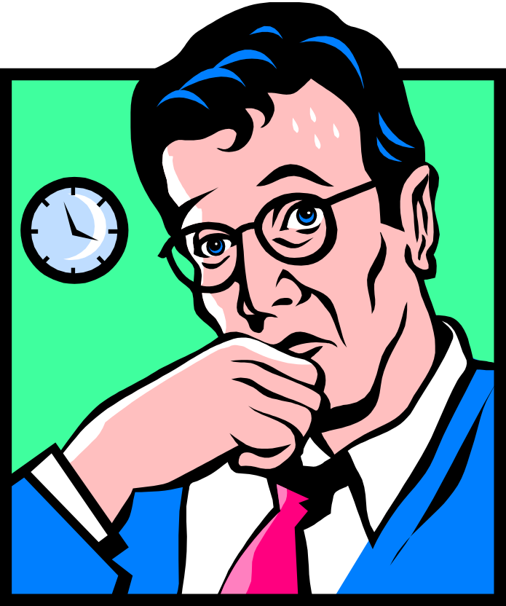
But what does it all mean?
We need an absolutely precise specification of what the combinators mean: their semantics
And we would like to do something useful with our (now precisely described) contracts
One very useful thing is to compute a contract’s value

Slide 25
Processing puddings
Wanted: S(P), the sugar content of pudding P
S(onTopOf p1 p2) = S(p1) + S(p2)
S(whipped p) = S(p)
S(take q i) = q * S(i)
…etc…
When we define a new recipe, we can calculate its sugar content with no further work
Only if we add new combinators or new ingredients do we need to enhance S

Slide 26
Processing puddings
Wanted: S(P), the sugar content of pudding P
S(onTopOf p1 p2) = S(p1) + S(p2)
S(whipped p) = S(p)
S(take q i) = q * S(i)
…etc…
S is compositional
To compute S for a compound pudding,
Compute S for the sub-puddings
Combine the results in some combinator-dependent way

Slide 27
What is the denotation of a contract?
The denotation of a program is a mathematical value that embodies what the program “means”
Two programs are equivalent if they have the same denotation
A denotational semantics should be compositional: the denotation of (P1 + P2) is gotten by combining somehow the denotations of P1 and P2

Slide 28
What is the denotation of a contract?
Main idea: the denotation of a contract is a random process that models the value of acquiring the contract at that moment.
ℇ : Contract -> RandomProcess
RandomProcess = Time -> RandomVariable
Uncertainty increases with time
Time

Slide 29

Compositional valuation
Add random processes point-wise
ℇ(c1 `and` c2) = ℇ (c1) + ℇ (c2)
ℇ(c1 `or` c2) = max(ℇ(c1), ℇ(c2) )
ℇ(give c) = - ℇ (c)
ℇ(anytime c) = snell( ℇ(c) )
ℇ(at t c) = discount( ℇ(c)[t] )
…etc…
This is a major payoff! Deal with the 10-ish combinators, and we are done with valuation!

Slide 30
Valuation
There are many numerical methods to compute discrete approximations to random processes (tons and tons and tons and tons and tons and tons and tons and tons and tons and tons of existing work)
Contract
Model of world
(e.g. interest rates)
Valuation engine

Slide 31
One possible evaluation model: BDT
Valuation engine
zcb 3 100 Pounds
100
contract C
100
6%
95
100
100
5%
0
1
2
3
4%
Value tree ℇ(C)
interest rate model M

Slide 32
Space and time
Obvious implementation computes the value tree for each sub-contract
But these value trees can get BIG
And often, parts of them are not needed
at t
simple discounting
t

Slide 33
Haskell to the rescue
“Lazy evaluation” means that
data structures are computed incrementally, as they are needed (so the trees never exist in memory all at once)
parts that are never needed are never computed
Slogan
We think of the tree as a first class value “all at once”
but it is only materialised “piecemeal”

Slide 34
An operational semantics
As time goes on, a contract evolves
  e.g. zcb t1 n k `and` zcb t2 n k
Want to value your current contract “book”
So we want to say formally how a contract, or group of contract evolves with time, and how it interacts with its environment (e.g. emit cash, make choice)
Work on the operational semantics of programming languages is directly relevant (e.g. bisimulation)

Slide 35
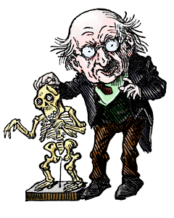
Reasoning about equivalence
Using this semantics we can prove (for example) that
anytime (anytime c) = anytime c
Depends on algebra of random processes (snell, discount, etc). Bring on the mathematicians!

Slide 36
A compiler for contracts
Contract
Take semantics
Transform using algebraic laws
Random process
Code generation
Valuation program

Slide 37
A compiler for contracts
Contract
Evolve using operational semantics
Take semantics
Random process
Code generation
Valuation program

Slide 38
Summary
Routine for us, radical stuff for financial engineers
A small set of built-in combinators: named and tamed
A user-extensible library defines the zoo of contracts
Compositional denotational semantics, leads directly to modular valuation algorithms
Risk Magazine Software Product of the Year Prize
Jean-Marc has started a company, LexiFi, to commercialise the ideas

Slide 39
Summary
Routine for us, radical stuff for financial engineers
A small set of built-in combinators: named and tamed
A user-extensible library defines the zoo of contracts
Compositional denotational semantics, leads directly to modular valuation algorithms
Risk Magazine Software Product of the Year Prize
Jean-Marc has started a company, LexiFi, to commercialise the ideas
Beats higher order logic hands down for party conversation

