Slide 1
Demo
Import Batch Demo

Slide 2
Agenda
Flow Chart
Common Architectures
- Layer Architecture is popular for web development
- Hexagonal Architect for Import Flow

Slide 3
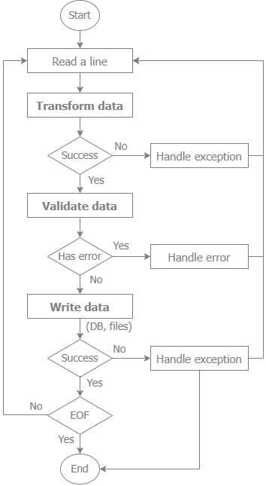
Flow Chart
Flow chart

Slide 4
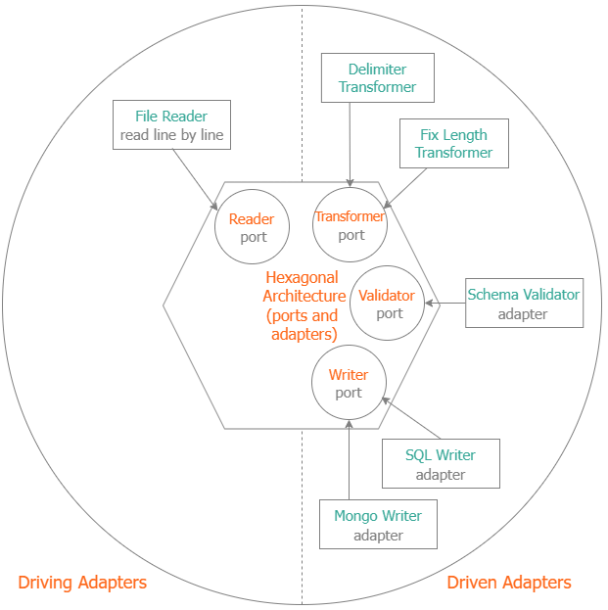
Common Architectures
Layer Architecture
Popular for web development
Hexagonal Architecture
Suitable for Import Flow
REST API Handler
Model
Business Logic
Repository

Slide 5
Questions and Anwers
Thank you

