Slide 1

TYPESCRIpt :
PROMISES
WESSAMAFTAB

Slide 2
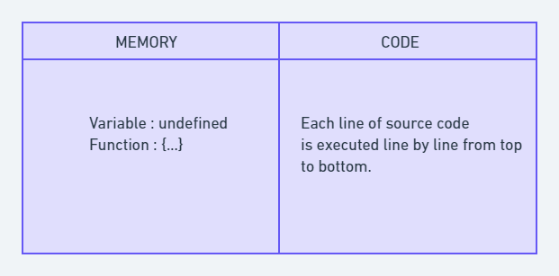
HOW DOES JAVASCRIPT WORKS? WHAT THE HELL IS EXECUTION CONTEXT?

Slide 3
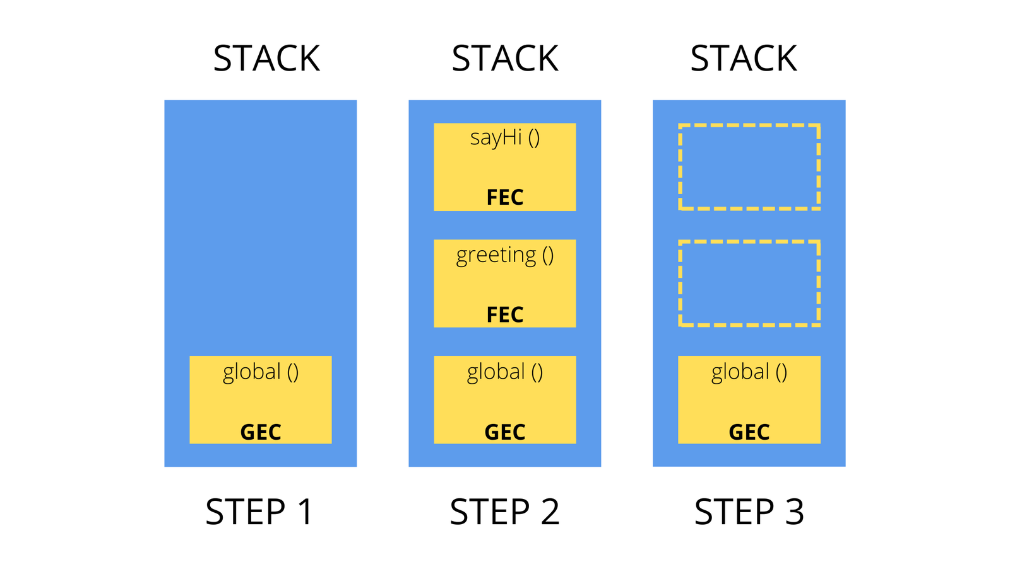
CALL BACK TAKES EXECUTION CONTEXT:

Slide 4
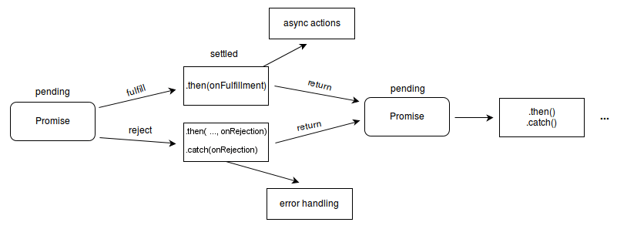
pending: initial state, neither fulfilled nor rejected. fulfilled: meaning that the operation was completed successfully. rejected: meaning that the operation failed.

Slide 5
PROMISE HAS OBJECT TYPE WITH DIFERRENT STATE (DISCUSSED EARLIER).
PROMISES EXECUTES in async and sync way . It depends upon how we utlilize them .
IN REAL TIME, PROMISES RETURN OBJECTS LIKE WE SAY IN INQUIRER OR FETCH API.
PRIORITY OF PROMISES:
AFTER EXECUTION , PROMISES AND DOM OPERATIONS ARE SENT INTO MICROQUEUE .
SO,AFTER MAIN STACK MICROQUEUE IS LOADED AND THEN UPON RENDERING ,
MACROQUEUE LOADS WHICH CONTAIN CALLBACK HAVING SETTIMMEOUT AND SETTIMEINTERVAL
In summary, macro tasks are typically used for less time-sensitive operations like timers and I/O,
while micro tasks are used for more critical tasks like Promise resolution and DOM updates.
Understanding the difference and their order of execution is crucial for writing efficient and
responsive asynchronous code in JavaScript.

Slide 6
You can create a new Promise using its constructor. The constructor takes a single function, commonly referred to as
the executor function, which has two parameters: resolve and reject.
Inside the executor function,
you perform the asynchronous operation and call resolve(result) when it succeeds or reject(error) when it fails.
//BELOW FOR THOSE WHO HAVE OOPS BACKGEOUND FOR BETTER UNDERSTANDING PROMISES:
class Person {
firstName: string;
lastName: string;
constructor(firstName: string, lastName: string) {
this.firstName = firstName;
this.lastName = lastName;
}
}
const john = new Person("John", "Doe");
console.log(john.firstName); // "John"
console.log(john.lastName); // "Doe"
.

Slide 7
We will practically discuss chaining,finally,then with two call backs:
If then can handle both resolution and rejection why to use catch:
Chaining.
Readibility.
Separation of concerns and consistency
Fiinally do execute in both situations (resolution or rejection)

Slide 8
PRONS
CHAINING.
EVENTS ARE LINKED NOT DEPENDENT
ELEMINATES NESTING.
ASYNC ITSELF UNLIKE CALLBACKS
ERROR HANDLING . CALLBACK HAD NO ERROR HANDLING

