Slide 1
Building and using pluggable type systems with the Checker Framework
print(@Readonly Object x) {
List<@NonNull String> lst;
…
}
Michael D. Ernst
MIT

Slide 2
Problem 1:
Java’s type checking is too weak
Type checking prevents many bugs
    int i = “42”; // type error
Type checking doesn’t prevent enough bugs
java.lang.NullPointerException
at checkers.util.GraphQualifierHierarchy.isSubtype(GraphQualifierHierarchy.java:210)
at checkers.types.QualifierHierarchy.isSubtype(QualifierHierarchy.java:70)
at checkers.types.TypeHierarchy.isSubtypeImpl(TypeHierarchy.java:100)
at checkers.types.TypeHierarchy.isSubtype(TypeHierarchy.java:64)
at checkers.basetype.BaseTypeChecker.isSubtype(BaseTypeChecker.java:305)
at checkers.basetype.BaseTypeVisitor.commonAssignmentCheck(BaseTypeVisitor.java:481)
at checkers.basetype.BaseTypeVisitor.commonAssignmentCheck(BaseTypeVisitor.java:464)
at checkers.basetype.BaseTypeVisitor.checkArguments(BaseTypeVisitor.java:597)
at checkers.basetype.BaseTypeVisitor.visitMethodInvocation(BaseTypeVisitor.java:278)
at com.sun.tools.javac.tree.JCTree$JCMethodInvocation.accept(JCTree.java:1315)
at com.sun.source.util.TreePathScanner.scan(TreePathScanner.java:67)
at checkers.basetype.BaseTypeVisitor.scan(BaseTypeVisitor.java:110)
at com.sun.source.util.TreeScanner.visitExpressionStatement(TreeScanner.java:239)
at com.sun.tools.javac.tree.JCTree$JCExpressionStatement.accept(JCTree.java:1155)
at com.sun.source.util.TreePathScanner.scan(TreePathScanner.java:67)
at checkers.basetype.BaseTypeVisitor.scan(BaseTypeVisitor.java:110)
at com.sun.source.util.TreeScanner.scanAndReduce(TreeScanner.java:80)
at com.sun.source.util.TreeScanner.scan(TreeScanner.java:90)
at com.sun.source.util.TreeScanner.visitBlock(TreeScanner.java:159)
at com.sun.tools.javac.tree.JCTree$JCBlock.accept(JCTree.java:781)
at com.sun.source.util.TreePathScanner.scan(TreePathScanner.java:67)
at checkers.basetype.BaseTypeVisitor.scan(BaseTypeVisitor.java:110)
at com.sun.source.util.TreeScanner.scanAndReduce(TreeScanner.java:80)
at com.sun.source.util.TreeScanner.visitIf(TreeScanner.java:233)
at com.sun.tools.javac.tree.JCTree$JCIf.accept(JCTree.java:1130)
at com.sun.source.util.TreePathScanner.scan(TreePathScanner.java:67)
at checkers.basetype.BaseTypeVisitor.scan(BaseTypeVisitor.java:110)
at com.sun.source.util.TreeScanner.scanAndReduce(TreeScanner.java:80)
at com.sun.source.util.TreeScanner.scan(TreeScanner.java:90)
at com.sun.source.util.TreeScanner.visitBlock(TreeScanner.java:159)
at com.sun.tools.javac.tree.JCTree$JCBlock.accept(JCTree.java:781)
at com.sun.source.util.TreePathScanner.scan(TreePathScanner.java:67)
at checkers.basetype.BaseTypeVisitor.scan(BaseTypeVisitor.java:110)
at com.sun.source.util.TreeScanner.scanAndReduce(TreeScanner.java:80)
at com.sun.source.util.TreeScanner.visitMethod(TreeScanner.java:143)
at checkers.basetype.BaseTypeVisitor.visitMethod(BaseTypeVisitor.java:184)
at com.sun.tools.javac.tree.JCTree$JCMethodDecl.accept(JCTree.java:681)
at com.sun.source.util.TreePathScanner.scan(TreePathScanner.java:67)
at checkers.basetype.BaseTypeVisitor.scan(BaseTypeVisitor.java:110)
at com.sun.source.util.TreeScanner.scanAndReduce(TreeScanner.java:80)
at com.sun.source.util.TreeScanner.scan(TreeScanner.java:90)
at com.sun.source.util.TreeScanner.scanAndReduce(TreeScanner.java:98)
at com.sun.source.util.TreeScanner.visitClass(TreeScanner.java:132)
at checkers.basetype.BaseTypeVisitor.visitClass(BaseTypeVisitor.java:127)
at com.sun.tools.javac.tree.JCTree$JCClassDecl.accept(JCTree.java:604)
at com.sun.source.util.TreePathScanner.scan(TreePathScanner.java:49)
at checkers.source.SourceChecker.process(SourceChecker.java:195)
at com.sun.tools.javac.processing.JavacProcessingEnvironment.callProcessor(JavacProcessingEnvironment.java:738)
at com.sun.tools.javac.processing.JavacProcessingEnvironment.discoverAndRunProcs(JavacProcessingEnvironment.java:667)
at com.sun.tools.javac.processing.JavacProcessingEnvironment.doProcessing(JavacProcessingEnvironment.java:812)
at com.sun.tools.javac.main.JavaCompiler.processAnnotations(JavaCompiler.java:1001)
at com.sun.tools.javac.main.JavaCompiler.compile(JavaCompiler.java:747)
at com.sun.tools.javac.main.Main.compile(Main.java:386)
at com.sun.tools.javac.main.Main.compile(Main.java:312)
at com.sun.tools.javac.main.Main.compile(Main.java:303)
at com.sun.tools.javac.Main.compile(Main.java:82)
at com.sun.tools.javac.Main.main(Main.java:67)

Slide 3
Problem 1:
Java’s type checking is too weak
Type checking prevents many bugs
    int i = “42”; // type error
Type checking doesn’t prevent enough bugs
  Null dereferences
  Incorrect equality tests
  Incorrect mutation
  SQL injection
  Privacy violations
  Misformatted data
Notes:
Programmers wish to prevent these.

Slide 4
Solution:
Pluggable type systems
Design a type system to solve a specific problem
Annotate your code with type qualifiers
  Or, use a type inference tool
  @NonNull Date d = ...;
  d.getMonth(); // no possible NPE
Type checker warns about violations (bugs)
% javac -processor NullnessChecker MyFile.java
MyFile.java:149: dereference of possibly-null reference bb2
assert vars1.containsAll(bb2.vars);
^

Slide 5

Problem 2:
Implementing pluggable types
Custom implementation: hard
Previous frameworks: too weak
Hampers use and understanding of type systems
Alternate evaluation strategies:
  Soundness proof for core calculus
  Toy examples
A type system is valuable only if it helps developers to find and prevent errors
  Robust implementation
  Case studies
  You learn a lot!
Notes:
To build and maintain, and is too brittle
TODO: Add “no toys” logo with a stuffed animal.

Slide 6
Solution:
The Checker Framework
Most checks are built in
Declarative syntax for common cases
  Type qualifier hierarchy
  Type introduction rules
Override a few methods for type rules
Simple type systems require no code
  But sophisticated type systems are possible

Slide 7
Tool integration
Type qualifiers: extension to Java annotation syntax
  List<@NonNull String> strings;
  myGraph = (@Immutable Graph) tmpGraph;
  class UnmodifiableList<T>
  implements @Readonly List<@Readonly T> {}
Carried through to classfile
Planned for inclusion in Java 7
Backward-compatible: compile with any Java compiler
  List</*@NonNull*/ String> strings;
IDE support: javac, Eclipse, Netbeans; IntelliJ planned
Type inference: 3 tools integrated so far

Slide 8
Sample type checkers
Null dereferences (@NonNull, @Nullable)
Errors in equality testing (@Interned)
Reference immutability (Javari)
Reference & object immutability (IGJ)
Basic checker (subtyping, etc.)
Comparison: JQual and JavaCOP authors attempted to build Javari checkers
  Only supported 1 out of 5 type qualifiers
  Incorrect semantics for method overriding
  Not usable in practice
  Ours was built by a sophomore working part-time

Slide 9
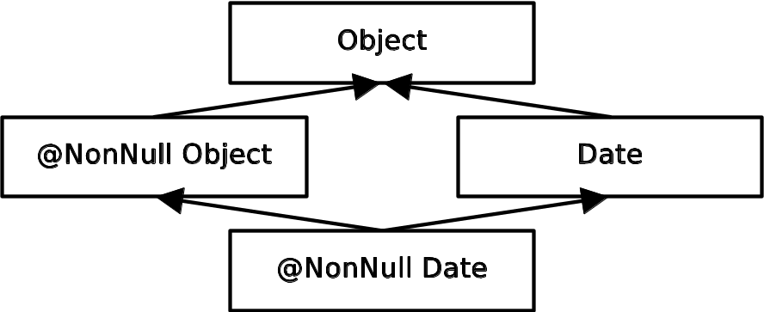
Problem: NullPointerExceptions Solution: Nullness checker
  Object obj; // might be null
  @NonNull Object nnobj; // never null
  nnobj.toString(); // OK
  obj.toString(); // possible NPE
  obj = ...; // OK
  nnobj = obj; // nnobj may become null
Type system:

Slide 10
Demo of Nullness checker

Slide 11
Local type refinement (inference)
/*@Nullable*/ Date d1, d2, d3;
d1 = new Date();
d1.getMonth(); // OK: d1 is non-null
assert d2 != null;
d2.getMonth(); // OK
if (d3 != null) {
d3.getMonth(); // OK
}
Often, no annotations
  Due to type refinement and careful choice of defaults

Slide 12
Comparison: other Nullness tools
 | Null pointer errors |  | False warnings | Annotations written
 | Found | Missed
JSR 308 | 8 | 0 | 4 | 35
FindBugs | 0 | 8 | 1 | 0
Jlint | 0 | 8 | 8 | 0
PMD | 0 | 8 | 0 | 0
Checking a 4KLOC program
Type checking finds all the null pointer bugs
The other tools also find other bugs

Slide 13
Interning
(= canonicalization, hash-consing)
Reuse an existing object instead of creating a new one
A space optimization: savings can be significant
A time optimization: use == for comparisons
Built into java.lang.String: intern() method
Users can add interning for their own classes
s1
“hello”
s2
“hello”
s3
“hello”

Slide 14
Interning
(= canonicalization, hash-consing)
Reuse an existing object instead of creating a new one
A space optimization: savings can be significant
A time optimization: use == for comparisons
Built into java.lang.String: intern() method
Users can add interning for their own classes
s1
“hello”
s2
“hello”
s3
“hello”

Slide 15
Interning
(= canonicalization, hash-consing)
Reuse an existing object instead of creating a new one
A space optimization: savings can be significant
A time optimization: use == for comparisons
Built into java.lang.String: intern() method
Users can add interning for their own classes
s1
“hello”
s1 = s1.intern();
s2
“hello”
s3
“hello”

Slide 16
Interning
(= canonicalization, hash-consing)
Reuse an existing object instead of creating a new one
A space optimization: savings can be significant
A time optimization: use == for comparisons
Built into java.lang.String: intern() method
Users can add interning for their own classes
s1
“hello”
s1 = s1.intern();
s2 = s2.intern();
s2
“hello”
s3
“hello”

Slide 17
Interning
(= canonicalization, hash-consing)
Reuse an existing object instead of creating a new one
A space optimization: savings can be significant
A time optimization: use == for comparisons
Built into java.lang.String: intern() method
Users can add interning for their own classes
s1
“hello”
s1 = s1.intern();
s2 = s2.intern();
s3 = s3.intern();
s2
“hello”
s3
“hello”

Slide 18
Interning
(= canonicalization, hash-consing)
Reuse an existing object instead of creating a new one
A space optimization: savings can be significant
A time optimization: use == for comparisons
Built into java.lang.String: intern() method
Users can add interning for their own classes
s1
“hello”
s1 = s1.intern();
s2 = s2.intern();
s3 = s3.intern();
s2
“hello”
s3
“hello”

Slide 19
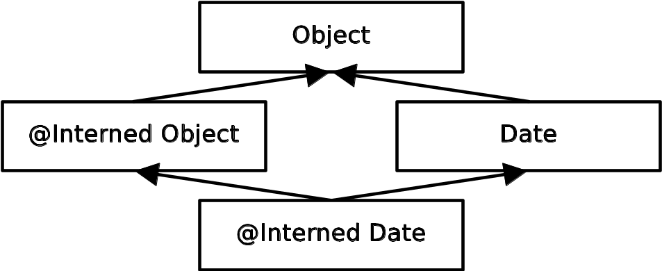
Problem: incorrect equality checks
Solution: Interning checker
  String s;
  @Interned String is, is2;
  ... is = myString.intern() ... // OK
  if (is == is2) { ... } // OK
  if (s == is) { ... } // unsafe equality
  is = s; // unsafe assignment
Type system:

Slide 20
Demo of Interning checker

Slide 21
Interning case study
Program: Daikon (250 KLOC)
Interning is important
  Daikon’s key scalability problem is memory
  1170 lines of code/comment refer to interning
    72% of files have none, 87% have 0, 1, or 2
  200 run-time assertions
  Emacs plug-in for String equality checking
124 annotations in 11 files (12KLOC)

Slide 22
Interning case study results
9 errors
  Missing calls to intern
2 performance bugs
  Unnecessary interning in inner loop of file reading
1 design flaw
  VarInfoName is not interned within its implementation, but all escaping objects are
  Too hard to understand complex interning
14 false positives (used @SuppressWarnings)

Slide 23
Security code in JDK 1.1
class Class {
private Object[] signers;
Object[] getSigners() {
return signers;
}
}

Slide 24
Security code in JDK 1.1
class Class {
private Object[] signers;
Object[] getSigners() {
return signers;
}
}
myClass.getSigners()[0] = “Sun”;

Slide 25
Immutability annotations prevent mutation errors
class Class {
private Object[] signers;
// Prohibits client from mutating
@Readonly Object[] getSigners() {
return signers;
}
}
myClass.getSigners()[0] = “Sun”; // Error

Slide 26
Immutability annotations prevent mutation errors
class Class {
// Forces getSigners to return a copy
private @Readonly Object[] signers;
Object[] getSigners() {
return signers; // Error
}
}
myClass.getSigners()[0] = “Sun”;

Slide 27
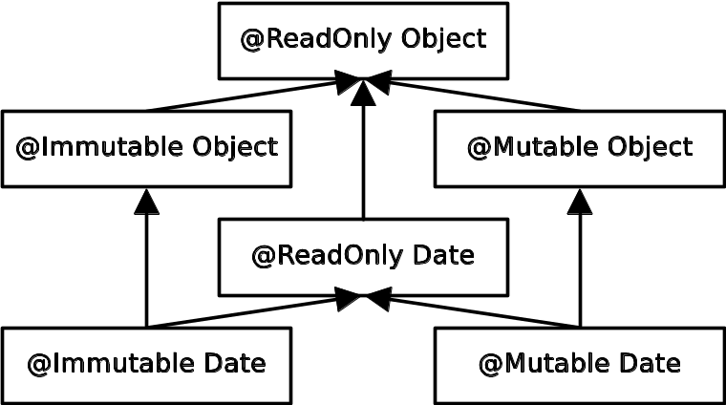
Problem: unintended side effects
Solution: IGJ (Immutability Generic Java)
Type system:
  ReadOnly: Reference immutability (aliases may modify)
  Immutable: Object immutability (object cannot change)
Inspired by generics

Slide 28
Demo of IGJ checker

Slide 29
IGJ case study
Programs (128KLOC)
  JOlden benchmarks
  htmlparser library
  tinySQL library
  SVNKit subversion client
  IGJ checker
4760 annotations (62133 possible locations)

Slide 30
IGJ case study results
Representation exposure errors
Constructors that left object in inconsistent state
In SVNKit:
  some getters have side effects
  some setters have no side effects
Used both reference and object immutability
More opportunities for immutability in new code than old

Slide 31
Usability of pluggable checkers
Scales to >200,000 LOC
Found bugs in every codebase
  More important: prevents bugs!
Few false positives
Programmers found the checkers easy to use
Is it too verbose?
  @NonNull: 1 per 75 lines
  @Interned: 124 annotations in 220KLOC revealed 11 bugs
  Possible to annotate part of program
  Fewer annotations in new code

Slide 32
A complete, useful type checker
@TypeQualifier
@SubtypeOf(Unqualified.class)
public @interface Encrypted { }
To use it:
Write @Encrypted in your program
Compile your program
javac -processor BasicChecker -Aquals=Encrypted YourProgram.java

Slide 33
Creating your own checker
Most users do not need to
Basic functionality: mention annotation on javac command line
Simple rules: declarative syntax (meta-annotations)
Special rules: override a few methods
  For Nullness: dereferences
  For Interning: equality
Examples of properties you can check:
  General-purpose (tainting)
  Project-specific (string formatting)

Slide 34
Defining type rules
Declarative and procedural syntax for type rules
  Expressive and concise
Common features are built in
  Subtyping: inheritance, overriding, assignment
  Arbitrary type qualifier hierarchy
  Polymorphism over types (Java generics)
  Polymorphism over type qualifiers
  Flow-sensitive type qualifier inference
  Implicit and default qualifiers
  Warning suppression
  ... see the manual for more

Slide 35
Who is using the tools?
Building type checkers:
  ETH Zurich, Radboud University, MIT, University of Buenos Aires, University of Saarland, Washington State University; others plan to
Integrating with other tools:
  IBM, INRIA, JetBrains, MIT, Oxford, Sun, Victoria University of Wellington
Using type checkers:
  Too many to count
Next user: you!

Slide 36
Conclusion
Checker Framework for writing type checkers
  Robust, scalable, easy to use, effective
  http://pag.csail.mit.edu/jsr308
    Web search: “JSR 308” or “Annotations on Java Types”
    Includes sample checkers, extensive documentation
Enables creation of new type systems
Yields insight into type systems
Programmers can prevent bugs

