Slide 1

Build Your Own Type System for Fun and Profit
Werner M. Dietl
Michael D. Ernst
http://types.cs.washington.edu/checker-framework/
University of Washington
Computer Science & Engineering

Slide 2
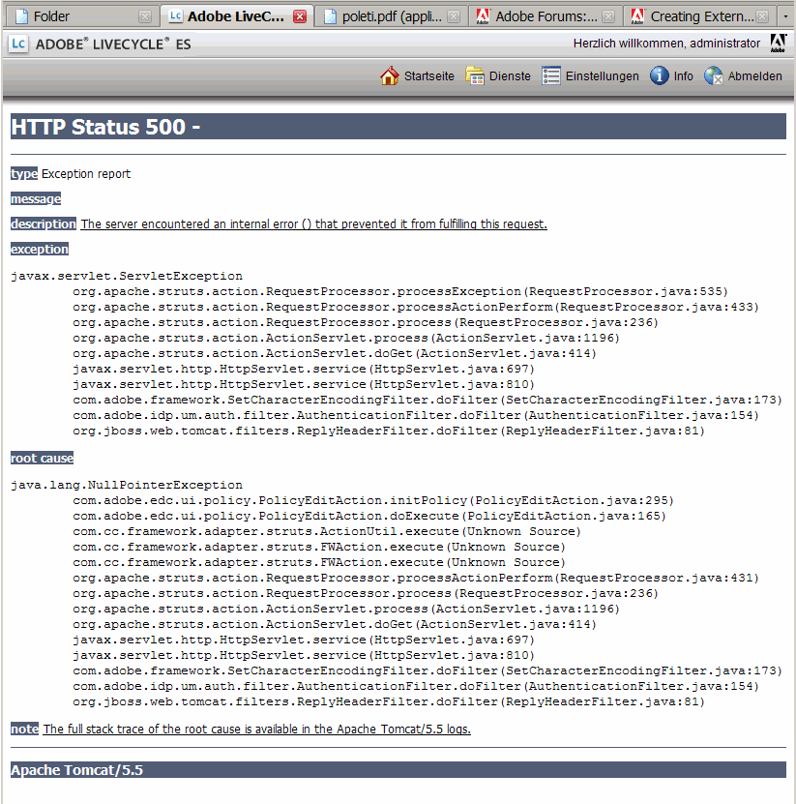
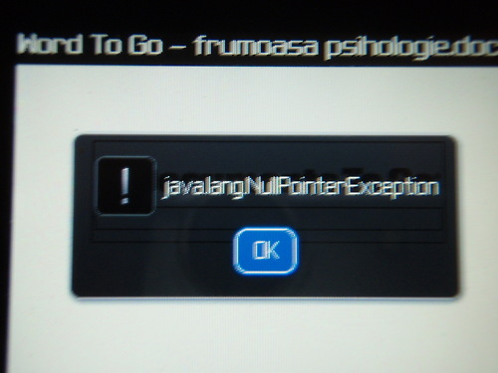
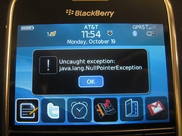
Software has too many errors

Slide 3
Java's type system is too weak
Type checking prevents many errors
int i = “hello”;
Type checking doesn't prevent enough errors
System.console().readLine();
Collections.emptyList().add(“one”);
dbStatement.executeQuery(userInput);

Slide 4
Better type systems can help!
  Null-pointer exceptions [Fähndrich & Leino '03]
  Unwanted mutations [Tschantz & Ernst '05]
  Concurrency errors [Boyapati et al. '02, Cunningham et al. '07]
  … many more!
Theory
Practice

Slide 5
Type system
Source
Code
Compiler,
Type Checker

Slide 6
Type system
Source
Code
Compiler,
Type Checker
Fix bugs
Errors
Change types

Slide 7
Type system
Crashes
Source
Code
Compiler,
Type Checker
0 errors
Executable
Fix bugs
Errors
Change types

Slide 8
Pluggable type system
0 warnings
Source
Code
Compiler,
Type Checker
Executable
Pluggable
Type Checker
Tool: the
Checker Framework
Fix bugs
Warnings
Add annotations
@Nullable Object myref;
…
myref.toString() // Warning!
Notes:
Prevent more bugs at compile time
Additional type annotations specify properties
Don't influence execution

Slide 9
sPluggable type systems
0 warnings
Source
Code
Compiler,
Type Checker
Executable
Pluggable
Type Checker
Pluggable
Type Checker
Pluggable
Type Checker
Fix bugs
Warnings
Add annotations
Notes:
Prevent more bugs at compile time
Additional type annotations specify properties
Don't influence execution

Slide 10
Outline
Pluggable type systems
Case studies & demo
Type system examples
How to build your own type system

Slide 11
The Checker Framework
A framework for pluggable type checkers
Plugs a type checker into the Java compiler
Easy to use:
javac -processor EncryptionChecker …
Ant, Maven, Eclipse
Free download:
http://types.cs.washington.edu/checker-framework/

Slide 12
Type annotation syntax
Annotations on all occurrences of types
  @Untainted String query;
List<@NonNull String> strings;
myGraph = (@Immutable Graph) tmpGraph;
class UnmodifiableList<T>
implements @Readonly List<@Readonly T> {}
Stored in classfile
Handled by javac, javadoc, javap, …
Part of Java 8, but you can use it with Java 5/6/7
  Backward compatible: write as a /*@comment*/

Slide 13
Outline
Pluggable type systems
Case studies & demo
Type system examples
How to build your own type system

Slide 14
Checker Framework experience
Type checkers reveal important latent bugs
  Ran on >3 million LOC of real-world code
  Found hundreds of user-visible bugs
Annotation overhead is low
  Mean 2.6 annotations per kLOC

Slide 15
Case study subject programs
Approach:
Write annotations
Run compiler
Each warning = program bug
or incorrect annotation
Fix the problem
Rerun the compiler
No more warnings →
Property guaranteed!
Swing: 610 kLOC
Lucene: 479 kLOC
Xerces: 257 kLOC
OpenJDK (17 packages): 231 kLOC
Daikon: 222 kLOC
JabRef: 117 kLOC
YaCy: 112 kLOC
Google Collections: 78 kLOC
GanttProject: 69 kLOC
ASM: 33 kLOC
Checker Framework: 31 kLOC
Annotation File Utilities: 17 kLOC

Slide 16
Null Pointer Exception type system
Runtime behavior to prevent:
NullPointerException
Legal operations:
Only dereference non-null references.
Types of data:
@NonNull reference is never null.
@Nullable reference may be null.
@Nullable Object
@NonNull Object

Slide 17
Null-pointer crash in Google Collections
class ForMapWithDefault {
@Nullable Object defaultValue;
public int hashCode() {
return map.hashCode() +
defaultValue.hashCode();
}
}
Found 9 such crashes, despite:
  45000 tests (2/3 of the LOC)
  Uses FindBugs @Nullable annotations,
  no FindBugs warnings
java.lang.NullPointerException

Slide 18
Java signatures type system
Runtime behavior to prevent:
ClassNotFoundException
Legal operations:
Class.forName takes a binary name
Types of data:
Unqualified strings: "Hello, world!"
Fully qualified names: "package.Outer.Inner"
Binary names: "package.Outer$Inner"
Field descriptors: "Lpackage/Outer$Inner;"

Slide 19
Java signatures type system
@Unqualified String
Runtime behavior to prevent
ClassNotFoundException
Legal operations
Class.forName takes a binary name
Types of data
Unqualified strings: "Hello, world!"
Fully qualified names: "package.Outer.Inner"
Binary names: "package.Outer$Inner"
Field descriptors: "Lpackage/Outer$Inner;"
@FullyQualifiedName
String
@BinaryName
String
@FieldDescriptor
String

Slide 20
Java signature bugs found
Example from java.lang.Class:
static Class<?> forName(String className)
“Returns the Class object associated with the class or interface with the given string name. ...
Parameters:
className - the fully qualified name of the
desired class”
Class.forName(“package.Outer.Inner”)
Class.forName(“package.Outer$Inner”)
java.lang.ClassNotFoundException
OK!

Slide 21
Signature String Checker
Found 11 crashing bugs in OpenJDK.
Found 13 crashing bugs in libraries.
Example annotations:
class Class<T> {
Class<?> forName(@BinaryName String className);
@BinaryName String getName();
@FullyQualifiedName String getCanonicalName();
}
String name = myclass.getCanonicalName();
Class.forName(name); // Warning

Slide 22
Regular expression type system
Runtime behavior to prevent:
PatternSyntaxException and
IndexOutOfBoundsException.
Legal operations:
Pattern.compile arg is a regex.
Matcher.group requires a regex with
minimum group count.
Types of data:
@Regex String: is a regex, has a group count
@Unqualified String: might not be a regex

Slide 23
Example: Regular expressions
Possible
PatternSyntaxException
String regex = getUserInput();
Pattern pat = Pattern.compile(regex);
Matcher mat = pat.matcher(content);
if (mat.matches()) {
println("Group: " + mat.group(4));
}
Possible
IndexOutOfBoundsException

Slide 24
DEMO!

Slide 25
Outline
Pluggable type systems
Case studies & demo
Type system examples
How to build your own type system

Slide 26
What we saw so far
What is pluggable type checking?
What is the Checker Framework?
Three examples:
  Nullness Checker
  Signature Checker
  Regex Checker

Slide 27
Brainstorming new type checkers
What runtime behavior do you wish to prevent?
  Properties of data, not of code structure, timing, ...
What operations are legal and illegal?
What types of data are there?

Slide 28
A sampling of type checkers
Property you care about:
Tainting
Java type signatures
Null dereferences
Concurrency
Mutability & side effects
Fake enumerations
Internationalization
Regular expressions
Object encapsulation
Energy efficiency
Equality tests
Annotation to use:
@Tainted
@BinaryName
@Nullable
@Lock, @GuardedBy
@Immutable
@SwingCompassDirection
@Localized
@Regex
@Rep, @Peer, @Any
@Approx, @Precise
@Interned

Slide 29
Outline
Pluggable type systems
Case studies & demo
Type system examples
How to build your own type system

Slide 30
Encryption type system
Runtime behavior to prevent:
Plaintext data sent over the network
Legal operations:
send() takes encrypted data
Types of data:
@Encrypted String: definitely encrypted
@Unqualified String: might be unencrypted
@Unqualified String
@Encrypted String

Slide 31
Encrypted communication
void send(@Encrypted String msg) {…}
@Encrypted String msg1 = ...;
send(msg1); // OK
String msg2 = ....;
send(msg2); // Warning!

Slide 32
Encrypted communication
void send(@Encrypted String msg) {…}
@Encrypted String msg1 = ...;
send(msg1); // OK
String msg2 = ....;
send(msg2); // Warning!
The complete checker:
@TypeQualifier
@SubtypeOf(Unqualified.class)
@Target(ElementType.TYPE_USE)
public @interface Encrypted {}
@Unqualified String
@Encrypted String

Slide 33
Parts of a Type Checker
@Unqualified String
Type qualifiers
  What qualifiers exist
  and how do they relate?
Qualifier introduction rules
  Implicit qualifiers
Type Rules
  Meaning of each operation
  including whether it is legal
@Encrypted String
"Hello, world!"
send(myCreditCardNum);

Slide 34
Part 1: Qualifiers and their relations
@TypeQualifier
@SubtypeOf(Unqualified.class)
public @interface Encrypted {}
@Unqualified String
@Encrypted String

Slide 35
Part 2: Implicit qualifiers
@TypeQualifier
@SubtypeOf({})
@ImplicitFor(
trees = {Tree.Kind.NULL_LITERAL},
typeNames = {Void.class})
public @interface Nullable {}
null
type is @Nullable

Slide 36
Part 3: Type rules
Default AST visitor enforces standard object-oriented typing rules
  Assignments, method calls, returns
  Method overriding
  Type well-formedness
Customize where needed
@Override public Void
visitMemberSelect(MemberSelectTree node, Void p) {
checkForNullability(node.getExpression(),
"dereference.of.nullable");
return super.visitMemberSelect(node, p);
}
x must be @NonNull
x.f

Slide 37
Java signatures type system
@Arbitrary String
Runtime behavior to prevent:
ClassNotFoundException
Legal operations:
Class.forName takes a binary name
Types of data:
Arbitrary strings: "Hello, world!"
Fully qualified names: "package.Outer.Inner"
Binary names: "package.Outer$Inner"
Field descriptors: "Lpackage/Outer$Inner;"
@FullyQualifiedName
String
@BinaryName
String
@FieldDescriptor
String

Slide 38
Signature String Checker
Type Qualifiers
@TypeQualifier
@SubtypeOf({Unqualified.class})
@ImplicitFor(stringPatterns="^[A-Za-z_]
[A-Za-z_0-9]*(\\.[A-Za-z_][A-Za-z_0-9]
*)*(\\[\\])*$")
public @interface FullyQualifiedName {}
@TypeQualifier
@SubtypeOf({Unqualified.class})
@ImplicitFor(stringPatterns="^[A-Za-z_]
[A-Za-z_0-9]*(\\.[A-Za-z_][A-Za-z_0-9]
*)*(\\$[A-Za-z_][A-Za-z_0-9]*)?(\\[\\]
)*$")
public @interface BinaryName {}
@TypeQualifier
@SubtypeOf({Unqualified.class})
@ImplicitFor(stringPatterns="^\\[*([BCDF
IJSZ]|L[A-Za-z_][A-Za-z_0-9]*(/[A-Za-z_]
[A-Za-z_0-9]*)*(\\$[A-Za-z_][A-Za-z_0-9]
*)?;)$")
public @interface FieldDescriptor {}
@TypeQualifier
@SubtypeOf({BinaryName.class,
FullyQualifiedName.class})
public @interface SourceName {}
@TypeQualifier
@SubtypeOf({Unqualified.class})
public @interface MethodDescriptor {}
@TypeQualifier
@SubtypeOf({BinaryName.class,
FieldDescriptor.class, SourceName.class,
FullyQualifiedName.class, MethodDescriptor.class})
@ImplicitFor(trees={Tree.Kind.NULL_LITERAL})
public @interface SignatureBottom {}
@TypeQualifiers({BinaryName.class,
FullyQualifiedName.class, SourceName.class,
FieldDescriptor.class, Unqualified.class,
MethodDescriptor.class, SignatureBottom.class})
public final class SignatureChecker
extends BaseTypeChecker {}
Type Checker

Slide 39
Complex checkers are possible
Nullness Checker is actually 3 checkers:
Nullness itself
Object initialization
Keys in maps
  Infers when Map.get returns non-null

Slide 40
Powerful analyses are built in
Example: flow-sensitive type inference
@Nullable Object x = …;
x.toString(); // Warning!
if (x != null) {
x.toString(); // OK
}
Contributes to low annotation overhead

Slide 41
More tools
Inference tools
Annotation tools to insert annotations
Specification files for libraries

Slide 42
The Checker Framework
Powerful framework for type checkers
Built-in checkers are ready to use
  Identify many latent bugs
Easy to create your own type system
  3 rules for designing a type system
Improve your code today!
http://types.cs.washington.edu/checker-framework/

