Slide 1
Pluggable type-checking
An application of Java SE 8 type annotations
Java's type-checker prevents errors
  int x = "hello world";
Java's type-checker doesn't prevent enough errors
  Null pointer exceptions
  Undesired side effects
  Mismatched parentheses in regular expressions
  ...
Idea: any run-time exception can be detected and prevented at compile time
  Run a more powerful type-checker as a compiler plug-in
  Warns about potential errors

Slide 2
Two examples of pluggable type-checking
Fake enumerations
Units of measure

Slide 3
Fake enumerations
Using int where enum would have been better
Problems:
Documentation
Error checking

Slide 4
Fake enumeration error examples:
JabRef bibliography manager
http://jabref.sourceforge.net
class EntryTypeDialog {
EntryTypeDialog() {
// should have been Component.RIGHT_ALIGNMENT (=1)
component.setAlignmentX(SwingConstants.LEFT); // 2
}
}
class FileListEditor {
Thread autoSetLinks(...) {
// args should be minimum and maximum values
new JProgressBar(JProgressBar.HORIZONTAL, types.length-1);
}
}
class FieldNameLabel {
FieldNameLabel()
// wrong constant; should be TOP
label.setVerticalAlignment(NORTH);
}
}
All these bugs have been fixed

Slide 5
Units of measure
meters vs. yards
kilograms vs. pounds
radians vs. degrees

Slide 6

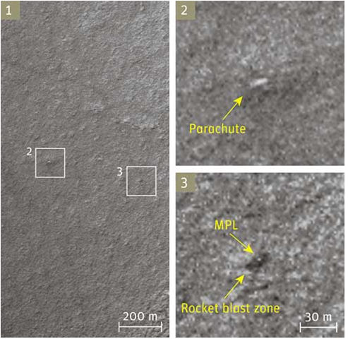
Mars Climate Orbiter
Unit error in thruster controller: lbf-s vs. N-s
Crashed into Mars
3 years of work, > $125 million

Slide 7

Gimli Glider
Fuel computation: pounds instead of kilograms
Ran out of fuel, glided to an abandoned airfield

Slide 8

Rampaging turtles
Moorpark College built an enclosure to contain a 250-pound tortoise
The first night, 250-kg Clarence pushed over a fencepost
and escaped

Slide 9
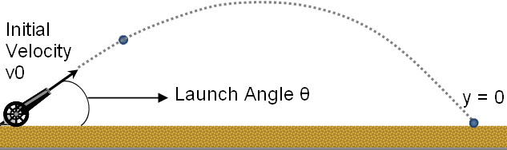
Ballistics
How far away do you need to be to be safe?

Slide 10
The Checker Framework
Tool for pluggable type-checking
  Comes with many type-checkers
    null pointers, == vs. equals(), locking, security, string syntax (regex, format strings), internationalization, ...
  You can build your own
  Uses Java 8 type annotations (or comments)
    List<@Nullable String>
    List</*@Nullable*/ String>
Improves documentation, prevents bugs
Try it! http://checker-framework.googlecode.com

