Slide 1
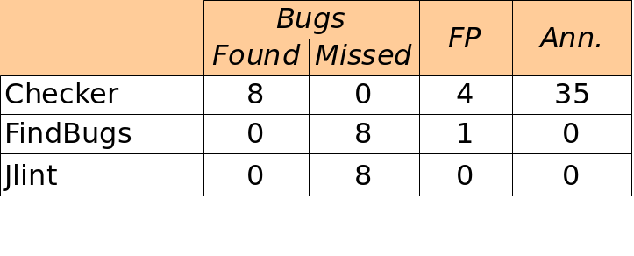
Compile-time Typechecking for Custom Java Type Qualifiers
http://pag.csail.mit.edu/jsr308
Mahmood Ali, Matthew M. Papi, and Michael D. Ernst Program Analysis Group, MIT CSAIL
Motivation
Goals
Type qualifiers:
Improve documentation
Find bugs in programs
Guarantee the absence of errors
Aid compilers and analysis tools
Reduce the need for assertions and run-time checks
1. Allow programmers to write type qualifiers
List<@NonNull String> names;
ResultSet executeQuery(@Untainted String query);
Planned for inclusion in Java 7
Backward-compatible: qualifiers in comments
- Use it today!
class Folder<F extends /*@Existing*/ File> {...}
class UnmodifiableList<T>
implements /*@ReadOnly*/ List<T> { ... }
2. Allow compile-time verification of qualifier semantics:
javac -processor NullnessChecker [source files]
javac parses
input files
checker finds
no errors
javac finishes
compilation,
writes class files
javac calls
typechecker
plug-in
checker finds
errors
javac reports
errors and
terminates
Writing a Checker
Using a Checker
Simple Checkers
Sophisticated Checkers
Effective
Usable
Example: Tainting checker checks usage of untrusted data
Complete checker:
@TypeAnnotation
@SubtypeOf(Unqualified.class)
public @interface Untainted { }
Simple checkers require no code
- declarative syntax for common use
Featureful:
- Type Rules: assignments, overriding, etc
- Polymorphic (Java Generics)
- Flow-sensitive type qualifier inference
- Qualifier default
- Warning suppression
Checkers for expressive type systems for:
- @NonNull: nullness errors
- @Interned: incorrect equality tests
- @ReadOnly: undesired side-effects
Sophisticated checkers are concise:
Override a method for each special check
- Nullness: dereferencing
- Interning: equality test
Publicly available:
http://pag.csail.mit.edu/jsr308
website includes all checkers and
documentation
Scales to > 200, 000 LOC
Each checker found errors in every code base it ran on (including itself)
Few false positives
Nullness Tools comparison:
4KLOC code base
Programmers found the checkers easy to use
Tool support: javac, Ant, Eclipse, Netbeans
Not too verbose
- @NonNull: 1 per 75 lines
- @Interned: 124 annotations in 220KLOC
revealed 11 bugs
Possible to annotate part of program
Fewer annotations in new code
Case studies details:
  “Practice Pluggable Types in Java,” ISSTA 2008
Ann. = annotations inserted by programmer
FP = false positives (suppressed by an annotation or assertion)

