Slide 1
Preventing bugs with pluggable type checking
print(@Readonly Object x) {
List<@NonNull String> lst;
…
}
Michael Ernst and Mahmood Ali
University of Washington and MIT
OOPSLA 2009 tutorial

Slide 2
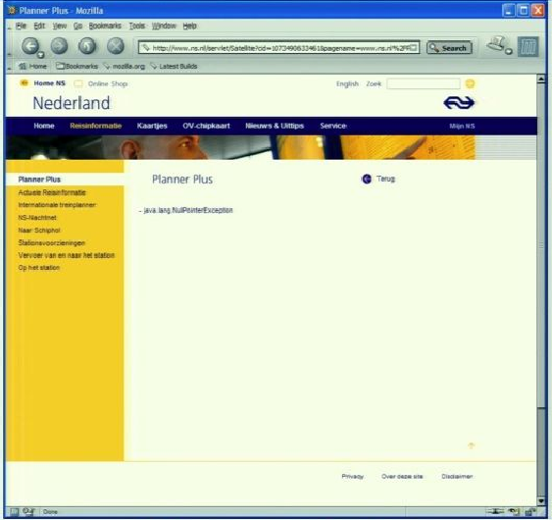
Motivation
java.lang.NullPointerException

Slide 3
Problem:
Java’s type checking is too weak
Type checking prevents many bugs
    int i = “hello”; // type error
Type checking doesn’t prevent enough bugs
  System.console().readLine();
    NullPointerException
  Collections.emptyList().add(“One”);
    UnsupportedOperationException
Notes:
Programmers wish to prevent these.

Slide 4
Some errors are silent
  Date date = new Date(0);
  myMap.put(date, “Java Epoch”);
  date.setYear(70);
  myMap.put(date, “Linux Epoch”);
    Corrupted map
  dbStatement.executeQuery(userInput);
    SQL injection attack
Information flow, initialization, data formatting, side effects, equality tests, …

Slide 5
Solution: Pluggable type systems
Design a type system to solve a specific problem
Write type qualifiers in your code (or, type inference)
  @Immutable Date date = new Date(0);
  date.setTime(70); // compile-time error
Type checker warns about violations (bugs)
% javac -processor NullnessChecker MyFile.java
MyFile.java:149: dereference of possibly-null reference bb2
allVars = bb2.vars;
^

Slide 6
Problem 2:
Implementing pluggable types
A type system is valuable only if it helps developers to find and prevent errors
A robust implementation is essential
  Learn from case studies, user feedback
A robust implementation is difficult
  Custom implementation: hard
  Previous frameworks: too weak
  Users are unlikely to use a special-purpose compiler
Hampers use and understanding of type systems
Alternate evaluation strategies:
  Soundness proof for core calculus
  Toy examples
Notes:
Hard to build and maintain, and is too brittle

Slide 7
Implementing pluggable types for immutability
Javari type system for reference immutability
  OOPSLA 2005 paper: 160KLOC case studies
IGJ type system for reference and object immutability
  FSE 2007 paper: 106KLOC case studies
Case studies provided essential preliminary insight
  We have since learned more from larger studies
Building compilers was tedious
  Language syntax was not 100% backward-compatible
Notes:
This slide is about our motivation for changing the Java syntax and creating the Checker Framework

Slide 8
Solution:
The Checker Framework
Enables creation of pluggable types for Java
Expressive
  Can create realistic type systems
Concise
  Most checks are built in
  Declarative syntax for common cases
Scalable
  Large programs
  Full Java language
  Java toolchain
Compatible
  Standard Java 7 language and compiler
Aids programmers and type system designers
Notes:
Are these the right key points to make?
The other tools also find other bugs
Most checks are built in
Override a few methods for type rules
Declarative syntax for common cases
Type qualifier hierarchy
Type introduction rules
Simple type systems require no code
But sophisticated type systems are possible

Slide 9
Goal of this tutorial
Enable you to build, customize, and/or use pluggable type-checkers
Aimed at:
  Researchers who wish to build, evaluate, and field new type systems
  Practitioners who wish to make their code more reliable

Slide 10
Outline
Type qualifiers
Pluggable type checkers
How to write your own checker
Case studies: source code of existing checkers
Practice: write and use checkers

Slide 11
Survey
What are your roles?
  Type system designer (researcher or practitioner)
  Programmer seeking to write better code
  Educator
  Other

Slide 12
Your background
Have you ever developed a type system?
  If not, would you feel comfortable doing so?
Do you write raw types (non-generic types)?
  Usually; generics are a nuisance
  Often
  Sometimes, anytime generics are inconvenient
  Rarely
  Only to interface with non-generic libraries
Notes:
Here’s a secret: developing a simple but useful type system is easy.

Slide 13
Your motivation
Implement a particular type system
  Question applies to researchers and practitioners
Make a particular application more reliable
  What are its application-specific type properties?
Educate students
  About robust programming, type systems, state of the art
Bring a compelling story/vision/demo to colleagues
  Or, maybe you are a skeptic yourself
Other motivations
Notes:
Having a type system or application in mind was very rare

Slide 14
What you want to see or do
See demos
Review & understand checker implementations
Get practice running pluggable type-checkers on your code
  Or, get yourself set up to do so on your own
Get practice writing pluggable type-checkers
Learn theory: type system features, pluggable types, defining a type system
Notes:
Most popular: demo, view code, write their own

Slide 15
Outline
Type qualifiers
Pluggable type checkers
How to write your own checker
Case studies: source code of existing checkers
Practice: write and use checkers

Slide 16
How the tools fit together
Nullness Checker
Mutation Checker
Tainting Checker
...
Your Checker
Type inference tools
Other tools
Checker Framework
(enables creation of pluggable type-checkers)
Annotation File Utilities
(.java ↔ .class files)
Type Annotations language syntax and classfile format (“JSR 308”)
(no built-in semantics)

Slide 17
Outline
Type qualifiers
Pluggable type checkers
How to write your own checker
Case studies: source code of existing checkers
Practice: write and use checkers

Slide 18
Type qualifiers
Java 7 annotation syntax
  @Untainted String query;
  List<@NonNull String> strings;
  myGraph = (@Immutable Graph) tmpGraph;
  class UnmodifiableList<T>
  implements @Readonly List<@Readonly T> {}
Backward-compatible: compile with any Java compiler
  List</*@NonNull*/ String> strings;
Notes:
Carried through to classfile

Slide 19
Tool integration
Language support:
  Compilers & IDEs:
    javac, Intellij IDEA, tIDE, some Eclipse support
    Underway: full Eclipse, NetBeans
  Type annotations are carried through to the classfile
Pluggable type-checking:
  Type inference: 5 tools integrated so far
    More underway
  Annotate libraries without source code

Slide 20
Benefits of type qualifiers
Improve documentation
Find bugs in programs
Guarantee the absence of errors
Aid compilers and analysis tools
Reduce number of assertions and run-time checks
Possible negatives:
  Must write the types (or use type inference)
  False positives are possible (must be suppressed)

Slide 21
Outline
Type qualifiers
Pluggable type checkers
How to write your own checker
Case studies: source code of existing checkers
Practice: write and use checkers

Slide 22
Sample type checkers
Null dereferences (@NonNull, @Nullable)
Errors in equality testing (@Interned)
Immutability:
  Reference immutability (Javari)
  Reference & object immutability (IGJ)
Locking (prevent concurrency bugs)
Tainting (information flow for security)
Many other simple checkers are possible
  Security: encryption, tainting, access control
  Encoding: SQL, URL, ASCII/Unicode

Slide 23
Using checkers
Designed as compiler plug-ins (i.e., annotation processors)
Use familiar error messages
        % javac -processor NullnessChecker MyFile.java
        MyFile.java:9: incompatible types.
        nonNull = nullable;
        ^
        found : @Nullable String
        required: @NonNull String

Slide 24
Nullness and mutation demo

Slide 25
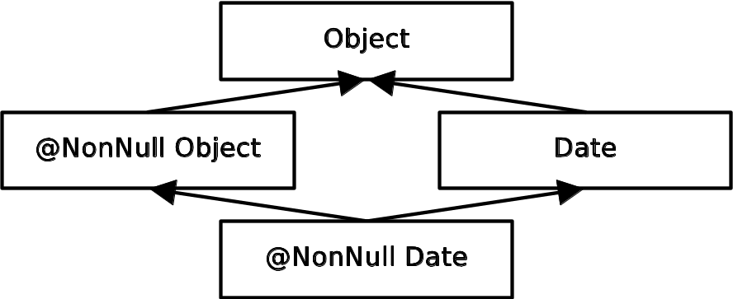
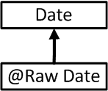
Problem: NullPointerExceptions Solution: Nullness checker
  Object obj; // might be null
  @NonNull Object nnobj; // never null
  nnobj.toString(); // OK
  obj.toString(); // possible NPE
  obj = ...; // OK
  nnobj = obj; // nnobj may become null
Type system:
Also handles nullness in partially-initialized objects

Slide 26
Local type refinement (inference)
/*@Nullable*/ Date d1, d2, d3;
d1 = new Date();
d1.getMonth(); // OK: d1 is non-null
assert d2 != null;
d2.getMonth(); // OK
if (d3 != null) {
d3.getMonth(); // OK
}
Often, no annotations
  Due to type refinement and careful choice of defaults

Slide 27
Demo of IGJ checker

Slide 28
Security code in JDK 1.1
class Class {
private Object[] signers;
Object[] getSigners() {
return signers;
}
}

Slide 29
Security code in JDK 1.1
class Class {
private Object[] signers;
Object[] getSigners() {
return signers;
}
}
myClass.getSigners()[0] = “Sun”;

Slide 30
Immutability annotations prevent mutation errors
class Class {
private Object[] signers;
// Prohibits client from mutating
@Readonly Object[] getSigners() {
return signers;
}
}
myClass.getSigners()[0] = “Sun”; // Error

Slide 31
Immutability annotations prevent mutation errors
class Class {
// Forces getSigners to return a copy
private @Readonly Object[] signers;
Object[] getSigners() {
return signers; // Error
}
}
myClass.getSigners()[0] = “Sun”;

Slide 32
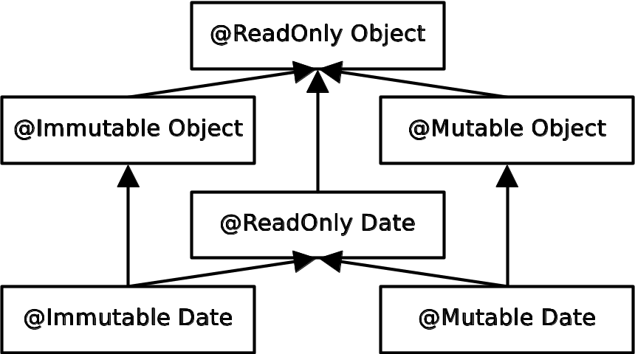
Problem: unintended side effects
Solution: IGJ (Immutability Generic Java)
Type system:
  ReadOnly: Reference immutability (aliases may modify)
  Immutable: Object immutability (object cannot change)
  Mutable: anyone can change it
2 questions:
  Can this reference modify?
  Can any other aliasing
  reference modify?

Slide 33
IGJ case study
Programs (128KLOC)
  JOlden benchmarks
  htmlparser library
  tinySQL library
  SVNKit subversion client
  IGJ checker
4760 annotations (62133 possible locations)

Slide 34
IGJ case study results
Representation exposure errors
Constructors that left object in inconsistent state
In SVNKit:
  some getters have side effects
  some setters have no side effects
Used both reference and object immutability
More opportunities for immutability in new code than old

Slide 35
Interning
(= canonicalization, hash-consing)
Reuse an existing object instead of creating a new one
A space optimization: savings can be significant
A time optimization: use == for comparisons
Built into java.lang.String: intern() method
Users can add interning for their own classes
s1
“hello”
s2
“hello”
s3
“hello”

Slide 36
Interning
(= canonicalization, hash-consing)
Reuse an existing object instead of creating a new one
A space optimization: savings can be significant
A time optimization: use == for comparisons
Built into java.lang.String: intern() method
Users can add interning for their own classes
s1
“hello”
s2
“hello”
s3
“hello”

Slide 37
Interning
(= canonicalization, hash-consing)
Reuse an existing object instead of creating a new one
A space optimization: savings can be significant
A time optimization: use == for comparisons
Built into java.lang.String: intern() method
Users can add interning for their own classes
s1
“hello”
s1 = s1.intern();
s2
“hello”
s3
“hello”

Slide 38
Interning
(= canonicalization, hash-consing)
Reuse an existing object instead of creating a new one
A space optimization: savings can be significant
A time optimization: use == for comparisons
Built into java.lang.String: intern() method
Users can add interning for their own classes
s1
“hello”
s1 = s1.intern();
s2 = s2.intern();
s2
“hello”
s3
“hello”

Slide 39
Interning
(= canonicalization, hash-consing)
Reuse an existing object instead of creating a new one
A space optimization: savings can be significant
A time optimization: use == for comparisons
Built into java.lang.String: intern() method
Users can add interning for their own classes
s1
“hello”
s1 = s1.intern();
s2 = s2.intern();
s3 = s3.intern();
s2
“hello”
s3
“hello”

Slide 40
Interning
(= canonicalization, hash-consing)
Reuse an existing object instead of creating a new one
A space optimization: savings can be significant
A time optimization: use == for comparisons
Built into java.lang.String: intern() method
Users can add interning for their own classes
s1
“hello”
s1 = s1.intern();
s2 = s2.intern();
s3 = s3.intern();
s2
“hello”
s3
“hello”

Slide 41
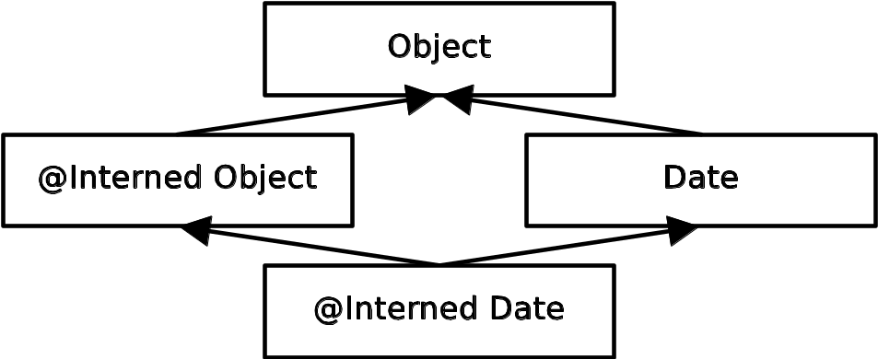
Problem: incorrect equality checks
Solution: Interning checker
  String s;
  @Interned String is, is2;
  ... is = myString.intern() ... // OK
  if (is == is2) { ... } // OK
  if (s == is) { ... } // unsafe equality
  is = s; // unsafe assignment
Type system:

Slide 42
Demo of Interning checker

Slide 43
Checkers are effective
Scales to > 200,000 LOC
Each checker found errors in each code base it ran on
  Verified by a human and fixed

Slide 44
Comparison: other Nullness tools
 | Null pointer errors |  | False warnings | Annotations written
 | Found | Missed
Checker framework | 8 | 0 | 4 | 35
FindBugs | 0 | 8 | 1 | 0
Jlint | 0 | 8 | 8 | 0
PMD | 0 | 8 | 0 | 0
Checking the Lookup program for file system searching
  4KLOC program, but we have verified programs >100KLOC
False warnings are suppressed via an annotation or assertion

Slide 45
Comparison: Other pluggable type-checking frameworks
JQual and JavaCOP authors attempted to implement Javari
  Only supported 1 out of 5 Javari keywords
  Incorrect semantics for method overriding
  Not usable in practice
  Ours was built by a sophomore working part-time

Slide 46
Checkers are featureful
Full type systems: inheritance, overriding, etc.
Generics (type polymorphism)
  Also qualifier polymorphism
Flow-sensitive type qualifier inference
Qualifier defaults
Warning suppression

Slide 47
Checkers are usable
Integrated with toolchain
  javac, Ant, Eclipse, Netbeans
Few false positives
Annotations are not verbose
  @NonNull: 1 per 75 lines
  @Interned: 124 annotations in 220KLOC revealed 11 bugs
  Possible to annotate part of program
  Fewer annotations in new code
  Inference tools: nullness, mutability
  Annotations reduce textual documentation (replace a sentence)
Notes:
Code clutter is a common concern

Slide 48
What a checker guarantees
The program satisfies the type property. There are:
  no bugs (of particular varieties)
  no wrong annotations
Caveat 1: only for code that is checked
  Native methods
  Reflection
  Code compiled without the pluggable type checker
  Suppressed warnings
    Indicates what code a human should analyze
  Checking part of a program is still useful
Caveat 2: the checker itself might contain an error

Slide 49
Annotating libraries
Each checker includes JDK annotations
  Typically, only for signatures, not bodies
  Finds errors in clients, but not in the library itself
Inference tools for annotating new libraries

Slide 50
Outline
Type qualifiers
Pluggable type checkers
How to write your own checker
Case studies: source code of existing checkers
Practice: write and use checkers

Slide 51
SQL injection attack
Server code bug: SQL query constructed using unfiltered user input
  query = “SELECT * FROM users ”
  + “WHERE name=‘” + userInput + “’;”;
User inputs: a’ or ‘t’=‘t
Result:
  query ⇒ SELECT * FROM users
  WHERE name=‘a’ or ‘t’=‘t’;
Query returns information about all users

Slide 52
Taint checker
@TypeQualifier
@SubtypeOf(Unqualified.class)
@ImplicitFor(trees = {STRING_LITERAL})
public @interface Untainted { }
To use it:
Write @Untainted in your program
List getPosts(@Untainted String category) { … }
Compile your program
javac -processor BasicChecker -Aquals=Untainted
MyProgram.java

Slide 53

Taint checker demo

Slide 54
Defining a type system
@TypeQualifier
public @interface NonNull { }
Notes:
Don’t go too fast in this sequence.

Slide 55
Defining a type system
Type qualifier hierarchy
Type introduction rules
Other type rules
@TypeQualifier
public @interface NonNull { }
Notes:
Don’t go too fast in this sequence.

Slide 56
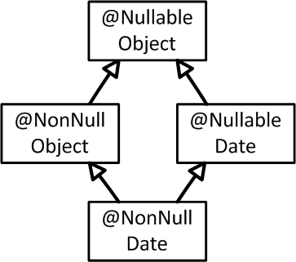
Defining a type system
Type qualifier hierarchy
Type introduction rules
Other type rules
@TypeQualifier
@SubtypeOf( Nullable.class )
public @interface NonNull { }
Notes:
Handles supertype modifiers (proper treatment of extends clauses).

Slide 57
Defining a type system
Type qualifier hierarchy
Type introduction rules
Other type rules
@TypeQualifier
@SubtypeOf( Nullable.class )
@ImplicitFor(trees={ NEW_CLASS,
PLUS,
BOOLEAN_LITERAL, ... } )
public @interface NonNull { }
new Date()
“hello ” + getName()
Boolean.TRUE

Slide 58
Defining a type system
Type qualifier hierarchy
Type introduction rules
Other type rules
void visitSynchronized(SynchronizedTree node) {
ExpressionTree expr = node.getExpression();
AnnotatedTypeMirror type = getAnnotatedType(expr);
if (! type.hasAnnotation(NONNULL))
checker.report(Result.failure(...), expr);
}
synchronized(expr) {
…
}
Warn if expr
may be null
Notes:
Override a method in the framework
Examples of procedural rules: for nullness, dereferences; for interning, equality checks
Some checkers have none

Slide 59
Built-in type system features
Subtyping: inheritance, overriding, assignment
Arbitrary type qualifier hierarchy
Polymorphism over types (Java generics)
Polymorphism over type qualifiers
Limited dependent types
Flow-sensitive type qualifier inference
Implicit qualifiers
User-controlled defaults
Warning suppression
... see the manual for more

Slide 60
Type polymorphism (generics)
Defining a generic class (usually, very few annotations):
  class ArrayList<E> {
  void put(E obj) { … }
  E get(int i) { … }
  boolean contains(@Nullable Object o) { … }
  }
  Can restrict instantiation:
  class PriorityQueue<E extends @NonNull Object> {…}
Using a generic class:
  List<@NonNull String> l1;
  List<@Nullable String> l2;
Semantics: substitute type argument (including qualifiers) for type parameter

Slide 61
Polymorphism over type qualifiers
Class.cast() method:
  @PolyNull T cast(@PolyNull Object obj) { ... }
This is like writing:
  @NonNull T cast( @NonNull Object obj) { ... }
  @Nullable T cast(@Nullable Object obj) { ... }
Usage tips:
  Not usually needed if generics are present
  Usually used on result and 1+ parameters
How to define @PolyNull:
  @PolymorphicQualifier
  public @interface PolyNull { }

Slide 62
Unused fields
A subtype can have more fields than its parent
The same can be true for qualified types
  class Person { ... @Unused(when=Single.class) Person spouse;
  ...
  }
  Person p;
  ... p.spouse ... // OK
  @Single Person bachelor;
  ... bachelor.spouse ... // ERROR

Slide 63
Dependent types
To get the same effect as on the previous slide:
  class Person {
  @Dependent(result=NonNull.class,
  when=Married.class)
  @Nullable Person spouse;
  ...
  }

Slide 64
Creating a checker
Each checker is <500 LOC
  Sometimes much less
Under construction at:
  CMU, ETH Zurich, MIT, Radboud U., U. of Buenos Aires, U. of California at Los Angeles, U. of Saarland, U. of Washington, U. of Wisconsin, Victoria U. of Wellington, Washington State U., …
  You can write your own!

Slide 65
How the tools fit together
Nullness Checker
Mutation Checker
Tainting Checker
...
Your Checker
Type inference tools
Other tools
Checker Framework
(enables creation of pluggable type-checkers)
Annotation File Utilities
(.java ↔ .class files)
Type Annotations language syntax and classfile format (“JSR 308”)
(no built-in semantics)

Slide 66
Outline
Type qualifiers
Pluggable type checkers
How to write your own checker
Case studies: source code of existing checkers
Practice: write and use checkers

Slide 67
Defining a type system
Type qualifier hierarchy
Type introduction rules
  Example: InterningAnnotatedTypeFactory
Other type rules
  Example: NullnessVisitor
Notes:
Don’t go too fast in this sequence.

Slide 68
Outline
Type qualifiers
Pluggable type checkers
How to write your own checker
Case studies: source code of existing checkers
Practice: write and use checkers

Slide 69
Outline
Type qualifiers
Pluggable type checkers
How to write your own checker
Case studies: source code of existing checkers
Practice: write and use checkers
Conclusion

Slide 70
What you have learned
Java 7 annotation syntax
Pluggable type-checkers you can use today
  Nullness, immutability, tainting, …
Theoretical framework for a type system
How to create a pluggable type-checker
  Detects/prevents bugs at compile time
  Featureful, effective, easy to use, scalable
  Using the Checker Framework
Download:
http://types.cs.washington.edu/checker-framework
Notes:
Catch me anytime for a demo.

