Slide 1
Preventing bugs with pluggable type checking
print(@Readonly Object x) {
List<@NonNull String> lst;
…
}
Michael Ernst
University of Washington
Joint work with Mahmood Ali and Matthew Papi

Slide 2
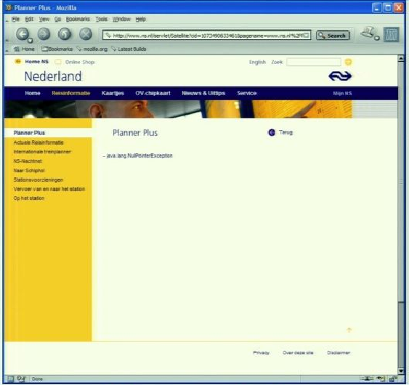
Motivation
java.lang.NullPointerException

Slide 3
Java’s type checking is too weak
Type checking prevents many bugs
    int i = “hello”; // type error
Type checking doesn’t prevent enough bugs
  System.console().readLine();
    NullPointerException
  Collections.emptyList().add(“One”);
    UnsupportedOperationException
Notes:
Programmers wish to prevent these.

Slide 4
Some errors are silent
  Date date = new Date(0);
  myMap.put(date, “Java Epoch”);
  date.setYear(70);
  myMap.put(date, “Linux Epoch”);
    Corrupted map
  dbStatement.executeQuery(userInput);
    UnsupportedOperationException
Equality tests, initialization, data formatting, …

Slide 5
Solution: Pluggable type systems
Design a type system to solve a specific problem
Write type qualifiers in your code (or, type inference)
  @Immutable Date date = new Date(0);
  date.setTime(70); // compile-time error
Type checker warns about violations (bugs)
% javac -processor NullnessChecker MyFile.java
MyFile.java:149: dereference of possibly-null reference bb2
allVars = bb2.vars;
^

Slide 6
Outline
Type qualifiers
Pluggable type checkers
Writing your own checker
Conclusion

Slide 7
Type qualifiers
Java 7 annotation syntax
  @Untainted String query;
  List<@NonNull String> strings;
  myGraph = (@Immutable Graph) tmpGraph;
  class UnmodifiableList<T>
  implements @Readonly List<@Readonly T> {}
Backward-compatible: compile with any Java compiler
  List</*@NonNull*/ String> strings;
Notes:
Carried through to classfile

Slide 8
Benefits of type qualifiers
Improve documentation
Find bugs in programs
Guarantee the absence of errors
Aid compilers and analysis tools
Reduce the need for assertions and run-time checks

Slide 9
Outline
Type qualifiers
Pluggable type checkers
Writing your own checker
Conclusion

Slide 10
Sample checkers
@NonNull: null dereference
@Interned: incorrect equality tests
@Immutable: incorrect mutation and side-effects
Many other simple checkers
  Security: encryption, tainting, access control
  Encoding: SQL, URL, ASCII/Unicode
Under construction:
  CMU, ETH Zurich, MIT, Radboud U., U. of Buenos Aires, U. of California at Los Angeles, U. of Saarland, U. of Washington, U. of Wisconsin, Washington State U., …...

Slide 11

Using Checkers
Designed as compiler plug-ins (i.e. annotation processors)
Use familiar error messages
        % javac -processor NullnessChecker MyFile.java
        MyFile.java:9: incompatible types.
        found : @Nullable String
        required: @NonNull String
        nonNull = nullable;
        ^

Slide 12
Nullness and mutation demo

Slide 13
Checkers are effective
Scales to > 200,000 LOC
Each checker found errors in each code base it ran on
  Verified by a human and fixed

Slide 14
Comparison: other Nullness tools
 | Null pointer errors |  | False warnings | Annotations written
 | Found | Missed
Checker framework | 8 | 0 | 4 | 35
FindBugs | 0 | 8 | 1 | 0
Jlint | 0 | 8 | 8 | 0
PMD | 0 | 8 | 0 | 0
Checking a 4KLOC program
False warnings are suppressed via an annotation or assertion

Slide 15
Checkers are featureful
Full type systems: inheritance, overriding, etc.
Generics (type polymorphism)
  Also qualifier polymorphism
Flow-sensitive type qualifier inference
Qualifier defaults
Warning suppression

Slide 16
Checkers are usable
Integrated with toolchain
  javac, Ant, Eclipse, Netbeans
Few false positives
Annotations are not too verbose
  @NonNull: 1 per 75 lines
  @Interned: 124 annotations in 220KLOC revealed 11 bugs
  Possible to annotate part of program
  Fewer annotations in new code
  Inference tools: nullness, mutability

Slide 17
What a checker guarantees
The program satisfies the type property
  There are no bugs (of particular varieties)
Caveat: only for code that is checked
  Native methods
  Reflection
  Code compiled without the pluggable type checker
  Suppressed warnings
    Indicates what code a human should analyze
Checking part of a program is still useful

Slide 18
Annotating libraries
Each checker includes JDK annotations
  Typically, only for signatures, not bodies
  Finds errors in clients, but not in the library itself
Inference tools for annotating new libraries

Slide 19
Outline
Type qualifiers
Pluggable type checkers
Writing your own checker
Conclusion

Slide 20
SQL injection attack
Server code bug: SQL query constructed using unfiltered user input
  query = “SELECT * FROM users ”
  + “WHERE name=‘” + userInput + “’;”;
User inputs: a’ or ‘t’=‘t
Result:
  query ⇒ SELECT * FROM users
  WHERE name=‘a’ or ‘t’=‘t’;
Query returns information about all users

Slide 21
Tainting checker
@TypeQualifier
@SubtypeOf(Unqualified.class)
@ImplicitFor(trees = {STRING_LITERAL})
public @interface Untainted { }
To use it:
Write @Untainted in your program
List getPosts(@Untainted String category) { … }
Compile your program
javac -processor BasicChecker -Aquals=Untainted
MyProgram.java

Slide 22

Tainting checker demo

Slide 23
Defining a type system
@TypeQualifier
public @interface NonNull { }
Notes:
Don’t go too fast in this sequence.

Slide 24
Defining a type system
Type qualifier hierarchy
Type introduction rules
Other type rules
@TypeQualifier
public @interface NonNull { }
Notes:
Don’t go too fast in this sequence.

Slide 25
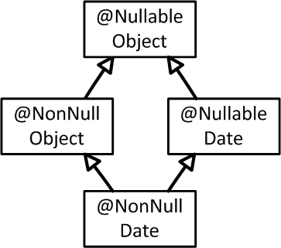
Defining a type system
Type qualifier hierarchy
Type introduction rules
Other type rules
@TypeQualifier
@SubtypeOf( Nullable.class )
public @interface NonNull { }
Notes:
Handles supertype modifiers (proper treatment of extends clauses).

Slide 26
Defining a type system
Type qualifier hierarchy
Type introduction rules
Other type rules
@TypeQualifier
@SubtypeOf( Nullable.class )
@ImplicitFor(trees={ NEW_CLASS,
PLUS,
BOOLEAN_LITERAL, ... } )
public @interface NonNull { }
new Date()
“hello ” + getName()
Boolean.TRUE

Slide 27
Defining a type system
Type qualifier hierarchy
Type introduction rules
Other type rules
void visitSynchronized(SynchronizedTree node) {
ExpressionTree expr = node.getExpression();
AnnotatedTypeMirror type = getAnnotatedType(expr);
if (! type.hasAnnotation(NONNULL))
checker.report(Result.failure(...), expr);
}
synchronized(expr) {
…
}
Warn if expr
may be null
Notes:
Override a method in the framework
Examples of procedural rules: for nullness, dereferences; for interning, equality checks
Some checkers have none

Slide 28
Outline
Type qualifiers
Pluggable type checkers
Writing your own checker
Conclusion

Slide 29
Research results
First practical system for pluggable types
  This lack held back research and practice
Significant case studies led to:
  new type systems
  new insights about old ones
Linear-time inference algorithm
See paper “Practical pluggable types for Java” (in ISSTA 2008)

Slide 30
My other research
Making it easier (and more fun!) to create reliable software
Security:
  Finding and exploiting web vulnerabilities
  Automatically patching vulnerabilities
  Quantitative information-flow
Programming languages:
  Type systems: immutability, canonicalization
  Type inference: abstractions, polymorphism, immutability
Testing:
  Creating complex test inputs
  Generating unit tests from system tests
  Classifying test behavior
More: Reproducing in-field failures; combined static & dynamic analysis; analysis of version history; refactoring; …
Notes:
Spiel: Bad segue.
TODO: lame title. Maybe it’s good enough.

Slide 31
Contributions
Checker Framework for creating type checkers
  Featureful, effective, easy to use, scalable
Prevent bugs at compile time
Create custom type-checkers
Download: http://pag.csail.mit.edu/jsr308
Notes:
Catch me anytime for a demo.

Slide 34

Problem 2:
Implementing pluggable types
Custom implementation: hard
Previous frameworks: too weak
Hampers use and understanding of type systems
Alternate evaluation strategies:
  Soundness proof for core calculus
  Toy examples
A type system is valuable only if it helps developers to find and prevent errors
  Robust implementation
  Case studies
  You learn a lot!
Notes:
Hard to build and maintain, and is too brittle

Slide 35
Implementing pluggable types for immutability
Javari type system for reference immutability
  OOPSLA 2005 paper: 160KLOC case studies
IGJ type system for reference and object immutability
  FSE 2007 paper: 106KLOC case studies
Case studies provided essential preliminary insight
  We have since learned more from larger studies
Building compilers was tedious
  Users are unlikely to use a special-purpose compiler

Slide 36
Solution:
The Checker Framework
Enables creation of pluggable types for Java
Expressive
  Can create realistic type systems
Concise
  Most checks are built in
  Declarative syntax for common cases
Scalable
  Large programs
  Full Java language
  Java toolchain
Aids programmers and type system designers
Notes:
Are these the right key points to make?
The other tools also find other bugs
Most checks are built in
Override a few methods for type rules
Declarative syntax for common cases
Type qualifier hierarchy
Type introduction rules
Simple type systems require no code
But sophisticated type systems are possible

Slide 37
Contributions
Syntax for type qualifiers in Java
Checker Framework for writing type checkers
Checkers written using the framework
Case studies enabled by the infrastructure
Insights about the type systems
Notes:
Reuse this as an outline slide, perhaps

Slide 38
Sample type checkers
Null dereferences (@NonNull, @Nullable)
Errors in equality testing (@Interned)
Reference immutability (Javari)
Reference & object immutability (IGJ)
~400 LOC per checker
Comparison: JQual and JavaCOP authors attempted to implement Javari
  Only supported 1 out of 5 Javari keywords
  Incorrect semantics for method overriding
  Not usable in practice
  Ours was built by a sophomore working part-time

