Slide 1
Preventing bugs with pluggable type-checking
Michael Ernst
MIT
http://pag.csail.mit.edu/jsr308/

Slide 2
Problem:
Java’s type checking is too weak
Type checking prevents many bugs
  int i = “42”; // type error
Type checking doesn't prevent enough bugs
  // possible NullPointerException!
  getValue().toString();
Java types cannot express important properties
  Non-null, interned, immutable, encrypted, tainted, ...
Solution: pluggable type systems
  Design a type system to solve a specific problem
  Annotate your code with type qualifiers
  Type checker warns about violations (bugs)

Slide 3
Code example:
Neighbors of a graph node
class Graph<Node, Edge> {
Set<Edge> edges;
// ...
List<Node>
getNeighbors( Node v) {
List<Node> neighbors = new LinkedList<Node>();
for (Edge e : edges)
if (e.from() == v)
neighbors.add(e.to());
return neighbors;
}
}

Slide 4
Prevent null pointer errors:
@NonNull type qualifier
@NonNullDefault
class Graph<Node, Edge> {
Set<Edge> edges;
// ...
List<Node>
getNeighbors( Node v) {
List<Node> neighbors = new LinkedList<Node>();
for (Edge e : edges)
if (e.from() == v)
neighbors.add(e.to());
return neighbors;
}
}

Slide 5
Prevent null pointer errors:
@NonNull type qualifier
@NonNullDefault
class Graph<Node, Edge> {
@NonNull Set<@NonNull Edge> edges;
// ...
@NonNull List<@NonNull Node>
getNeighbors( @NonNull Node v) {
List<Node> neighbors = new LinkedList<Node>();
for (Edge e : edges)
if (e.from() == v) // OK: no null ptr
neighbors.add(e.to()); // OK: no null ptr
return neighbors;
}
}

Slide 6
Prevent incorrect equality tests:
@Interned type qualifier
class Graph<Node, Edge> {
Set<Edge> edges;
// ...
List<Node>
getNeighbors(@Interned Node v) {
List<Node> neighbors = new LinkedList<Node>();
for (Edge e : edges)
if (e.from() == v) // OK
neighbors.add(e.to());
return neighbors;
}
}

Slide 7
Prevent incorrect side effects:
@ReadOnly type qualifier
class Graph<Node, Edge> {
Set<Edge> edges;
// ...
List<Node>
getNeighbors(@ReadOnly Node v) @ReadOnly {
List<Node> neighbors = new LinkedList<Node>();
for (Edge e : edges)
if (e.from() == v)
neighbors.add(e.to());
return neighbors;
} // body is OK: no side effects
}

Slide 8
Using a checker
Write annotations on the code
  Or use an inference tool
Compiler plugin for javac
javac -processor NonnullChecker MyFile.java
  Produces additional errors/warnings
  Can use it from an IDE (e.g., Eclipse)

Slide 9
Outline
NonNull checker
Interned checker
IGJ (immutability) checker
Creating your own checker

Slide 10
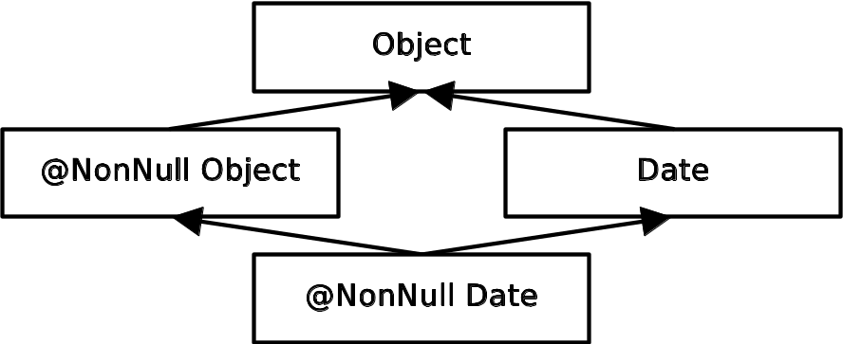
Null dereference checker.
Problem: NullPointerExceptions
  Object obj; // might be null
  @NonNull Object nnobj; // never null
  nnobj.toString(); // OK
  obj.toString(); // possible NPE
  obj = ...; // OK
  nnobj = obj; // nnobj may become null
Type system:

Slide 11
Demo of null dereference checker

Slide 12
Comparison with other tools
 | Null pointer errors |  | False warnings | Annotations written
 | Found | Missed
JSR 308 | 7 | 0 | 7 | 45
FindBugs | 0 | 7 | 1 | 0
Jlint | 0 | 7 | 8 | 0
PMD | 0 | 7 | 0 | 0
Checking a 4KLOC program
Type checking finds all the NPE bugs
The other tools also find non-NPE bugs

Slide 13
Good defaults reduce user effort
Nullable default:
  Dictated by backward compatibility
  Many instances of @NonNull – too verbose
  Flow-sensitive analysis inferred many NonNull types for local variables, reducing annotation burden
NonNull default
  Less verbose in signatures
    Draws attention to exceptions rather than the rule
  More annotations in method bodies
Our system: Nullable only for local variables
  Not for generics on local variables
  An alternative to type inference; effect may be similar

Slide 14
Local type inference
(flow-sensitivity)
/*@Nullable*/ Date d1, d2, d3;
d1 = new Date();
d1.getMonth(); // OK: d1 is non-null
assert d2 != null;
d2.getMonth(); // OK
if (d3 != null) {
d3.getMonth(); // OK
}
Often, no need for annotations on local vars

Slide 15
Interning
(= canonicalization, hash-consing)
Reuse an existing object instead of creating a new one
A space optimization: savings can be significant
A time optimization: use == for comparisons
Built into java.lang.String: intern() method
Users can add interning for their own classes
s1
“hello”
s2
“hello”
s3
“hello”

Slide 16
Interning
(= canonicalization, hash-consing)
Reuse an existing object instead of creating a new one
A space optimization: savings can be significant
A time optimization: use == for comparisons
Built into java.lang.String: intern() method
Users can add interning for their own classes
s1
“hello”
s2
“hello”
s3
“hello”

Slide 17
Interning
(= canonicalization, hash-consing)
Reuse an existing object instead of creating a new one
A space optimization: savings can be significant
A time optimization: use == for comparisons
Built into java.lang.String: intern() method
Users can add interning for their own classes
s1
“hello”
s1 = s1.intern();
s2
“hello”
s3
“hello”

Slide 18
Interning
(= canonicalization, hash-consing)
Reuse an existing object instead of creating a new one
A space optimization: savings can be significant
A time optimization: use == for comparisons
Built into java.lang.String: intern() method
Users can add interning for their own classes
s1
“hello”
s1 = s1.intern();
s2 = s2.intern();
s2
“hello”
s3
“hello”

Slide 19
Interning
(= canonicalization, hash-consing)
Reuse an existing object instead of creating a new one
A space optimization: savings can be significant
A time optimization: use == for comparisons
Built into java.lang.String: intern() method
Users can add interning for their own classes
s1
“hello”
s1 = s1.intern();
s2 = s2.intern();
s3 = s3.intern();
s2
“hello”
s3
“hello”

Slide 20
Interning
(= canonicalization, hash-consing)
Reuse an existing object instead of creating a new one
A space optimization: savings can be significant
A time optimization: use == for comparisons
Built into java.lang.String: intern() method
Users can add interning for their own classes
s1
“hello”
s1 = s1.intern();
s2 = s2.intern();
s3 = s3.intern();
s2
“hello”
s3
“hello”

Slide 21
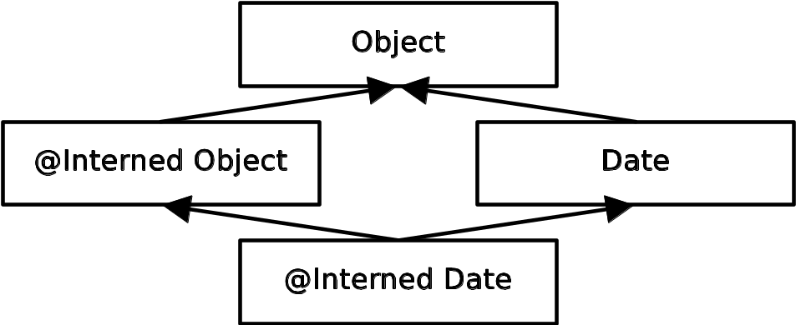
Interned checker.
Problem: incorrect equality checks
  String s;
  @Interned String is, is2;
  ... is = myString.intern() ... // OK
  if (is == is2) { ... } // OK
  if (s == is) { ... } // unsafe equality
  is = s; // unsafe assignment
Type system:

Slide 22
Demo of Interned checker

Slide 23
Interned case study
Program: Daikon (250 KLOC)
Interning is important
  Daikon’s key scalability problem is memory
  1170 lines of code/comment refer to interning
    72% of files have none, 87% have 0, 1, or 2
  200 run-time assertions
  Emacs plug-in for String equality checking
124 annotations in 11 files (12KLOC)

Slide 24
Interned results
9 errors
  Missing calls to intern
2 performance bugs
  Unnecessary interning in inner loop of file reading
1 design flaw
  VarInfoName is not interned within its implementation, but all escaping objects are
  Too hard to understand complex interning
14 false positives (used @SuppressWarnings)

Slide 25
Observer methods can expose state
class Class {
private Object[] signers;
Object[] getSigners() {
return signers; // JDK 1.1 bug
}
}
myClass.getSigners()[0] = “Sun”;

Slide 26
Observer methods can expose state
class Class {
private Object[] signers;
@Readonly Object[] getSigners() {
return signers; // Fixes JDK 1.1 bug
}
}
myClass.getSigners()[0] = “Sun”; // Error

Slide 27
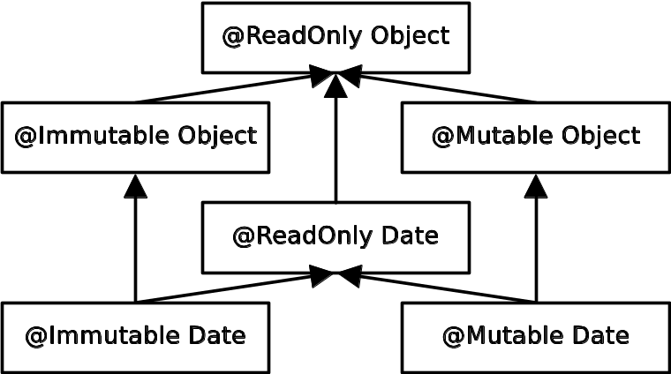
IGJ (Immutability Generic Java).
Problem: unintended side effects
Type system:
  ReadOnly: Reference immutability (aliases may modify)
  Immutable: Object immutability (object cannot change)
Inspired by generics
Syntax uses annotations, not generics

Slide 28
Demo of IGJ checker

Slide 29
IGJ case study
Programs (128KLOC)
  JOlden benchmarks
  htmlparser library
  tinySQL library
  SVNKit subversion client
  IGJ checker
4760 annotations (62133 possible locations)

Slide 30
IGJ case study results
Representation exposure errors
Constructors that left object in inconsistent state
In SVNKit:
  some getters have side effects
  some setters have no side effects
Used both reference and object immutability
More opportunities for immutability in new code than old

Slide 31
Java syntax for
Annotations on types
Permits annotations in new locations
  List<@NonNull String> myList;
  myGraph = (@Immutable Graph) tmpGraph;
  class UnmodifiableList<T>
  implements @Readonly List<@Readonly T> {…}
Planned for inclusion in Java 7 (“JSR 308”)
Publicly-available implementation
Implementation is backwards compatible
  Optionally write annotations in comments
  List</*@NonNull*/ String> myList;
  Compiles with any Java compiler

Slide 32
Case studies
4 checkers
360KLOC
75 bugs verified by a human and fixed
See technical report from September 2007 (better today!)

Slide 33
Usability of pluggable checkers
Scales to >200,000 LOC
Found bugs in every codebase
  More important: prevents bugs!
Few false positives
Programmers found the checkers easy to use
Is it too verbose?
  @NonNull: 1 per 75 lines
  @Interned: 124 annotations in 220KLOC revealed 11 bugs
  Possible to annotate part of program
  Fewer annotations in new code

Slide 34
Creating your own checker
Most users do not need to
Basic functionality: mention annotation on javac command line
Simple rules: declarative syntax (meta-annotations)
Special rules: override a few methods
  For NonNull: dereferences
  For Interned: equality
Examples of properties you can check:
  General-purpose (tainting)
  Project-specific (string formatting)

Slide 35
Your turn to use pluggable type checkers
Webpage: Search for “JSR 308” or “Annotations on Java types”
  http://pag.csail.mit.edu/jsr308/
Downloads:
  Checkers: @NonNull, @Interned, @Readonly, @Immutable
  Inference tools: NonNull, Readonly
  Checkers Framework for writing new checkers
  JSR 308 compiler (patch to OpenJDK)‏
Go forth and prevent bugs!

Slide 39
Checkers Framework for writing type checkers
Just override a few methods for special checks
  Use Sun’s Tree API to access AST
Declarative syntax for common cases
  Type qualifier hierarchy
  Implicit types
Simple type systems require no code
  But sophisticated type systems are possible
Handles both super- and sub-type qualifiers
Generic type inference
Flow-sensitive type inference
Plug-in to Java compiler (a.k.a. annotation processor)

Slide 40
Annotations on Java types (JSR 308)‏
Two problems with Java:
Syntactic limitation on annotations
  Can only be written on declarations
Semantic limitation of the type system
  Doesn't prevent enough bugs
JSR 308 solves these problems:
  Extends Java syntax: permits annotations in more locations
  Enables creation of more powerful annotation processors

Slide 41
Synactic problem: Annotations can only be written on declarations
Classes:
  package java.security;
  @Deprecated class Signer { ... }
Methods:
  @Test void additionWorks() { assert 1 + 1 == 2; }
  @Override equals(MyClass other) { ... } // warning
Fields:
  @CommandLineArg(name="input", required=true)‏
  private String inputFilename;
Locals/statements:
  List<Object> objs = ...;
  @SuppressWarnings List<String> strings = objs;
Goal: write annotations on type uses

Slide 42
Generics and arrays
Generics:
  List<@NonNull String> strings;
  class UnmodifiableList<T>
  implements @Readonly List<@Readonly T>
  {
  ...
  }
Arrays are treated analogously
  Separately annotate the element type and the array itself

Slide 43
Local variables
  @Interned String s = getName().intern();
  @NonEmpty List<String> strings = ...;
Possible to annotate in Java 5
  Annotations are not preserved in the class file

Slide 44
Casts
  // Both variables are null, or neither is.
  Pattern startRegex, endRegex;
  ...
  if (startRegex != null) {
  endRegex = (@NonNull Pattern) endRegex;
  ...
  }
  Graph g = new Graph();
  ...
  ...
  // Now, g will not be changed any more
  g = (@Immutable Graph) g;
    }
    add nodes and edges

Slide 45
Receiver
It is possible to annotate the explicit parameters
  package javax.xml.bind;
  class Marshaller {
  void marshal(@Readonly Object jaxbElement,
  @Mutable Writer writer) { }
  }
It should be possible to annotate the receiver, too
  package javax.xml.bind;
  class Marshaller {
  void marshal(@Readonly Object jaxbElement,
  @Mutable Writer writer) @Readonly { }
  }

