Slide 1

I WANT YOU
TO FIGHT
BAD CODE!
Get the tools & demos from:
http://tinyurl.com/cf-osb11

Slide 2

Preventing
Runtime Errors at
Compile Time
Werner M. Dietl Michael D. Ernst
David Lazar

Slide 3
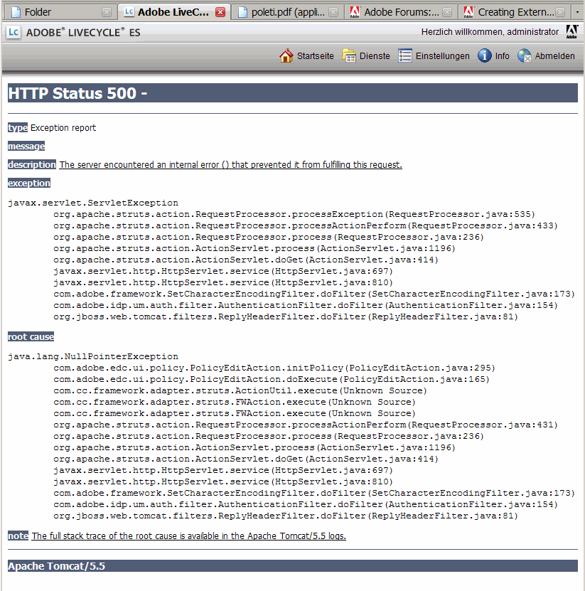
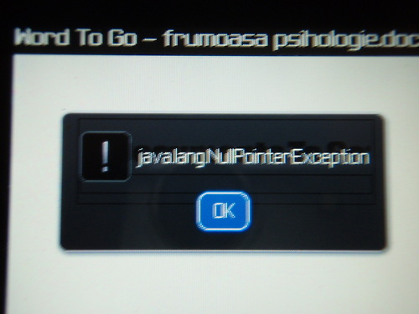
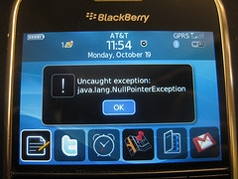
Software still has errors

Slide 4
Static type systems
Crashes
0 errors,
0 warnings
Source
Code
Compiler,
Type Checker
Executable

Slide 5
Static type systems
Java/C# provide limited type systems
Static type systems could prevent:
  Null-pointer exceptions [Fähndrich & Leino '03]
  Unwanted mutations [Tschantz & Ernst '05]
  Concurrency errors [Boyapati et al. '02, Cunningham et al. '07]
Express additional facts about a program
Statically ensure absence of certain errors

Slide 6
Pluggable type checkers
Source
Code
Compiler,
Type Checker
Executable
Pluggable
Type Checker
Fix Bugs
Warnings
Add Annotations
Notes:
Prevent more bugs at compile time
Additional type annotations specify properties
Don't influence execution

Slide 7
Pluggable type checkers
Source
Code
Compiler,
Type Checker
Executable
Pluggable
Type Checker
Pluggable
Type Checker
Pluggable
Type Checker
Fix Bugs
Guarantees partial correctness!
Warnings
Add Annotations
Notes:
Prevent more bugs at compile time
Additional type annotations specify properties
Don't influence execution

Slide 8
Java 8 extends annotation syntax
Annotations on all occurrences of types
  Casts
  @Interned String s = (@Interned String) o;
  Type arguments
  @NonNull List<@Interned String> l;
  Extends/implements clauses
  class UnmodifiableList<T> implements
  @Readonly List<@Readonly T> {}
Stored in bytecode
Handled by javac, javap, javadoc, …
Included with the Checker Framework

Slide 9
Pluggable type systems
Example: Ensure encrypted communication
void send(@Encrypted String msg) {…}
@Encrypted String msg1 = ...;
send(msg1); // OK
String msg2 = ....;
send(msg2); // Warning!

Slide 10
The Checker Framework
A framework for pluggable type checkers
“Plugs” into the OpenJDK compiler
Easy to use
javac -processor EncryptionChecker …
Eclipse plug-in, Ant and Maven integration

Slide 11
Our experience
Checkers reveal important latent bugs
  Ran on 2 million LOC of real-world code
  Found 40 user-visible bugs, hundreds of mistakes
Annotation overhead is low
  Mean 2.6 annotations per kLOC

Slide 12
Checkers reveal important latent bugs
Nullness Checker:
9 crashing bugs in Google Collections
  45000 tests (2/3 of the LOC)
  Uses FindBugs @Nullable annotations,
  no FindBugs warnings
>90 bugs in Daikon

Slide 13
Reveals bugs: null-pointer exceptions
Example from Google Collections:
class ForMapWithDefault {
@Nullable Object defaultValue;
public int hashCode() {
return map.hashCode() +
defaultValue.hashCode();
}
…
}
java.lang.NullPointerException

Slide 14
Outline
Intro
Demo of the Checker Framework
How it can help your project
Use the Checker Framework
Conclusions

