Slide 1

I WANT YOU
TO FIGHT
BAD CODE!
Get the tools & demos from:
http://types.cs.washington.edu/
checker-framework/2012-oscon/

Slide 2

Developing and Using
Pluggable Type Systems
Werner M. Dietl
Michael D. Ernst
University of Washington
Computer Science & Engineering

Slide 3
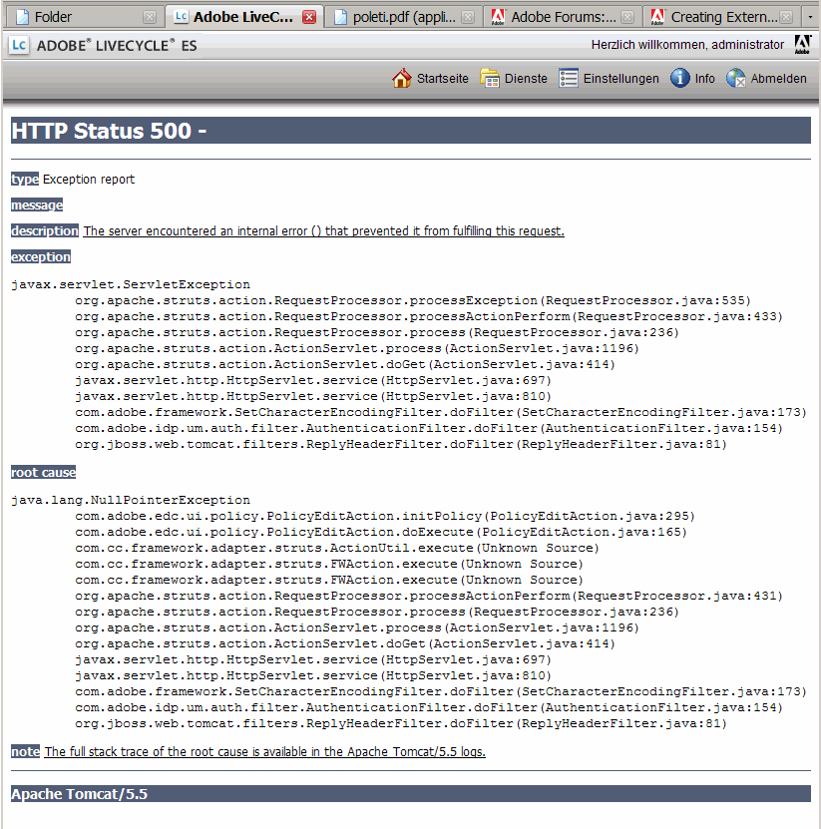
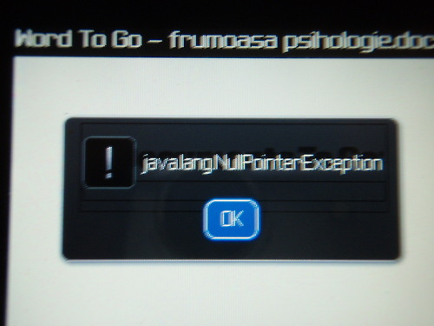
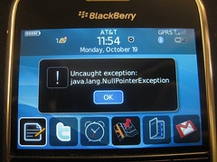
Software has too many errors

Slide 4
Java's type system is too weak
Type checking prevents many errors
int i = “hello”;
Type checking doesn't prevent enough errors
System.console().readLine();
Collections.emptyList().add(“one”);
dbStatement.executeQuery(userInput);

Slide 5
Better type systems can help!
  Null-pointer exceptions [Fähndrich & Leino '03]
  Unwanted mutations [Tschantz & Ernst '05]
  Concurrency errors [Boyapati et al. '02, Cunningham et al. '07]
  … many more!
Theory
Practice

Slide 6
Static type systems
Crashes
0 errors,
0 warnings
Source
Code
Compiler,
Type Checker
Executable

Slide 7
Pluggable type checkers
Source
Code
Compiler,
Type Checker
Executable
Pluggable
Type Checker
Fix Bugs
Warnings
Add Annotations
Notes:
Prevent more bugs at compile time
Additional type annotations specify properties
Don't influence execution

Slide 8
Pluggable type checkers
Source
Code
Compiler,
Type Checker
Executable
Pluggable
Type Checker
Pluggable
Type Checker
Pluggable
Type Checker
Fix Bugs
Warnings
Add Annotations
Notes:
Prevent more bugs at compile time
Additional type annotations specify properties
Don't influence execution

Slide 9
Java 8 extends annotation syntax
Annotations on all occurrences of types
  @Untainted String query;
List<@NonNull String> strings;
myGraph = (@Immutable Graph) tmpGraph;
class UnmodifiableList<T>
implements @Readonly List<@Readonly T> {}
Stored in classfile
Handled by javac, javap, javadoc, …
You can use it with Java 5/6/7!
  Backward compatible: write in /*@comments*/

Slide 10
The Checker Framework
A framework for pluggable type checkers
“Plugs” into the OpenJDK compiler
Easy to use
javac -processor EncryptionChecker …
Eclipse plug-in, Ant and Maven integration

Slide 11
Example: Regular expressions
String regex = getUserInput();
Pattern pat = Pattern.compile(regex);
Matcher mat = pat.matcher(content);
if (mat.matches()) {
.println("Group: " + mat.group(4));
} else {
.println("No match!");
}

Slide 12
Regular expression type system
What runtime exceptions do you wish to prevent?
PatternSyntaxException and
IndexOutOfBoundsException.
What properties of data should always hold?
Indicate strings containing valid regexs
and group counts.
What operations are legal and illegal?
Matcher.group only on regex with
minimum group count.

Slide 13
Example: Encrypted communication
void send(@Encrypted String msg) {…}
@Encrypted String msg1 = ...;
send(msg1); // OK
String msg2 = ...;
send(msg2); // Warning!

Slide 14
Encryption type system
What runtime exceptions do you wish to prevent?
Invalid information flow.
What properties of data should always hold?
Separate encrypted and plain strings.
What operations are legal and illegal?
Forbid sending unencrypted data.

Slide 15
Our experience
Checkers reveal important latent bugs
  Ran on >3 million LOC of real-world code
  Found hundreds of user-visible bugs
Annotation overhead is low
  Mean 2.6 annotations per kLOC

Slide 16
Null-pointer crash in Google Collections
class ForMapWithDefault {
@Nullable Object defaultValue;
public int hashCode() {
return map.hashCode() +
defaultValue.hashCode();
}
}
Found 9 such crashes, despite:
  45000 tests (2/3 of the LOC)
  Uses FindBugs @Nullable annotations,
  no FindBugs warnings
java.lang.NullPointerException

Slide 17
Building checkers is easy
Example: Ensure encrypted communication
void send(@Encrypted String msg) {…}
@Encrypted String msg1 = ...;
send(msg1); // OK
String msg2 = ....;
send(msg2); // Warning!
The complete checker:
@TypeQualifier
@Target(ElementType.TYPE_USE)
@SubtypeOf(Unqualified.class)
public @interface Encrypted {}
Unqualified
Encrypted

Slide 18
Building complex checkers is possible
Nullness Checker is actually 3 checkers:
Nullness itself
Correct object initialization
Correct usage of keys in map accesses
Refined defaulting:
Refined flow-sensitive inference
Heuristics for Map.get behavior

Slide 19
SQL injection demo
Goal: no SQL injection attacks possible
  Uses @Tainted and @Untainted annotations
Open-source blogging software
  Download personalblog.zip demo
  Go into directory
  personalblog-demo
  Requires 8 annotations; we wrote 6
  Follow me along!

Slide 20
Brainstorming new type checkers
What runtime exceptions do you wish to prevent?
What properties of data should always hold?
What operations are legal and illegal?
Type-system checkable properties:
  Dependency on values
  Not on program structure, timing, ...

Slide 21
A sampling of type checkers
Property you care about:
Tainting
Java type signatures
Null dereferences
Concurrency
Mutability & side effects
Fake enumerations
Internationalization
Regular expressions
Object encapsulation
Energy efficiency
Equality tests
Annotation to use:
@Tainted
@BinaryName
@Nullable
@Lock, @GuardedBy
@Immutable
@SwingCompassDirection
@Localized
@Regex
@Rep, @Peer, @Any
@Approx, @Precise
@Interned

Slide 22
Your turn to improve your code!
Choose a project you care about
  Or, try pircbot (download from tutorial page)
Improve it
  Apply an existing checker to your code, or
  Create a new domain-specific type checker

Slide 23
Checker Framework: Much More!
Powerful framework to develop sophisticated type checkers
Inference tools
Annotation tools to insert annotations
Specification files for libraries

Slide 24
What to do next
Improve your projects using type checkers
Develop your own type checkers
Contribute to the Checker Framework project
Problems or suggestions? Give us feedback!

Slide 25
I WANT YOU
TO FIGHT
BAD CODE!
Get the tools & demos from:
http://types.cs.washington.edu/
checker-framework/2012-oscon/

